Slide 1
The Church in Japan Today
Our Challenges and Hope
2026.7.12
Takehiko Nakanishi
Hokkaido Bible Institute (HBI)
Notes:
Hello everyone. / Thank you so much / for welcoming us today.
It is a great joy / to worship together / and to have this time / to share our report.
Also, / thank you for letting us see / the many ministries of your church / during this trip.
We are learning a lot. / Thank you very much.

Slide 2
1. Introduction
Notes:
Let me introduce myself. / My name is Takehiko.
I serve as a pastor, / and I am also a teacher / at our seminary.

Slide 3
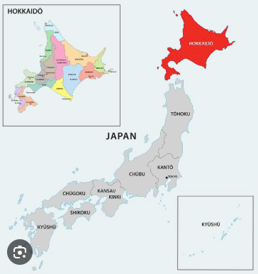
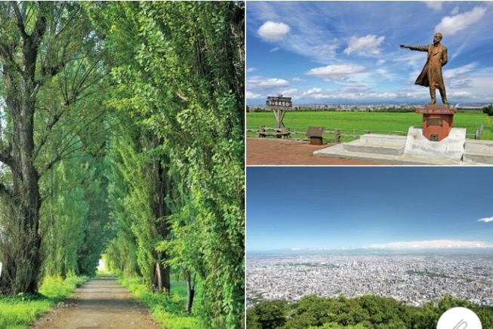
We're from Hokkaido (North Japan)
Notes:
We are from Hokkaido Bible Institute, / or HBI.
It is a Bible school / in Hokkaido, / the northern part of Japan.
HBI started in 1963 / as an evening Bible school.

Slide 4
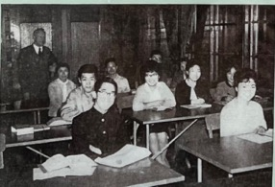
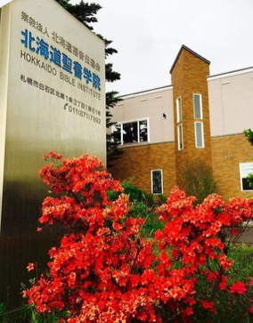
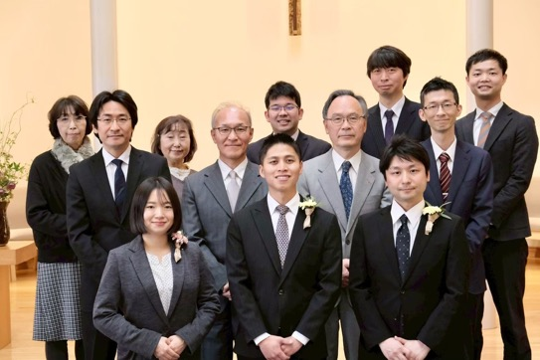
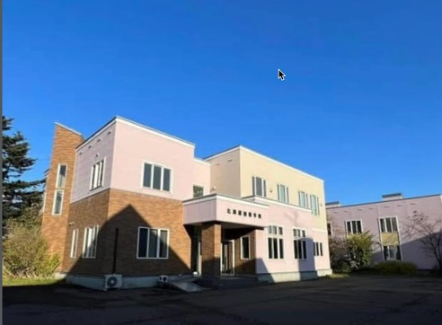
Hokkaido Bible Institute (HBI)
Notes:
OMF missionaries helped to start it, / and many churches prayed for it.
It is a three-year school, / and many graduates / become pastors / or church workers.
Visiting the UK / is a part of our school program / called "Overseas Training."

Slide 5
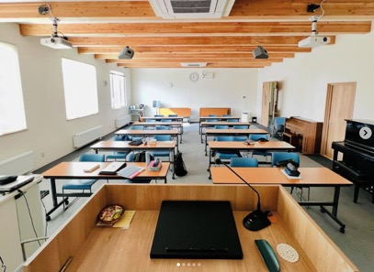
Hokkaido Bible Institute (HBI)
Notes:
The photo on the left shows the classroom, which also serves as a chapel.
The right was taken during a picnic.

Slide 6
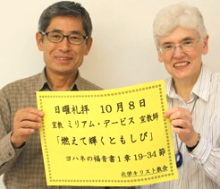

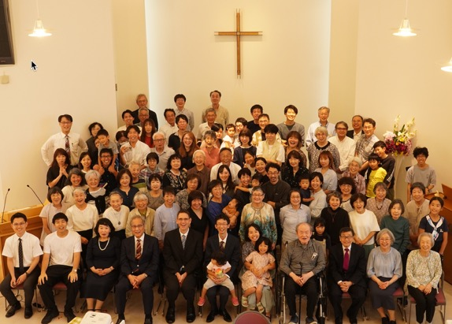
My Connection to Miriam
Notes:
On a personal note, / I have known Miriam / since I was a university student. /
She served as a missionary / at the church where I grew up, / and where I now serve as a pastor.
Our English is not very good, / so she is helping us so much / and remembering her Japanese for us. /
I want to thank Miriam / from the bottom of my heart.

Slide 7
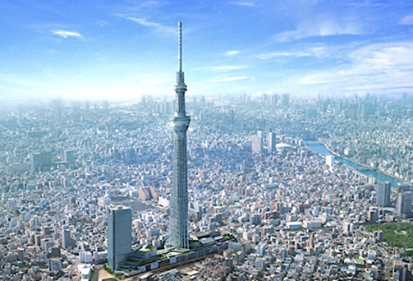
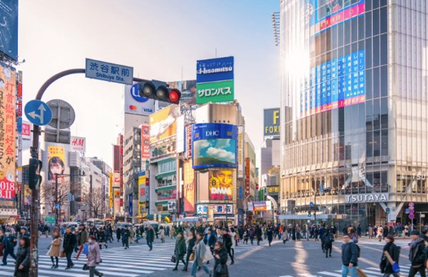
2. Aspects of Modern Japan
Notes:
I would like to share / about the current situation / of Japanese society / and churches.
Now, / what comes to your mind / when you hear the word "Japan"? / (少し間を空ける)

Slide 8



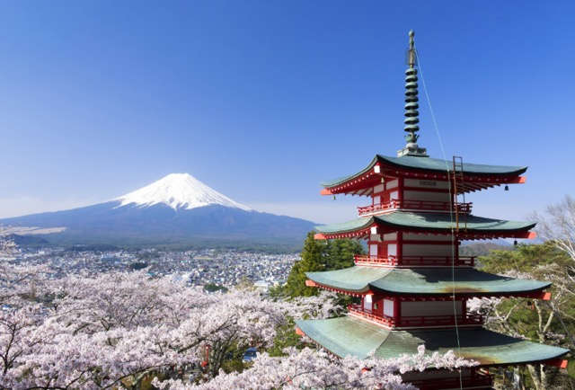
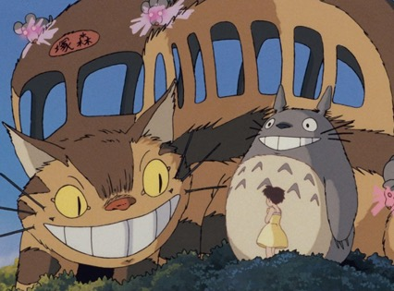
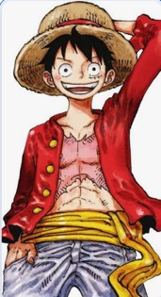
What Comes to Mind When You Hear "Japan"?
Notes:
Perhaps you think of anime / like Ghibli or Pokemon.
Or maybe our beautiful traditional culture, / or our safe streets.
These are truly wonderful things, / and I love these beautiful aspects of Japan.

Slide 9
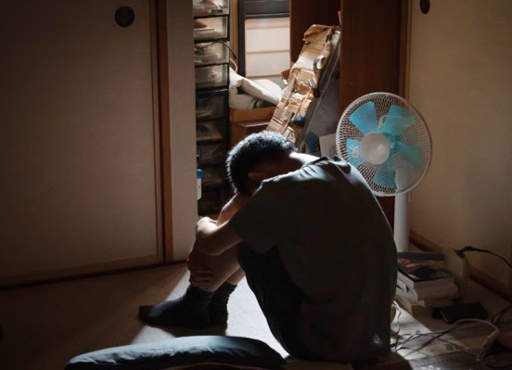

The Reality: "Hikikomori" (Social Isolation)
Notes:
However, / behind this peaceful society, / there are deep challenges.
In Japan, / we have a unique social problem called "Hikikomori" / — severe social withdrawal.
Today, / about 1.5 million people / — one in every fifty — / have cut off contact with society / and cannot leave their homes.
My own uncle / is one of them.
Under the pressure where "failure is not allowed," / they cannot ask for help, / and they become completely isolated.

Slide 10

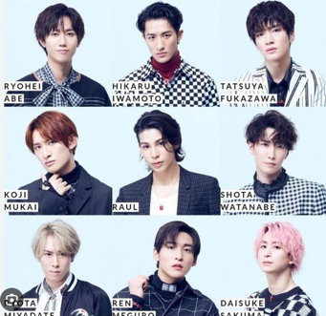
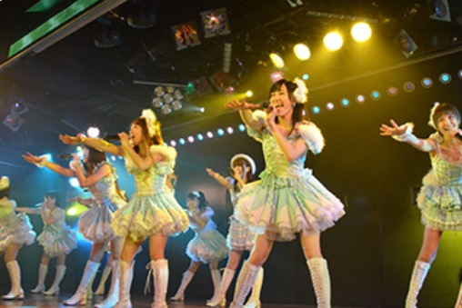
Seeking a "Story" (Oshikatsu Boom)
Notes:
However, / isolation is not the only issue.
Because of the general feeling of suffocation in society, / a boom called "Oshikatsu" / is happening in Japan right now.
This is when people obsessively support / pop idols or anime characters.
They give all their time, / money, / and even their whole lives to them. /

Slide 11
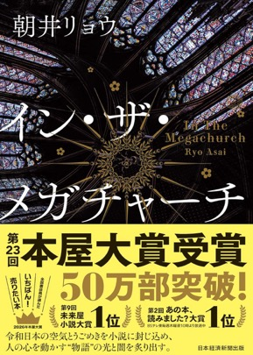
Seeking a "Story" (Oshikatsu Boom)
"In this godless country,
the best way to control people is to give them a 'story’.”
―In the Megachurch
Notes:
Recently, / there is a bestselling novel in Japan / about this idol culture. /
Interestingly, / the title of this novel / is "In the Megachurch." /
It is a story about promoters / who copy the marketing of American megachurches, / and use it to make people fanatic / just to make money.
Many Japanese people / do not know the true God's unconditional love, / or His grace that allows us to start over. /
So, / they are desperately seeking someone to accept them, / and a solid "story" to hold on to. /
Wandering around / seeking salvation in made-up stories... /
This is the reality / of modern Japanese people.

Slide 12
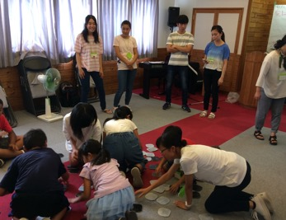
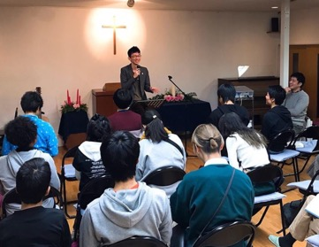
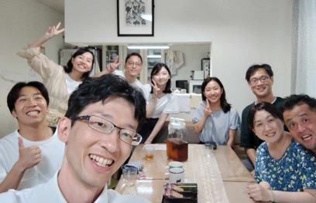
3. The Current State of Churches in Japan
Christian population: ＜1%
Notes:
Now, / let me talk about the current situation / of churches in Japan.
First of all, / the Christian population in Japan today / is less than 1%.
We are an overwhelming minority.

Slide 13
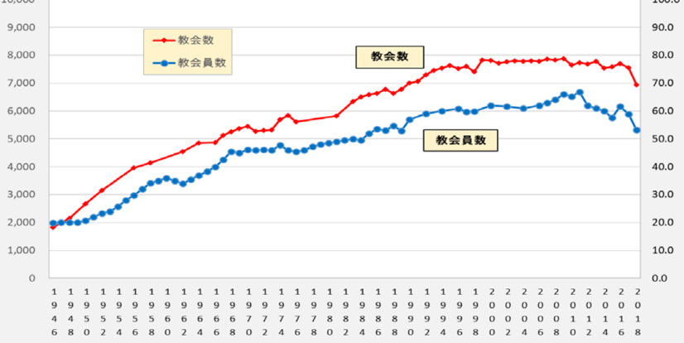
The State of Protestant Churches in Japan
Number of Church Members
(in tens of thousands)
Number of Churches
Notes:
Right after World War II, / there was a boom in Christianity, / and many people came to church.
But since then, / the growth has stopped.
Through all those difficult years, however, / many OMF missionaries, / including Miriam, / continued to come to Japan.
We are deeply grateful for that.

Slide 14
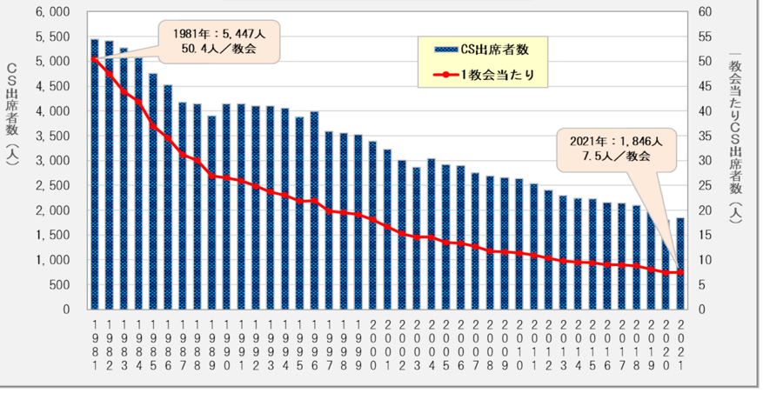
Trends in Sunday School Attendance
Notes:
Today, / the Japanese church faces a strong headwind. / Because of past incidents with dangerous cults, / Japanese society has a strong allergy to religion.
Many people think, / "All religions are dangerous," / which creates a deep stagnation / in our churches. /
During the post-war boom, / Sunday Schools easily had over 100 children.
But today, / one-fourth of our churches / have no kids' ministry at all.

Slide 15
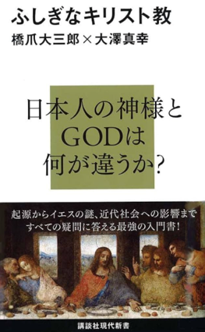
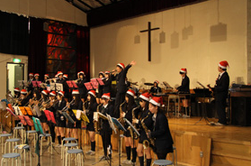
Christianity’s Positive Public Image
Notes:
However, / it sounds like a paradox, / but Christianity actually has a good public image in Japan.
Christian schools and hospitals / are highly respected.
Many Japanese people want to learn about Christianity / as general knowledge, / and books about it sell very well.
But their attitude is:
"I want to learn about it, / but I will not believe it, / and I will not go to church."

Slide 16
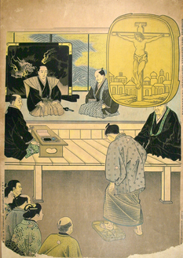
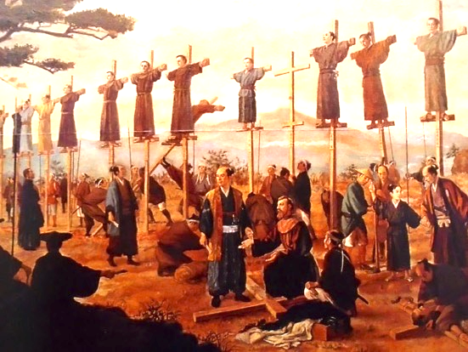
The Legacy of Persecution and Cultural Barriers
Notes:
Also, / especially in rural areas, / there is a long history of persecution / from the era of the Samurai, / a few hundred years ago.
Because of this history, / some people still feel / that Christianity is a "foreign" / or even "dangerous" religion / that goes against our ancestors.

Slide 17
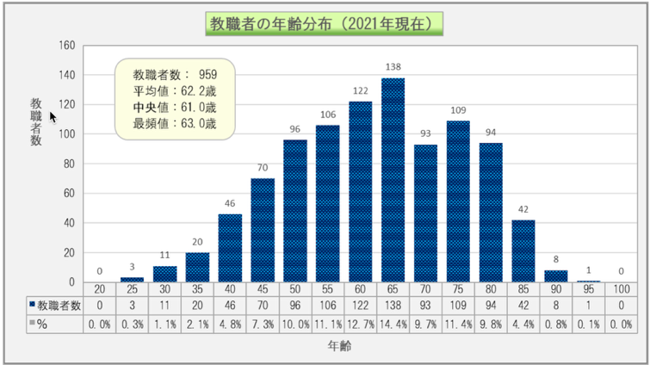
Age Distribution of Pastors (2021)
Number of Pastors
Average: 62.2
(Under 40: 3.5%)
Age
Notes:
Alongside these cultural barriers, / our churches are hit hard / by a "hyper-aging" society.
Today, / the most common size of a church in Japan / is only about 20 people. /
/ and the average pastor is 62 years old. /
At 38, / I am considered a very rare, / young pastor. / The same is true / for the students with me today. /
Because the number of Bible school graduates / has dropped by 30% / compared to 40 years ago,
/ pastors of my generation constantly ask:
/ "How can we simplify / the heavy ministries / our seniors built?" /

Slide 18
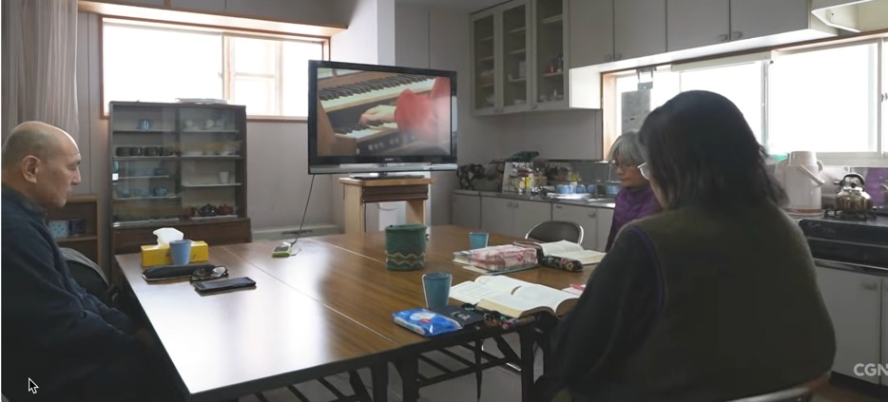
A Church Without a Pastor
Notes:
Recently, / a Christian TV network made a documentary / called "Churches Without Pastors." /
It showed many churches / that have no pastor, / or have to share a pastor. /
For example, / one pastor is taking care of five different churches / at the same time. /
In another case, / only three church members / are desperately keeping their church going / without a pastor.
In the future, / as older pastors retire, / this trend will accelerate. /
We will definitely see more churches / without pastors, / sharing pastors, / or even closing and merging. /
This is the painful reality / of the Japanese church today.

Slide 19
4. Future Outlook

Slide 20
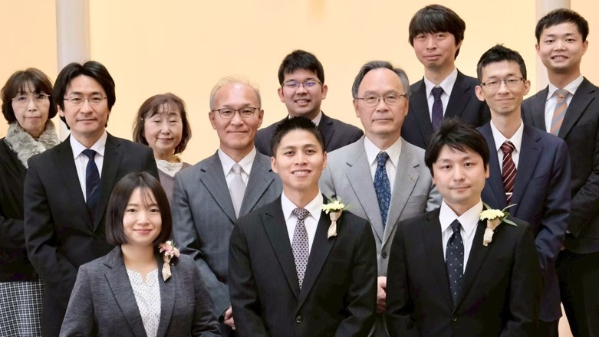
Recent Challenges at Our Seminary
Notes:
To respond to this crisis, / our seminary, HBI, / is taking action. /
Currently, / we have five regular students, / but also about ten lay people / auditing our classes. /
To support churches without pastors, / HBI recently started a "Lay Preacher Course."
We train lay leaders / to preach the Word of God / when no pastor is available.
It is a ministry of hope / to help them protect their own churches. /

Slide 21
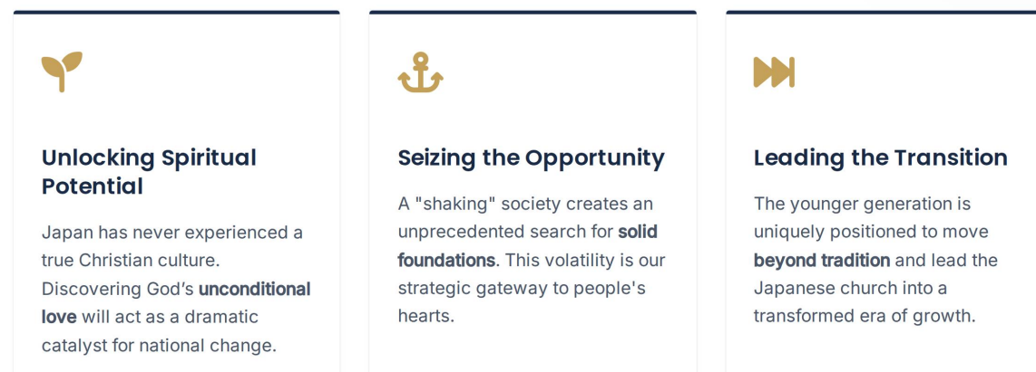
Beyond the Challenges: Finding Reasons for Hope
Notes:
I have shared many difficult things / about the Japanese church today. /
However, / we are not pessimistic. /
We believe / there is great hope / for the church in Japan.
There are two reasons for this. /
First, / Japan has never truly experienced / "true Christian culture." /
Many Japanese people follow Buddhist traditions, / but deep down, / they don't really believe it can save them. /
So, / when Japanese people finally realize / the true value of the Gospel / and His unconditional love, / our society has the potential / to change dramatically.
Second, / our society is shaking right now. /
But this shaking / is actually a great opportunity. /
People are desperately seeking a solid foundation, / and they will come to the church. /
The Japanese church is at a turning point. /
For better or worse, / we must change our traditional ways. /
And we, / the young generation here today, / are the ones called to experience / and lead this change.

Slide 22
Prayer Requests
1. For the Gospel
2. For HBI's Ministry
3. For Future Leaders
Notes:
Therefore, / finally, / I have three prayer requests for you.
First, / please pray that our churches / will stand firm on the Gospel, / and be able to share it boldly / with Japanese people who do not know it. /
Second, / please pray that our seminary, / HBI, / will be powerfully used / to build up churches / across Japan. /
And third, / please pray with us / that God will send FIVE new students / to our seminary / every year.
Thank you very much for listening, / and thank you for your partnership in the Gospel.

Slide 23
Thank you very much!

Slide 24
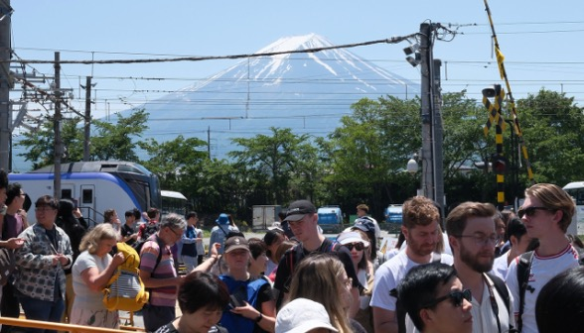

Social and National Challenges
Notes:
While we face this loneliness / at a personal level, / we also feel a deep sense of crisis / at the social and national level.
One of the main reasons / we came to the UK / is to learn about / your church's ministry to immigrants. / Because of our aging population, / Japan expects to receive / many more foreign workers / in the future. / Also, / because of the weak Yen, / we are seeing more foreign tourists / than ever before.

Slide 25
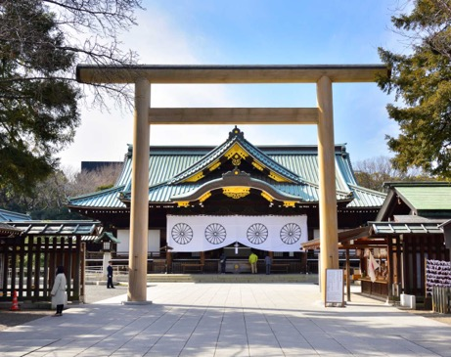
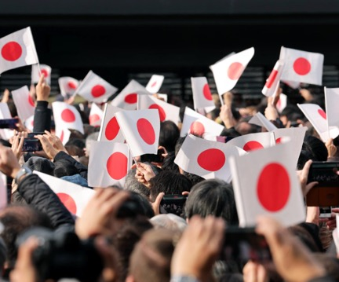
Social and National Challenges
Notes:
Sadly, / this has caused some problems.
We see growing hostility / toward foreigners, / and tension from over-tourism.
In our recent elections, / the liberal parties lost badly.
We feel a growing wave / of nationalism / and a shift to the political right / across our society.
As Japanese Christians, / we cannot ignore / the issue of "Church and State", / especially the presence of "State Shinto" / and the Emperor system.
During World War II, / the Japanese people were united / under the Emperor / to fight the war.
It is a very sad and bitter history, / but the Japanese Church at that time / gave in to state pressure / and cooperated with the war. We carry this guilt.
As our society becomes more nationalistic / and exclusive, / we fear that our country / might head in that same direction again.
That is why / the Japanese Church today / must pray and prepare / so we do not repeat / the mistakes of the past.
We believe / we are called / to be the "Watchman" / for our society.

