Slide 1

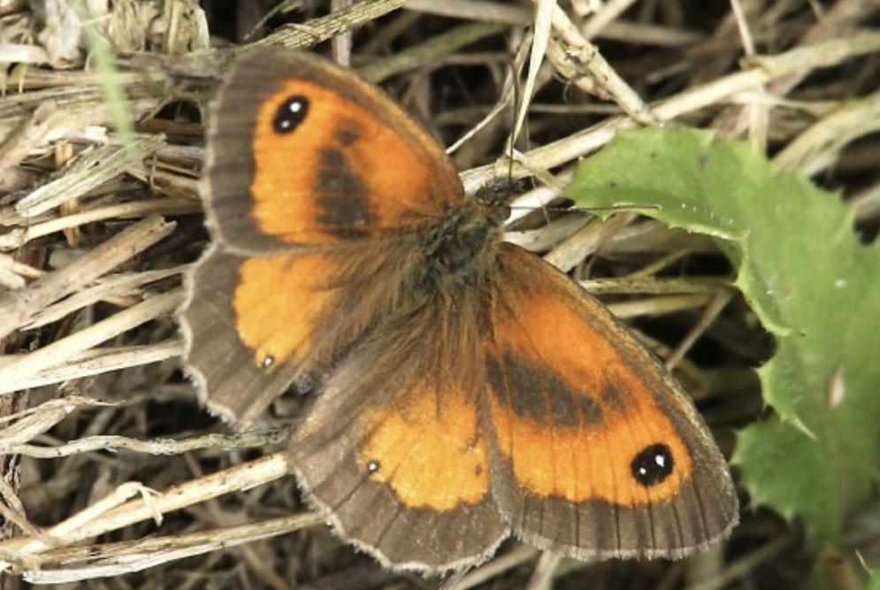
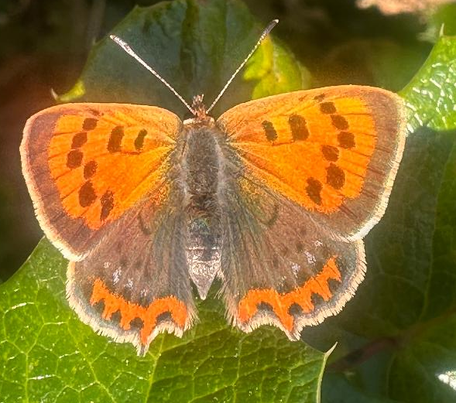
SP TTED
in the Churchyard
Aug 2026
Small copper
Gatekeeper
FACT FILE
Latin name:
Lycaena phlaeas
Length: 12-15mm
Wingspan: 2.6-36mm
Habitat: grassland heathland and parks and gardens
Conservation status: Least concern
Photo: Bean Trainer
FACT FILE
Latin name:
Pyronia tithonus
Wingspan: 3.7-4.8cm
Habitat: Everywhere!
Conservation status:
Least concern
You can see the gatekeeper butterfly between July and August with individuals only living between 3.5 - 8 days. They thrive on a lot of plants however their favourite plants are bramble and shallow tightly clustered flowers like wild marjoram because gatekeeper butterflies have relatively short tongues (proboscises). The two small white 'pupils’ in the eyespots are used to confuse predators and differentiate them from the meadow brown which only has one. If you’re a loose end and you want to learn about the story behind the gatekeeper’s scientific name I would really recommend it as it has links to fire, princes, grasshoppers and Greek mythology! The common name origin is less mysterious - males establish small territories right next to gates, path gaps and hedgerow openings, where they take the "keeper" role literally. They are fiercely territorial and will actively launch aerial attacks to chase away much larger butterfly species like Red Admirals and Meadow Browns that try to fly through “their” gate.
Photo: Bud Trainer
The small copper is one of my favourite butterflies! It is a small butterfly that is on the wing throughout the summer between April and October. The forewings feature a vivid, metallic orange-copper colour with dark spots, mirroring the look of a shiny copper coin with a thick, dark brown margin. It has dark brown hindwings that are banded with orange. Males are territorial and can be seen basking on the ground or on a rock waiting for females, every now and again they will chase off other insects that come too close. Adults usually feed on ragwort and thistles, while the caterpillars feed on common sorrel and sheep’s sorrel. The genus Lycaena is associated with light matching the brilliant sheen of these butterflies when the sun catches their wings! The species name Phlaeas is believed to originate from phlego (to burn/blaze), pointing directly to the bright, glowing orange-red and copper colours of the forewing!

Slide 2

SP TTED
AUGUST 2026
in the Churchyard
Photo: Bean Trainer
Gatekeeper
FACT FILE
Latin name: Pyronia tithonus
Wingspan: 3.7-4.8cm
Habitat: Everywhere!
Conservation status: Least concern
If you’re a loose end and you want to learn about the story behind the gatekeeper’s scientific name I would really recommend it as it has links to fire, princes, grasshoppers and Greek mythology! The common name origin is less mysterious - males establish small territories right next to gates, path gaps and hedgerow openings, where they take the "keeper" role literally. They are fiercely territorial and will actively launch aerial attacks to chase away much larger butterfly species like Red Admirals and Meadow Browns that try to fly through “their” gate. The two small white 'pupils’ in the eyespots are used to confuse predators and differentiate them from the meadow brown which only has one. Their favourite plants are bramble and shallow tightly clustered flowers like wild marjoram because they have relatively short tongues (proboscises).
Photo: Bud Trainer
Small copper
FACT FILE
Latin name: Lycaena phlaeas
Length: 12-15mm Wingspan: 2.6 - 36mm
Habitat: grassland, heathland, parks & gardens
Conservation status: Least concern
This small butterfly is on the wing between April and October. The forewings are a vivid, metallic copper with dark spots, mirroring the look of a shiny copper coin with a thick, dark brown margin. Its dark brown hindwings are banded with orange. Males are territorial and can be seen basking on the ground waiting for females and will chase off other insects that come too close. Adults usually feed on ragwort and thistles, while the caterpillars feed on common sorrel and sheep’s sorrel. The genus Lycaena is associated with light matching the brilliant sheen of these butterflies when the sun catches their wings and the species name Phlaeas is believed to originate from phlego (to burn/blaze), pointing directly to the bright, glowing orange-red and copper colours of the forewing!

