Slide 1


Welcome

Slide 2
St Peter and St Paul, Ospringe
There has been a church here for over 1100 years.
As you came up the path you might have noticed a cross in the north chancel door, creatures heads high up by the downpipe and stylised Tudor roses.
As you entered you will have seen an animal head holding the door handle
The church we are standing in was remodelled during the time of William Griffin by Edward Lushington Blackburne 1850!

Slide 3
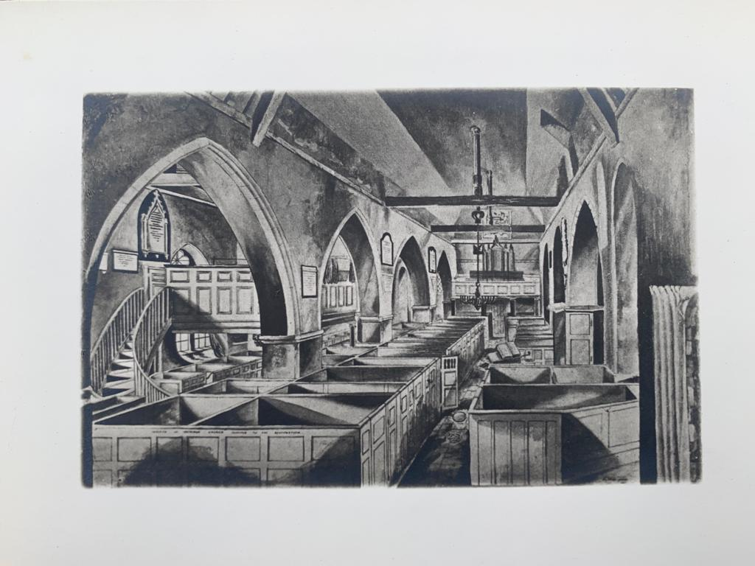
Ospringe Pre Victorian Refurbishment

Slide 4
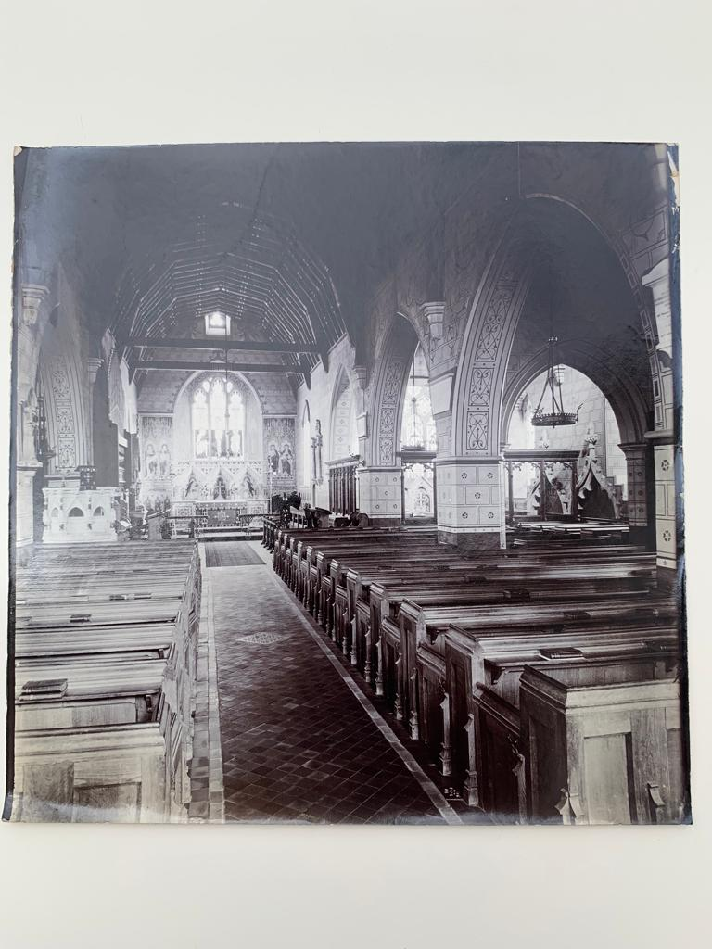
Ospringe Post Victorian Refurbishment

Slide 5
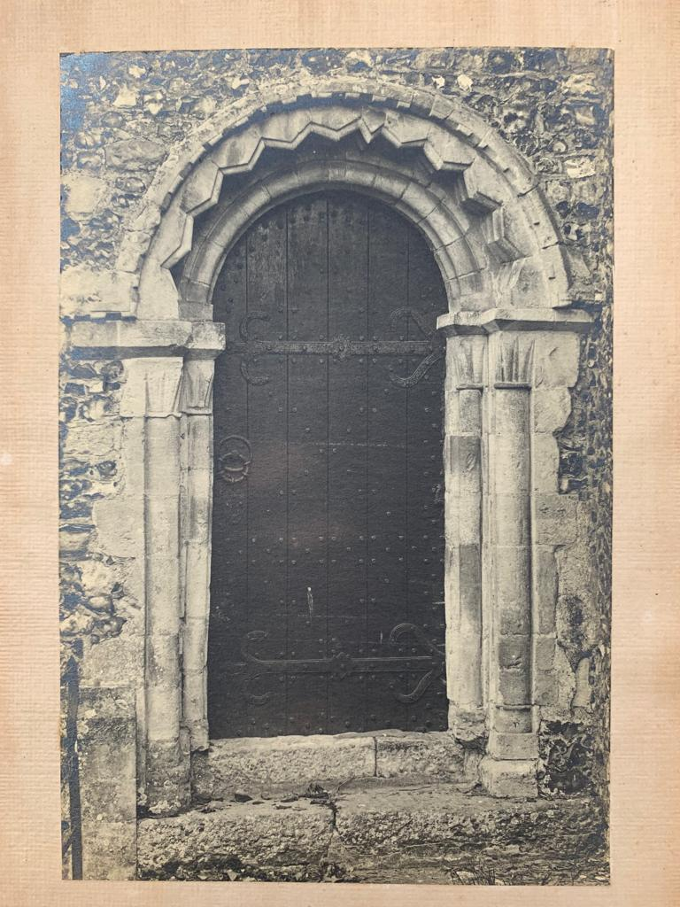
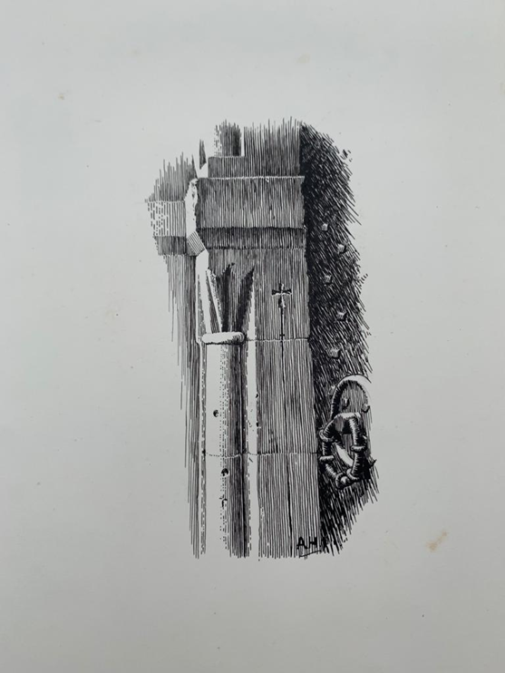
Chancel door north side
Note cross on portal.

Slide 6
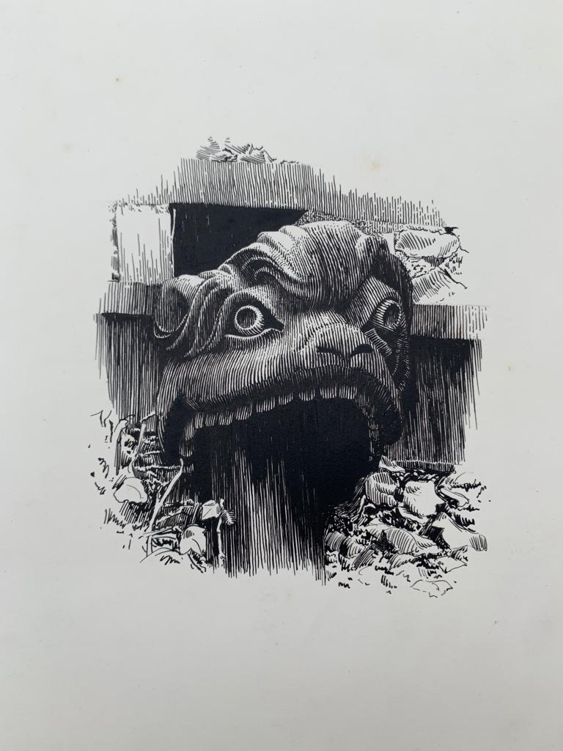
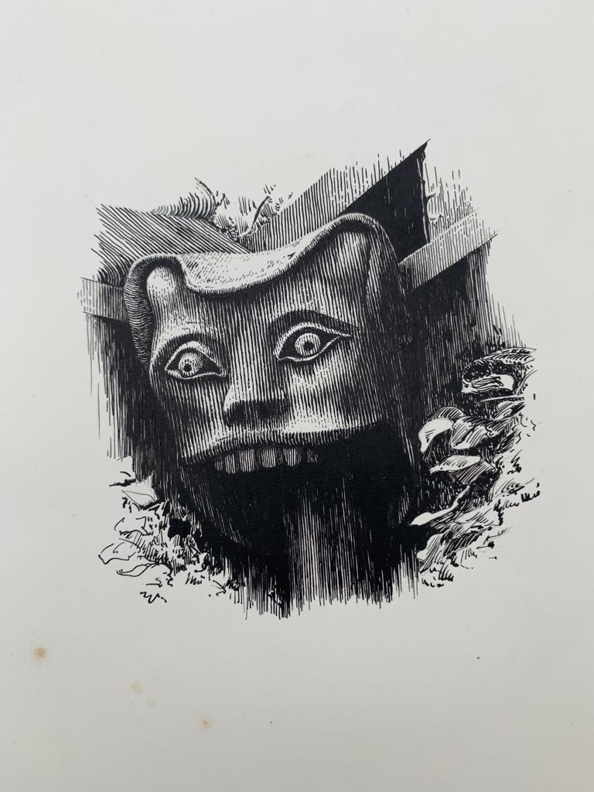
External North wall
Who are theses creatures

Slide 7
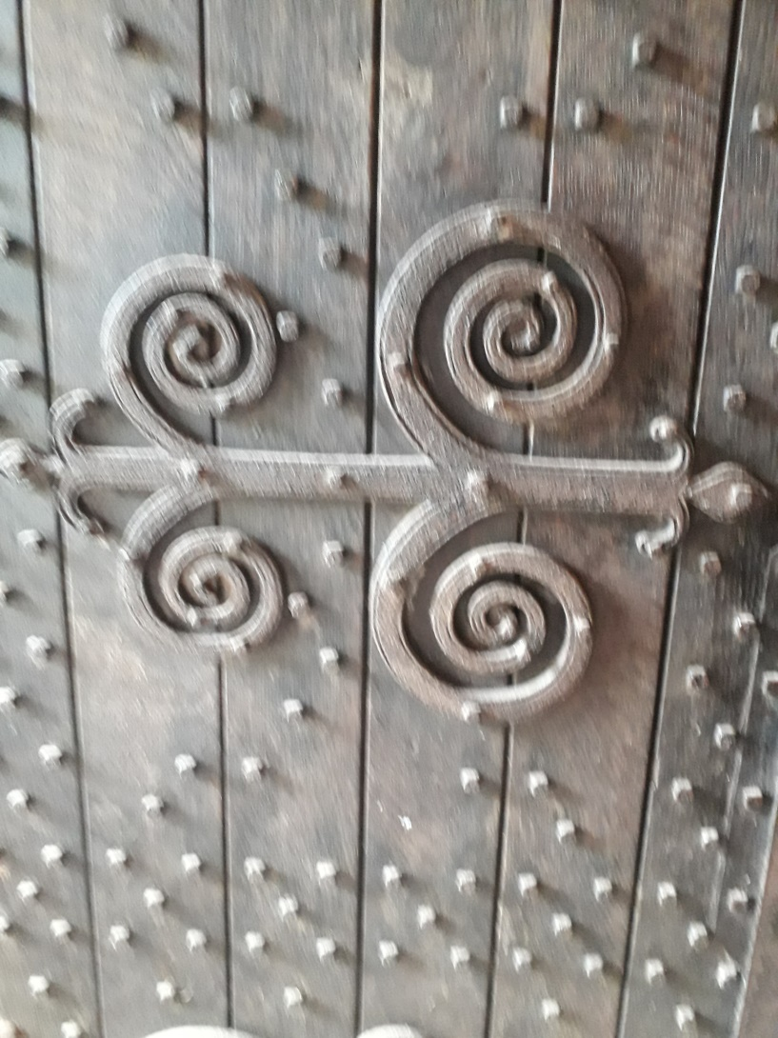
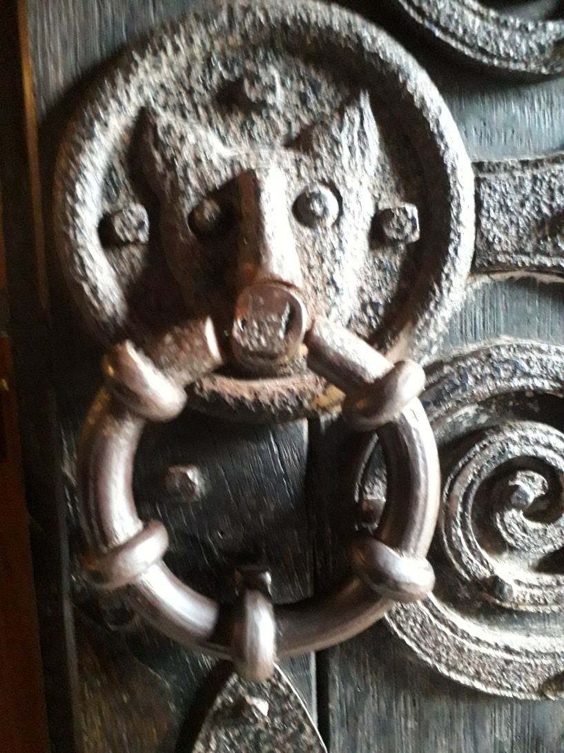
North Door
Ironwork

Slide 8
The art of Ospringe church
The church building offers a range of artistic forms.
Sculpture
Mosaics
Paintings
Woodcarving
Wrought iron work
Glasswork
Tapestry and needlework
This presentation begins an exploration of the art inside and outside the building.

Slide 9
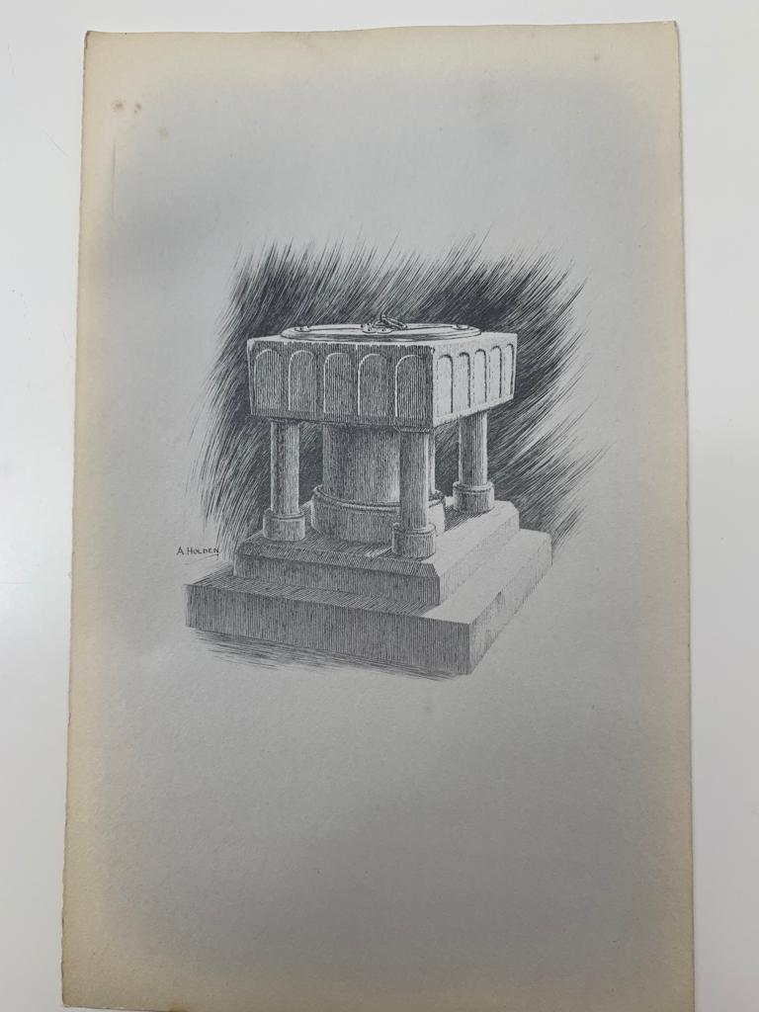
Font
Made of
Bethersdan Marble.
Thought to be from the original Norman church.

Slide 10
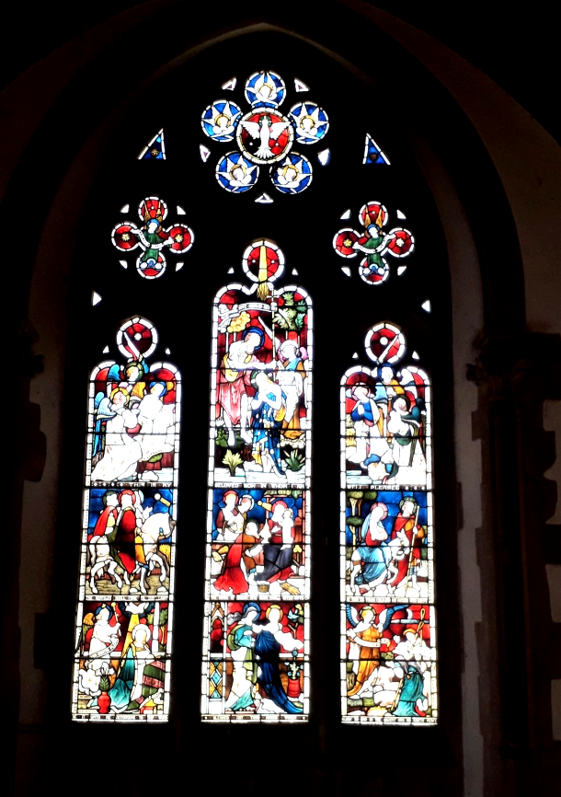
West Wall
Willement 1851
Description of panels
Baptism of Jesus
Dove of Peace surrounded by 5 Angels.
Two Angels carrying scrolls saying ‘alleluia’
This is my beloved Son in whom I am well pleased. (Matthew 12 v18)
The gentiles shall come to my light (Isaiah 60 v3)
The kings of Sheba and Sheba shall offer gifts (Psalm 72 v10)
He took the young child and his mother to Egypt. (Matthew 2 v14)
Ave gratia plena : Latin for ‘Hail(Mary) full of grace’
Be it according to thy word, blessed art though amongst women. (Luke 1 v42-43)

Slide 11
West wall
continued
Note the depiction of the events
leading to His baptism
Bulrushes, water plants (Moses)
Visitation of the wise men
Mary’s visit to Elizabeth
Angel visiting Mary
Angel visiting shepherds with scroll saying 'I bring you tidings of great joy’ (Luke 2v10)
John the Baptist
Angels worshipping at the baptism of Jesus.

Slide 12
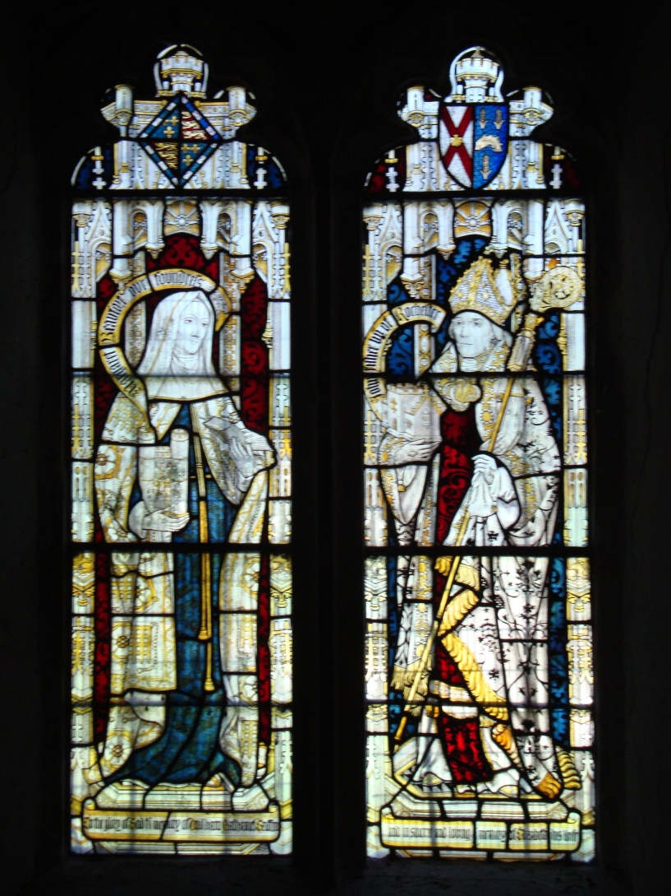
West Wall
Possibly Comper and Bucknall circa 1898
Left Panel:
Margaret Beaufort :
( founder St Johns College Cambridge mother of Henry V11)
Right Panel:
John Fisher :
Bishop of Rochester 1533-35
( Canonised 19th May 1935)
In memory of William Nathaniel Griffin and Elizabeth Griffin his wife.

Slide 13
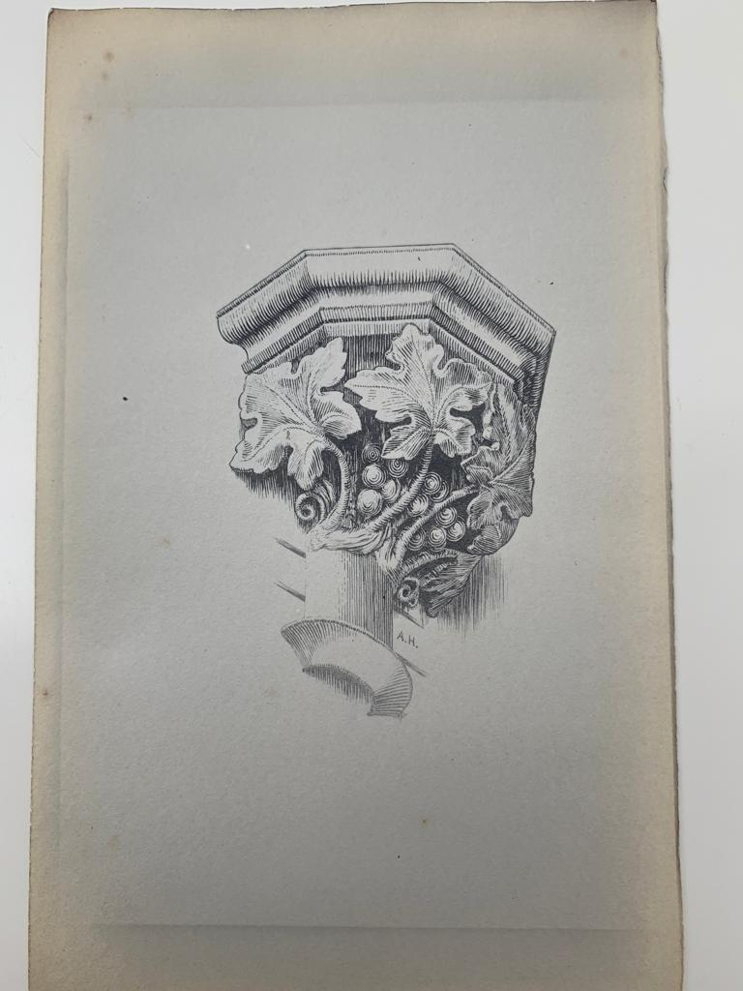
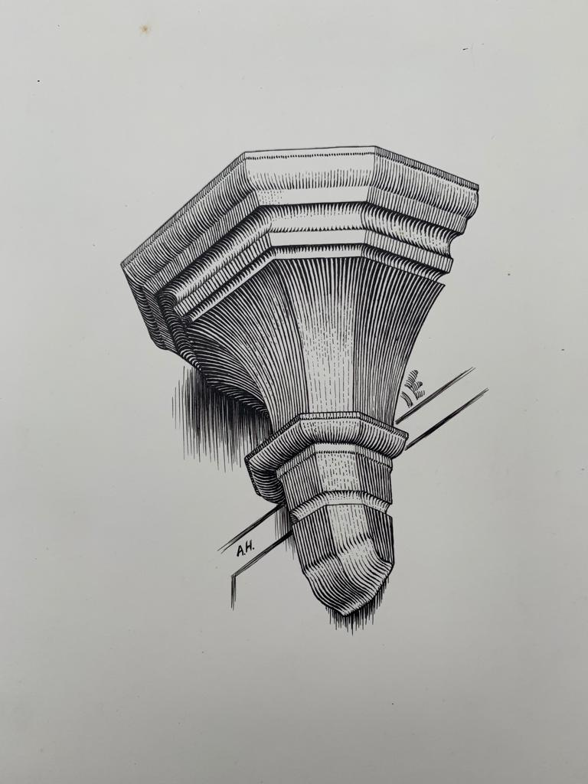
Internal corbels external wall/ central columns
Note the leaf forms and grapes

Slide 14
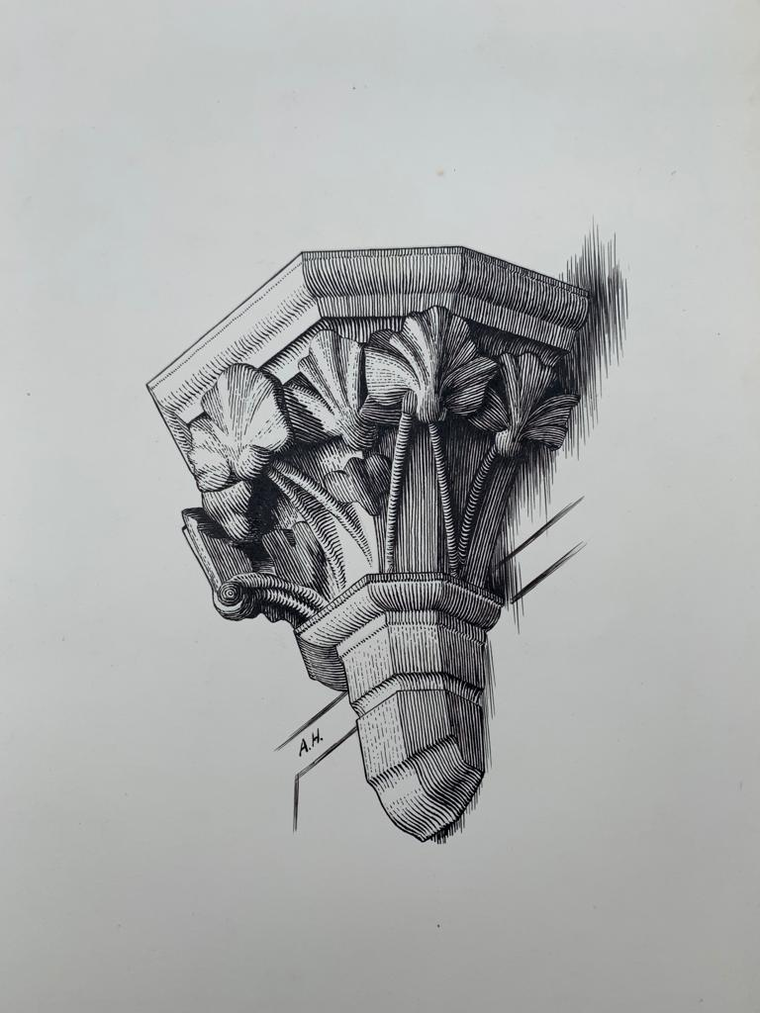
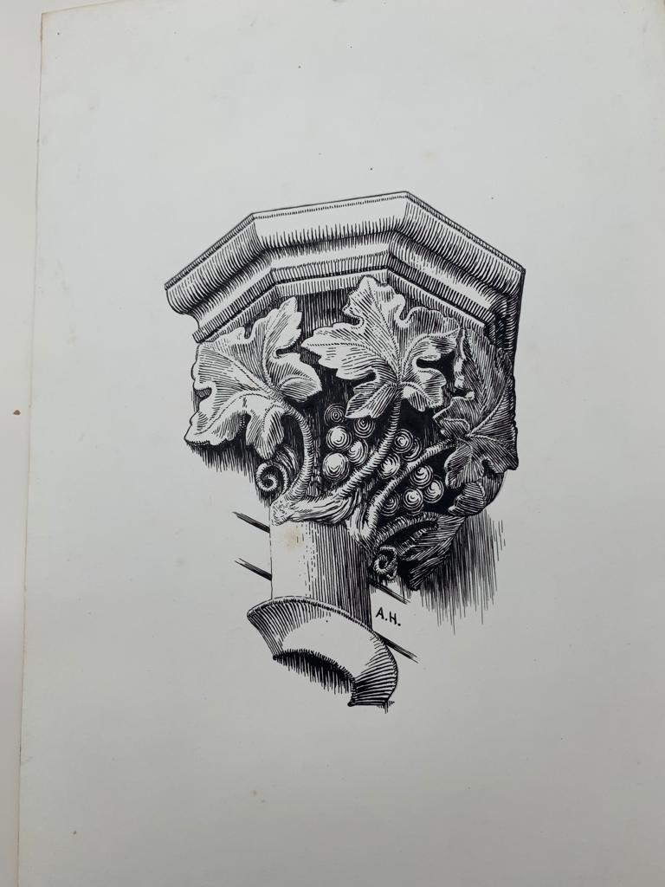
Corbels external walls(internal)
Note different leaf shapes

Slide 15
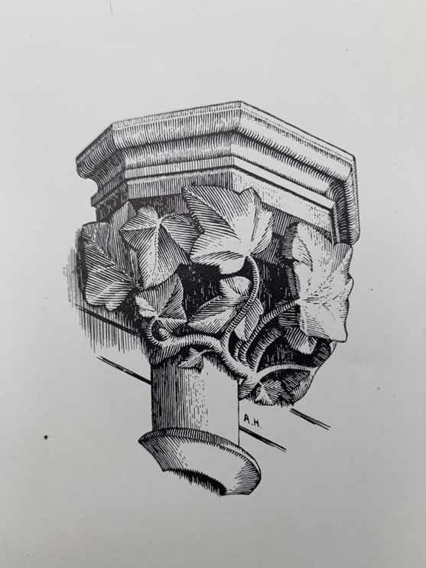
Internal decorations

Slide 16
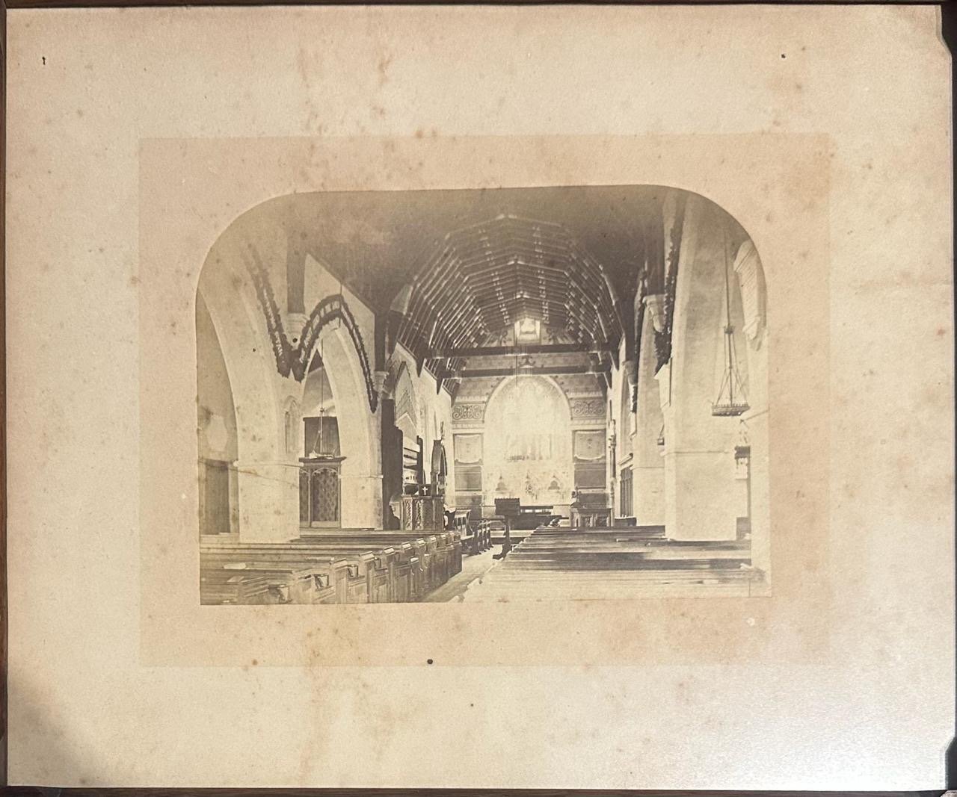
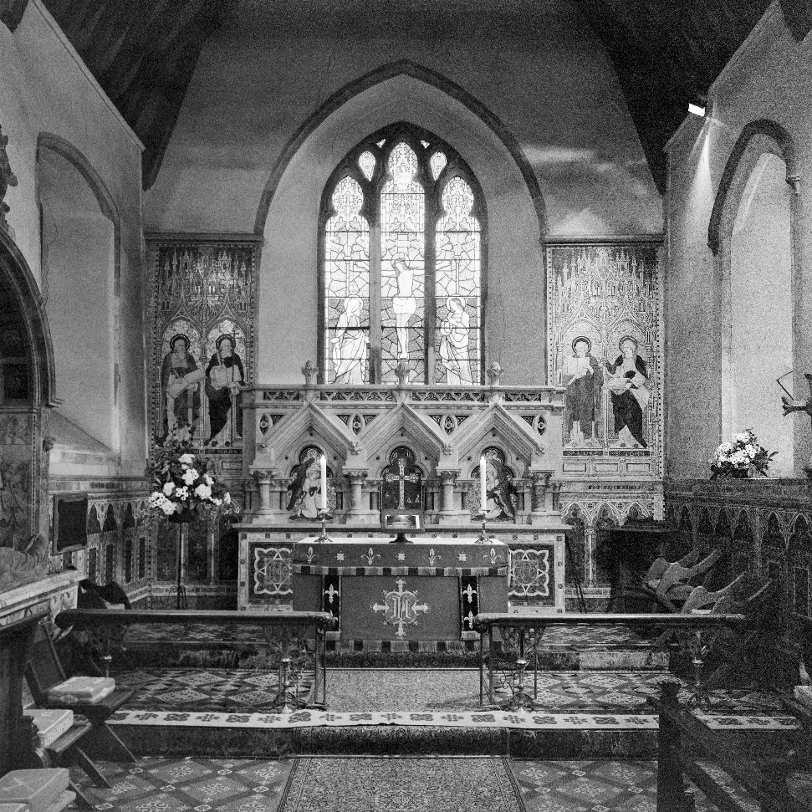
Chancel Pre and Post Griffin Memorial

Slide 17
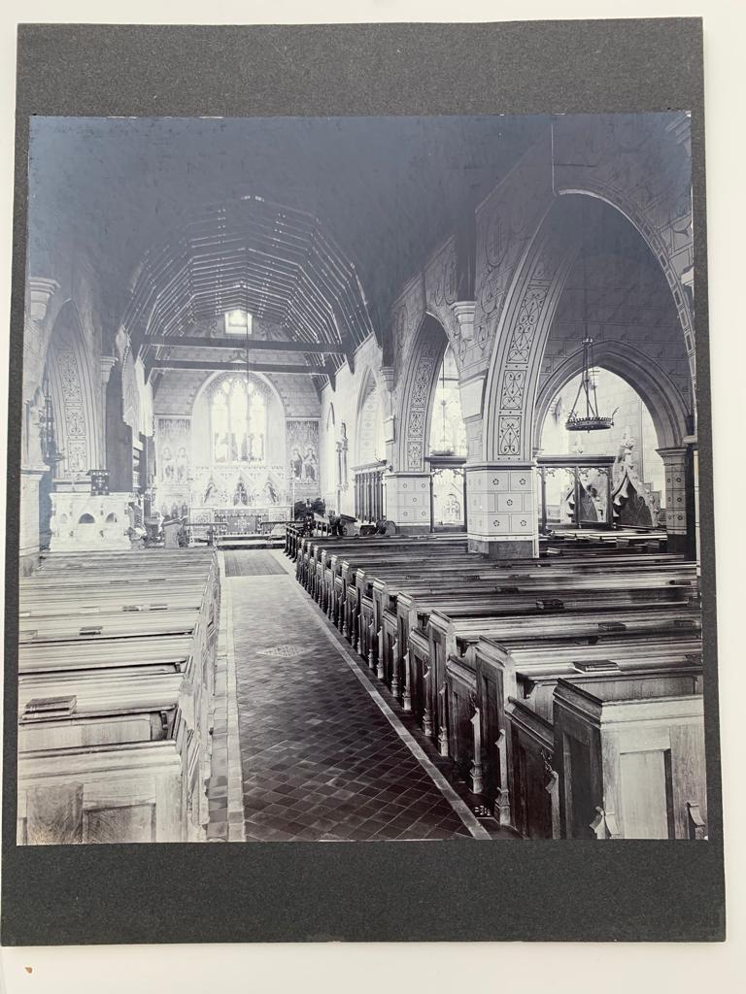
Internal views showing Victorian decoration

Slide 18
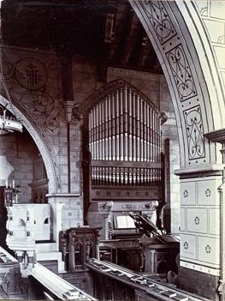
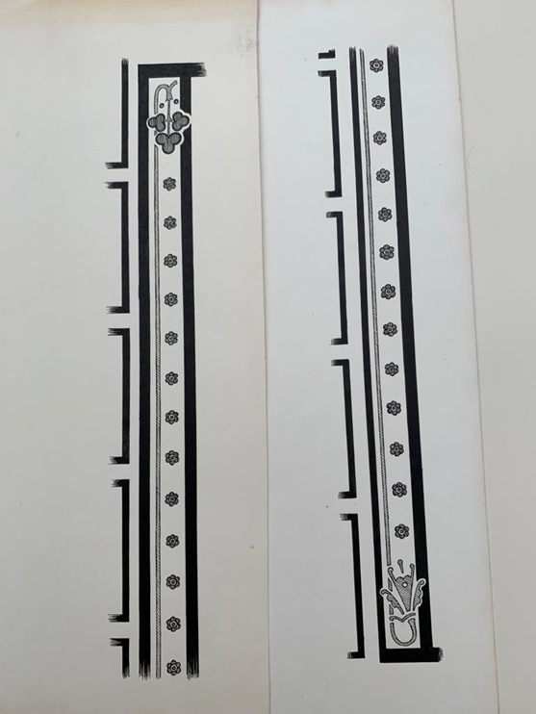
Internal views showing Victorian decoration

Slide 19
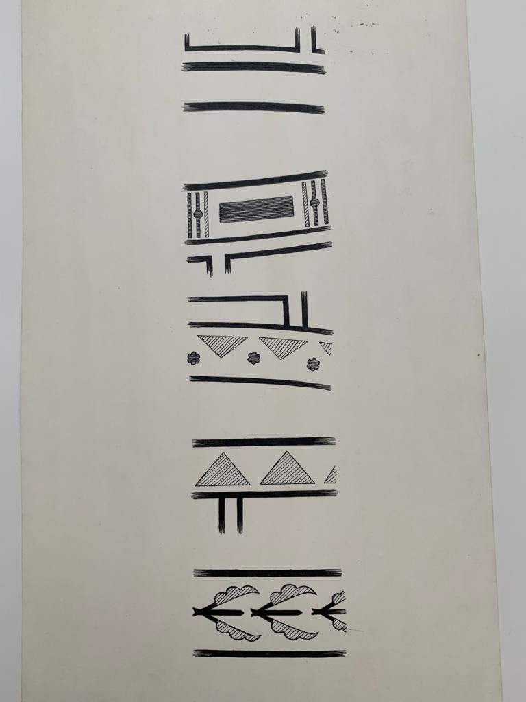
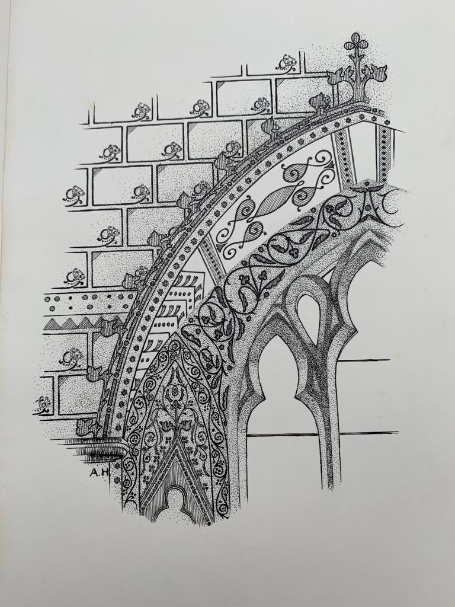
Patterns on walls no longer visible

Slide 20
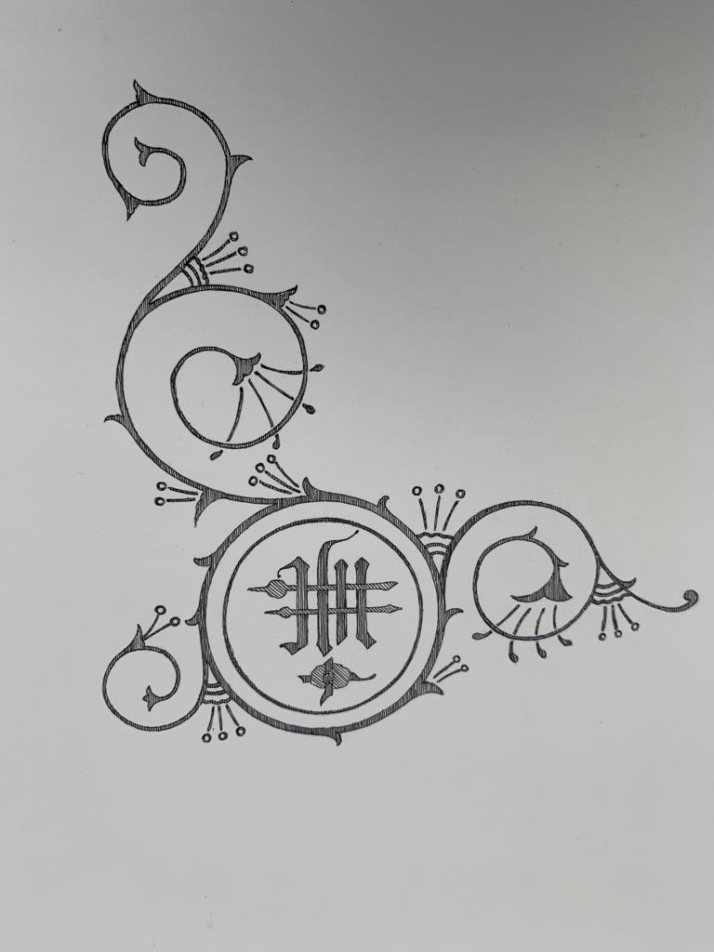
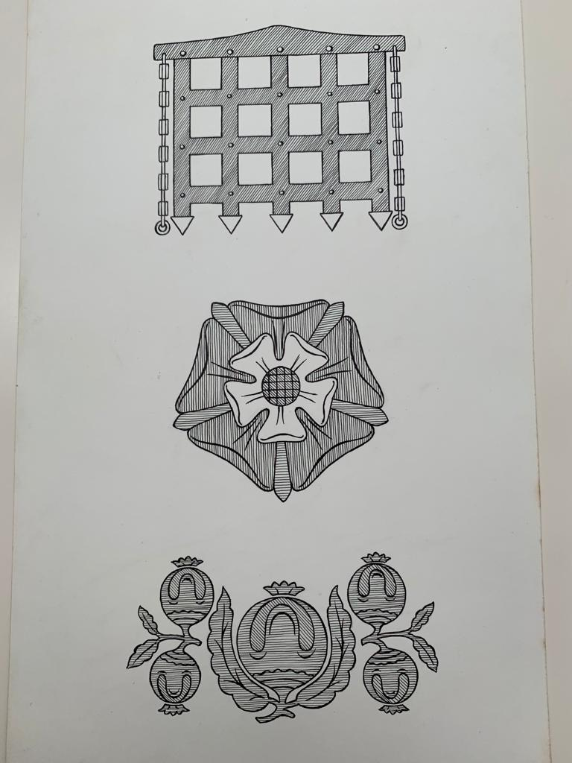
Patterns on walls no longer visible

Slide 21
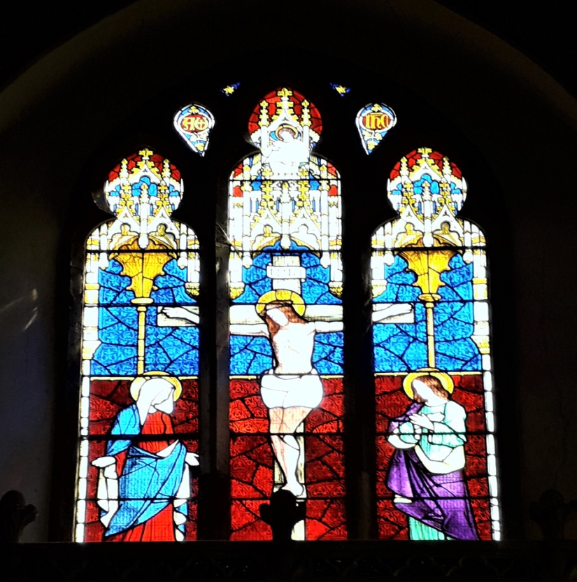
East window
Made by Thomas Willement. circa 1861
To the glory of God and in memory of John Townend who died July 12th aged 39 MDCCCLVI (1856)
Jesus is Lord Crucifixion Mary, John
(Inri Latin for Jesus of Nazareth King of the Jews)
Top left panel
Alpha and Omega
Top right panel
Inri (Jesus of Nazareth King of the Jews)
Centre
God is Love held by angel
Jesus on the cross
Right Panel
John
Left Panel
Mary
Underneath
‘By thy cross and passion good Lord deliver us’
(Litany in the Book of Common Prayer)

Slide 22
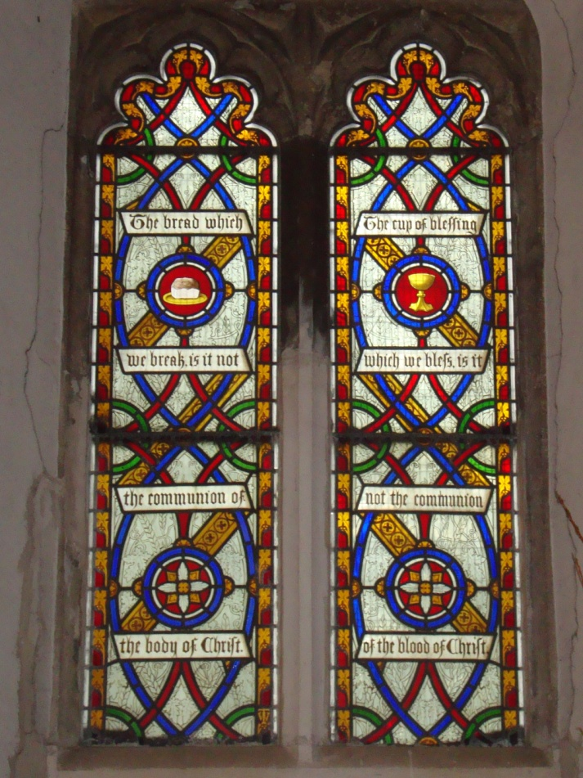
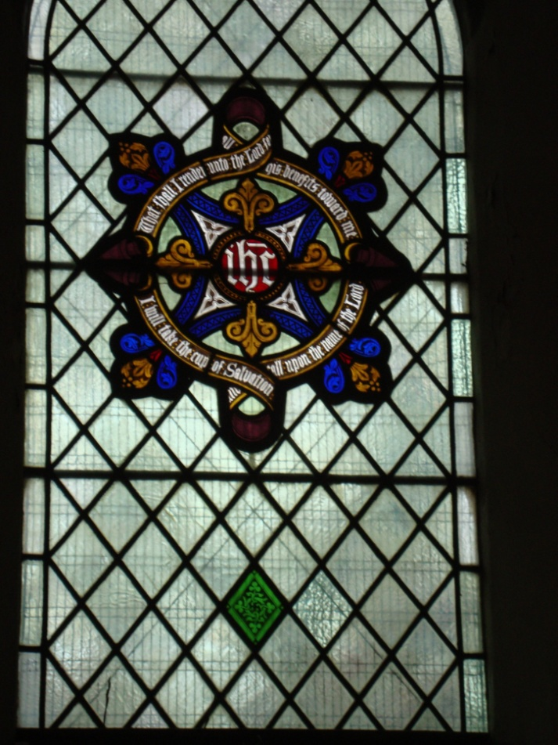
Sanctuary
North wall, Thomas Willement circa 1854
South wall ,Thomas Willement circa 1852
Bread and wine.
The bread which we break is it not the communion of Christ .The cup of blessing which we bless is it not the communion of the blood of Christ.
( 1 Corinthians 10 verse 16)
What shall render unto the Lord for all his benefits to me . I will take the cup of salvation and call upon the Lord.
( Psalm 116 verses 12-17)

Slide 23
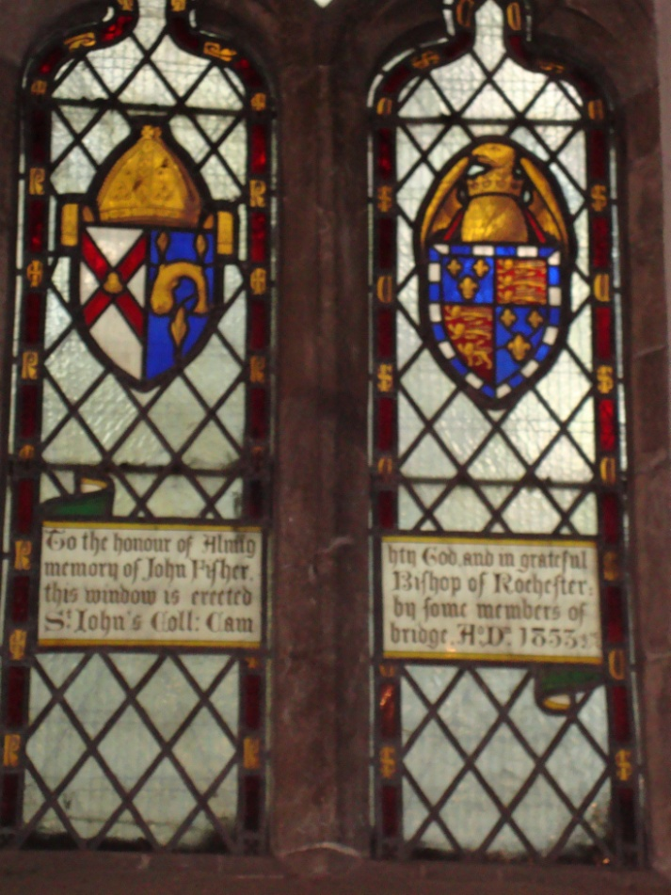
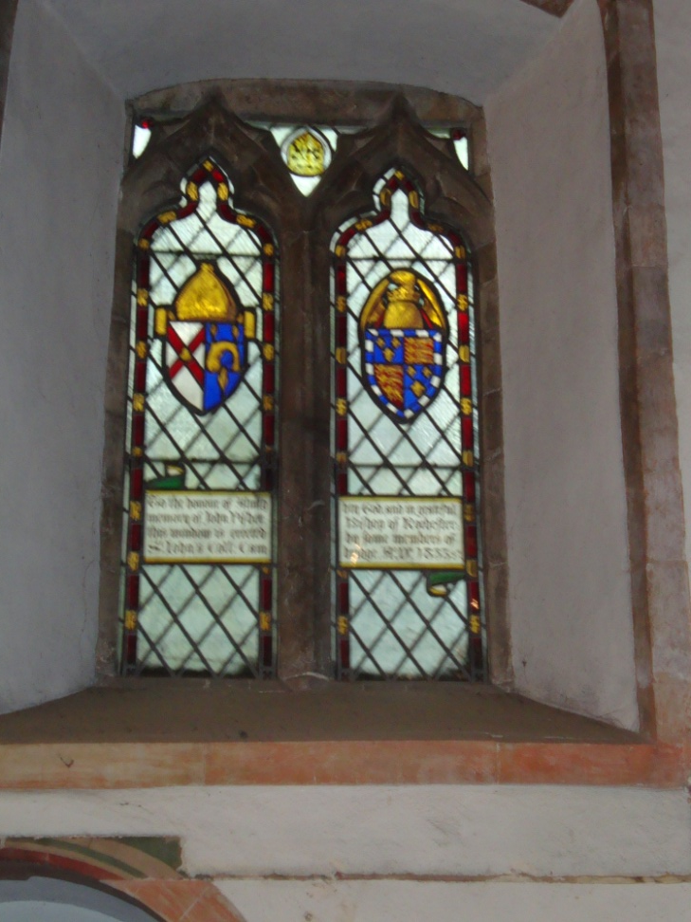
Sanctuary
North wall Thomas Willement 1853
To the honour of Almighty God and in grateful memory of John Fisher, Bishop of Rochester, this window is erected by some members of St. Johns College Cambridge AD1855
The right crest is that of St Johns College Cambridge.
The left crest is that of John Fisher Bishop of Rochester
See also West window

Slide 24
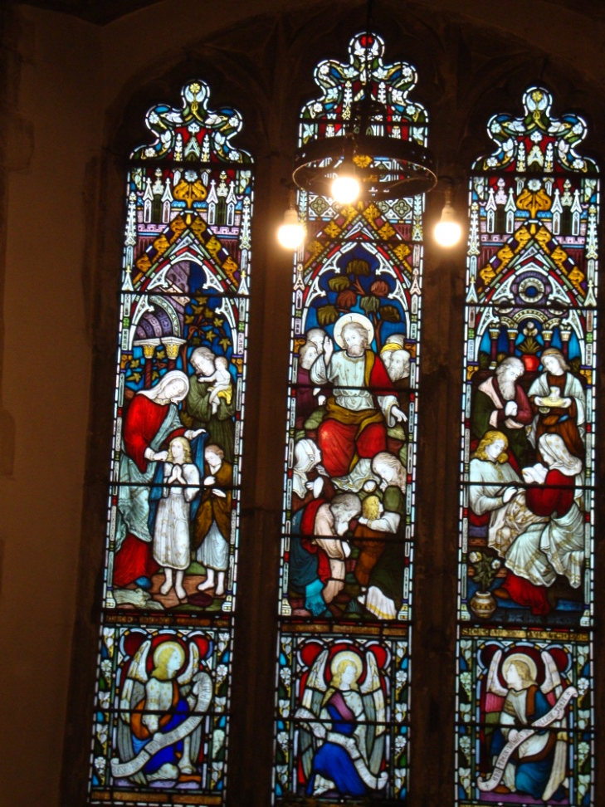
Nave North Wall
Preedy circa 1878-1885
Panels from left to right
In affectionate memory of Elizabeth Shepherd(1855) erected by her daughters .
‘Naked and you clothed me’
(Matthew 25 v36)
‘Blessed are the pure in Heart’
(Matthew 5 v8)
‘Sick and you visited me’
(Matthew 25v36)
The Angels scrolls say
‘Blessed are the dead who die in the Lord’
‘Yea saith the spirit that they may rest from their labours ‘
‘And their works do follow them’
(All from Revelation 14v13)

Slide 25
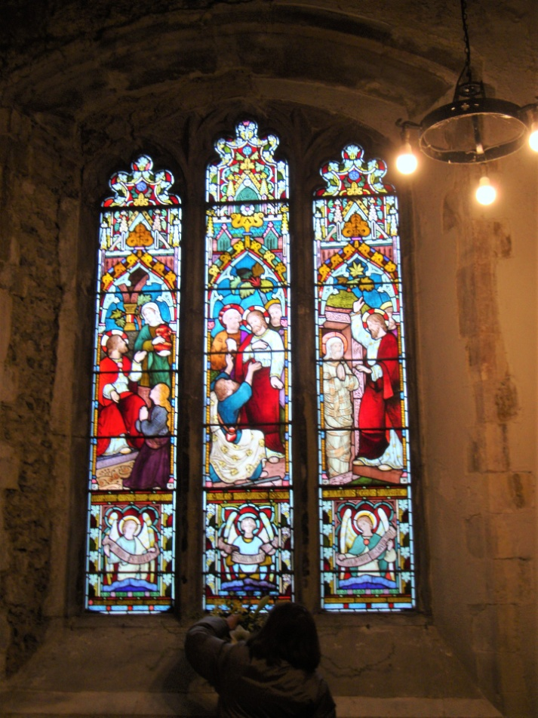
North wall
Preedy circa 1878-1883
To the Glory of God and in memory of William Hall who died December 13th 1876
‘With Christ which is far better’
Philippians 1 v 24
Scenes depicting the relationship between Mary, Martha , Lazarus and Jesus .
(Left to right)
Mary and Martha ‘Mary which hath chosen that good part’
(Luke 10 v42)
Jesus and Mary ‘thou whom thou lovest is sick’
(John 11v3)
Lazarus and Jesus ’Lazarus come forth’
(John 11v43)
Three angels holding scrolls saying from
left to right
One thing is needful
(Luke 10v42)
I am the resurrection and the life
(John11v25)
Behold how he loved him
(John11v36)

Slide 26
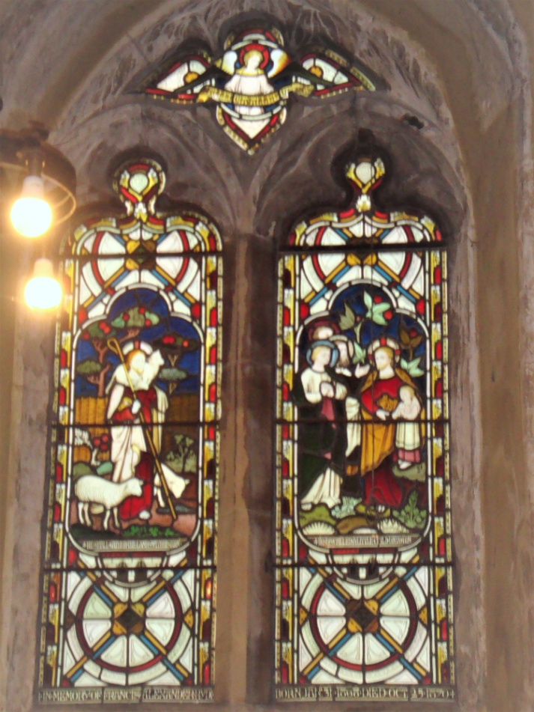
South wall
Clayton and Bell 1871
In memory of Francis Hyde
born January 31st 1868 died October 25th 1870
Top
Angel holding scroll saying
‘Alleluia Alleluia’
Left Panel
Shepherd with 3 sheep
‘He shall gather lambs with his arms’
(Isaiah 40v11)
Right Panel
Jesus with children
‘Jesus called little children unto him’
(Luke 18v16)

Slide 27
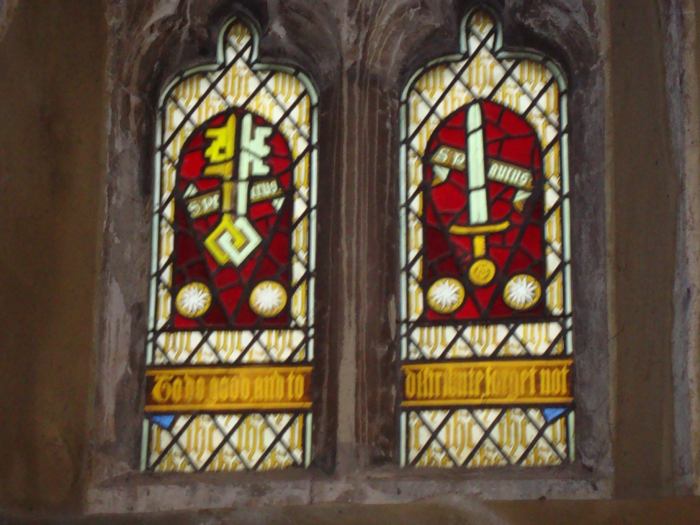
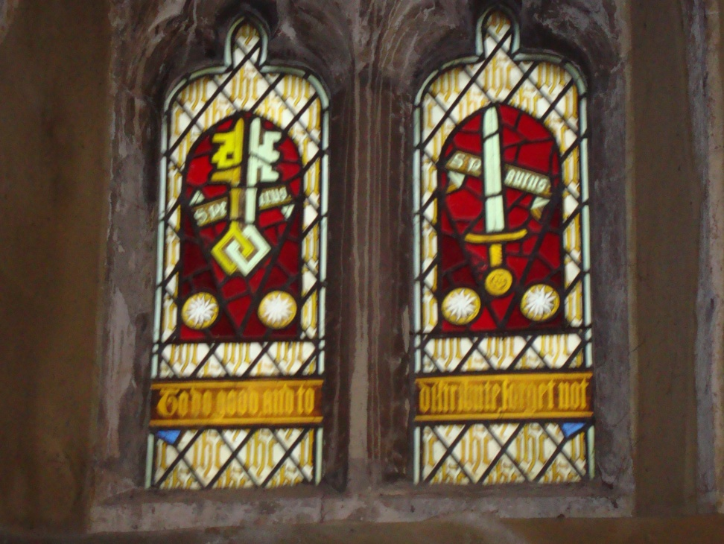
St. Peter And St. Paul
South Wall
Willement 1851
Cross keys for St. Peter(St Petrus)
Sword for St Paul(St Paulus)
The background letters are IHC which is the Greek spelling of Jesus (IHCOYC)
‘To do good and to distribute, forget not’
This is the first part of Hebrews 13 v16 it finishes ‘for with such sacrifices God is pleased.’

Slide 28
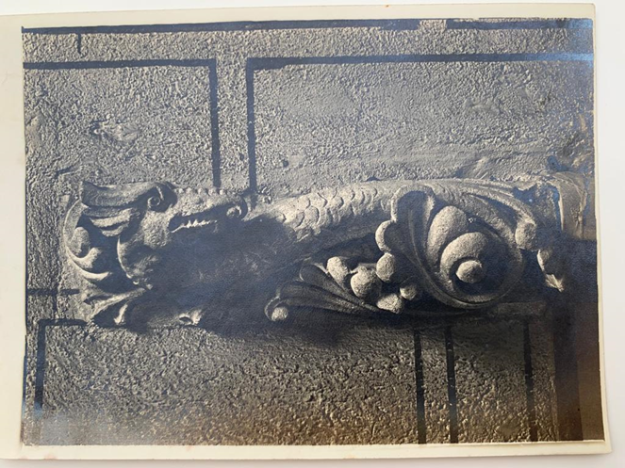
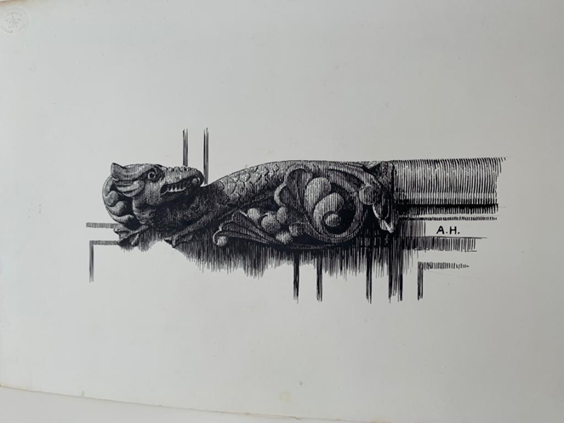
Parish room
A former vicar was named Griffin

Slide 29
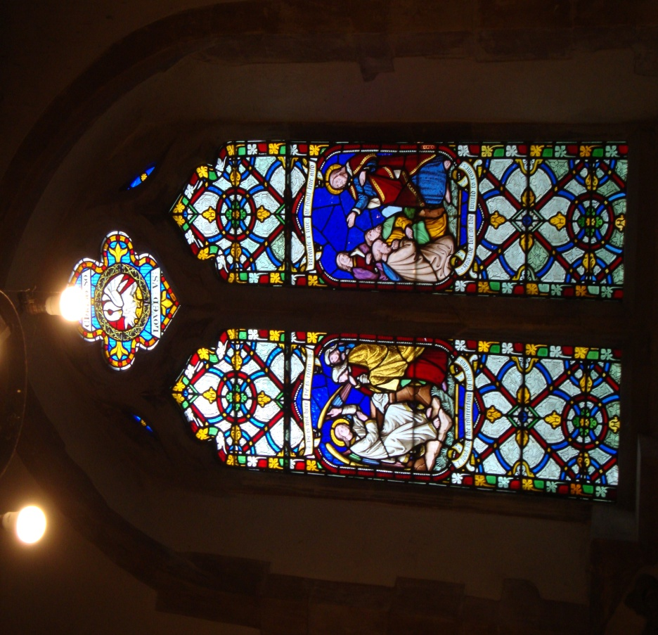
Hart Chapel
1858 South wall (Thomas Willement)
In memory of Rev. Morgan Jones BD
1843 -1870
Top window
Pelican caring for her young
‘Christ so loved us’
Left Panel
Two women and an angel in the tomb.
‘he is not here he is risen’
(Matthew 26v6)
Right panel
‘Because I live you shall live also’
(John 14v19)
‘I look for the resurrection of the dead and the Life of the world to come’
(Nicene Creed)

Slide 30
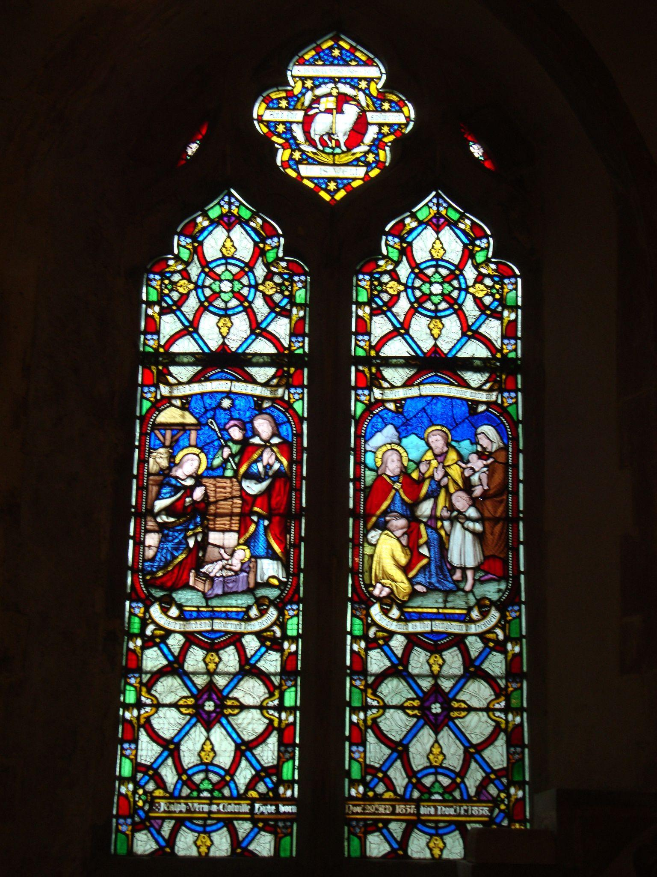
Hart Chapel
South wall
Willement 1859
In memory of Ralph Vernon Hyde
Born Nov.29th 1857 died November 14th 1858
In the bottom right hand corner is the signature of Thomas Willement
Top window
Angel with scroll saying
‘is it well with the child? He answered it is well’
(2 Kings 4 v26)
Left Panel
Blessed be the Lord God of Israel for he hath redeemed his people.
(Luke 1 v68)
Right Panel
Suffer the little children to come to me for of such is the kingdom of God .
(Matthew 19 v 14)

Slide 31
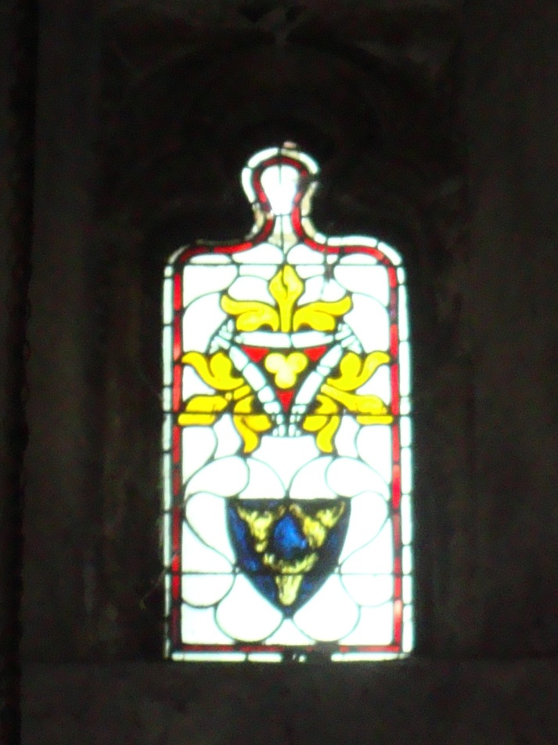
Hart Chapel (Lady Chapel)
High up in the West wall
The Harts were an important family.
Robert Hart was Mayor of Faversham in 1323 and 1327.
Said to have been in apex of original chapel window.
Restored by Willement 1851
Three lilies.
Hart crest in lower portion of window .
The hart is a sign of spiritual longing.

Slide 32
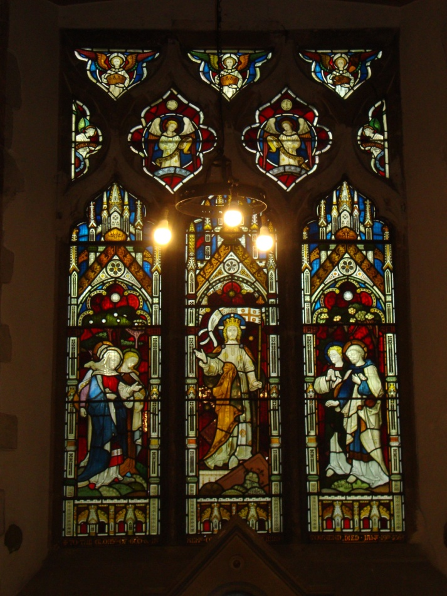
Hart Chapel
East Window
By Clayton and Bell (founded 1855 closed 1993)
The Resurrection Window
To the glory of God and in memory of
Thomas Shepherd Townend 1865
Top three
Three Angels carrying crowns
Next level
Two Angels
‘Behold He is our redemption’
Two side panels
Holy Holy
Left panel
Mary Magdalene and Joanna
(note jar of spices)
Centre Panel
Christ the King
Right Panel
Two men one young one older
(Peter and John?)

Slide 33
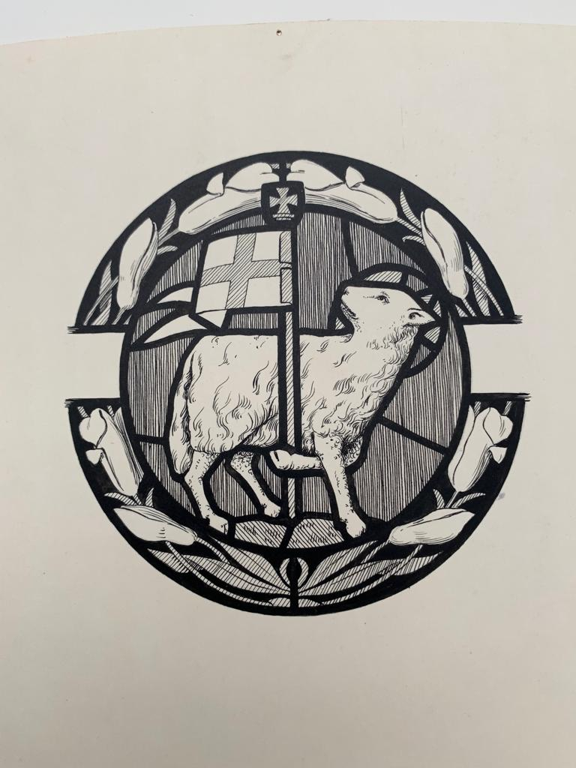
Detail of window in Hart Chapel
Note the lilies circular around the Agnes Dei
( Lamb of God)
The pennant of St George.
The lily is sometimes known as the Gethsemane and was supposed to have been sprinkled with Jesus’ blood as it grew at the foot of the cross.

Slide 34
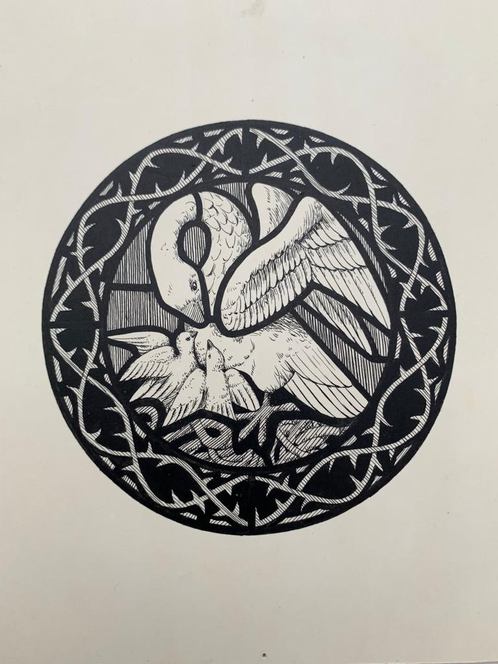
Detail from window in Hart Chapel
Showing a Pelican feeding her young .
The pelican was said to peck its breast to feed its young with its own blood. (This selfless giving of its blood to feed, nurture and save its offspring, was seen as a direct analogy with Jesus’ sacrifice)
Crown of thorns surrounding the Pelican.

Slide 35
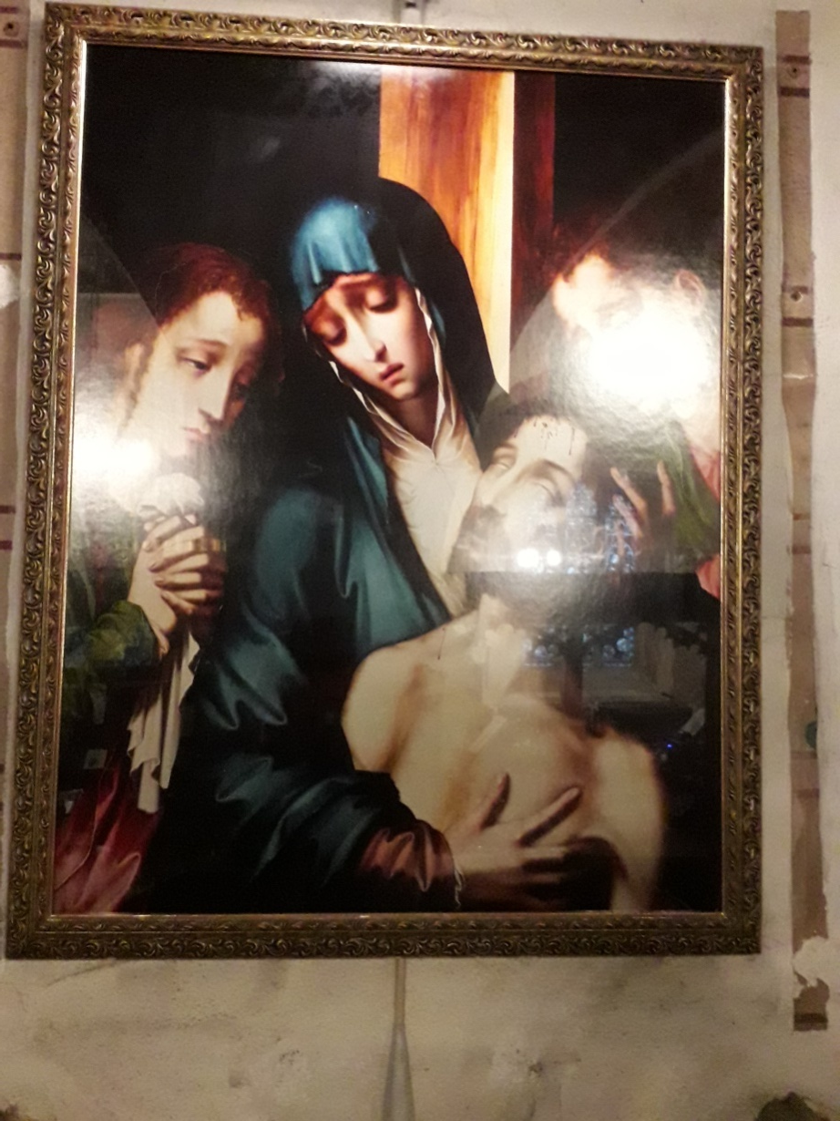
The Pieta
Copy of a painting by
Louis de Morales
(1510 to 1586)
Pieta is Latin for dutifulness or devotion or pity or compassion.
Usually a picture or a sculpture of Mary holding Jesus at the end of his earthly life.
This one shows Mary the mother of Jesus, Mary Magdalene and the disciple Jesus loved.(John 19 v25-27)
From accepting Gods human form to letting it return.
Mary was there at the beginning and the end of God's human interaction with the world in time and space

Slide 36
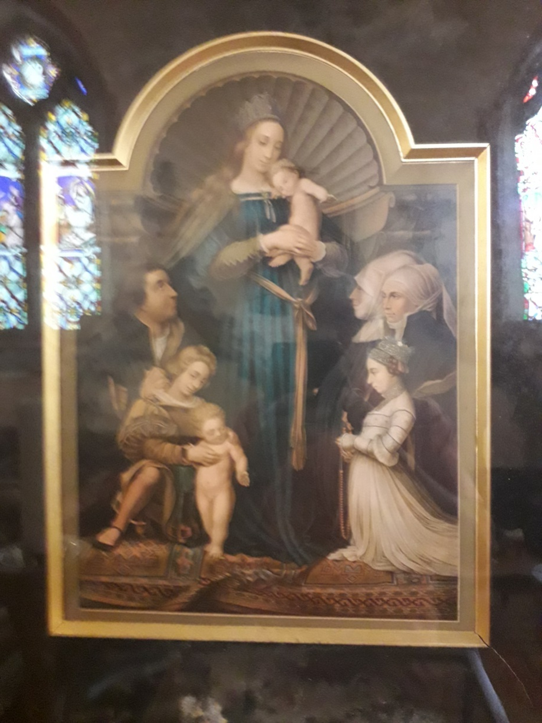
The Darmstadt Madonna
In memory of Dorothea Williams wife of Rev. B Williams
( Vicar 1944-1956)
A copy (probably late Victorian) of a picture by Hans Holbein the Younger.
The original was painted in 1536.
Shows Hans Meyer a mayor of Darmstadt. He was a staunch Catholic and opposed to the Reformation.
It shows his first and second wives plus their daughter and two deceased sons.
The crown on the Madonna's head signifies her status as the Queen of Heaven.

Slide 37
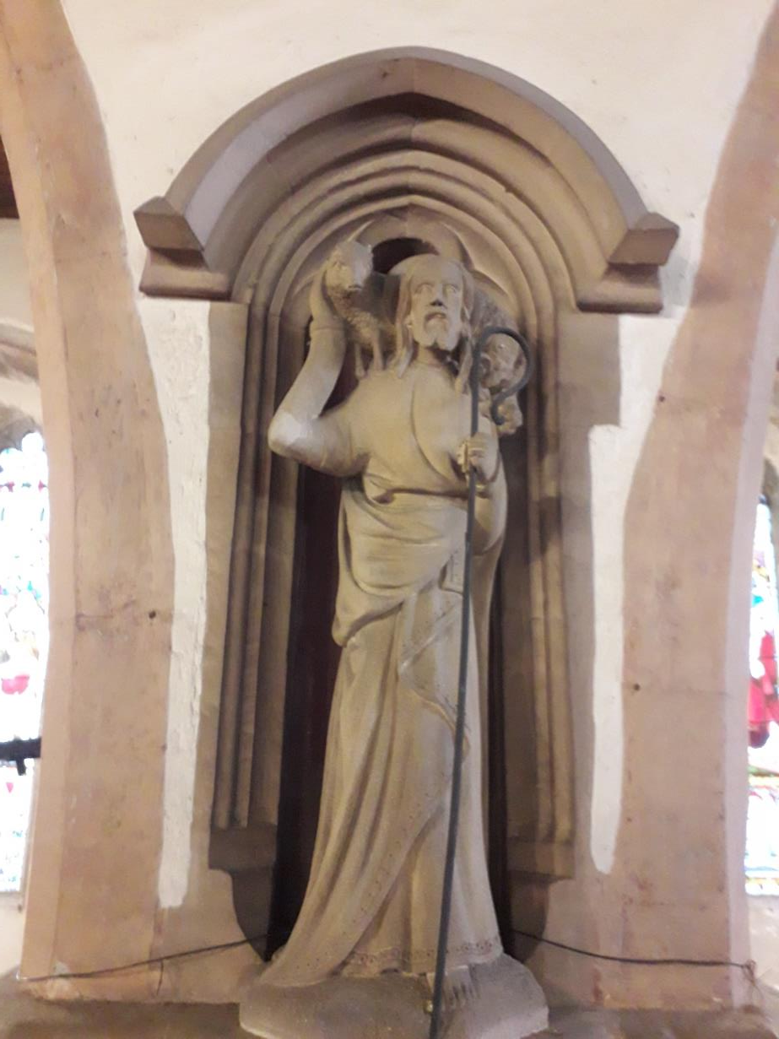
North East Pillar
Shepherd carrying Lamb
Could be relating to:
Jesus the shepherd,
St Francis of Assis
or
the Agnes Dei.

Slide 38
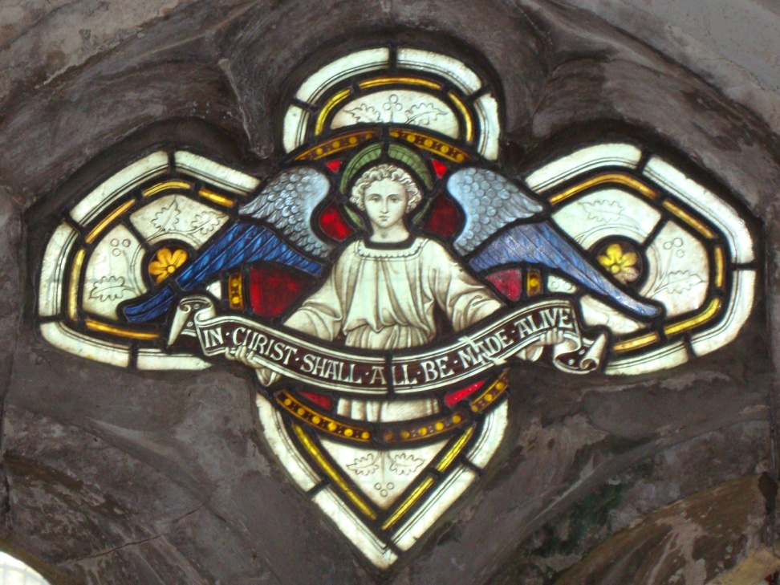
South wall Above vestry
Clayton and Bell 1885
Angel with scroll saying
‘in Christ all shall be made alive’
(1 Corinthians 15 v 22)
Leaves ,cherries , flowers behind Angel’s blue wings.

Slide 39
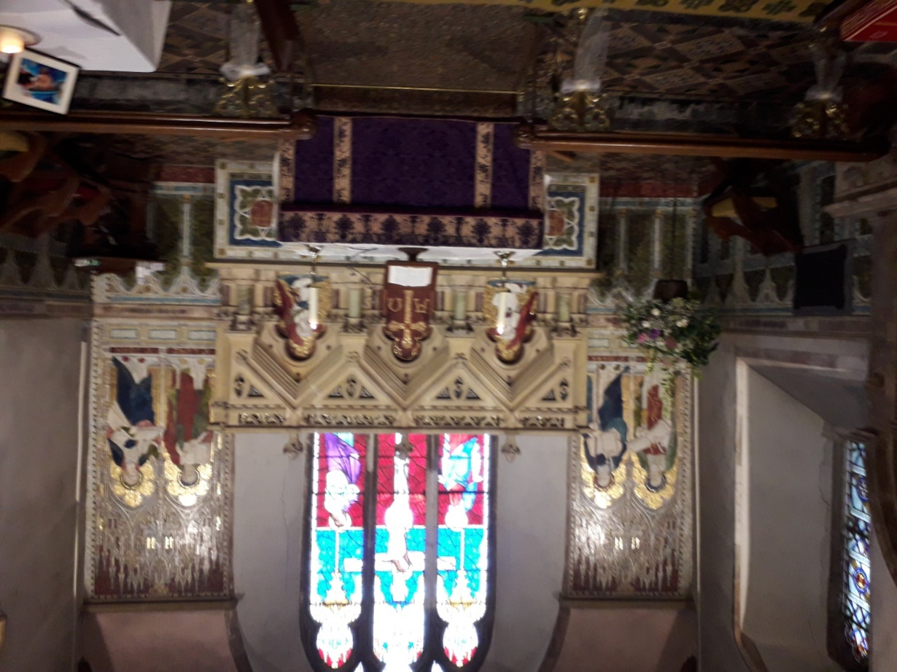
Mosaics
East end of church
The East end of the church is set out in mosaics.
Mosaics by Powell 1894
From left to right.
Mathew, Mark, Angel, Cross, Angel, Luke and John.
The mosaics depict the gospel writers with their identifying symbols.
Money bag for Matthew Tax collector.
Staff with cross at end for St Mark.
Angel with palm leaf

Slide 40
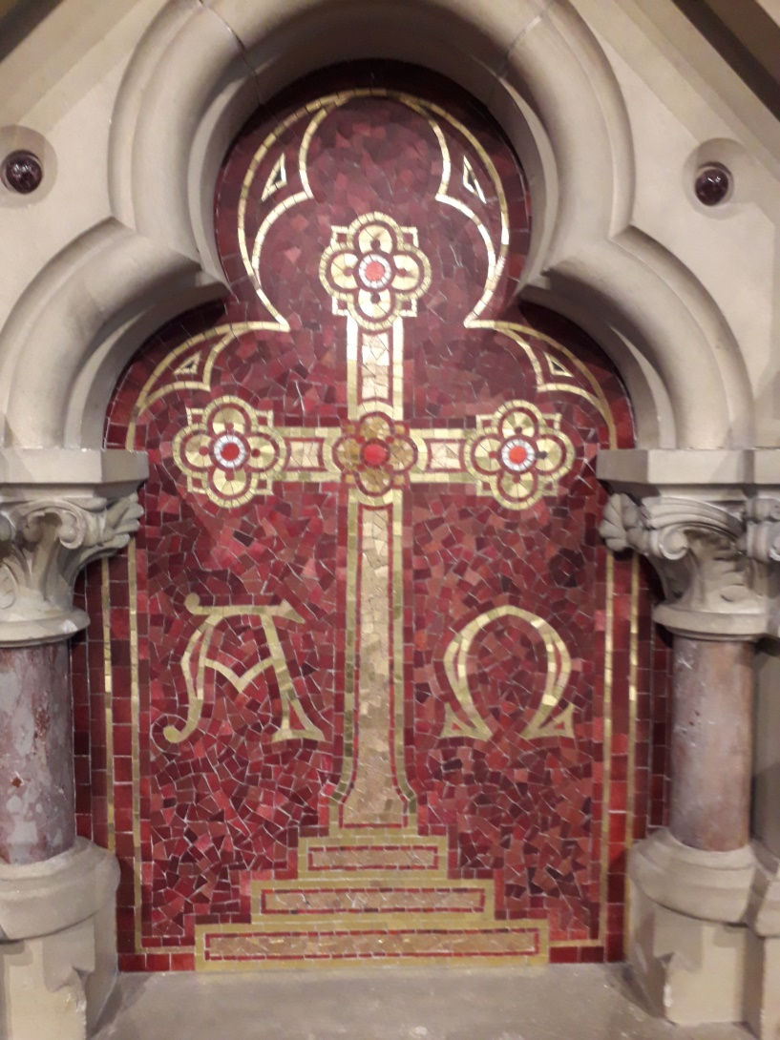
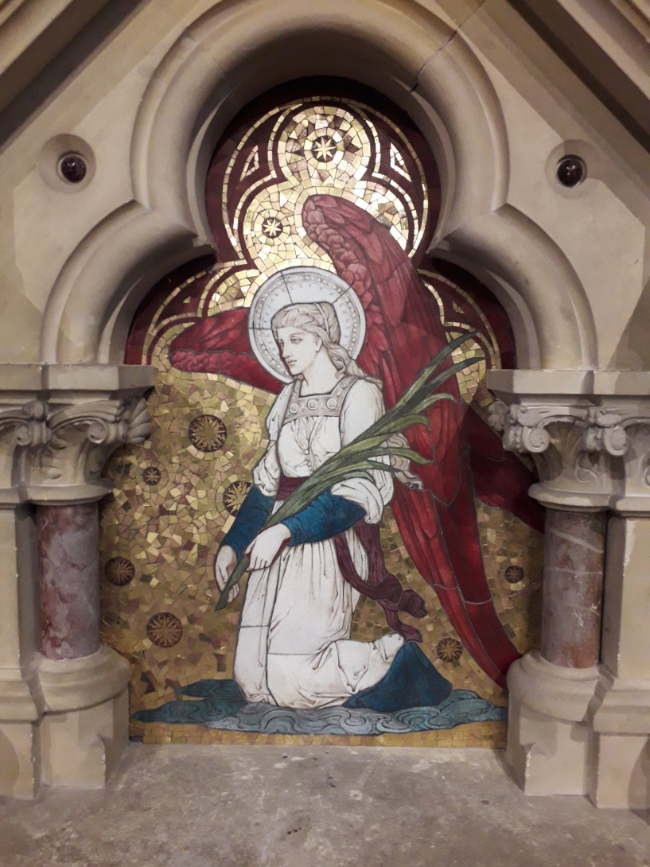
Mosaics (East End)

Slide 41


Woodwork

Slide 42

North Wall
Choir vestry Willement 1852
With the Lord there is plenteous redemption.
Three Angels worshipping the lamb who was slain.
(Agnus Dei)
One Angel has a lute .
At the bottom:
To the Glory of Almighty God ,the adornment of this house and in grateful remembrance of blessings received, this window was completed in the year of our Lord 1912

Slide 43
Glass Designers
Thomas Willement.
One of the earliest Gothic revivalist artists of the 19th century.
Specialised in Armorial Glass and figural windows.
Lived in Faversham at Davington Priory although born in London.
Clayton and Bell.
Founded 1855 closed 1993.
Prolific stained glass firm in 19th and 20th century.
Frederick Preedy.
Trained as an architect in Worcestershire .
Moved to London where he designed and made his own windows.
Comper and Bucknell.
Sir J Ninian Comper and his nephew Arthur Bucknell founded the firm in 1889. They made use of clear glass and or square quarries decorated with silver stained motifs. Dark reds , emerald greens and light royal blue.

Slide 44


External

Slide 45


External
South wall gutters
Priests or Monks head Note long hair and coronet

Slide 46


North door/Lych Gate

Slide 47


View from South West
At top of Tower. No longer visible
?the image may be a negative?

Slide 48

View West end South door

Slide 49


South wall faces around windows
The griffins seem to have gone

Slide 50

Windows West end

Slide 51
Church before remodernisation under Griffin.

Slide 52

An old postcard of Ospringe Church

Slide 53

St. Peter and St Paul
Ospringe
A photograph looking from the west towards the north door. Note the beacon to the left. This is no longer visible and no evidence remains.
By the clothes we may conclude this was erected to commemorate the Queen ‘s ( Victoria) Jubilee in around 1897.

Slide 54

Bells going for the war effort circa 1914

Slide 55

Waterfall at Lorrenden no longer running. Fed stream which ran along Water Lane
Concrete buttresses still observable in a copse at Lorrenden although water no longer running.

