Slide 1
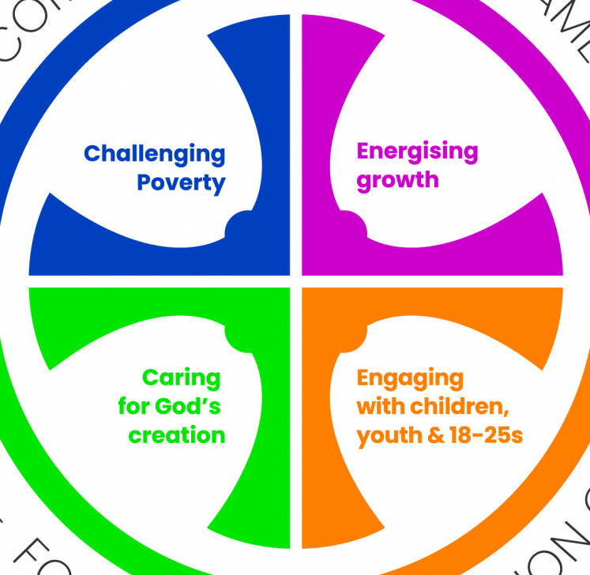
Growing Younger: 18-25s

Slide 2
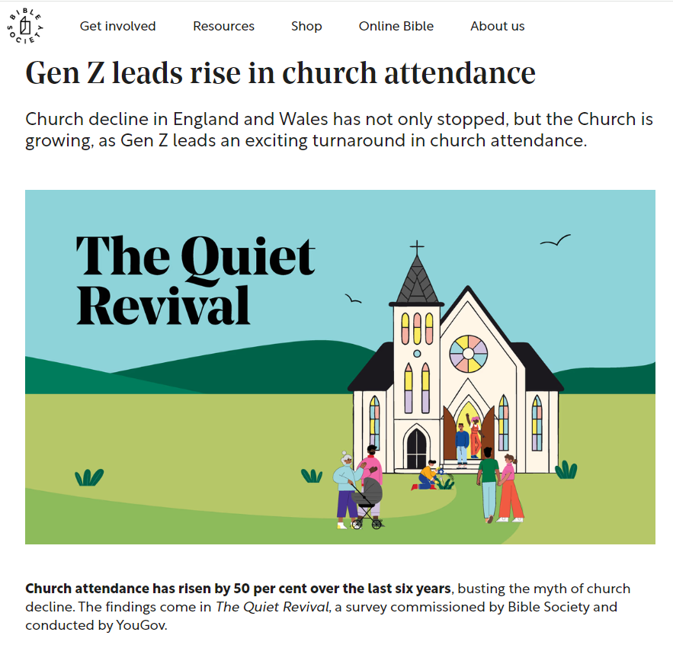
According to Nielsen BookScan data, Bible sales increased by 79% between 2019 and 2024, driven by Gen Z.
More young adults attending church, particularly more young men (from 4% to 16% in the past five years)
Churches are growing more diverse.
A growing number of young adults are engaging with faith in a way that previous generations did not.
Research shows that 62% of 18-24-year-olds describe themselves as “very” or “fairly” spiritual, a notable contrast to only 35% of those over 65.
Only 13% of Generation Z identify as atheists - far lower than the 20% of millennials and 25% of Generation X who do. This suggests that Gen Z is approaching faith differently—not necessarily through traditional institutions but by exploring spirituality on their own terms.

Slide 3
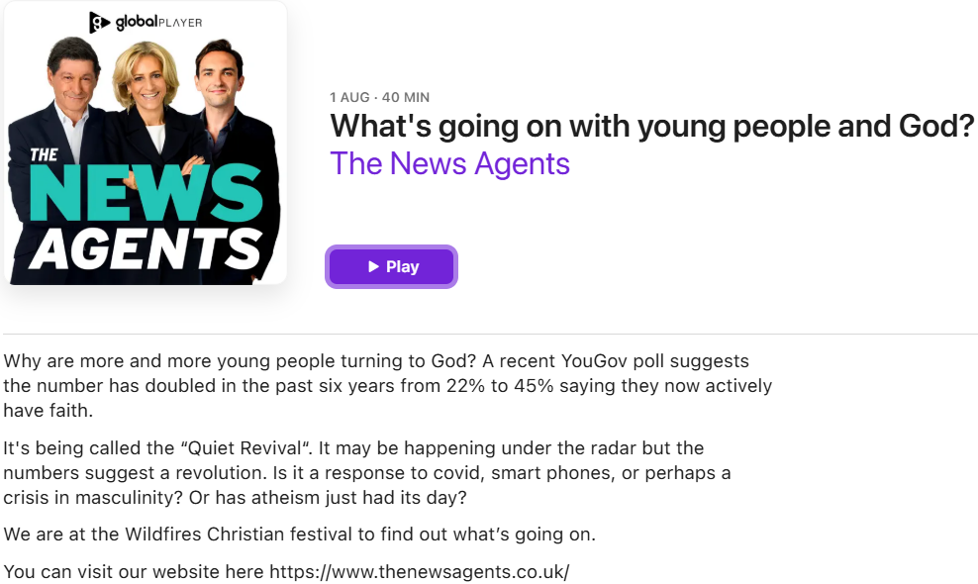
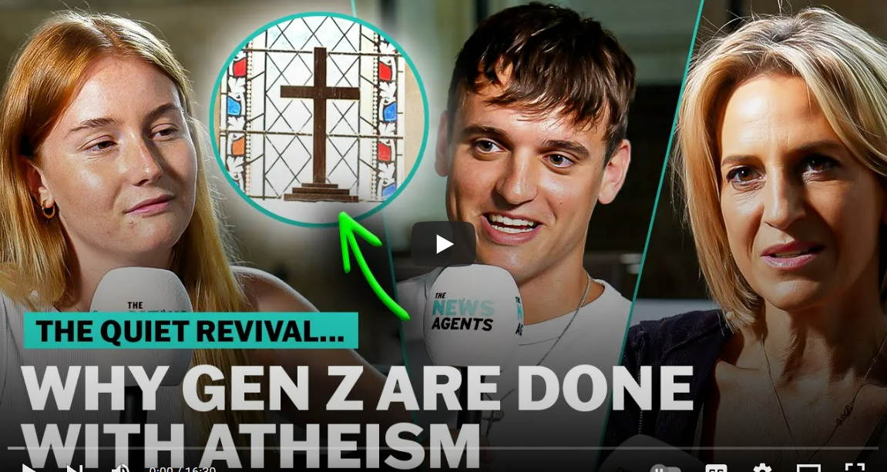
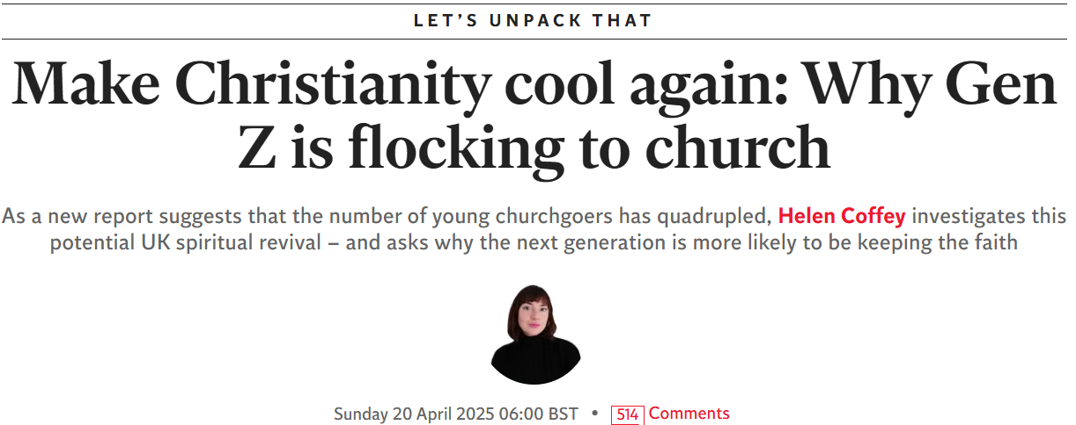
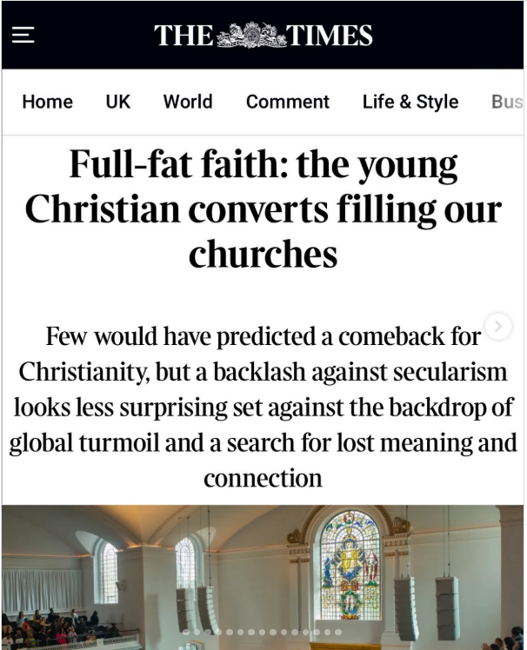
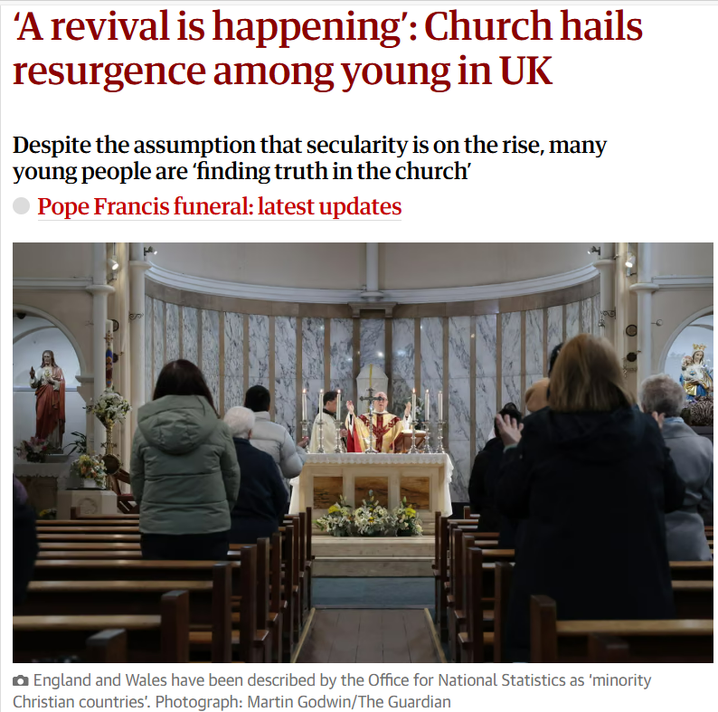
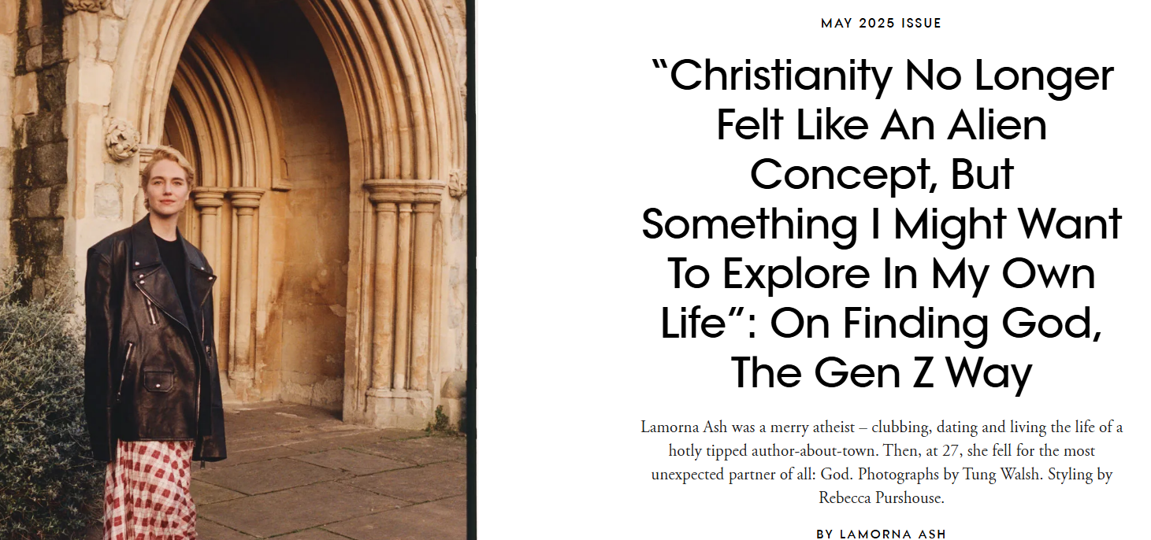
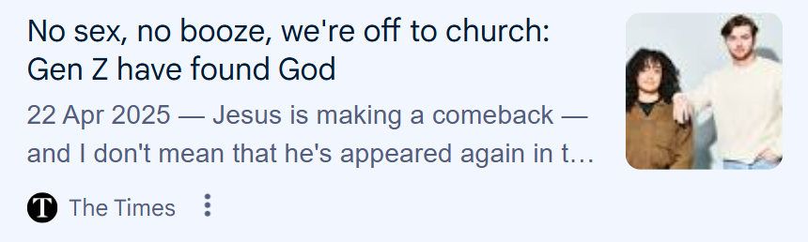
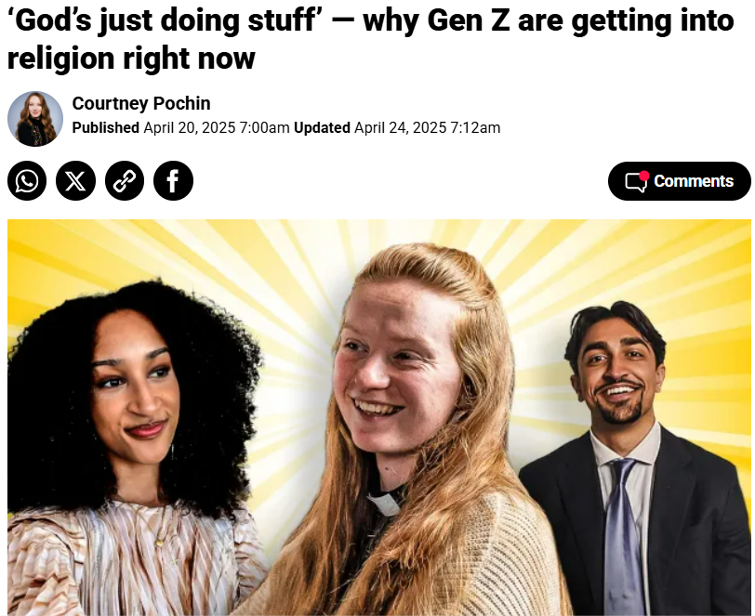

Slide 4
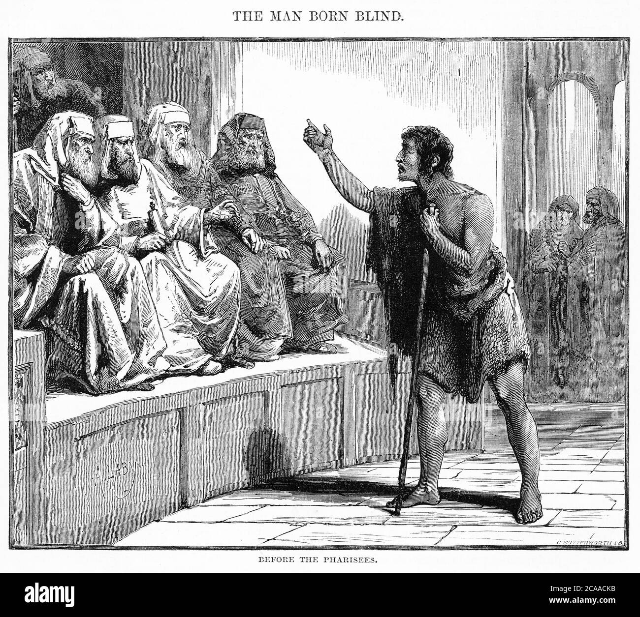

Slide 5
The Pharisees Investigate the Healing
13 They brought to the Pharisees the man who had been blind. 14 Now the day on which Jesus had made the mud and opened his eyes was a Sabbath. 15 So the Pharisees also asked him how he had received his sight. The man answered, “He put mud on my eyes, and I washed, and now I can see.” 16 Because of this, some of the Pharisees said, “This man is not from God, for He does not keep the Sabbath.” But others said, “How can a sinful man perform such signs?” And there was division among them. 17 So once again they asked the man who had been blind, “What do you say about Him, since it was your eyes He opened?” “He is a prophet,” the man replied. 18 The Jews still did not believe that the man had been blind and had received his sight until they summoned his parents 19 and asked, “Is this your son, the one you say was born blind? So how is it that he can now see?”20 His parents answered, “We know he is our son, and we know he was born blind. 21 But how he can now see or who opened his eyes, we do not know. Ask him. He is old enough to speak for himself.” 22 His parents said this because they were afraid of the Jews. For the Jews had already determined that anyone who confessed Jesus as the Christ would be put out of the synagogue. 23 That was why his parents said, “He is old enough. Ask him.” 24 So a second time they called for the man who had been blind and said, “Give glory to God! We know that this man is a sinner.” 25 He answered, “Whether He is a sinner I do not know. There is one thing I do know: I was blind, but now I see!” 26 “What did He do to you?” they asked. “How did He open your eyes?” 27 He replied, “I already told you, and you did not listen. Why do you want to hear it again? Do you also want to become His disciples?” 28 Then they heaped insults on him and said, “You are His disciple; we are disciples of Moses. 29 We know that God spoke to Moses, but we do not know where this man is from.” 30“That is remarkable indeed!” the man said. “You do not know where He is from, and yet He opened my eyes. 31 We know that God does not listen to sinners, but He does listen to the one who worships Him and does His will. 32 Never before has anyone heard of opening the eyes of a man born blind. 33 If this man were not from God, He could do no such thing.” 34 They replied, “You were born in utter sin, and you are instructing us?” And they threw him out.
Spiritual Blindness
35 When Jesus heard that they had thrown him out, He found the man and said, “Do you believe in the Son of Manb?” 36“Who is He, Sir?” he replied. “Tell me so that I may believe in Him.” 37 “You have already seen Him,” Jesus answered. “He is the One speaking with you.” 38 “Lord, I believe,” he said. And he worshiped Jesus. 39 Then Jesus declared, “For judgment I have come into this world, so that the blind may see and those who see may become blind.” 40 Some of the Pharisees who were with Him heard this, and they asked Him, “Are we blind too?” 41“If you were blind,” Jesus replied, “you would not be guilty of sin. But since you claim you can see, your guilt remains.”

Slide 6
Who identifies as atheist?
25% of 45-60-year-olds
20% of 30-45-year-olds
13% of 13-30-year-olds

Slide 7
The Pharisees Investigate the Healing
13 They brought to the Pharisees the man who had been blind. 14 Now the day on which Jesus had made the mud and opened his eyes was a Sabbath. 15 So the Pharisees also asked him how he had received his sight. The man answered, “He put mud on my eyes, and I washed, and now I can see.” 16 Because of this, some of the Pharisees said, “This man is not from God, for He does not keep the Sabbath.” But others said, “How can a sinful man perform such signs?” And there was division among them. 17 So once again they asked the man who had been blind, “What do you say about Him, since it was your eyes He opened?” “He is a prophet,” the man replied. 18 The Jews still did not believe that the man had been blind and had received his sight until they summoned his parents 19 and asked, “Is this your son, the one you say was born blind? So how is it that he can now see?”20 His parents answered, “We know he is our son, and we know he was born blind. 21 But how he can now see or who opened his eyes, we do not know. Ask him. He is old enough to speak for himself.” 22 His parents said this because they were afraid of the Jews. For the Jews had already determined that anyone who confessed Jesus as the Christ would be put out of the synagogue. 23 That was why his parents said, “He is old enough. Ask him.” 24 So a second time they called for the man who had been blind and said, “Give glory to God! We know that this man is a sinner.” 25 He answered, “Whether He is a sinner I do not know. There is one thing I do know: I was blind, but now I see!” 26 “What did He do to you?” they asked. “How did He open your eyes?” 27 He replied, “I already told you, and you did not listen. Why do you want to hear it again? Do you also want to become His disciples?” 28 Then they heaped insults on him and said, “You are His disciple; we are disciples of Moses. 29 We know that God spoke to Moses, but we do not know where this man is from.” 30“That is remarkable indeed!” the man said. “You do not know where He is from, and yet He opened my eyes. 31 We know that God does not listen to sinners, but He does listen to the one who worships Him and does His will. 32 Never before has anyone heard of opening the eyes of a man born blind. 33 If this man were not from God, He could do no such thing.” 34 They replied, “You were born in utter sin, and you are instructing us?” And they threw him out.
Spiritual Blindness
35 When Jesus heard that they had thrown him out, He found the man and said, “Do you believe in the Son of Manb?” 36“Who is He, Sir?” he replied. “Tell me so that I may believe in Him.” 37 “You have already seen Him,” Jesus answered. “He is the One speaking with you.” 38 “Lord, I believe,” he said. And he worshiped Jesus. 39 Then Jesus declared, “For judgment I have come into this world, so that the blind may see and those who see may become blind.” 40 Some of the Pharisees who were with Him heard this, and they asked Him, “Are we blind too?” 41“If you were blind,” Jesus replied, “you would not be guilty of sin. But since you claim you can see, your guilt remains.”

Slide 8
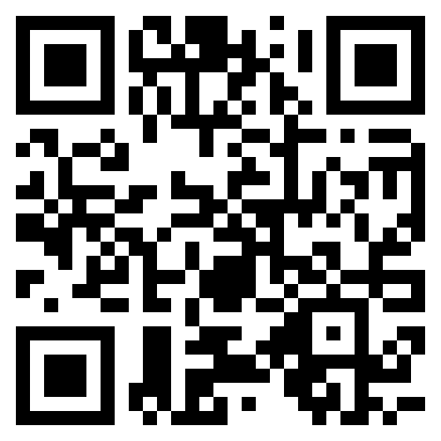
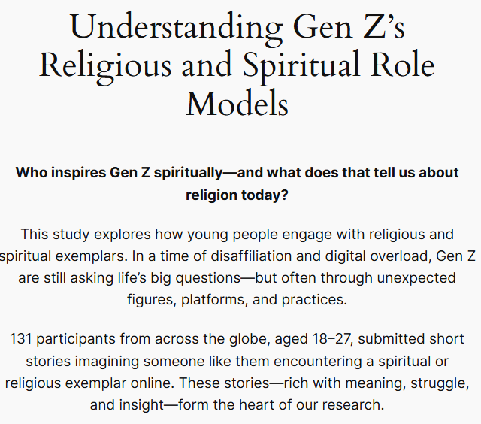
The Gen Z Role Models project
32 unread messages. Jesse put down the phone, frustrated. How would Jesse get through the next few days? Looking for answers -- or distraction -- Jesse picked up the phone and started watching videos.
One video caught Jesse's eye. A remarkable individual, talking about something religious or spiritual. Jesse couldn't quite make it out, but Jesse was interested and found something impressive, maybe admirable, about the person.
So, Jesse continued watching and . . . .

Slide 9
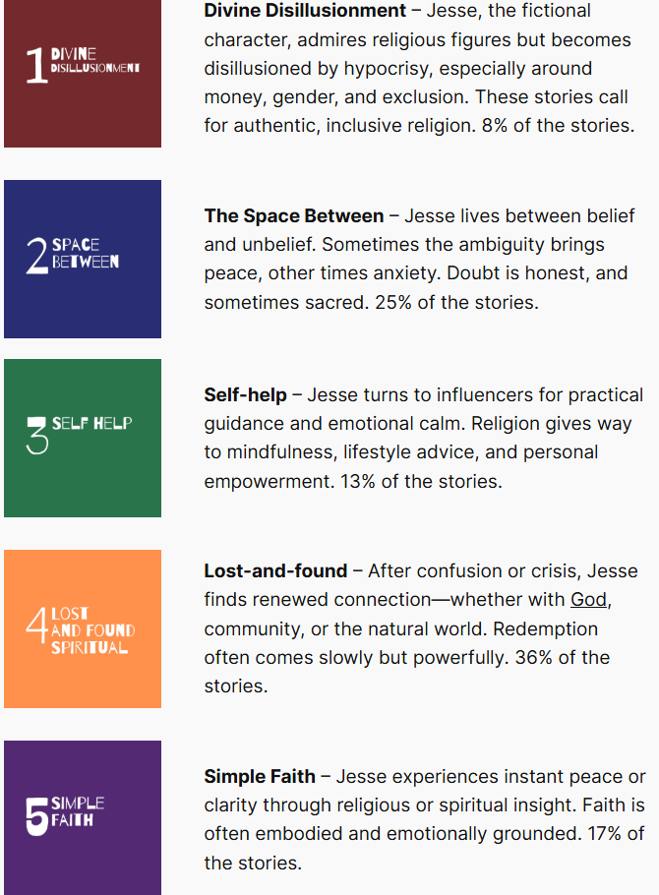

Slide 10
Lost-and-found
‘Another convert, Jack, 33, describes Christianity as “the rediscovery of an inheritance of which I’d been deprived’ - The Times August 2025
Overview: these are hopeful stories where Jesse, feeling lost in the digital chaos, reconnects with people and reality—often through an emotional experience with a religious or spiritual exemplar. Some stories focus on finding God (the religious versions), while others are about reconnecting with family and friends (the spiritual versions). These narratives suggest that while Gen Z struggles with isolation and tech distractions, they crave deeper connections in real life—whether with others, God, or the world around them.
…paid close attention. Was it the way he spoke? Was it what he spoke? Was it the fact that this person was a charismatic, and powerful leader? While trying to figure it out, she heard him mention the name Jesus. From his speech, this "Jesus" solves all problems. He is present when others leave, he is vocal when others are silent, and he heals the broken-hearted. Something began to stir up in her heart, as the individual's words pierced right through her. Is it because of this man, or is it the Man he speaks about? Does He really exist? Numerous questions rose in her heart, and she found herself making plans to go to church the next Sunday.

Slide 11
Space between
Overview: Here, Jesse navigates life’s uncertainties, caught between belief and unbelief. Sometimes, the space between is comforting—embracing the unknown like in Eastern philosophies. Other times, it’s overwhelming, leading to feelings of chaos or being stuck in a digital loop. Tech, social media, and information overload often add to this uncertainty. But many stories show that peace can be found by accepting life's ambiguities rather than fighting them.
…started to listen to the preacher. His words were kind and talked about God and his love for his children. She wasn't sure what to think. Did God really love her like that? If he did why did she never really have any contact with him during her life? She continued to listen but wasn't sure what to think after the message was over. She had a good feeling but wasn't sure what the preacher said was true

Slide 12
Uncertainty about the nature of Jesus and of God’s inherent love
‘Does God really love me?’ – A Gen Zers response
‘Whether he is a sinner I do not know’ – John 9:25

Slide 13


Slide 14
For young adults who relate to the ‘lost-and-found’ narrative, we need to create community.
For young adults who relate to the ‘space between’ narrative, we need to make space for Gen Zers to ask questions and express doubt in a safe and non-judgemental way.

Slide 15
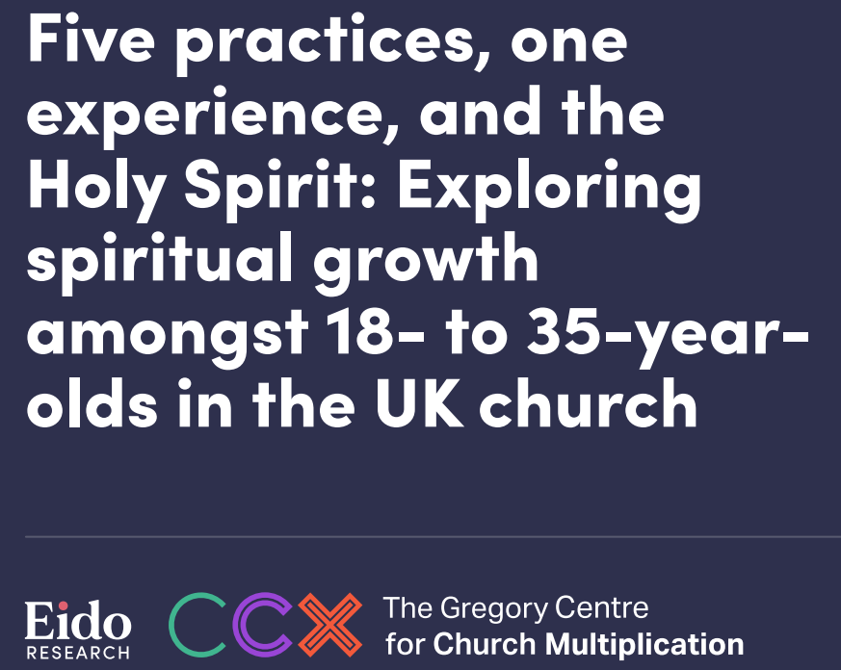
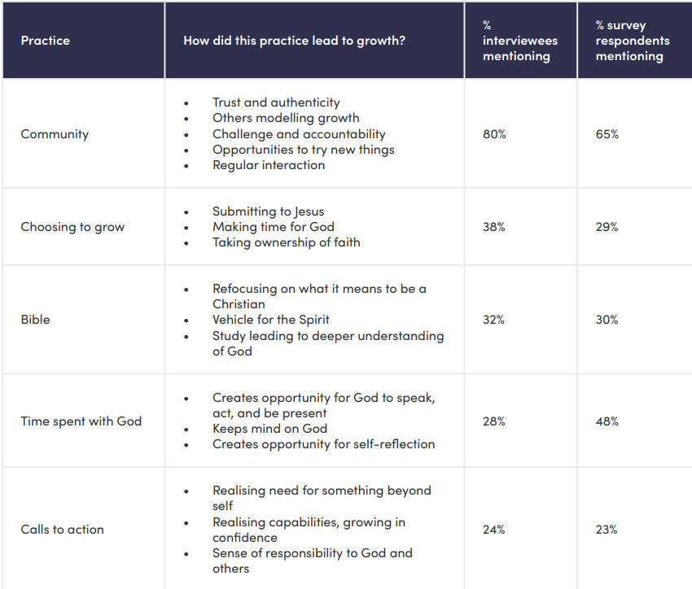

Slide 16
For young adults who relate to the ‘lost-and-found’ narrative, we need to create community.
For young adults who relate to the ‘space between’ narrative, we need to make space for Gen Zers to ask questions and express doubt in a safe and non-judgemental way.

Slide 17
Group discussion and feedback

Slide 18
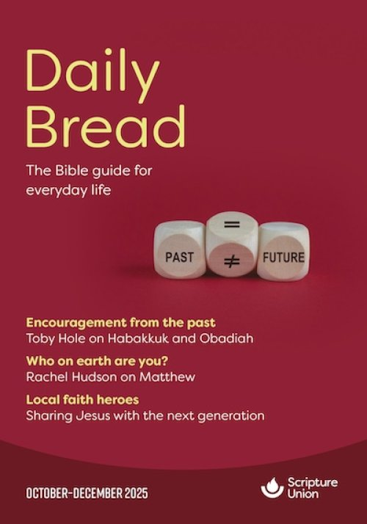
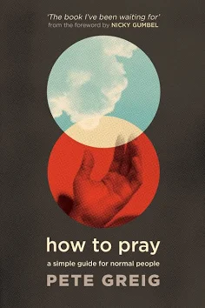
Expectant and ready for young adults

Slide 19
Ministering to one or two young adults
‘Lord show me who I can bless today, and lead me to someone curious’.

Slide 20

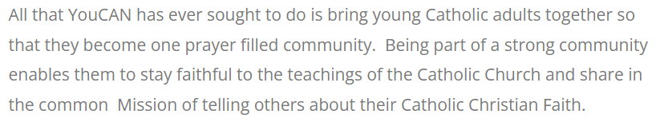

Creating community
3Generate is the national gathering of Children and Young People from across the country. It meets annually at the NEC in Birmingham and is a weekend of faith. fellowship and fun for the children and young people of the Methodist Church.

Slide 21
One of the young people at YouthFest, 18-year-old Liv Harder, has seen the ‘Quiet Revival’ for herself, having started an online bible study and group chat for young Christians. More than 170 people now join weekly from across the world!
“Though it’s called the ‘Quiet Revival’, it doesn’t take away the powerful nature of what God’s doing,” says Michael Shorey who is Head of Youth from Highfield Church. “We are getting more young people happy to just come along. Even those who wouldn’t say they are Christian, will happily sit in our Worship Nights and be inquisitive about why we’re doing what we’re doing. I think it’s the first time in years that young people are coming along and wanting to understand, rather than just coming to a youth group because it’s a Friday night and they have nothing else to do.”
Matt, who described himself as being “stuck on the cusp of atheism and agnosticism” but says he was forced to face tough questions about life head on, when a close friend passed away. He said “It was there that I found God for the first time, I knocked and He answered. A great light illuminated within me. I now know that I was presented with the Holy Spirit, which guided me on my pursuit of life’s deepest truths.”
“A few weeks ago, I was rummaging through the box and a couple of girls asked, ‘what’s in the box?’. I said, ‘there’s some Bibles. You could have one if you like.’ They all said, ‘could we take one to give to our friend?’ They were looking in the front of them because they have topics, such as where to turn if you’re anxious, what to do if you need peace. About five of them took Bibles that day, and it was just amazing to see. The opportunity for conversations has been incredible.”

Slide 22
18-year-old Caspar has been a Christian for just over a year and attends the Download youth group at Christ Church. “I was the lowest I’ve ever been and felt like there was nothing going for me. I didn’t believe, but I prayed one night, and I said ‘God, if you’re there I need help because I have nothing left’. The next morning, he just answered everything. Social media and stuff like that can have a negative effect on mental health but it’s like God has seen this and he’s turning it around. It’s such an incredible thing when you see the numbers of young people who are now experiencing God.”
Asked why young people are turning to Jesus, 18-year-old Philip said, “I think there’s a lot going on in the world at the moment with wars and politics so when people see how broken the world is, they realise that there’s so much safety in Christ and you can trust in him.”
The church also runs a bible study for young people in a Winchester coffee shop and around 15 attended the last meeting for discussions over a hot chocolate. Dave Thornton says, “They’re really getting into God’s Word and they’re excited about it. We had a young man turn up for the first time and after the session he asked for a bible. Then his friend said ‘I haven’t got a bible either, so can I have one?’ One of them then turned to the other one and said, ‘I could come round to your house, and we could read the Bible together’. I thought ‘how did they even know that was a thing?’ They’re just wanting to read the Bible and are getting together to do it. Again, that is something that I just haven’t seen.”

Slide 23
What do you know about the young adults in your parish?
What are the challenges and opportunities you’re facing?
What would help you reach and minister to young adults?
A Diocese-wide inter-church young adult fellowship group?
A pilot project for mission amongst young adults?
Resources for discipleship of young adults?

Slide 24

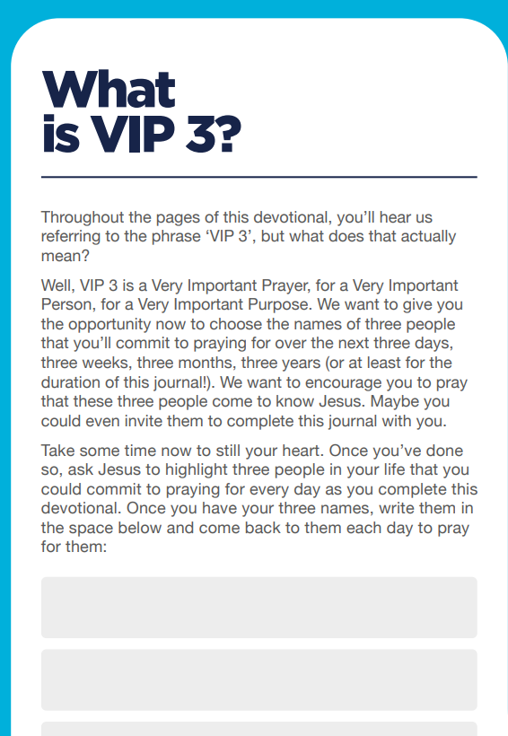
Thy Kingdom Come prayer resource: Digital Detox

Slide 25

Diocese of Oxford: YouShape

Slide 26
Engaging Gen Z in your church - Church Support Hub

Slide 27
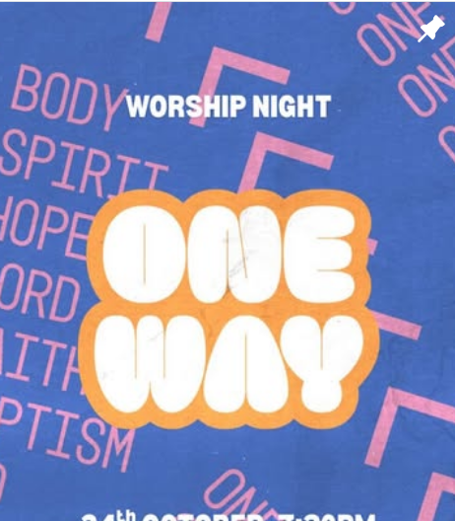
Upcoming events for young adults:
‘Do It Again’ – a worship and prayer night for young adults organised by Fusion, UCCF, Agape, Navigators, Revive Europe, 24-7 Prayer. 30th January 2026 – Newcastle.
One Way – a network of young adults in the Northeast that are gathering for a worship night on Friday 27th February and a teaching conference on Saturday 28th February.
Saturday 9th May 2026 – Gen Z Research Summit comes to Sunderland.

