Slide 1

Lent course for St. Helen’s Church Cliffe
Written and presented by
Reverend Clifford Stocking
2026
This Cup
Week One: 25th February: The first cup, the cup of sanctification, the Kiddush cup. The preparation for the start of the meal.
Week Two: 4th March: The second cup, the cup of proclamation, the Haggadah cup, the start of the historical story of the Passover.
Week Three: 11th March: The third cup, the cup of blessing, the Berakah cup, the meal is had.
Week Four: 18th March: The fourth cup, the cup of praise, the Hallel cup, final toast to end the meal.
Week Five: 25th March: The fifth cup Elijah’s cup: Our cup given to us by Christ, the thanksgiving cup which translates as eucharistia.

Slide 2
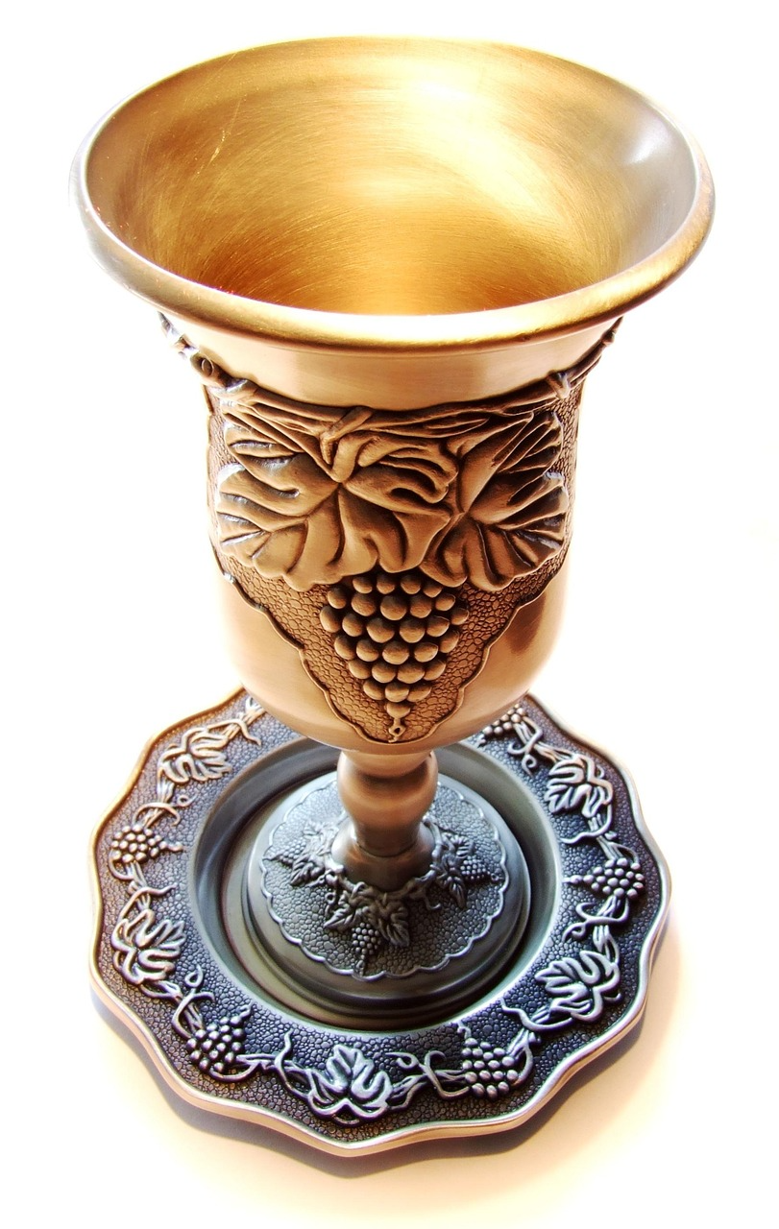
The Kiddush cup.
Aim: during these five weeks in Lent, we will start to look at the origins of the Passover Meal and how Jesus might have shared this with his disciples on Maundy Thursday. We will clearly see that the meal we call the Last Supper looked very different from what we do at Communion over two thousand years later, a communion that has been shaped by the church through different traditions and simplified. The course aims to look at the practical reason for so many cups within the Passover meal. It will also look at how Jesus fulfilled a new Passover becoming the sacrificial lamb, changing the tradition by being all the elements of the original Passover.
I want to argue that it was the wine that was shared and not the cup and that in this we have changed the central focus of communion by the element that delivers wine rather than the produce and symbol of suffering.

Slide 3
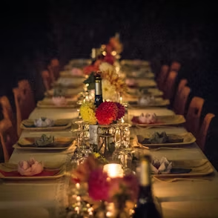
Mark 14: 12-16
Preparations
12 On the first day of the Festival of Unleavened Bread, when it was customary to sacrifice the Passover lamb, Jesus’ disciples asked him, “Where do you want us to go and make preparations for you to eat the Passover?”
13 So he sent two of his disciples, telling them, “Go into the city, and a man carrying a jar of water will meet you. Follow him. 14 Say to the owner of the house he enters, ‘The Teacher asks: Where is my guest room, where I may eat the Passover with my disciples?’ 15 He will show you a large room upstairs, furnished and ready. Make preparations for us there.”
16 The disciples left, went into the city and found things just as Jesus had told them. So, they prepared the Passover.

Slide 4
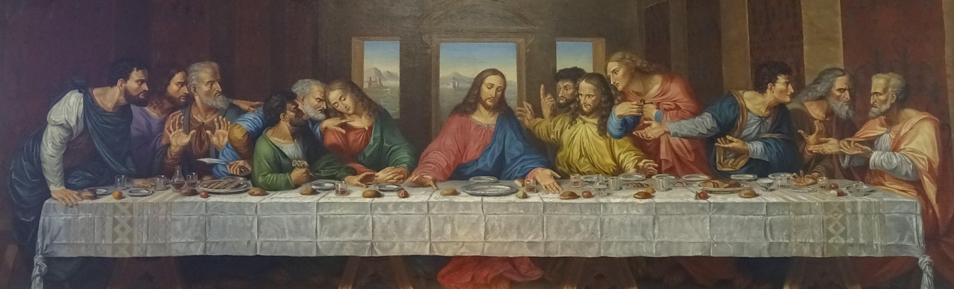
First it is the time of the Passover, Jerusalem would have been packed with Jewish pilgrims, lodgings and rooms would have been in short supply, that is why Jesus is probably staying outside the city in Bethany.
• Do you think Jesus had already booked a room for this meal?
It’s not a small venue it is a large room it came at a premium unless Jesus knew the owner.
• Why might he have known the owner?
• Did the disciples have any idea where it was?

Slide 5
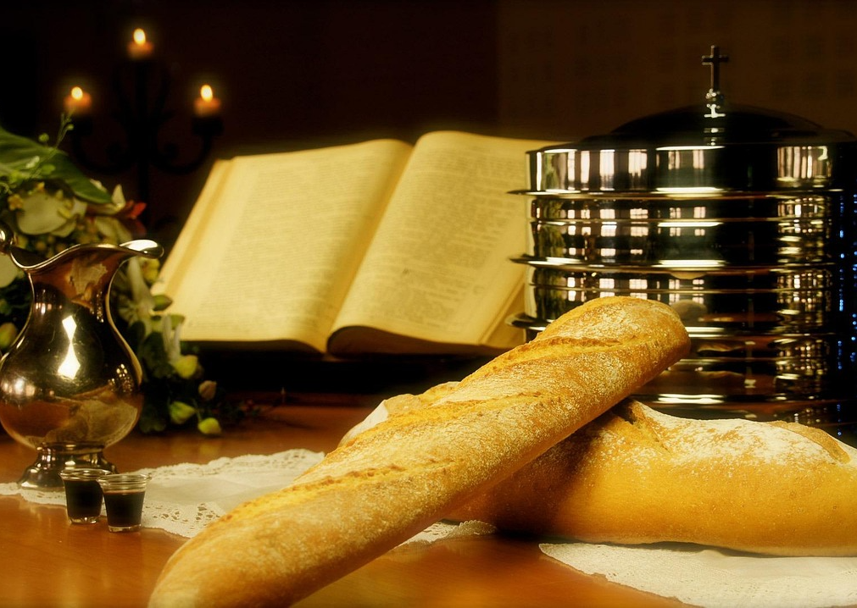
1st time John 2:13 The Passover of the Jews was near, and Jesus went up to Jerusalem. (Jesus clears the temple for the first time just after turning water into wine!)
2nd time John 5:1 After this there was a festival of the Jews, and Jesus went up to Jerusalem. (Jesus was in the middle of his healing ministry)
3rd time John 6:4 Now the Passover, the festival of the Jews, was near. (Jesus fed 5000+ with bread and fish)
4th time John 13: 1 Now before the festival of the Passover, Jesus knew that his hour had come to depart from this world and go to the Father. Having loved his own who were in the world, he loved them to the end. (Jesus must face death)

Slide 6
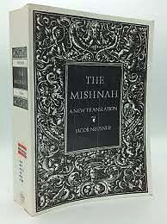

Slide 7

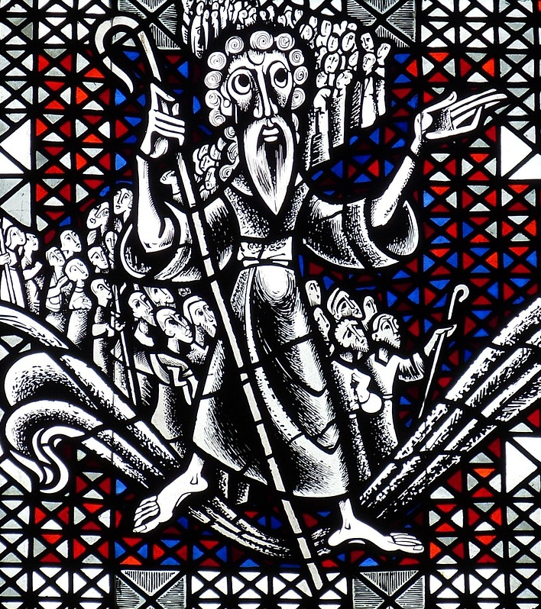
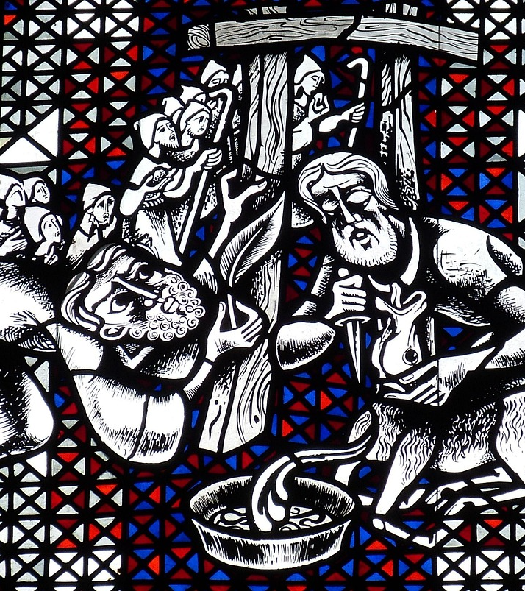
That first cup the Kiddush cup is all about a story, a story that will be told through the next three cups, it introduces the story of the exodus, a story of salvation, God saves His children, the first born on the night of the Passover and through the mighty waters of the dead sea.

Slide 8
Lent course for St. Helen’s Church Cliffe
Written and presented by
Reverend Clifford Stocking
2026
This Cup
Week One: 25th February: The first cup, the cup of sanctification, the Kiddush cup. The preparation for the start of the meal.
Week Two: 4th March: The second cup, the cup of proclamation, the Haggadah cup, the start of the historical story of the Passover.
Week Three: 11th March: The third cup, the cup of blessing, the Berakah cup, the meal is had.
Week Four: 18th March: The fourth cup, the cup of praise, the Hallel cup, final toast to end the meal.
Week Five: 25th March: The fifth cup Elijah’s cup: Our cup given to us by Christ, the thanksgiving cup which translates as eucharistia.

Slide 9
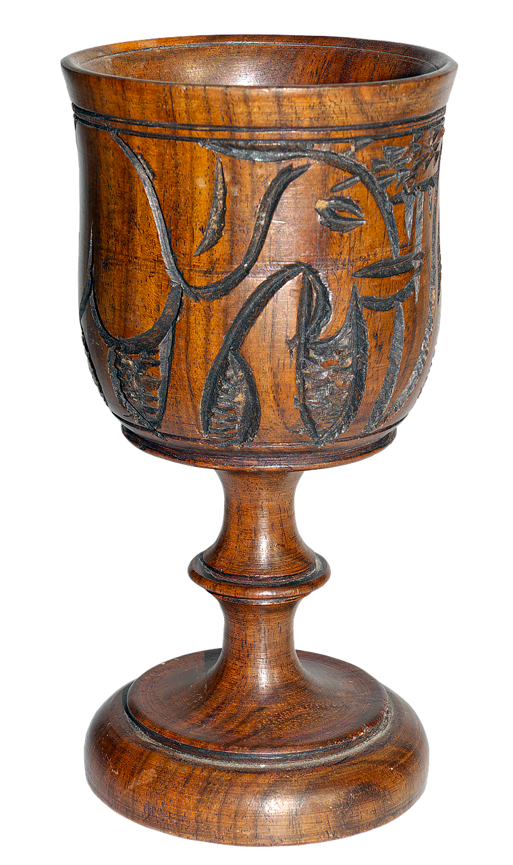
The Haggadah cup

Slide 10
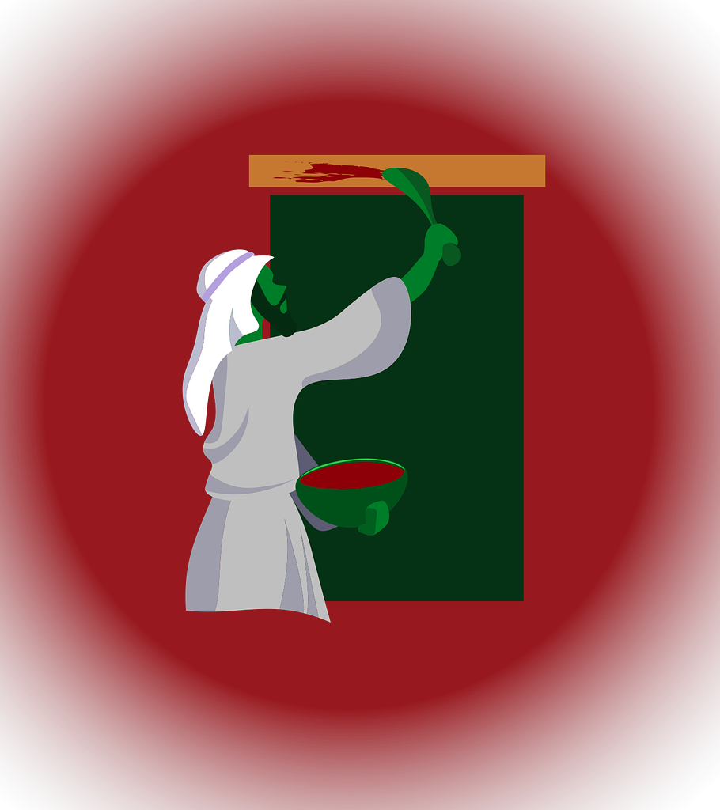
The instructions for the first Passover meal:
The whole community of Israel must share a meal.
Each man (head of each household) must take a lamb.
The lamb must be a year old, a male lamb.
The lamb must have no defects. It must not have any broken bones.
It can be a sheep or a goat.
Look after the lamb for four days the on that day at twilight everyone of them must be slaughtered.
Take some of the lamb's blood and paint it on the sides and tops of every Hebrew doorframe, each house where the lamb will be eaten. In verse 22 you will note it is to be applied on a hyssop stick. Hyssop was seen as bringing purification and was used for cleansing people with leprosy . * We will come back to this shortly as it links with Jesus’s crucifixion.
That same night eat the lamb; it must be roasted on an open fire accompanied with bitter herbs.
Bread must be baked and consumed without yeast.
Every part of the lamb must be eaten including the head and inner parts.
Any left must be burnt without trace.
Eat it with your cloak on, tucked into your belt and wearing your sandals, holding a staff in one hand, eat it quickly.
Do not leave your house at anytime during the night.

Slide 11

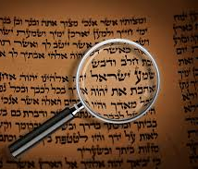
How will you tell your
Story?

Slide 12
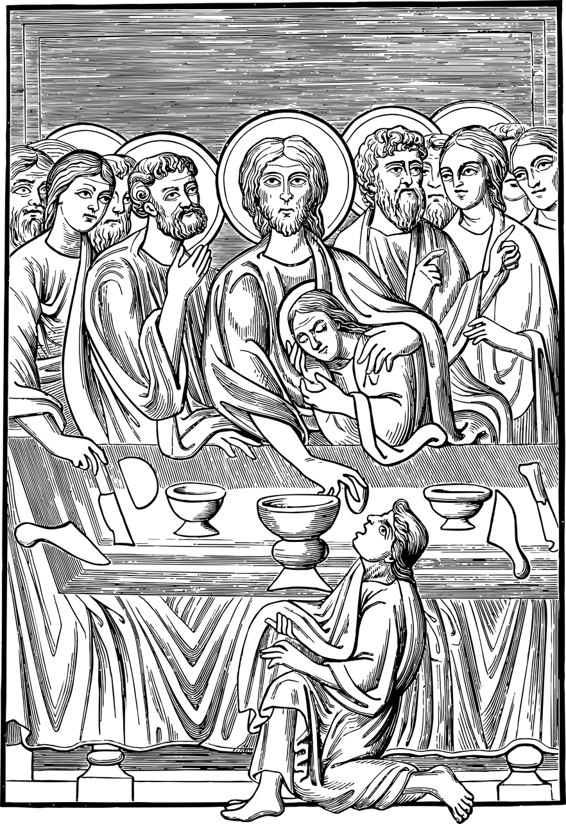
Outline instructions for the Passover meal at the time of Jesus.
The first requirement was that all leaven was sought out and removed by candlelight, there then follows pages of instruction as to what to do with the leaven bread as not to waste it, such as feeding it to the dogs.
Space is made for wine in the vaults.
Herbs are bought for the meal they can be, Lettuce, chicory, pepperwort, endives, dandelion fresh or dried. They can not be pickled or cooked.
Women are to remove all makeup.
The women’s role, three of them to prepare the bread for the meal.
An unblemished, no older than a year male lamb is slaughtered which can only be used for the Passover meal.
The lamb is slaughtered by the Temple Priests and its blood tossed at the altar; this is repeated for all who require a Passover Lamb.
The carcasses are flayed out on wooden hooks; metal spits were not permitted (these were wooden stakes that looked as though the lambs had been crucified.)
A cup is filled with the blood of the lamb before being tossed.
Only when it was dark could the lamb then be roasted.
Any bones or scraps leftover must be burnt to nothing.
If a bone is broken of the Passover Lamb, the person who breaks it receives forty stripes.
The meal can only be eaten in the hours of darkness.
There must be no fewer than four cups of wine provided for each person including the poor, funds should be made through charity for this purpose.

Slide 13
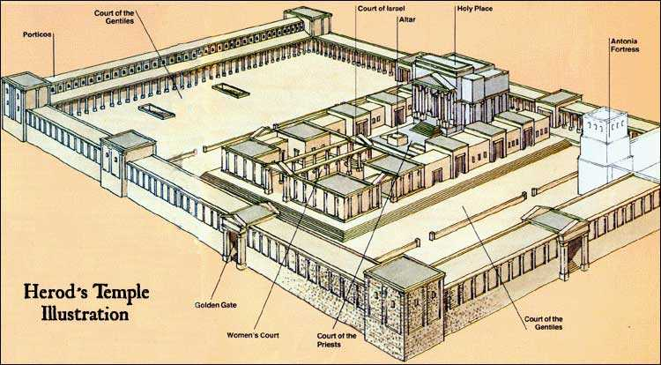
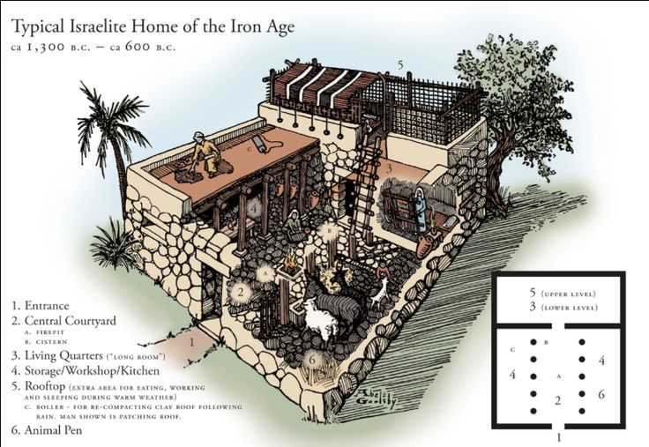
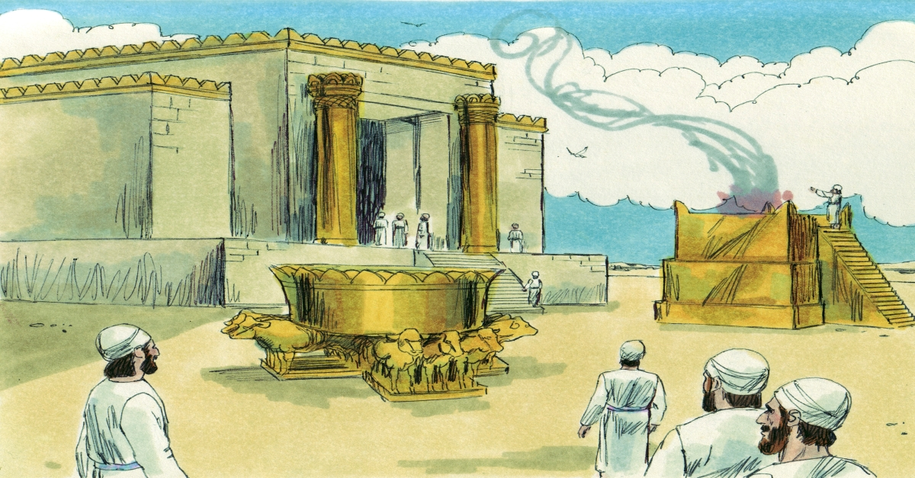

Slide 14
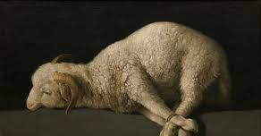
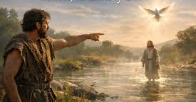
With the second cup the Father of the meal would explain the meaning of the various elements of the Passover, Jesus was doing the same, this is my blood, this is my body. Jesus was declaring that he was now the sacrificial lamb, the cup of affliction was now his.

Slide 15
Lent course for St. Helen’s Church Cliffe
Written and presented by
Reverend Clifford Stocking
2026
This Cup
Week One: 25th February: The first cup, the cup of sanctification, the Kiddush cup. The preparation for the start of the meal.
Week Two: 4th March: The second cup, the cup of proclamation, the Haggadah cup, the start of the historical story of the Passover.
Week Three: 11th March: The third cup, the cup of blessing, the Berakah cup, the meal is had.
Week Four: 18th March: The fourth cup, the cup of praise, the Hallel cup, final toast to end the meal.
Week Five: 25th March: The fifth cup Elijah’s cup: Our cup given to us by Christ, the thanksgiving cup which translates as eucharistia.

Slide 16
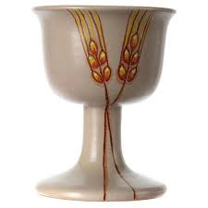

The word Berakah simply translates as blessing, the cup of blessing. Sticking with Luke’s account to begin with Jesus breaks bread and shares it with his disciple then after the meal he takes the cup, which can only be the third cup of the Passover because this was not raised until the meal was finished. Taking the cup Jesus declares that this cup is a new covenant, it represents his blood, the same blood that is pour out over the altar from a cup in the Temple when the sacrificial Lamb is slaughtered. This cup says: ‘I WILL redeem you with an outstretched arm.’

Slide 17
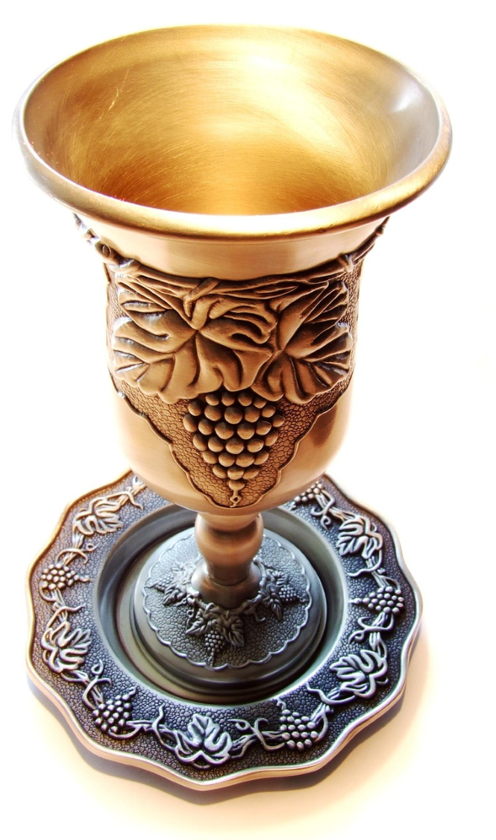

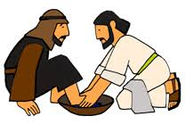
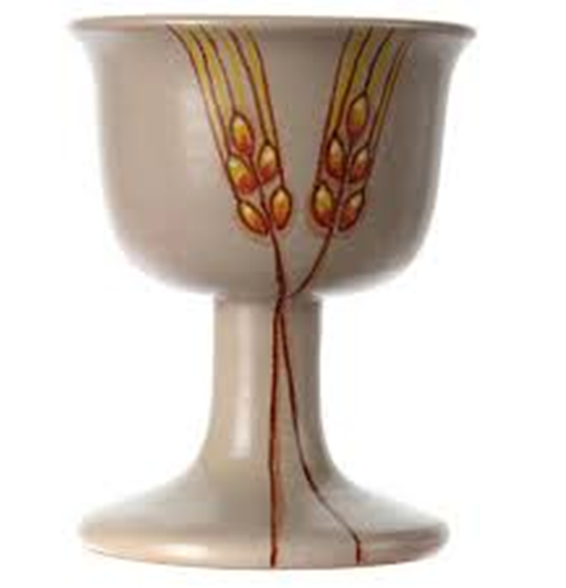

Slide 18
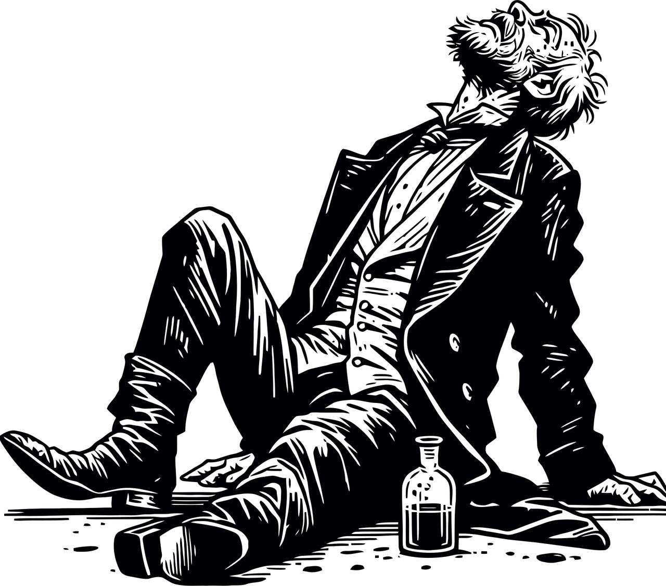
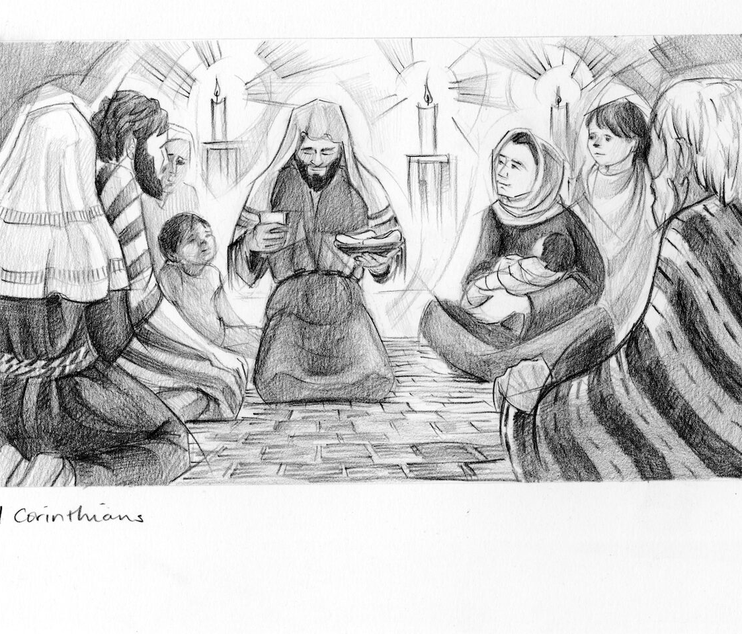
1 Corinthains 11 our understanding
of communion is born

Slide 19
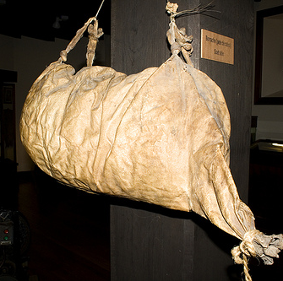
‘And no one puts new wine into old wineskins; otherwise, the wine will burst the skins, and the wine is lost, and so are the skins; but one puts new wine into fresh wineskins.’
I want to ask if it is blood/wine that is the core of the Passover; why have we focused on the actual cups that we present that symbol in as being central to our communion?
We say there is one cup when there wasn’t, but what is true is there is one blood, that blood was finally shed on a cross, the wine we share/serve is simply a reminder of that act of sacrifice. ‘Do this in remembrance of me.’

Slide 20
Lent course for St. Helen’s Church Cliffe
Written and presented by
Reverend Clifford Stocking
2026
This Cup
Week One: 25th February: The first cup, the cup of sanctification, the Kiddush cup. The preparation for the start of the meal.
Week Two: 4th March: The second cup, the cup of proclamation, the Haggadah cup, the start of the historical story of the Passover.
Week Three: 11th March: The third cup, the cup of blessing, the Berakah cup, the meal is had.
Week Four: 18th March: The fourth cup, the cup of praise, the Hallel cup, final toast to end the meal.
Week Five: 25th March: The fifth cup Elijah’s cup: Our cup given to us by Christ, the thanksgiving cup which translates as eucharistia.

Slide 21
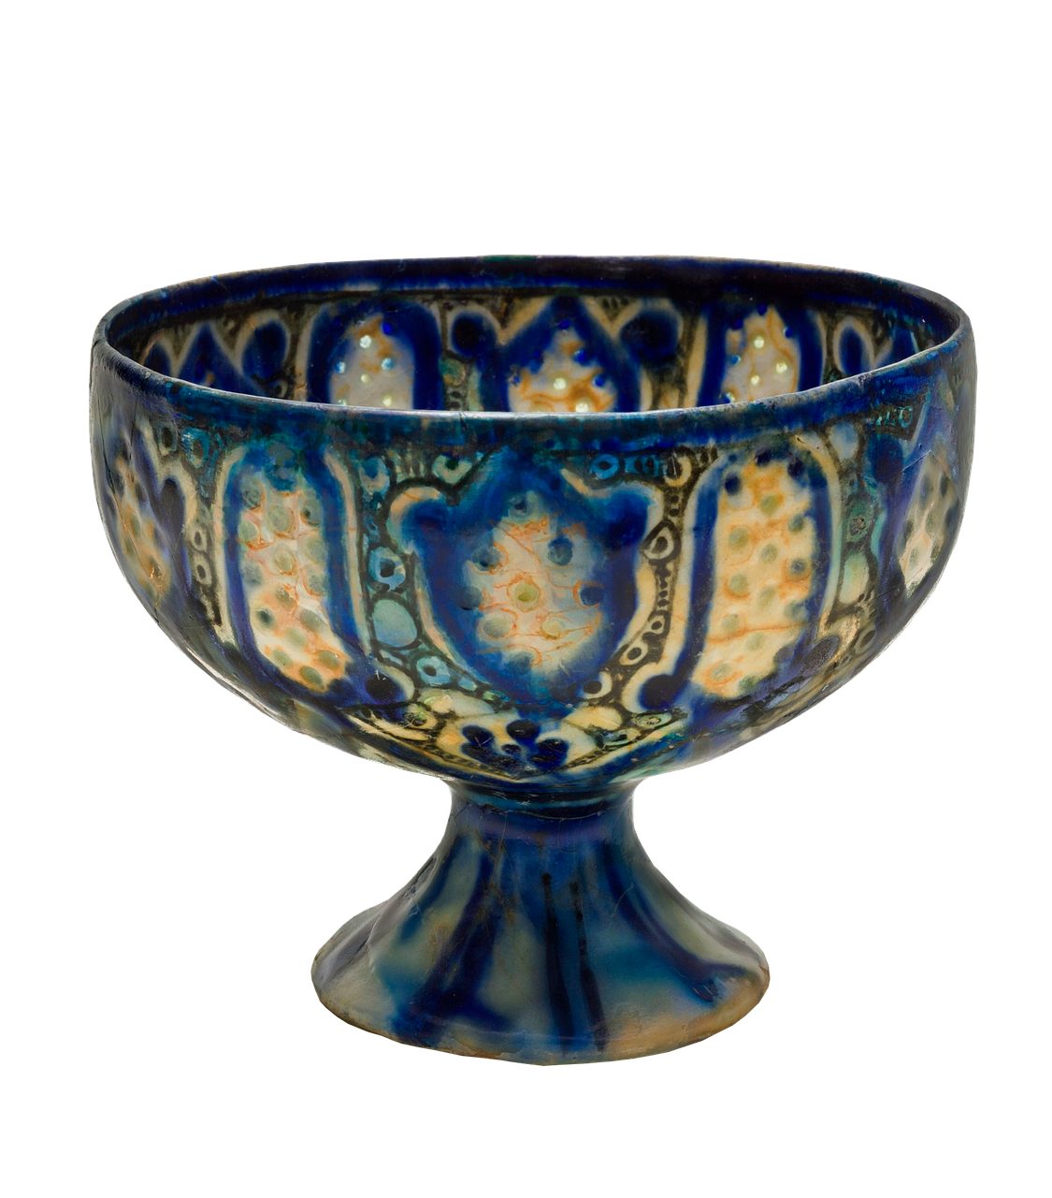
The Hallel cup
What was the fourth cup as part of the original Passover at the time of Jesus.
Well, it is the Hallel cup which simply translates as praise, the cup of praise. Before the final cup is raised and drunk the tradition was to sing from the psalms, these psalms were familiar to Jesus and his disciples because the same ones are sung at every Passover.

Slide 25
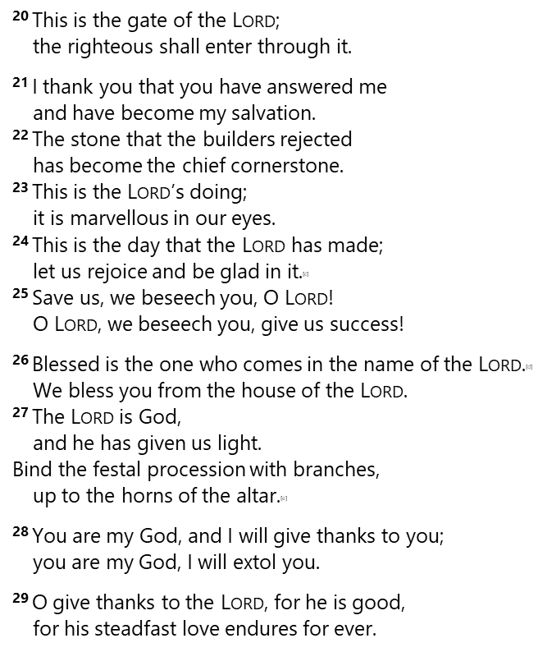
118 O give thanks to the Lord, for he is good; his steadfast love endures for ever!
² Let Israel say, ‘His steadfast love endures for ever.’ ³ Let the house of Aaron say, ‘His steadfast love endures for ever.’ ⁴ Let those who fear the Lord say, ‘His steadfast love endures for ever.’
⁵ Out of my distress I called on the Lord; the Lord answered me and set me in a broad place. ⁶ With the Lord on my side I do not fear. What can mortals do to me? ⁷ The Lord is on my side to help me; I shall look in triumph on those who hate me. ⁸ It is better to take refuge in the Lord than to put confidence in mortals. ⁹ It is better to take refuge in the Lord than to put confidence in princes.
¹⁰ All nations surrounded me; in the name of the Lord I cut them off! ¹¹ They surrounded me, surrounded me on every side; in the name of the Lord I cut them off! ¹² They surrounded me like bees; they blazed^{[a]} like a fire of thorns; in the name of the Lord I cut them off! ¹³ I was pushed hard,^{[b]} so that I was falling, but the Lord helped me. ¹⁴ The Lord is my strength and my might; he has become my salvation.
¹⁵ There are glad songs of victory in the tents of the righteous: ‘The right hand of the Lord does valiantly; ¹⁶ the right hand of the Lord is exalted; the right hand of the Lord does valiantly.’ ¹⁷ I shall not die, but I shall live, and recount the deeds of the Lord. ¹⁸ The Lord has punished me severely, but he did not give me over to death.
¹⁹ Open to me the gates of righteousness, that I may enter through them and give thanks to the Lord.

Slide 26
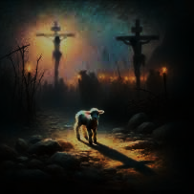
The snares of death encompassed me;
the pangs of Sheol laid hold on me;
I suffered distress and anguish.
I will offer to you a thanksgiving sacrifice
and call on the name of the LORD.
Out of my distress I called on the LORD;
the LORD answered me and set me in a broad place.
With the LORD on my side I do not fear.
What can mortals do to me?
All nations surrounded me;
in the name of the LORD I cut them off!
They surrounded me, surrounded me on every side;
in the name of the LORD I cut them off!
They surrounded me like bees;
they blazed like a fire of thorns;
in the name of the LORD I cut them off!
I was pushed hard, so that I was falling,
The LORD has punished me severely,
but he did not give me over to death.

Slide 27
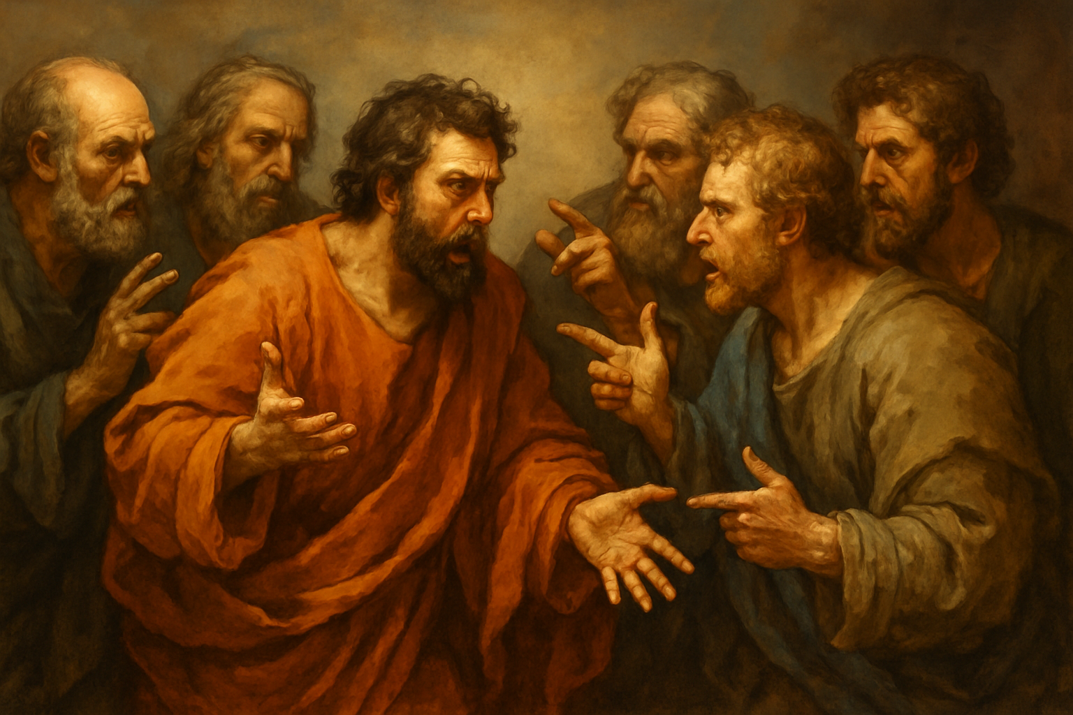
Mark 14: 26 When they had sung the hymn, they went out to the Mount of Olives.
Matthew 26: 30 When they had sung the hymn, they went out to the Mount of Olives.
In Lukes account (chapter 22: 24-38) as soon as Jesus had given them the third cup the meal was brought to an abrupt end as a dispute broke out among the disciples as to who was the greatest, Mark and Matthew hint at this because they both have a dialogue between Jesus and Peter.
John’s gospel is totally different as it does not really describe the order of the meal, but it does record Jesus dipping bread into a dish 13: 26-27 and giving the bread to Judas, after that we perhaps see a deeper account of the dispute and conversations that took place, John dedicates four chapters (14,15,16,17) to this before they leave the upper room and head out.

Slide 28
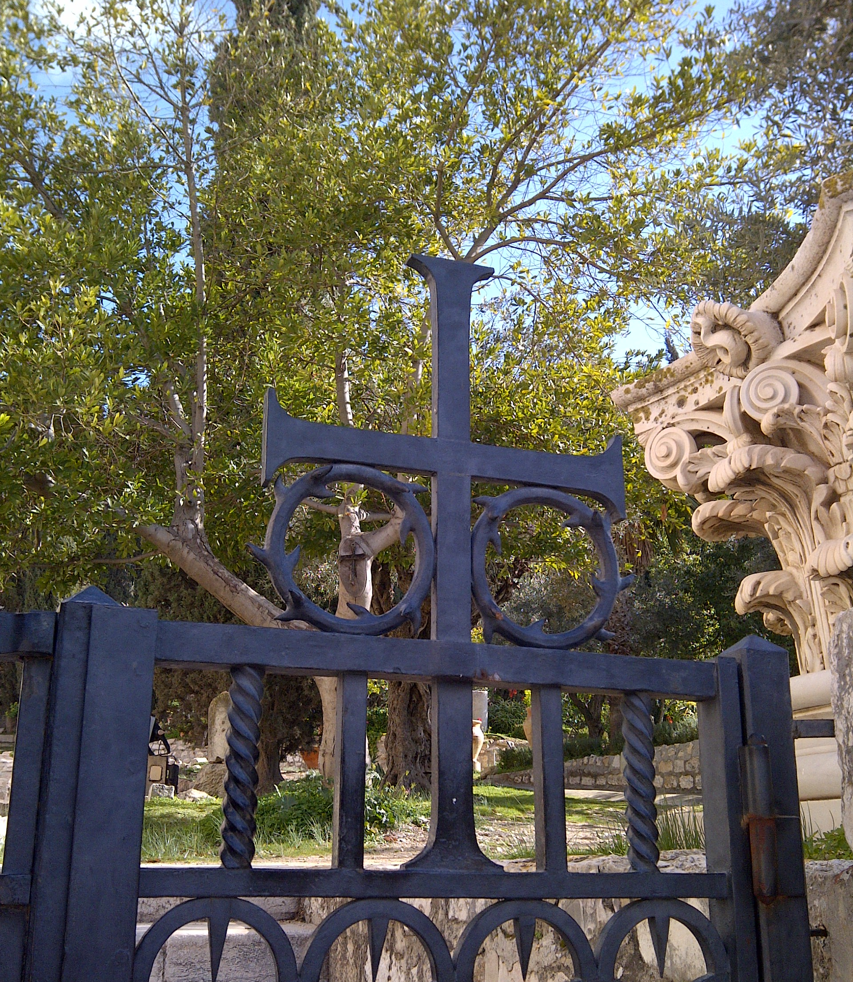
Mark 14: 35 And going a little farther, he threw himself on the ground and prayed that, if it were possible, the hour might pass from him. 36 He said, ‘Abba, Father, for you all things are possible; remove this cup from me; yet, not what I want, but what you want.’
Matthew 26: 39 And going a little farther, he threw himself on the ground and prayed, ‘My Father, if it is possible, let this cup pass from me; yet not what I want but what you want.’
42 Again he went away for the second time and prayed, ‘My Father, if this cannot pass unless I drink it, your will be done.’ NRSV in the NIV if it is not possible for this cup to be taken away unless I drink it.
Luke 22: 41 Then he withdrew from them about a stone’s throw, knelt down, and prayed, 42 ‘Father, if you are willing, remove this cup from me; yet, not my will but yours be done.’ [[43 Then an angel from heaven appeared to him and gave him strength. 44 In his anguish he prayed more earnestly, and his sweat became like great drops of blood falling down on the ground.]]
John 18: 11 Jesus said to Peter, ‘Put your sword back into its sheath. Am I not to drink the cup that the Father has given me?’

Slide 29
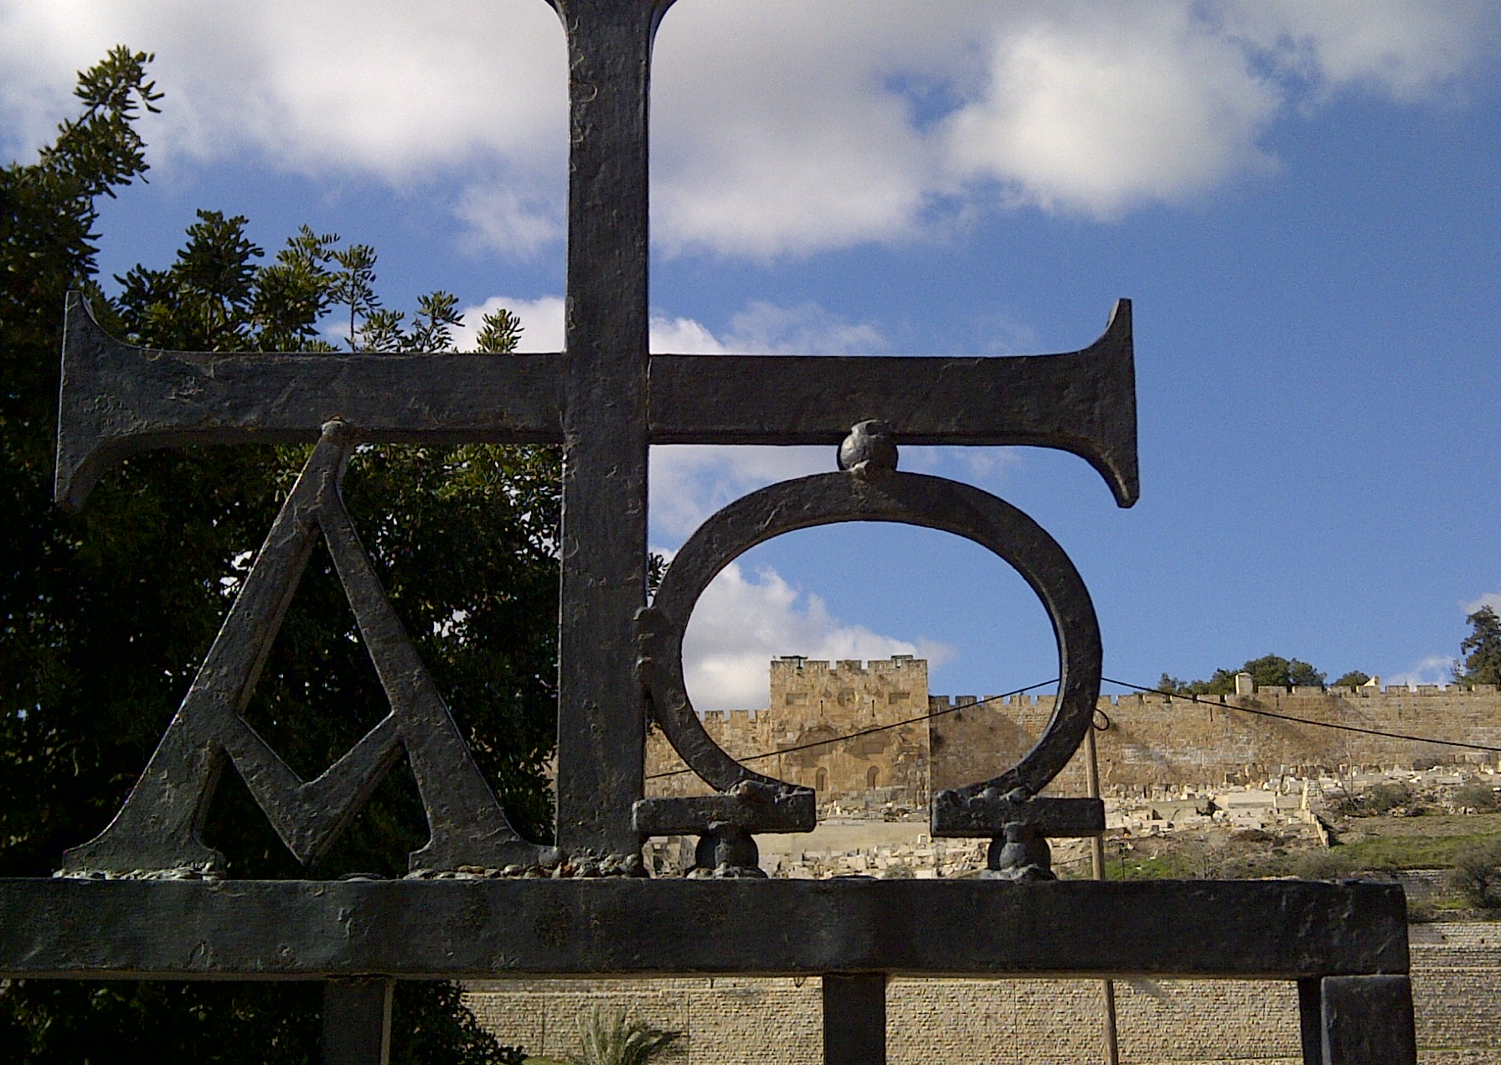
Matthew 27: 33-34 33 And when they came to a place called Golgotha (which means Place of a Skull), 34 they offered him wine to drink, mixed with gall; but when he tasted it, he would not drink it.
Mark 15: 22-23 Then they brought Jesus to the place called Golgotha (which means the place of a skull). 23 And they offered him wine mixed with myrrh; but he did not take it.
Luke 23: 36 The soldiers also mocked him, coming up and offering him sour wine,
With seconds left before Jesus died the fourth cup, the wine was accepted by Jesus.
Mark 15: 35-37 When some of the bystanders heard it, they said, ‘Listen, he is calling for Elijah.’ And someone ran, filled a sponge with sour wine, put it on a stick, and gave it to him to drink, saying, ‘Wait, let us see whether Elijah will come to take him down.’ 37 Then Jesus gave a loud cry and breathed his last.
Matthew 27: 47-50 When some of the bystanders heard it, they said, ‘This man is calling for Elijah.’ 48 At once one of them ran and got a sponge, filled it with sour wine, put it on a stick, and gave it to him to drink. 49 But the others said, ‘Wait, let us see whether Elijah will come to save him.’ 50 Then Jesus cried again with a loud voice and breathed his last.
John 19: 28-30 After this, when Jesus knew that all was now finished, he said (in order to fulfil the scripture), ‘I am thirsty.’ 29 A jar full of sour wine was standing there. So they put a sponge full of the wine on a branch of hyssop and held it to his mouth. 30 When Jesus had received the wine, he said, ‘It is finished.’ Then he bowed his head and gave up his spirit.

Slide 30
Lent course for St. Helen’s Church Cliffe
Written and presented by
Reverend Clifford Stocking
2026
This Cup
Week One: 25th February: The first cup, the cup of sanctification, the Kiddush cup. The preparation for the start of the meal.
Week Two: 4th March: The second cup, the cup of proclamation, the Haggadah cup, the start of the historical story of the Passover.
Week Three: 11th March: The third cup, the cup of blessing, the Berakah cup, the meal is had.
Week Four: 18th March: The fourth cup, the cup of praise, the Hallel cup, final toast to end the meal.
Week Five: 25th March: The fifth cup Elijah’s cup: Our cup given to us by Christ, the thanksgiving cup which translates as eucharistia.

Slide 31
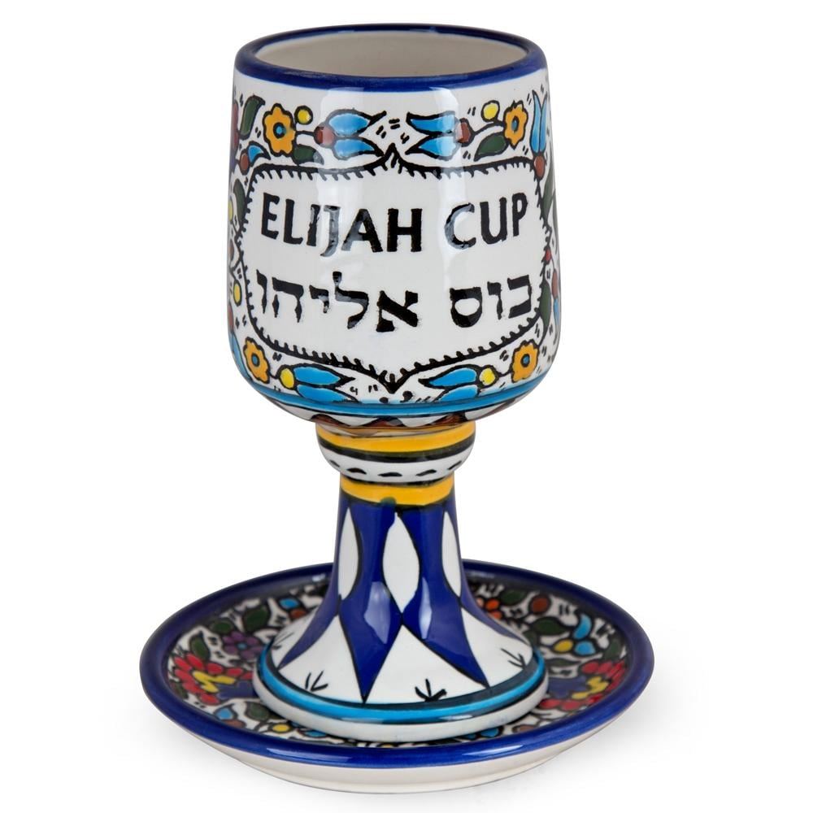
The fifth cup: Elijah’s cup
Matthew 11: 11-14 Truly I tell you, among those born of women no one has arisen greater than John the Baptist; yet the least in the kingdom of heaven is greater than he. 12 From the days of John the Baptist until now the kingdom of heaven has suffered violence, and the violent take it by force. 13 For all the prophets and the law prophesied until John came; 14 and if you are willing to accept it, he is Elijah who is to come

Slide 32
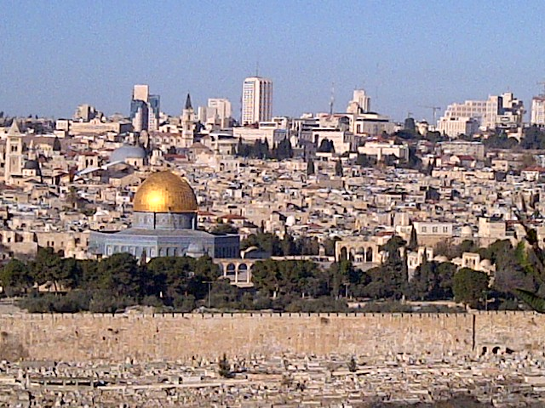
What we will experience on Maundy Thursday is a modern Seder meal, it is still the Passover Meal the word Seder just translates as order, this meal is very ordered it must follow the strict pattern as various cups are shared, yes four cups are drunk throughout as the story of the exodus is told again.
What became traditional by the 11th century was the expectation that Eiljah might come to any seder at any time. Three things are observed in the meal:
1. an extra place is set at the table for Eiljah
2. the door of the house is left open for him to enter
3. a fifth cup is reserved for him called the cup of Eiljah

Slide 33

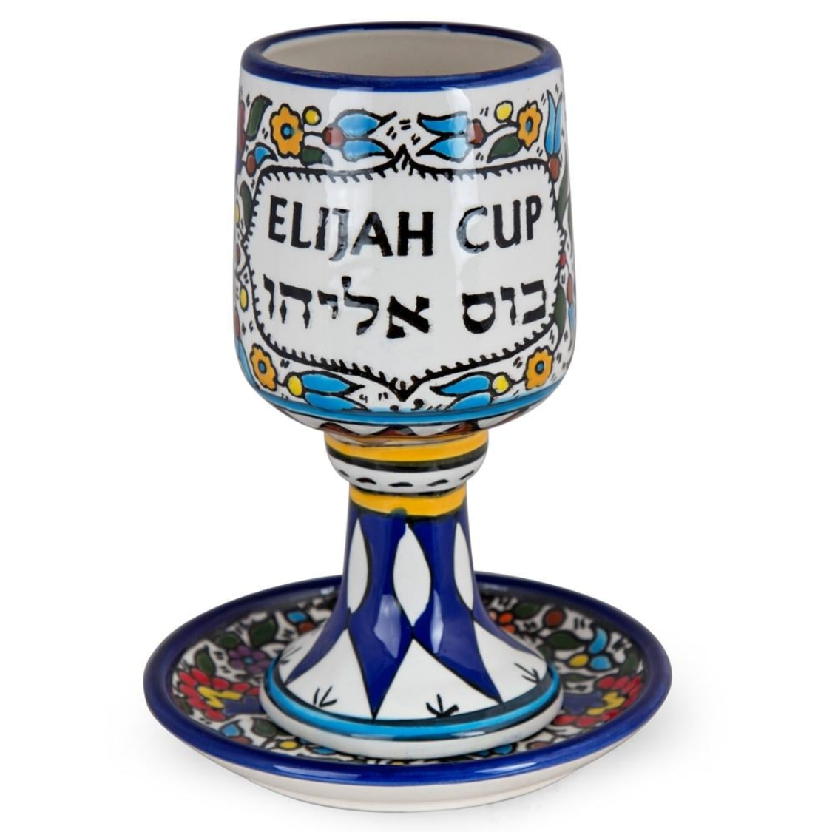
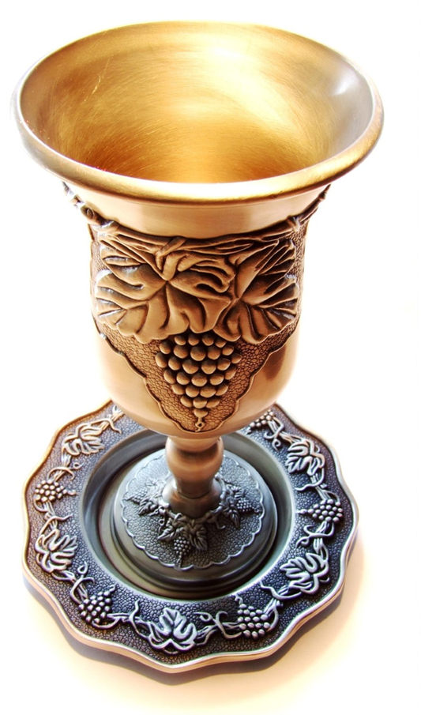
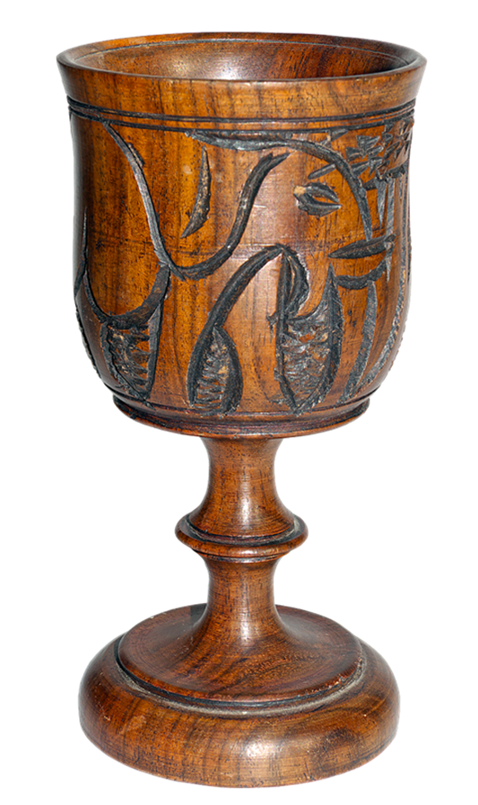

Conclusion, it’s not the cup or the cups that matter, they are but vessels, it is the blood, the symbol of it, that is wine that is important, it is not the how we take it but the why we take it, traditions as we have heard and seen change, but Jesus remains the same.
John 1: 29 the voice of the new Elijah, John the Baptist to finish:
The next day he saw Jesus coming towards him and declared, ‘Here is the Lamb of God who takes away the sin of the world!
JESUS CHRIST

