Slide 1

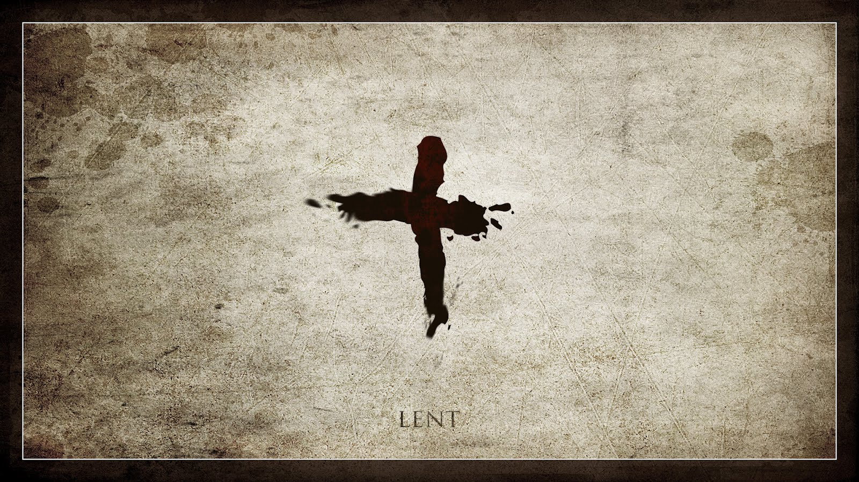
Lent: Origins, Customs, Christian Significance
Origins, practices, and meaning in the Christian tradition
Notes:
Image source: AI-generated

Slide 2

Historical Origins of Lent
Notes:
Biblical Foundations and Early Christian Practice, Development in the Early Church, Variations Across Christian Traditions

Slide 3
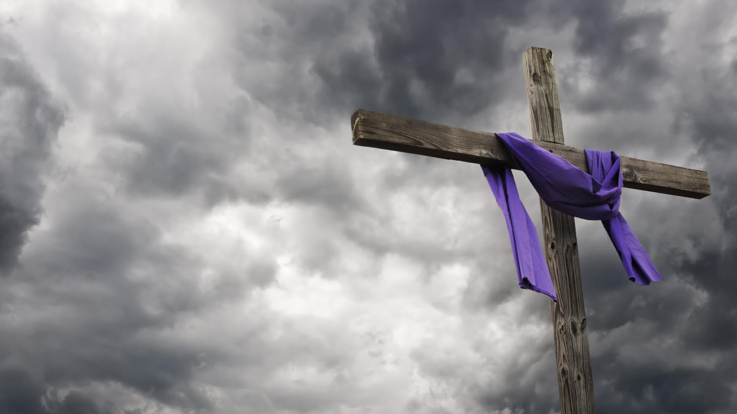
What is Lent?
The word ‘Lent’ is actually the Anglo-Saxon word for ‘Spring’.
Lent may originally have followed Epiphany, just as Jesus’ sojourn in the wilderness followed immediately on his baptism, but it soon became firmly attached to Easter, as the principal occasion for baptism and for the reconciliation of those who had been excluded from the Church’s fellowship for apostasy or serious faults. This history explains the characteristic notes of Lent – self-examination, penitence, self-denial, study, and preparation for Easter, to which almsgiving has traditionally been added.

Slide 4

Biblical Foundations and Early Christian Practice
Biblical Foundation
Jesus’ 40 days of fasting (Matthew 4:1–11) model spiritual preparation and reliance on God.
Early Christian Adoption
Early Church writings emphasize fasting, penitence, and repentance in preparation for Easter.
Formative Practices (2nd–3rd c.)
Textual and archaeological evidence shows widespread pre‑Easter discipline, not yet standardized.
Notes:
Lent finds its roots in biblical events such as Jesus Christ’s 40 days of fasting in the wilderness (Matthew 4:1-11), symbolizing spiritual preparation and reliance on God. Early Christians adopted these themes of fasting and penitence, as seen in early Church writings and practices that emphasized repentance before Easter. Archaeological and textual evidence from the 2nd and 3rd centuries indicates that pre-Easter preparation was a widespread disciplinary period, though not fully standardized in length or form. Image source: AI-generated

Slide 5

Development in the Early Church
01
Council of Nicaea (325 AD)
Lent recognized; trend toward a 40‑day standard preparing for Easter and baptism.
02
Regional Practices Consolidate
Diverse fast lengths and start dates gradually harmonize across East and West.
03
Fathers Affirm Discipline
Augustine and Athanasius stress fasting, penance, and catechetical preparation.
04
40‑Day Season Formalized
By the 4th century’s end, a unified penitential season is widely observed.
Notes:
By the 4th century, Lent had become formalized as a 40-day period of fasting and penance, established by Church councils such as Nicaea (325 AD). It served to prepare catechumens for baptism and the faithful for Easter. Various Church Fathers like St. Augustine and St. Athanasius wrote on its spiritual importance, reinforcing Lent’s role as both discipline and devotion. Regional variations existed, but the trend moved towards a unified penitential season.

Slide 6





Variations Across Christian Traditions
Western Christianity
40-day Lent excluding Sundays; focus on repentance and preparation for Easter; grace emphasized alongside tradition.
Eastern Orthodox
40-day fast including Sundays, followed by Holy Week (≈48 days); strong ascetic discipline; tradition and communal fasting central.
Protestant Groups
Diverse practices; some observe Lent strictly, others symbolically or not at all; focus may be on personal reflection or grace over ritual.
Eastern Rites (Advent/Pentecost Fasts)
Additional fasts (Advent, Pentecost); varying rules and lengths; emphasis on asceticism and liturgical rhythm.
Notes:
While Western Christianity typically observes a 40-day Lent excluding Sundays, Eastern Orthodox traditions often observe a 40-day fast including Sundays, followed by Holy Week, totaling around 48 days. The Advent and Pentecost fasts in some Eastern rites also show differing disciplinary emphases. Protestant groups have diverse approaches; some maintain Lenten fasting and repentance, others see it as optional or symbolic. These differences highlight theological emphases on grace, asceticism, and tradition. Image source: AI-generated

Slide 7
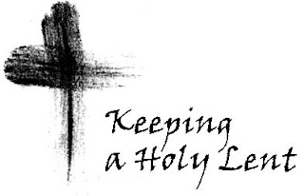
Theological Meaning and Spiritual Purpose
Notes:
Symbolism of Forty Days, Themes of Repentance and Preparation, Connection to the Easter Narrative

Slide 8
Symbolism of Forty Days
Trial & Testing
The number forty in Scripture often marks times of hardship and challenge, such as the forty days of rain during Noah’s flood, the forty years of the Israelites travelling in the wilderness to the Promised Land and Jesus’ 40 days of fasting and temptation in the desert. These periods test faith and perseverance.
Preparation & Purification
Forty days signify preparation for a new beginning—Moses’ forty days on Sinai prepared him to receive the Law, while Lent prepares believers for Easter through self-denial and prayer.
Renewal & Resurrection
The forty-day journey is a pilgrimage toward spiritual renewal and resurrection, inviting Christians to reset their relationship with God and embrace transformation.
Notes:
The number forty appears frequently in Scripture, symbolizing periods of trial, testing, and preparation (e.g., Noah’s flood, Moses on Sinai). Lent’s 40 days echo Christ’s wilderness fast, marking it as a time for believers to emulate spiritual discipline and purification. This period symbolizes a pilgrimage toward renewal and resurrection, inviting Christians to reset their relationship with God through self-denial and prayer.

Slide 9
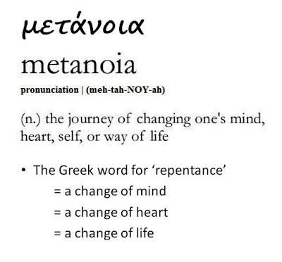
Themes of Repentance and Preparation
Lent centres on repentance—turning away from sin—and preparing the heart for Easter’s celebration of Christ’s resurrection. This includes acknowledging human frailty, seeking forgiveness, and committing to spiritual growth. The liturgical scriptures and prayers during Lent emphasize humility, conversion, and renewal of baptismal promises, reinforcing the season’s purpose as a spiritual cleansing process.
Key word: metanoia – ‘make a complete turnaround/U-turn towards God.’
Notes:
Lent centers on repentance—turning away from sin—and preparing the heart for Easter’s celebration of Christ’s resurrection. This includes acknowledging human frailty, seeking forgiveness, and committing to spiritual growth. The liturgical scriptures and prayers during Lent emphasize humility, conversion, and renewal of baptismal promises, reinforcing the season’s purpose as a spiritual cleansing process.

Slide 10

Connection to the Easter Narrative
Passion and Suffering
Lent retraces Christ’s journey to the cross, inviting reflection on sacrifice and obedience.
Death and Sacrifice
Rituals and readings deepen participation in the salvific mystery of the cross.
Resurrection and Hope
The Lenten path culminates in Easter’s joy, transforming abstinence into renewed hope.
Notes:
Lent is integrally connected to the Passion, Death, and Resurrection of Jesus Christ. The journey through Lent recalls Jesus’ suffering and sacrifice, culminating in the joy of Easter Sunday. Rituals and readings during Lent guide believers through this narrative arc, fostering deeper understanding and participation in the salvific mystery. This connection underscores Lent as not just a time of abstinence but of hope and transformation. Image source: AI-generated

Slide 11


Customs and Practices During Lent (Pray/Fast/Give)
Notes:
Fasting and Abstinence Rituals, Prayer, Almsgiving, and Spiritual Disciplines, Liturgical Observances and Special Services

Slide 12
Fasting and Abstinence Rituals
2 days
Roman Catholics observe strict fasting on Ash Wednesday and Good Friday.
Abstinence from meat is customary on Fridays; Orthodox fasts are typically more rigorous.
Notes:
Fasting during Lent typically involves reducing food intake or abstaining from specific foods such as meat, reflecting penitential discipline. In the Roman Catholic tradition, Ash Wednesday and Good Friday are days of strict fasting, while abstinence from meat is customary on Fridays. Eastern Orthodox fasts are more rigorous, often excluding meat, dairy, and oil. These practices serve to foster self-control, solidarity with the poor, and spiritual focus.

Slide 13



Prayer, Almsgiving, and Spiritual Disciplines
Almsgiving
Expresses charity and solidarity with the marginalized, reinforcing repentance through active love.
Prayer
Deepens relationship with God through devotionals, Stations of the Cross, and Lenten retreats.
Fasting
Practiced as self-denial and spiritual focus, reminding believers of dependence on God.
Notes:
Alongside fasting, Lent encourages increased prayer and almsgiving as integral disciplines. Prayer deepens one’s relationship with God, often including devotional practices such as the Stations of the Cross or Lenten retreats. Almsgiving embodies charity and solidarity with the marginalized, reinforcing repentance through active love. These combined disciplines foster holistic spiritual growth during the Lenten season. Image source: AI-generated

Slide 14
Liturgical Observances and Special Services
01
Ash Wednesday
Imposition of ashes invites repentance and recalls human mortality.
02
Lenten Penance
Communal services emphasize confession, forgiveness, and renewal of heart. (more common in Roman Catholic tradition)
04
Triduum Rites
Holy Thursday foot washing and Good Friday veneration deepen devotion.
05
Easter Vigil
Scripture, baptismal rites, and candlelight proclaim resurrection hope.
03
Palm Sunday
Processions honour Christ’s entry and open the Passion narrative.
Notes:
Churches mark Lent with specific liturgical rites such as the imposition of ashes on Ash Wednesday, Lenten penance services, and Holy Week ceremonies culminating in the Easter Vigil. These observances use scripture, hymns, and symbolically rich rituals to engage the faithful in communal penitence and anticipation. Such liturgies often highlight themes of mortality, forgiveness, and resurrection.

Slide 15
Significance of Lent in Contemporary Christian Life
Notes:
Personal and Communal Transformation, Modern Adaptations and Ecumenical Approaches, Lent’s Ongoing Relevance and Challenges

Slide 16

Personal and Communal Transformation
Personal Renewal
Break unhealthy habits, deepen faith, and practice daily reflection.
Communal Strengthening
Join collective fasting, service projects, and shared worship practices.
Meaningful Outcomes
Studies show lasting life changes and clearer spiritual priorities.
Notes:
Today, Lent continues to be a time for both personal spiritual renewal and communal strengthening. Individuals use this season to break unhealthy habits, deepen faith, and engage in acts of service, while communities often sponsor collective fasting or charity projects. Studies indicate that many Christians find Lent to foster meaningful life changes and heightened awareness of spiritual priorities. Image source: AI-generated

Slide 17



Modern Adaptations and Ecumenical Approaches
Traditional Practices
Classic fasting, prayer, and almsgiving remain central for many Christians during Lent, emphasizing spiritual discipline and reflection.
Modern Adaptations
Flexible fasting, digital detox, and environmental stewardship reflect contemporary approaches to Lent, adapting to current cultural and social contexts.
Ecumenical Opportunities
Shared Lenten themes and interdenominational services foster unity and dialogue among different Christian traditions.
Notes:
Some contemporary Christians adopt flexible fasting practices or incorporate new disciplines such as digital detox or environmental stewardship, reflecting evolving cultural contexts. Ecumenically, Lent can serve as a bridge fostering unity across denominations through shared themes of repentance and renewal, despite doctrinal differences. Interdenominational Lenten services and dialogues have increased in recent decades. Image source: AI-generated

