Slide 1
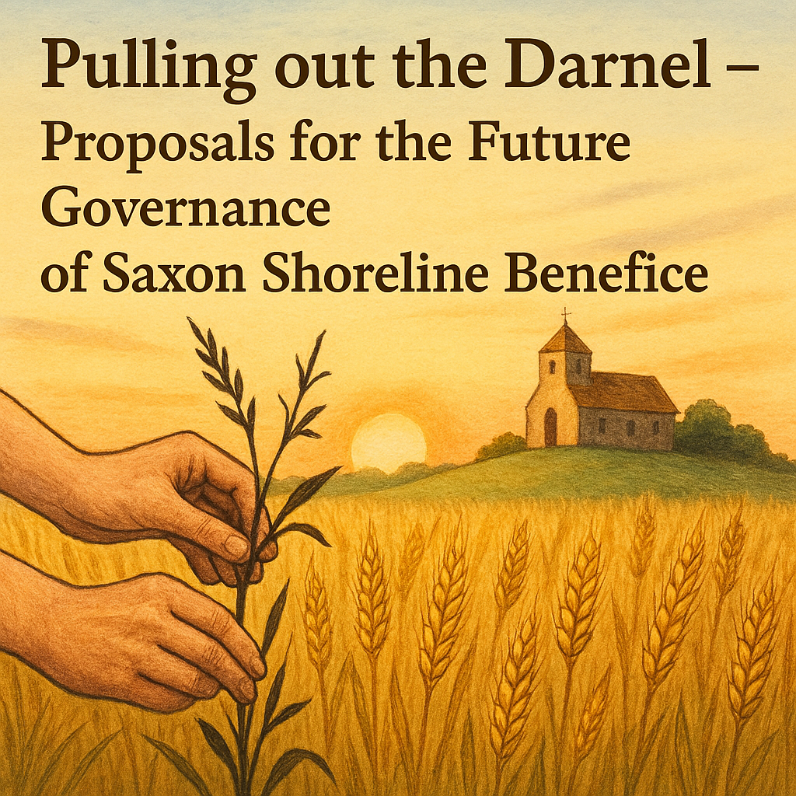
Pulling out the Darnel – Proposals for the Future Governance of Saxon Shoreline Benefice
Strategies to enhance leadership and community collaboration
Notes:
AI-generated content may be incorrect. ---

Slide 2
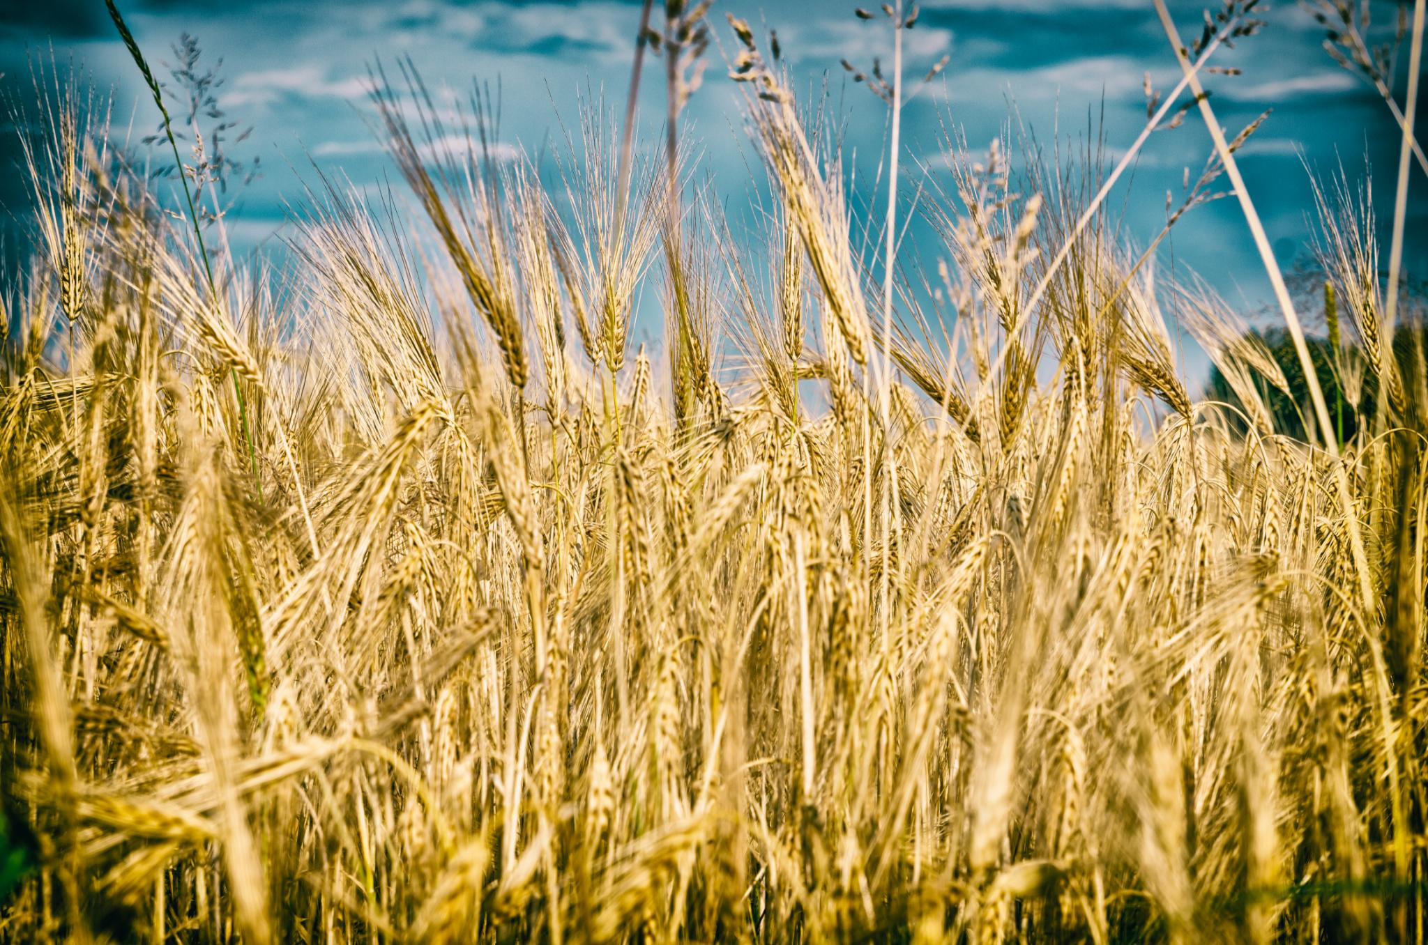
The Wheat and Darnel Parable – Mt 13.24-32
Parable of Wheat and Darnel
A farmer finds darnel sown by an enemy among his wheat. Both grow together until harvest time.
Notes:
24 Jesus put a parable before the crowds, ‘The kingdom of heaven may be compared to a man who sowed good seed in his field. 25 While everybody was asleep his enemy came, sowed darnel all among the wheat, and made off. 26 When the new wheat sprouted and ripened, the darnel appeared as well. 27 The owner’s servants went to him and said, “Sir, was it not good seed that you sowed in your field? If so, where does the darnel come from?” 28 “Some enemy has done this,” he answered. And the servants said, “Do you want us to go and weed it out?” 29 But he said, “No, because when you weed out the darnel you might pull up the wheat with it. 30 Let them both grow till the harvest; and at harvest time I shall say to the reapers: First, collect the darnel and tie it in bundles to be burnt, then gather the wheat into my barn.”’

Slide 3

Dwelling in the Word - Reflecting on Wheat & Darnel
Listen to the passage and notice what strikes you. Be curious – why is this?
Pair up with a neighbour and listen to their thoughts.
Report back to the rest of the group what your partner has said, not what you yourself said.
Reflect on common threads that may emerge from the sharing that takes place as a group.
Notes:
1. Listening carefully as the passage is read, notice where your attention is drawn to a word or phrase where your mind lingers.
2. Pair up with a neighbour.
Listen to that person as he or she tells you what they heard in the passage. They may mention something they’d never heard before, something odd or something comforting, or something about which they’d like to ask a biblical scholar.
3. Listen well, because your job will be to report back to the rest of the group what your partner has said, not what you yourself said. Some people even take notes to help them focus and remember.
4. The facilitator then looks for common threads that may emerge from the sharing that takes place as a group.

Slide 4
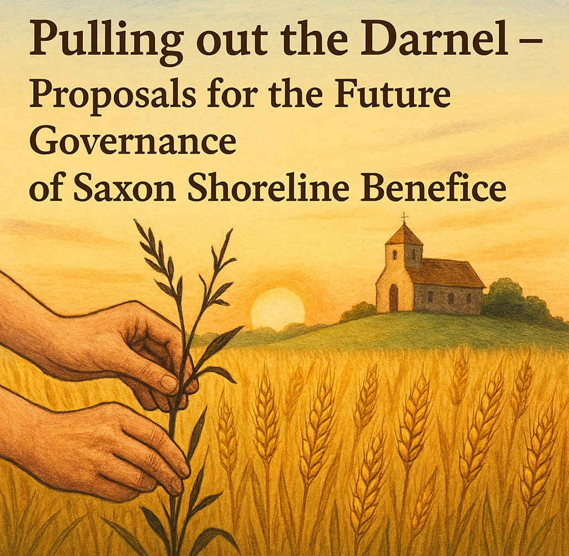
Introduction
Parable as Metaphor
The Parable of the Wheat and the Darnel could be applied as a metaphor for our current situation in the Saxon Shoreline Benefice. Balance in valuing what is good about current practise, but the need to root out what is hindering growth and mission.
Current Community Assessment
It is time to evaluate worship patterns and structures to ensure the church’s sustainability and future growth.
Leadership Approach
A collaborative and respectful leadership honours traditions while guiding necessary changes for mission success.
Mission Action Plans
Insights from Leading Your Church into Growth inform strategic decisions to overcome barriers and promote growth.
Notes:
Reflecting on the Parable of the Wheat and the Darnel from Matthew 13:24-30, I find a compelling metaphor for our current situation in the Saxon Shoreline Benefice. Just as the farmer in the parable waits until harvest to separate the wheat from the weeds, I have held off making significant changes to our worship patterns and structures, hoping to nurture what is good without causing harm. However, the time has come to assess our position and make decisions that will ensure the sustainability and future of our local church community. For me, the 'darnel' represents those outdated structures, entrenched attitudes, and sometimes even individuals who, whether intentionally or not, hinder the growth of the Kingdom. Since my arrival in April 2023, I have focused on encouraging what is already thriving and promoting our Benefice’s strapline: 'Sowing the Seeds of Hope.' While growth is ultimately God's mission, we must act wisely and missionally. I have shared insights from Leading Your Church into Growth (LYCiG), which have informed our Mission Action Plans. My leadership approach has been collaborative and respectful, honouring parish traditions and sensitivities. Now, I believe it is my duty to make some difficult decisions, in consultation with you, to identify and address the 'darnel' that impedes our mission.

Slide 5
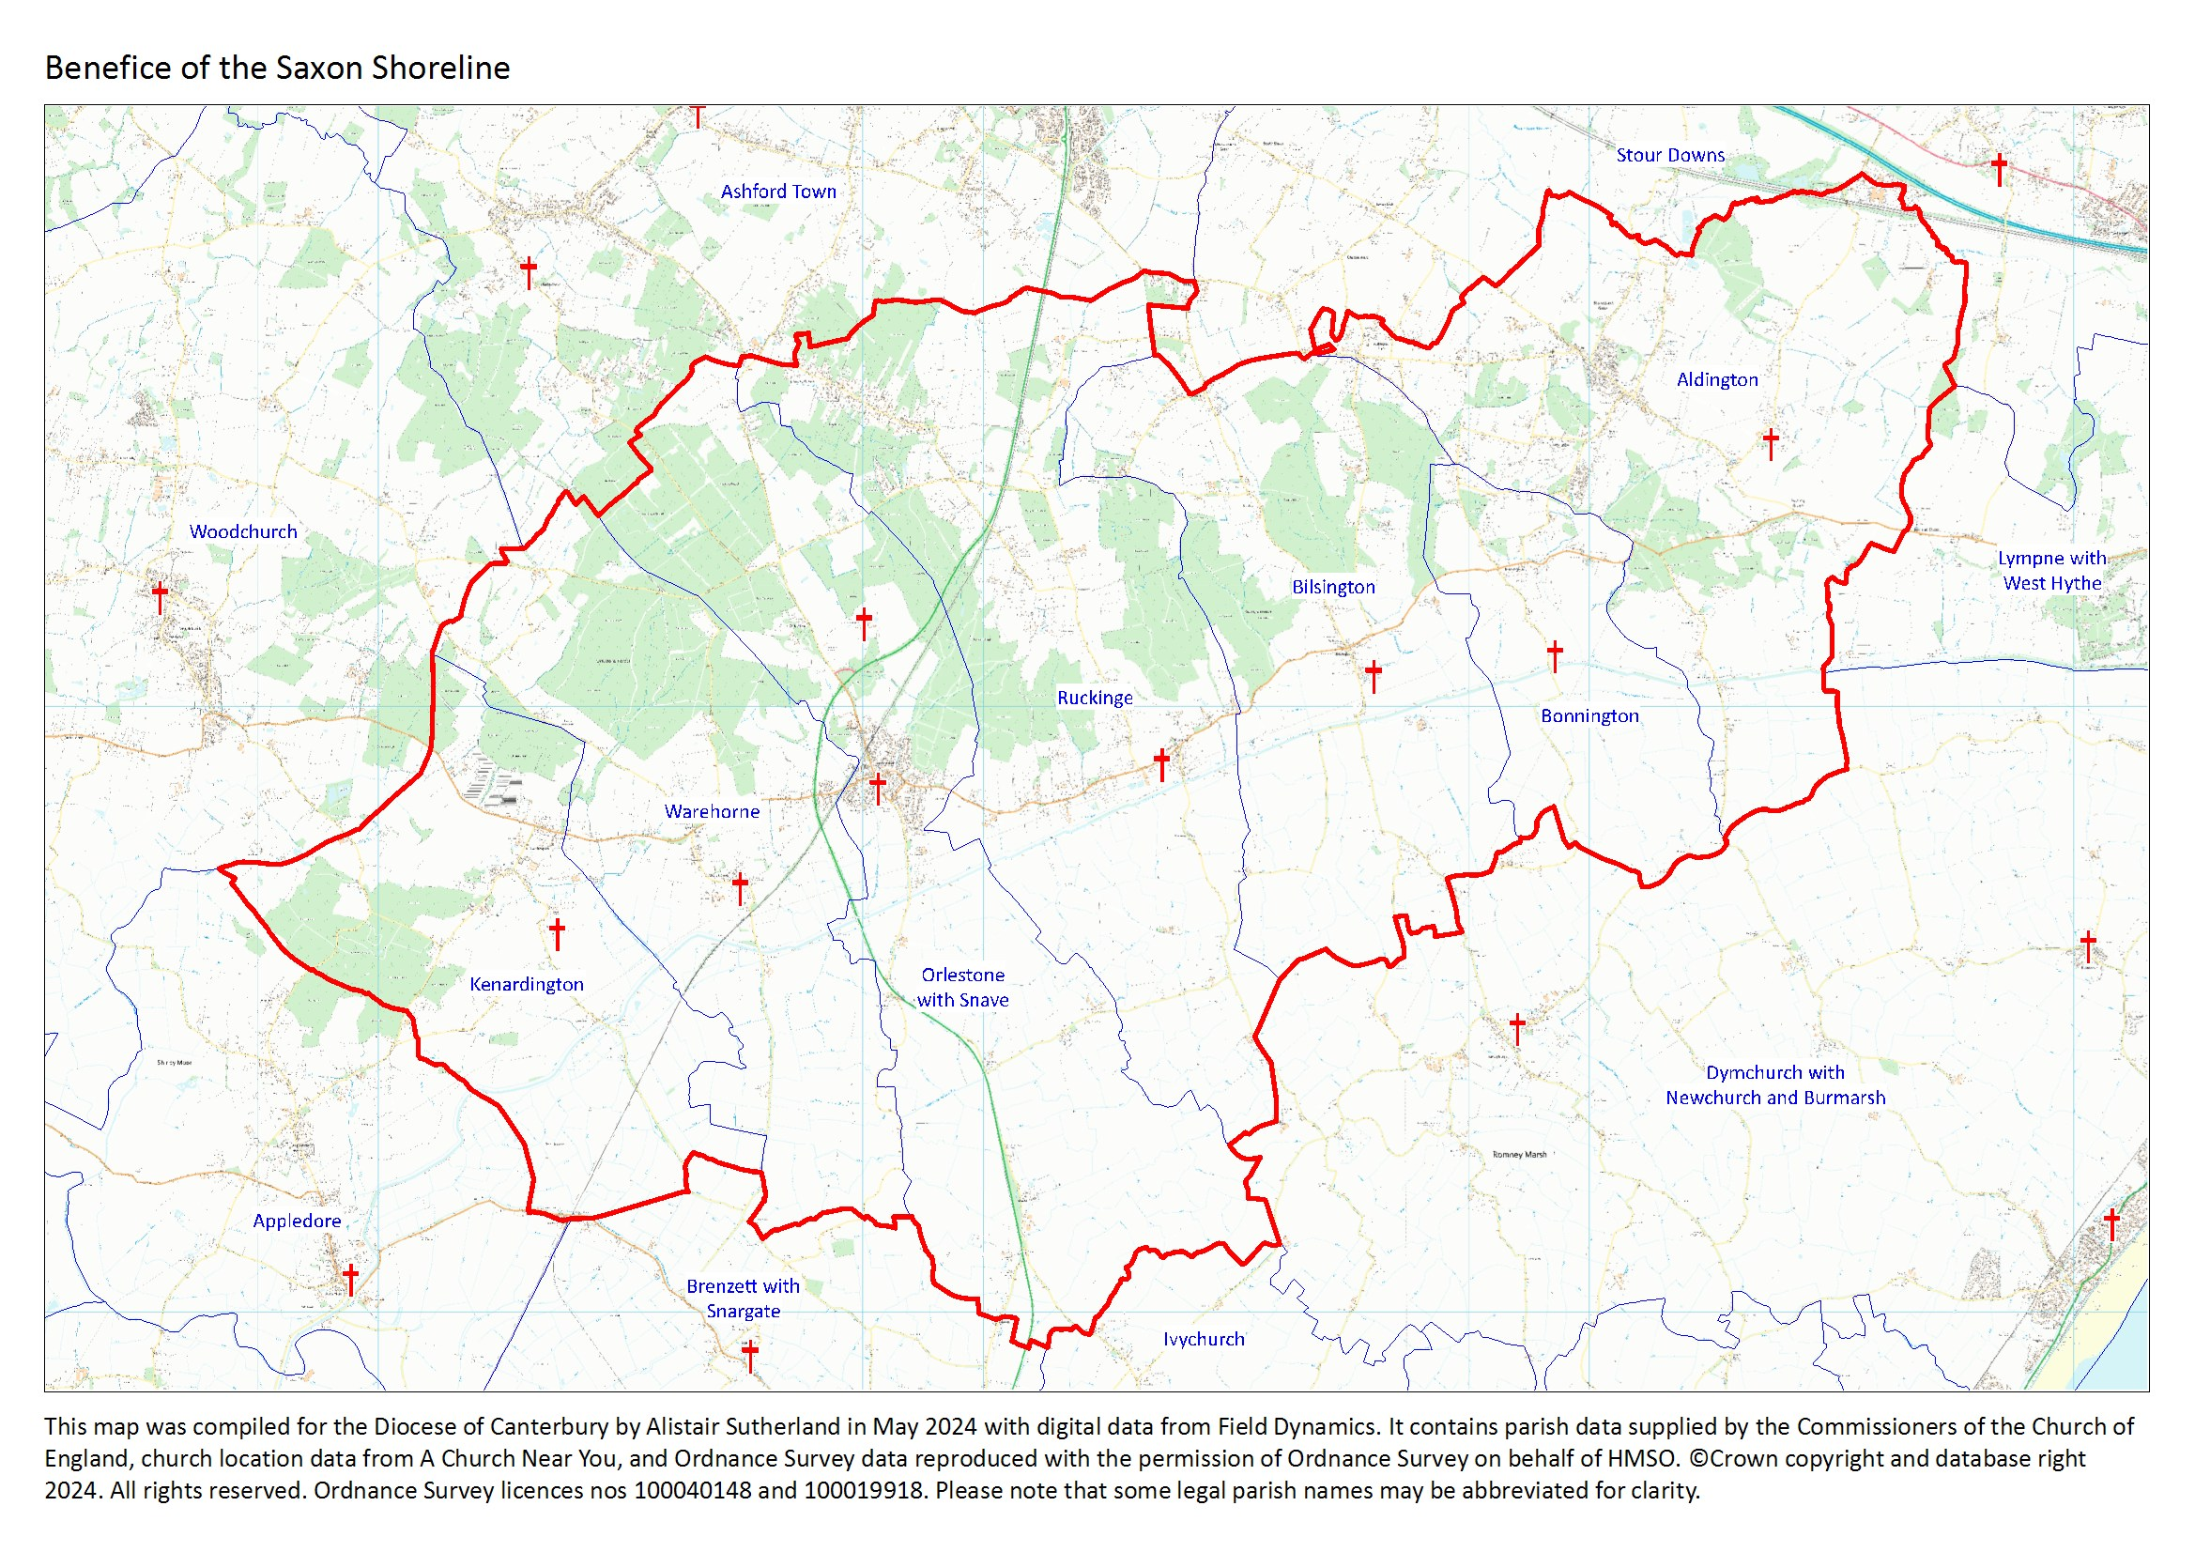

Slide 6
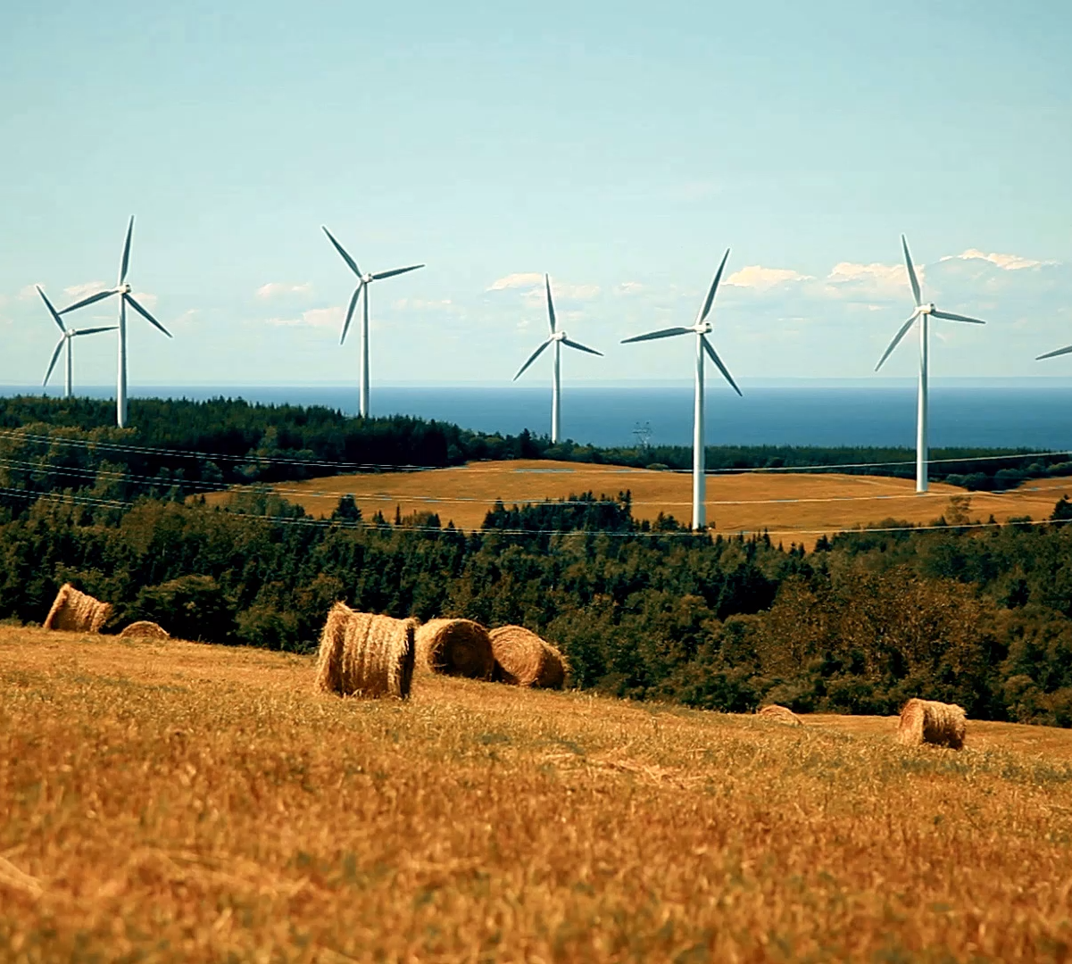
Facing Reality
Resource Constraints
The Benefice faces stretched human and financial resources, impacting sustainability and operations.
Changing Religious Landscape
Operating in a post-Christian society, organised religion faces declining relevance and fewer vocations.
Operational Challenges
Clergy are overwhelmed with administration, limiting time for pastoral care and sustainable worship practices.
Financial Difficulties
Some parishes face debt and struggle with Parish Share payments, threatening financial stability.
Notes:
To ensure the survival of our Benefice, we must confront some hard truths. Our human and financial resources are stretched thin, and we need to foster a missional heart and work more collaboratively. Fear of change is understandable, but ignoring reality will not secure our future. We are operating in a post-Christian society where organised religion is often viewed as irrelevant. The Church of England’s national strategy increasingly focuses on urban renewal, leaving rural parishes like ours with fewer resources. We are also facing a vocational crisis, with fewer individuals discerning a call to ordained ministry. Locally, our seven-parish Benefice has around 80 regular attendees, most of whom are elderly. Recruiting volunteers for key roles is becoming increasingly difficult, and some parishes struggle to meet legal governance requirements. Financial challenges are mounting, with one parish in debt and others unable to pay their Parish Share in full. Our clergy team is stretched, and the current pattern of worship and administration is unsustainable. Much of my time is consumed by administration and strategic planning, rather than pastoral care—the heart of my calling. I have become more of a manager than a shepherd, which is deeply frustrating.

Slide 7
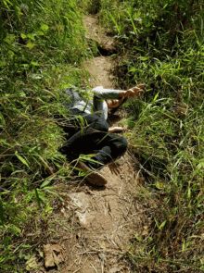
Naming the Darnel
Outdated Governance Model
The medieval governance structure is unsustainable and drains energy, requiring urgent modernization.
Focus on Maintenance Over Mission
Meetings and concerns focus more on buildings and finances than missional growth and community impact.
Clergy and Volunteer Burnout
Unrealistic demands and aging teams risk burnout among clergy and volunteers, threatening sustainability.
Call for Collective Leadership
Leadership should focus on collective Benefice unity, shared resources, and collaborative mission progress.
Notes:
The main obstacles I identify as 'darnel' include unsustainable governance structures, a focus on maintenance over mission, unrealistic demands on clergy and volunteers, and parochialism that hinders collective progress. Our medieval governance model is draining our energy and no longer viable. The 'one priest, one parish' model is outdated and unrealistic. We spend excessive time in meetings rather than on mission. Our focus tends to be on survival and maintaining the status quo, rather than pursuing missional growth. PCC meetings are dominated by concerns about buildings and finances, rather than mission. The current worship and administrative patterns risk burnout for clergy and volunteers, and our teams are aging and tired. My role is to lead the Benefice collectively, not to act as the priest of each individual parish. Progress toward unity has been partial, and we must embrace the collective and share resources, including finances.

Slide 8

A Way Forward
Commitment to Common Vision
Unity is inspired by shared vision and mission, fostering collaboration for survival and sustainability.
Embracing Necessary Change
Like pruning rose bushes, change is essential for new growth and renewal within the community.
Focus on Pastoral Care
Reducing administrative burdens enables greater focus on pastoral care and mission work.
Trust and Proactive Unity
Trusting in divine guidance encourages proactive steps to shape a vibrant future together.
Notes:
Inspired by the Early Church’s unity as described in Acts 2:44, I propose that we commit to a common vision and mission. This does not mean uniformity, but rather collaboration for survival and sustainability. Sometimes, as with the rose bushes in my garden, heavy pruning is necessary for new growth. We must trust that this is God’s Church and be willing to undergo change. By embracing a shared vision, we can move forward together, supporting one another and pooling our resources to ensure a vibrant future for our Benefice. This approach will allow us to focus more on pastoral care and mission, rather than being bogged down by administrative burdens. It is a call to unity, to trust in God’s guidance, and to be proactive in shaping our future.

Slide 9
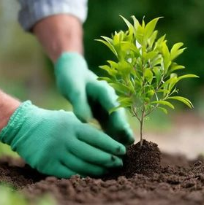
Outline of Remedial Action
Single Parish Benefice
Simplifying governance by uniting parishes frees clergy for pastoral care and attracts future leaders.
Church Status Review
Reevaluating churches to designate some as Festival Churches for special occasions and events.
Worship Provision Review
Enhancing worship by using clergy effectively and introducing informal, lay-led services to engage more people.
Collaborative Leadership
Encouraging consultation and shared decision-making to face challenges proactively and inclusively.
Notes:
After much reflection and prayer, I propose the following remedial actions: First, we should become a Single Parish Benefice. Simplifying governance will free clergy for pastoral care and make the Benefice more attractive to future incumbents. Local teams can handle day-to-day operations, with one PCC for legal governance. Second, we should review the status of individual churches. Some churches, initially Kenardington and Orlestone, may become Festival Churches, focusing on special occasions. Third, we need to review our worship provision. We must use clergy more effectively and consider more informal, lay-led services to attract new congregants. These proposals are intended for consultation, not as final plans. Leadership involves making difficult choices, but we must do this together. If you disagree, I invite you to propose alternatives. We cannot afford to wait; we must be proactive.

Slide 10
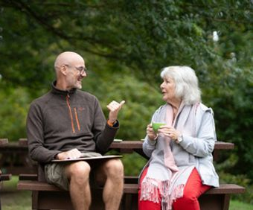
Consultation Process
Proposal Presentation
Initial proposal presentation will occur at the Churchwarden’s meeting on Monday, 3rd November, setting the consultation in motion.
Public Parish Meetings
In 2026, public meetings in each parish will allow open discussion and community engagement before voting.
Decision-making and Implementation
PCC decisions scheduled for November 2026 will determine if proposals proceed to implementation starting January 2027.
Inclusive and Transparent Process
The process promotes inclusivity and transparency, fostering open dialogue and collective decision-making in faith.
Notes:
The consultation process will begin with a presentation of these proposals at the Churchwarden’s meeting on Monday, 3rd November. In 2026, I will hold public meetings in each parish for discussion, followed by PCC decisions in November. If the majority support these proposals, implementation will begin in January 2027. The process for Festival Churches will begin in Spring 2026. This process is designed to be inclusive and transparent, allowing for open dialogue and collective decision-making. I am committed to working with you to ensure that every voice is heard and that we move forward together in faith and unity.

Slide 11

Closing Thoughts
Spirit of Hope and Collaboration
Proposals are offered with hope and trust in God’s guidance and community partnership.
Leadership Through Engagement
True leadership involves making tough decisions while listening and working together.
Commitment to Mission
Embracing change fosters a vibrant, mission-focused church community equipped to serve.
Moving Forward with Faith
Advancing with faith, courage, and shared commitment to grow God’s Kingdom locally.
Notes:
I offer these proposals in the spirit of hope and collaboration, trusting in God’s guidance and your partnership as we seek a sustainable future for our Benefice. Leadership means making difficult decisions, but it also means listening, engaging, and working together. I believe that by embracing these changes, we can create a more vibrant, mission-focused church community that is better equipped to serve our parishioners and fulfil our calling. Let us move forward with faith, courage, and a shared commitment to the growth of God’s Kingdom in our midst.

