Slide 1
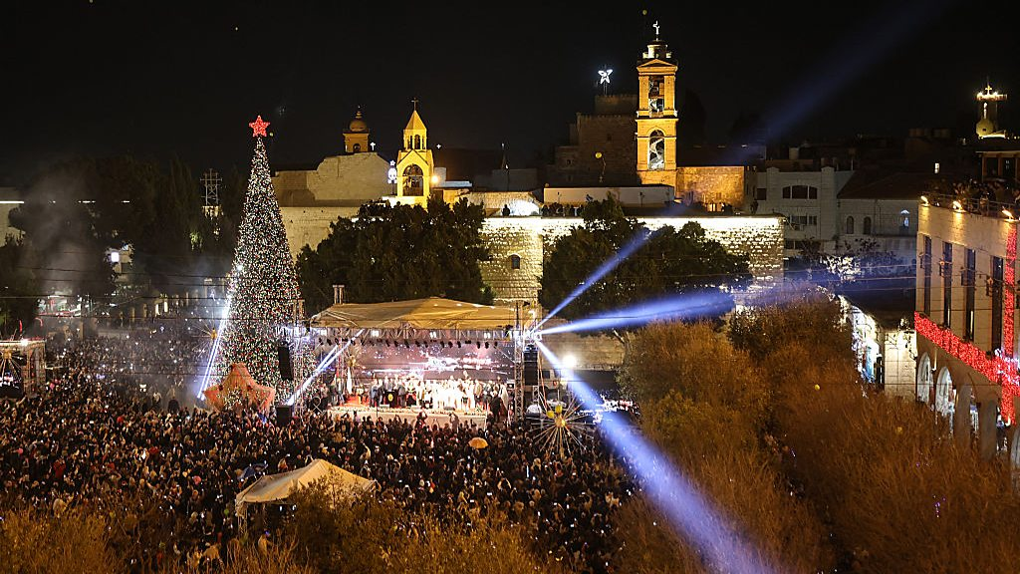
Advent in Bethlehem

Slide 2
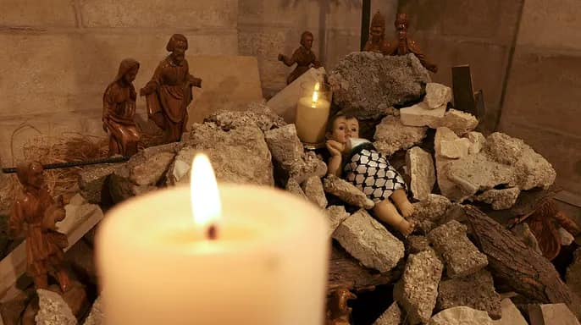
Advent in Bethlehem
The Crib, 2023, at the Lutheran Church in Bethlehem

Slide 3
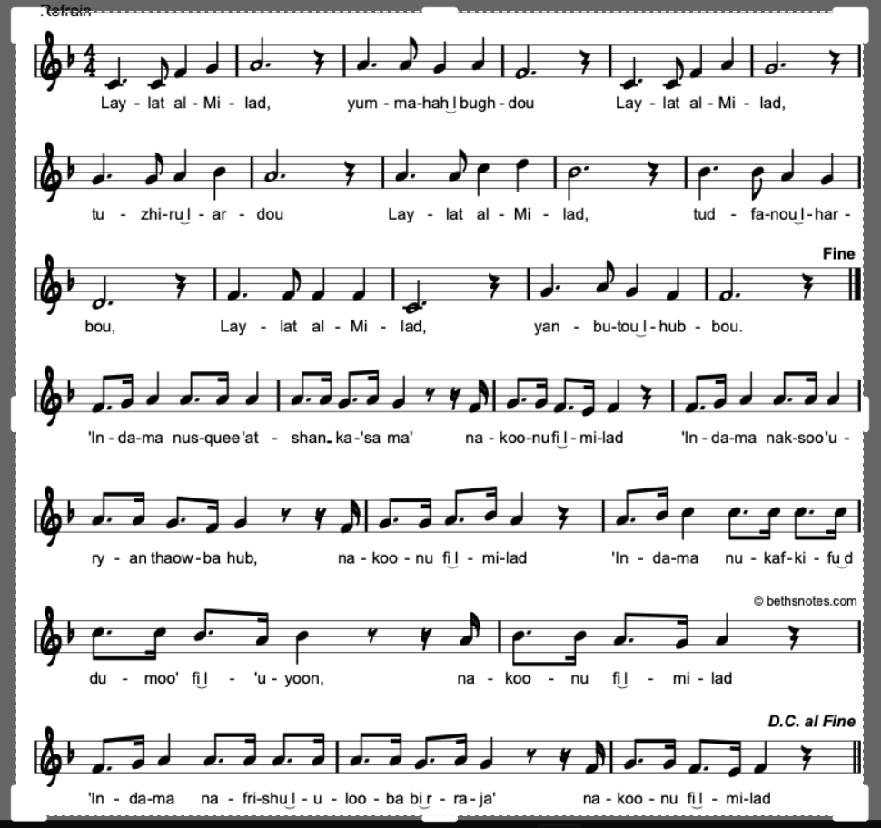
Laylat al-milad ~ on the night of Christmas
Sung by various senior clergy in the Diocese of Jerusalem and the Middle East on Advent Sunday this year
https://www.facebook.com/reel/1184812523118110

Slide 4
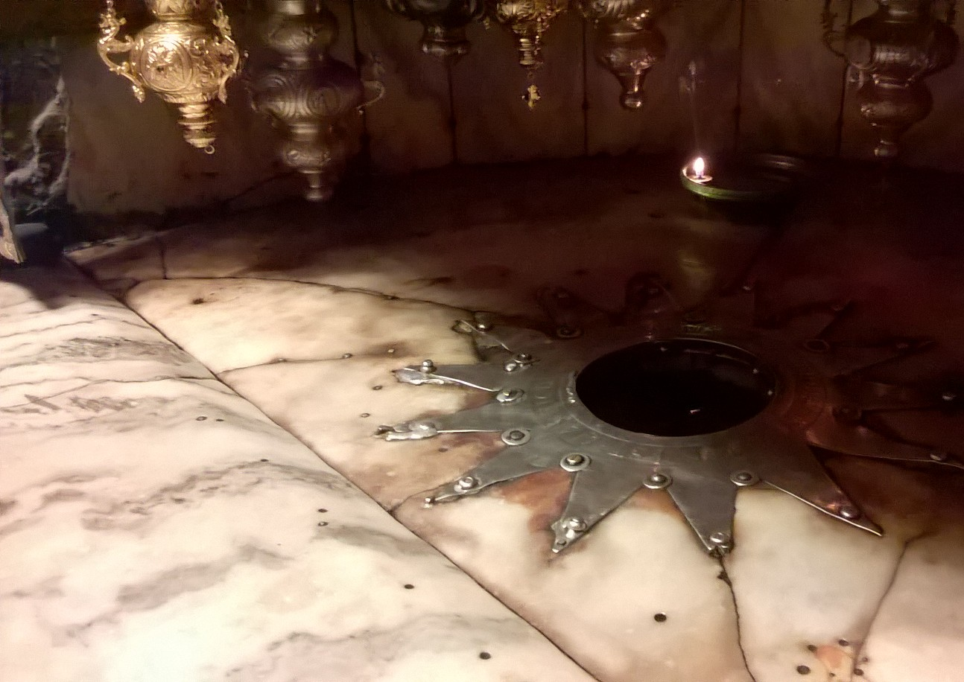
Laylat al-milad ~ On the night of Christmas
On the night of Christmas hatred will vanish,
On the night of Christmas the earth will flourish.
On the night of Christmas war will be gone,
On the night of Christmas, love will be born.

Slide 5
Laylat al-milad ~ On the night of Christmas
When we offer a cup of water to the needy,
Then we find that it is Christmas
When we clothe the naked with a robe of love,
Then we find that it is Christmas
When we wipe away the tears from weeping eyes,
Then we find that it is Christmas
When we gird the hopeless heart with love,
Then we find that it is Christmas

Slide 6
Laylat al-milad ~ On the night of Christmas
When I welcome a friend without deceit,
Then I know that it is Christmas
When the spirit of revenge in me dies down,
Then I know that it is Christmas
When my heart no longer wants to be alone,
Then I know that it is Christmas
When I lose myself in God’s own love,
Then I know that it is Christmas

