Slide 1

Understanding Advent: Significance, Commemoration, and Symbolism in the Liturgical Season
Exploring traditions and meaning in the Christian season
This Photo by Unknown Author is licensed under CC BY
Notes:
AI-generated content may be incorrect. --- This presentation explores the season of Advent, focusing on its place in the Christian calendar, its historical background, theological significance, and the symbolism associated with Advent traditions such as the wreath.

Slide 2


The Place of Advent in the Christian Calendar
Beginning of Liturgical Year
Advent marks the start of the Christian liturgical calendar across many denominations, symbolizing new beginnings.
Season of Anticipation
Advent is a time of hopeful anticipation and spiritual preparation for the celebration of Christmas.
Reflection and Preparation
During Advent, Christians reflect on spiritual themes and prepare their hearts for the coming of Christ.
Notes:
--- Advent is the beginning of the liturgical year in many Christian denominations and serves as a season of anticipation leading up to Christmas. It sets the tone for reflection and preparation. Image source: Microsoft 365 content library

Slide 3

Timing and Duration of Advent
Advent Duration
Advent lasts four weeks beginning on the Sunday nearest to November 30 and ends on Christmas Eve, marking a period of preparation.
Significance of Timing
The timing of Advent highlights anticipation of both the birth of Christ and his eventual second coming.
Notes:
--- Advent typically spans four weeks, starting on the Sunday nearest to November 30 and lasting until Christmas Eve. This timing emphasizes the anticipation of Christ’s birth and his eventual second coming. Image source: Microsoft 365 content library

Slide 4
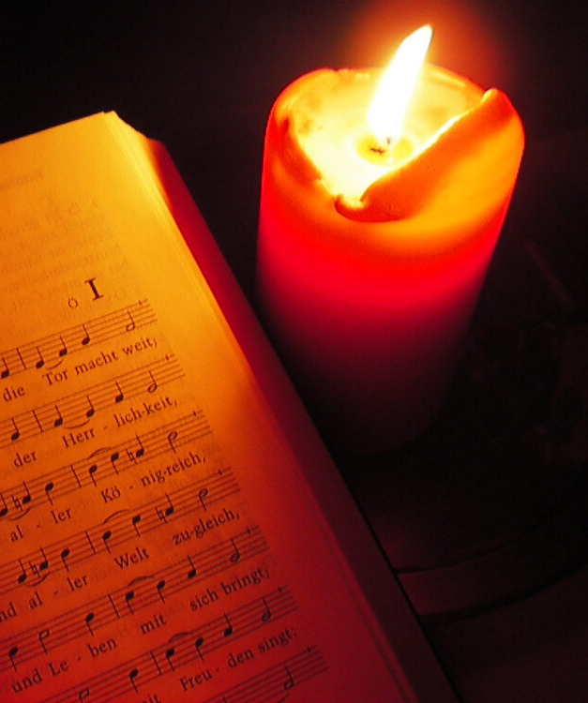
Distinctive Practices and Traditions During Advent
Prayer and Reflection
Prayer is a central practice during Advent, helping believers prepare spiritually for Christmas.
Fasting Traditions
Fasting is observed by many Christians to encourage discipline and spiritual focus during Advent.
Lighting Advent Candles
Lighting candles each week symbolizes hope, peace, joy, and love during the Advent season.
Special Church Services
Special church services unite communities and deepen spiritual readiness for Christmas celebrations.
Notes:
--- During Advent, Christians engage in various practices such as prayer, fasting, lighting candles, and special church services. These traditions foster spiritual readiness and community participation. Image source: Microsoft 365 content library

Slide 5
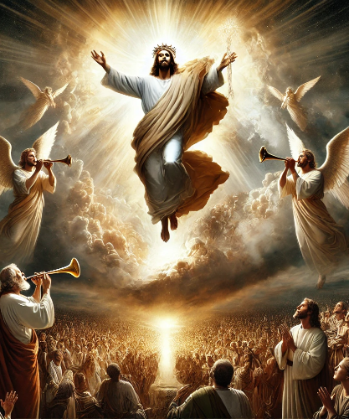
Origins and Historical Development of Advent
Early Christian Practices
Advent began with early Christian fasting and preparation to anticipate the coming of Christ.
Evolution into Liturgical Season
Over centuries, Advent developed into a formal liturgical season with structured observances.
This Photo by Unknown Author is licensed under CC BY-NC-ND
Notes:
--- Advent’s origins trace back to early Christian practices of fasting and preparation, evolving through centuries to become a formal liturgical season with structured observances. Image source: Microsoft 365 content library

Slide 6
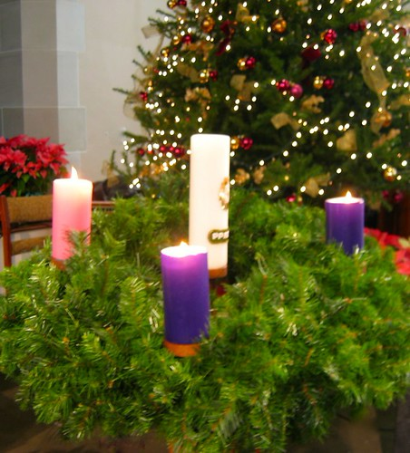
Advent as a Time of Preparation for Christ’s Coming
Spiritual Preparation
Advent encourages spiritual reflection and readiness for celebrating Christ's birth and second coming.
Celebration of Christ’s Birth
Advent anticipates the joyous celebration of the nativity and Christ’s arrival into the world.
Expectation of Second Coming
Advent holds a hopeful expectation for Christ’s promised return, blending remembrance with future anticipation.
This Photo by Unknown Author is licensed under CC BY-SA-NC
Notes:
--- Advent is a period to spiritually prepare for both the celebration of Christ’s birth and his promised second coming, blending themes of remembrance and expectation. Image source: Microsoft 365 content library

Slide 7
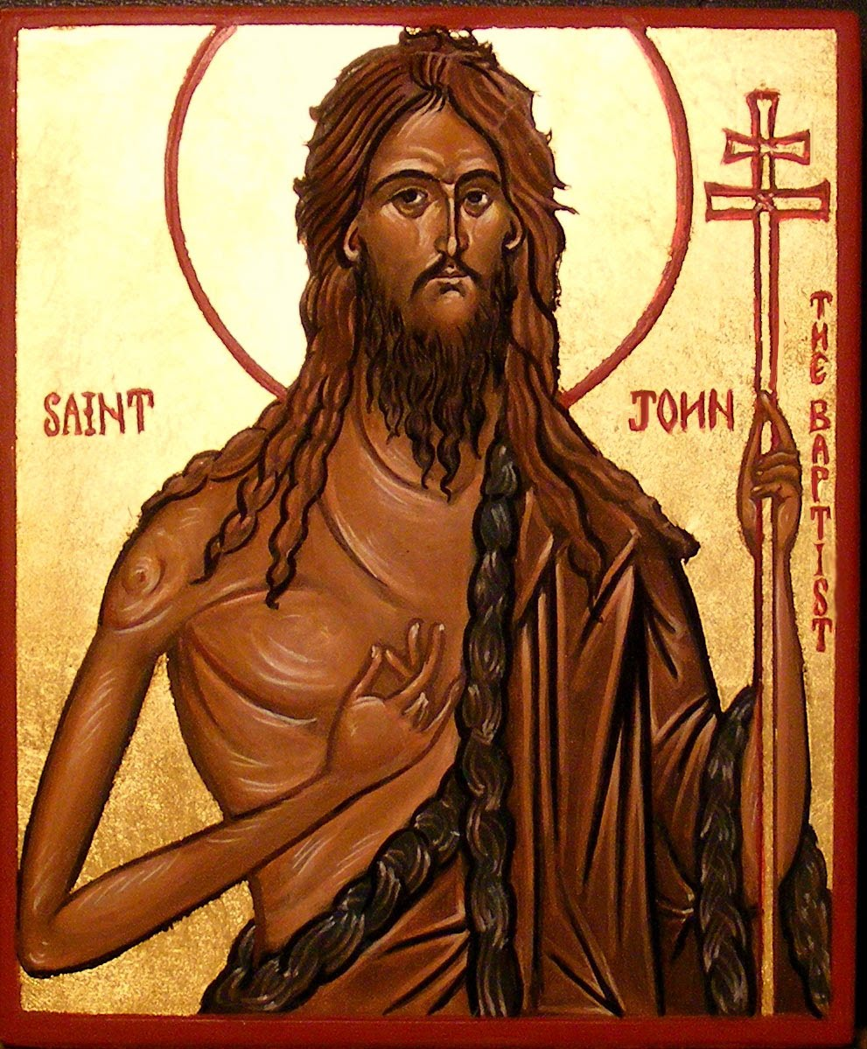
Key Events and Figures Commemorated During Advent
Prophetic Announcements
Advent involves reflecting on prophecies that foretold the coming of Jesus, emphasizing God's unfolding plan.
John the Baptist's Role
John the Baptist is honored for preparing the way for Jesus, representing a key figure in Advent traditions.
Continuity of God's Plan
Advent highlights the seamless continuity of God’s plan through prophetic messages and fulfilled promises.
This Photo by Unknown Author is licensed under CC BY
Notes:
--- During Advent, the Church reflects on prophetic announcements and figures such as John the Baptist who prepared the way for Jesus, highlighting the continuity of God’s plan. Image source: Microsoft 365 content library

Slide 8
Themes of Hope, Expectation, and Preparation
Hope in Advent
Hope is a central theme during Advent, symbolizing trust in the promise of Christ's coming.
Anticipation and Expectation
Advent involves anticipation, preparing believers mentally and spiritually for Christ’s arrival.
Preparation of Hearts
Believers prepare their hearts and minds, fostering readiness for both historical and future fulfillment.
Notes:
--- Central to Advent are the themes of hope and anticipation as believers prepare their hearts and minds for the coming of Christ in history and in the future. Image source: Microsoft 365 content library

Slide 9
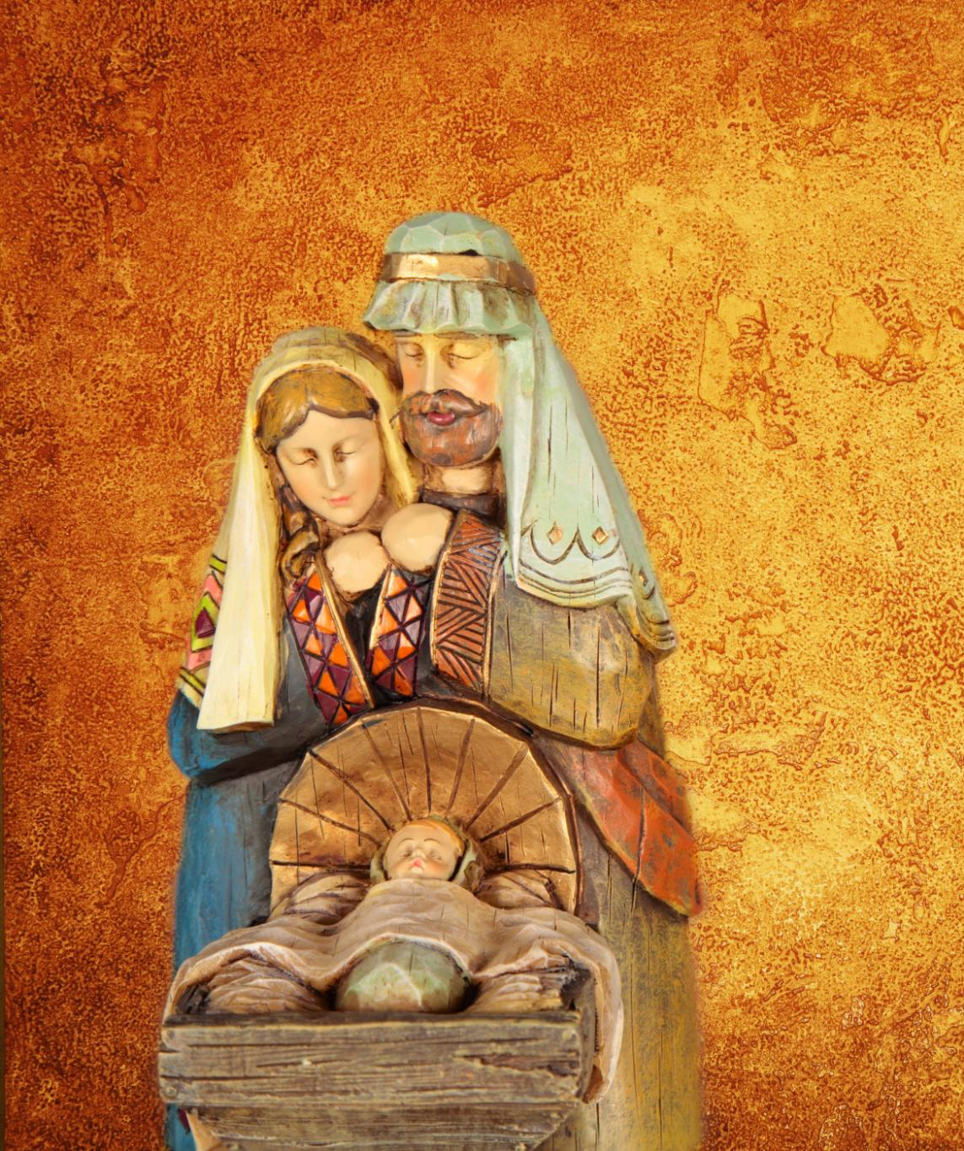
Reflection on the Dual Coming of Christ
First Coming of Christ
Advent celebrates Jesus's birth, emphasizing joyful remembrance of the incarnation and humility.
Second Coming Expectation
Advent also anticipates Jesus's future return, inspiring sober hope and spiritual readiness.
Balance of Emotions
Advent encourages a balance between joyful celebration and thoughtful expectation during the season.
Notes:
--- Advent uniquely recognizes both the first coming of Jesus as a child and the future second coming, encouraging a balance of joyful remembrance and sober expectation. Image source: Microsoft 365 content library

Slide 10

Advent as a Time for Spiritual Renewal
Opportunity for Self-Examination
Advent invites believers to reflect on their lives and faith, promoting personal spiritual growth.
Repentance and Renewal
The season encourages repentance, fostering renewal and preparation for Christ’s arrival.
Deepening Faith and Readiness
Advent deepens faith and readiness to welcome Christ’s presence in one’s life.
Notes:
--- The season offers an opportunity for self-examination, repentance, and renewal, helping believers deepen their faith and readiness for Christ’s presence. Image source: Microsoft 365 content library

Slide 11

Origins and Traditional Use of the Advent Wreath
Historical Origin
The Advent wreath tradition began in the 19th century as a meaningful Christian practice.
Symbolic Countdown
The wreath serves as a visual countdown to Christmas during the Advent season.
Family and Worship Use
Used in homes and congregations to foster devotion and reflection during Advent.
Notes:
--- The Advent wreath tradition originated in the 19th century, serving as a tangible countdown to Christmas and a tool for family and congregational devotion. Image source: Microsoft 365 content library

Slide 12

Significance of Candles and Their Colors
Advent Candle Representation
The four candles on the wreath represent the four weeks of Advent, marking spiritual preparation.
Purple Candle Symbolism
Three purple candles symbolize penitence and reflection during the Advent season.
Pink Candle Significance
One pink candle represents joy, highlighting a moment of celebration during Advent (the Third Sunday of Advent – Gaudate Sunday or Sunday of Joy). The emphasis changes to anticipation of the celebration of Christmas.
Notes:
--- The wreath typically has four candles representing each week of Advent, often with three purple and one pink candle, symbolizing penitence and joy respectively. Image source: Microsoft 365 content library

Slide 13

The Advent Wreath as a Visual and Spiritual Reminder
Weekly Candle Lighting Ritual
Lighting candles weekly encourages reflection on Advent's spiritual themes, fostering hope and anticipation.
Symbolism of the Wreath
The circular wreath visually represents eternity and continuous life, enhancing spiritual awareness during Advent.
Notes:
--- Lighting the candles weekly serves as a ritual that fosters reflection on the season’s themes, inspiring hope and spiritual awareness in the anticipation of Christ’s coming. Image source: Microsoft 365 content library

Slide 14
Conclusion
Advent Season Significance
Advent blends history, theology, and symbolism, preparing believers for Christ’s birth and return.
Spiritual Reflection
Advent traditions encourage deep spiritual reflection and renewal during the season.
Notes:
Advent is a rich liturgical season blending history, theology, and symbolism to prepare believers for the joyous celebration of Christ’s birth and his future return. Its traditions offer meaningful ways to engage in spiritual reflection and renewal.

