Slide 1
The art of Ospringe church
The church building offers a range of artistic forms.
Sculpture
Mosaics
Paintings
Woodcarving
Glasswork
This booklet begins an exploration of the art inside and outside the building.

Slide 2
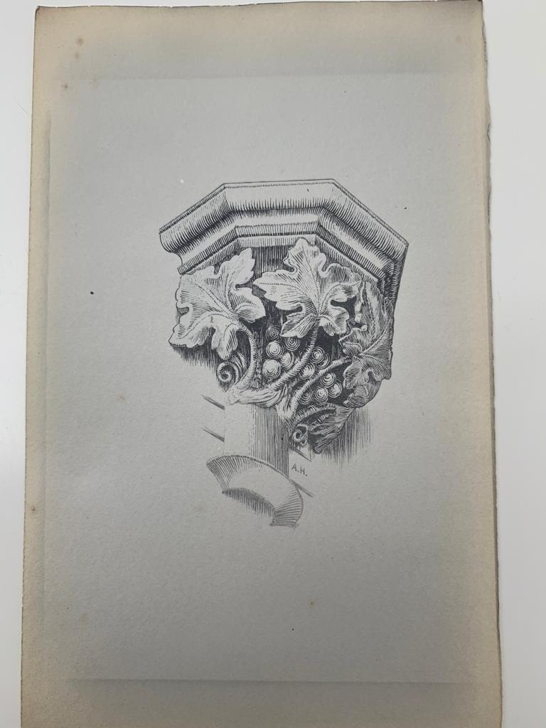
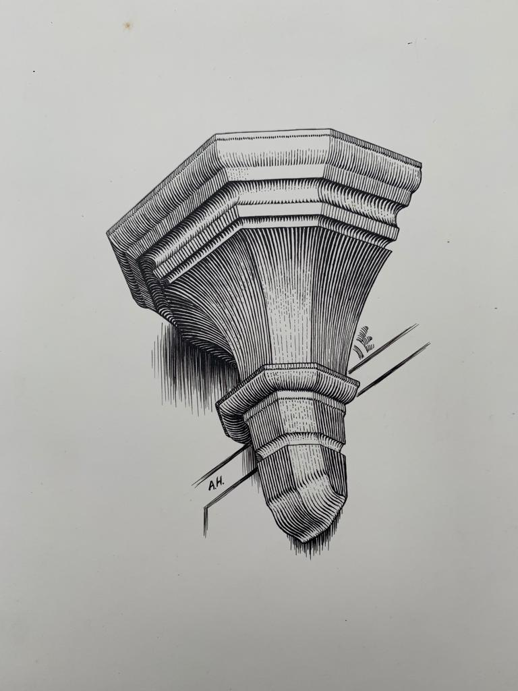
Internal corbels external wall/ central columns
Note the leaf forms and grapes

Slide 3
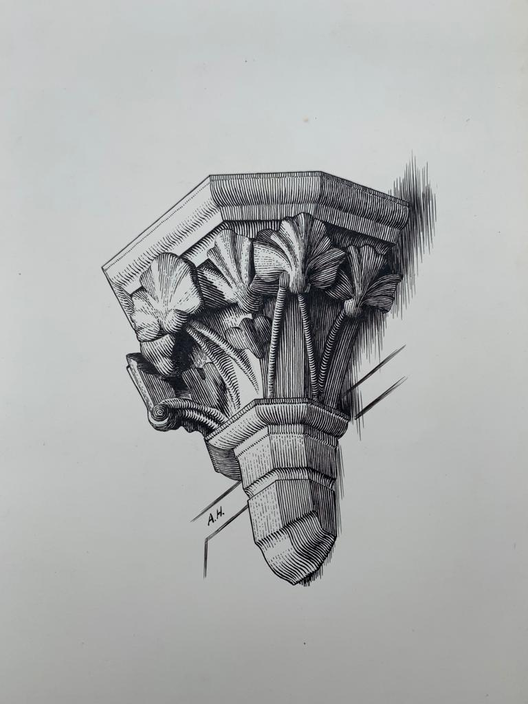
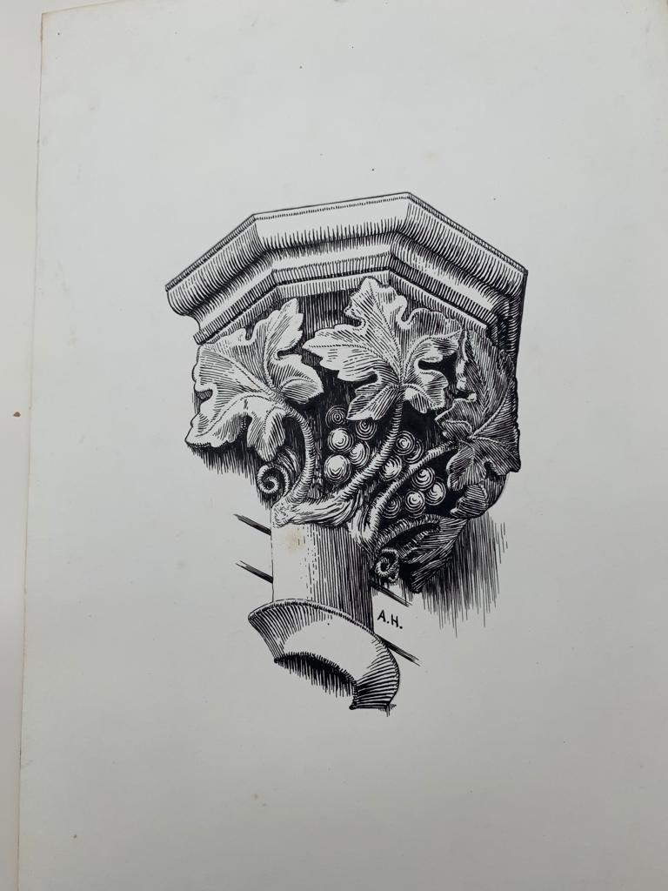
Corbels external walls(internal)
Note different leaf shape

Slide 4
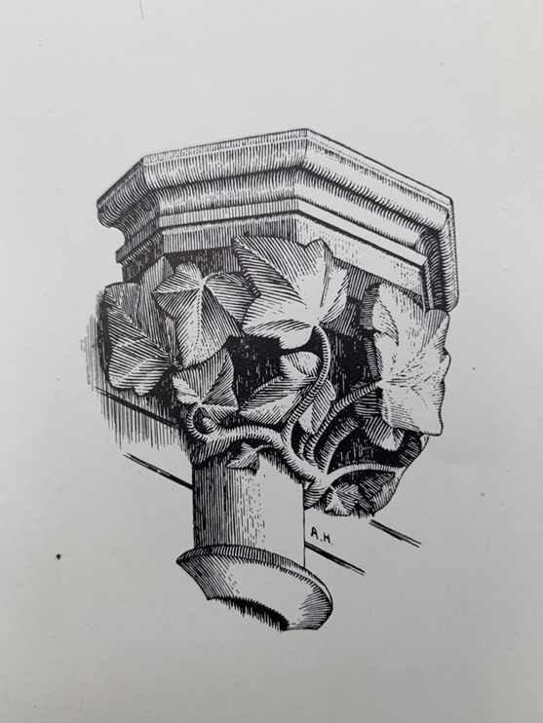
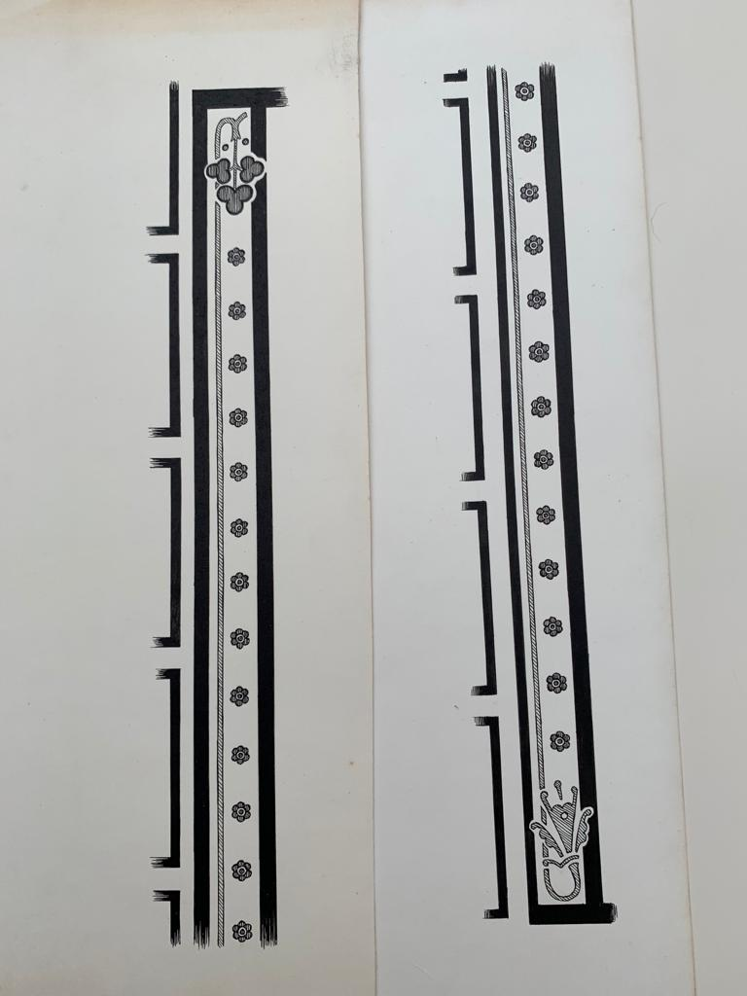
Internal decorations
What the internal patterns may have looked like

Slide 5
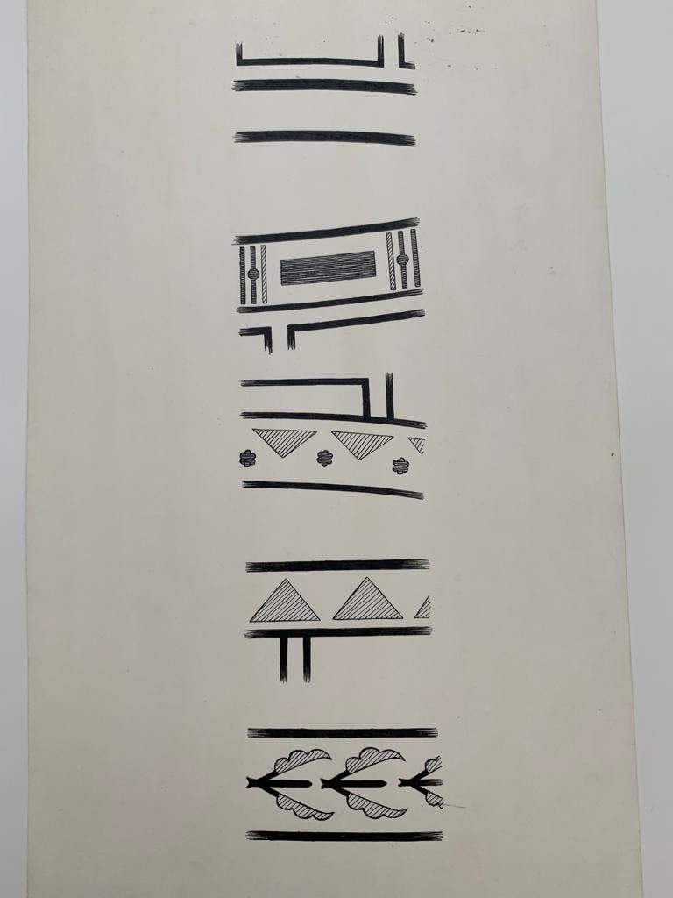
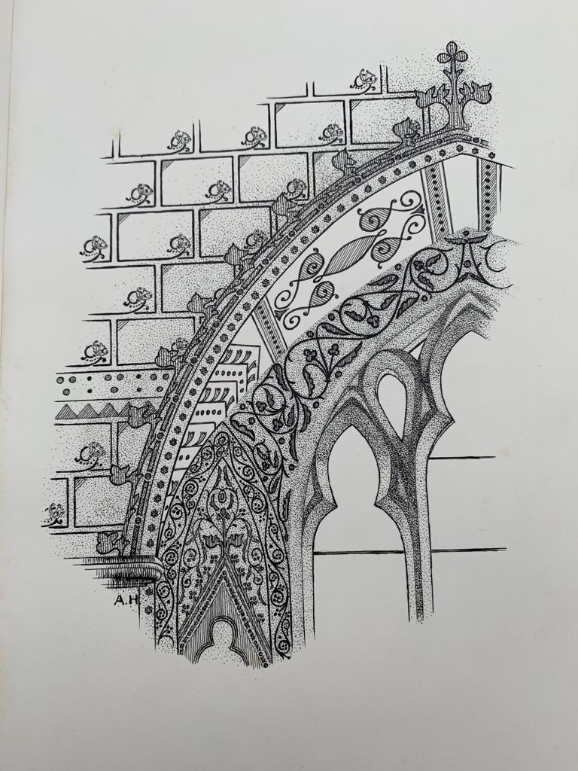
Patterns on walls no longer visible

Slide 6
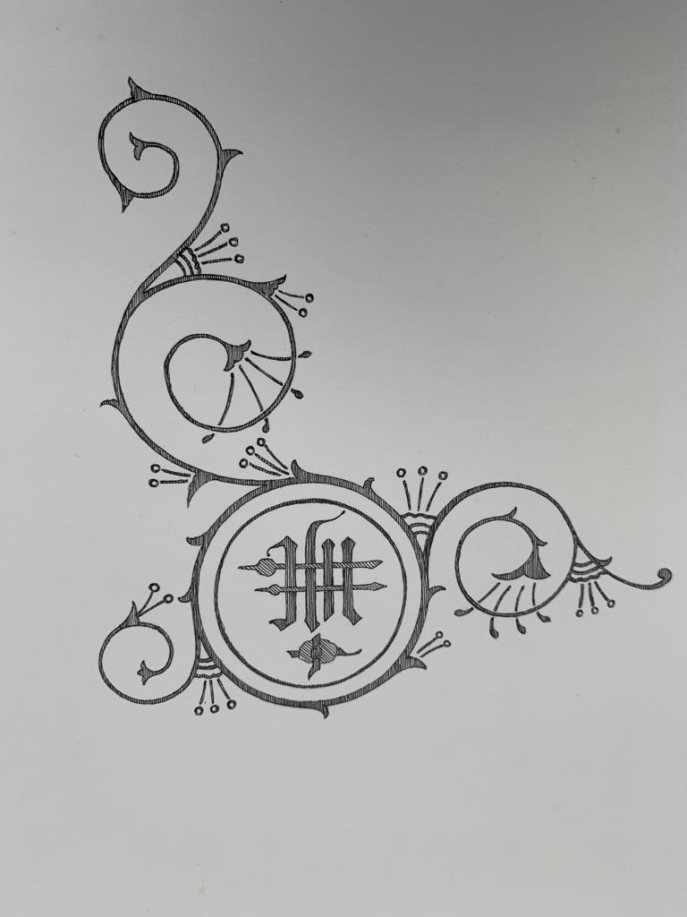
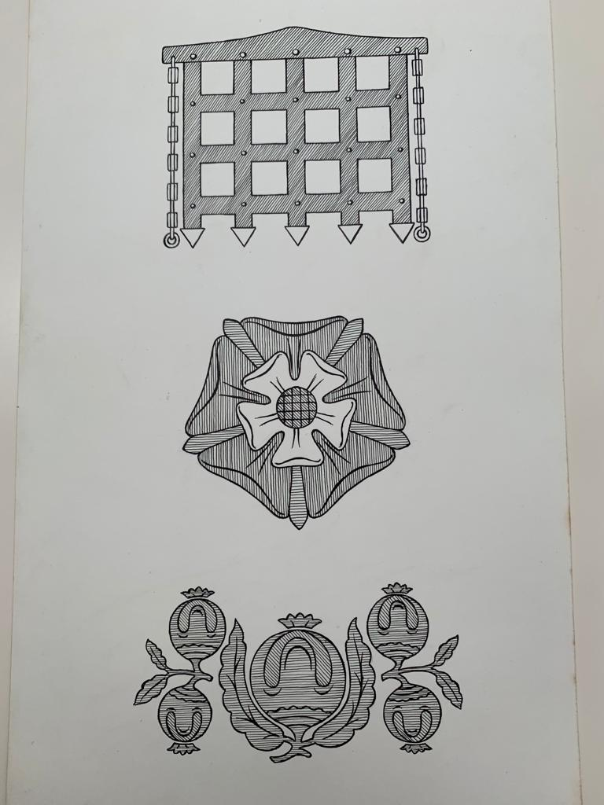
Patterns on walls no longer visible

Slide 7
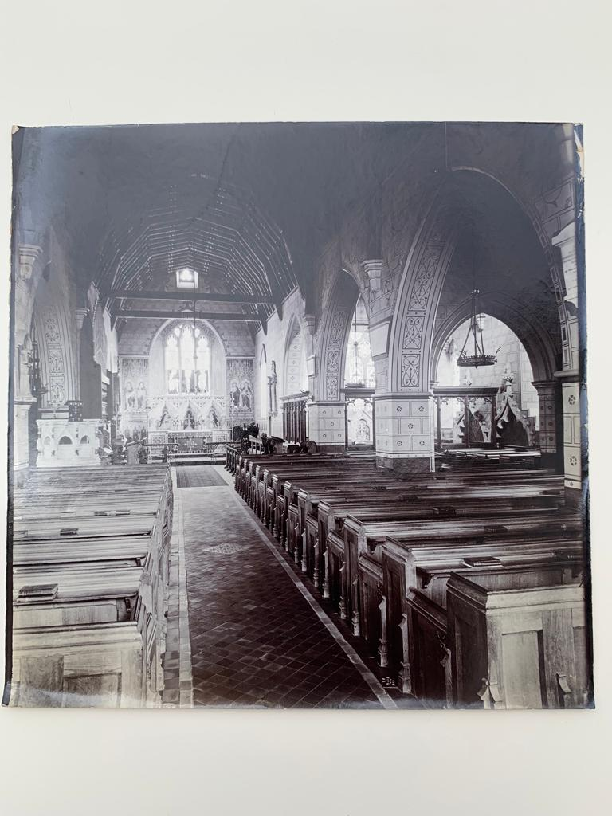
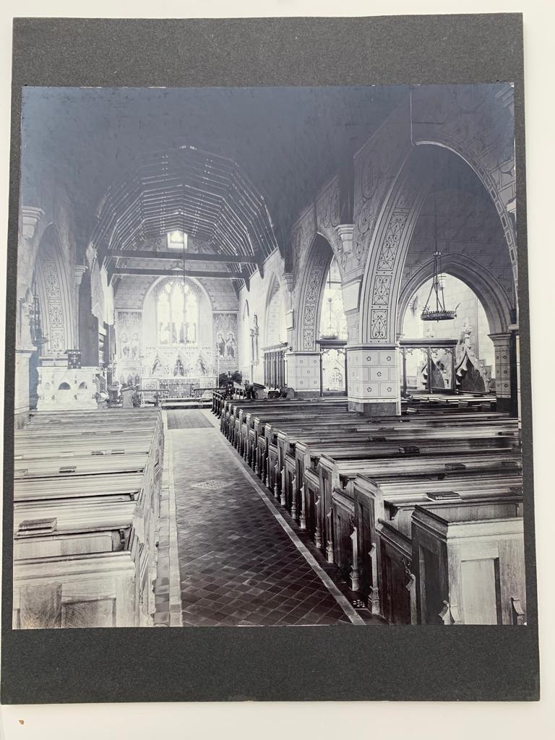
Internal views showing Victorian decoration

Slide 8
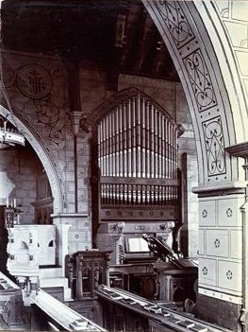
Internal views showing Victorian decoration

Slide 9
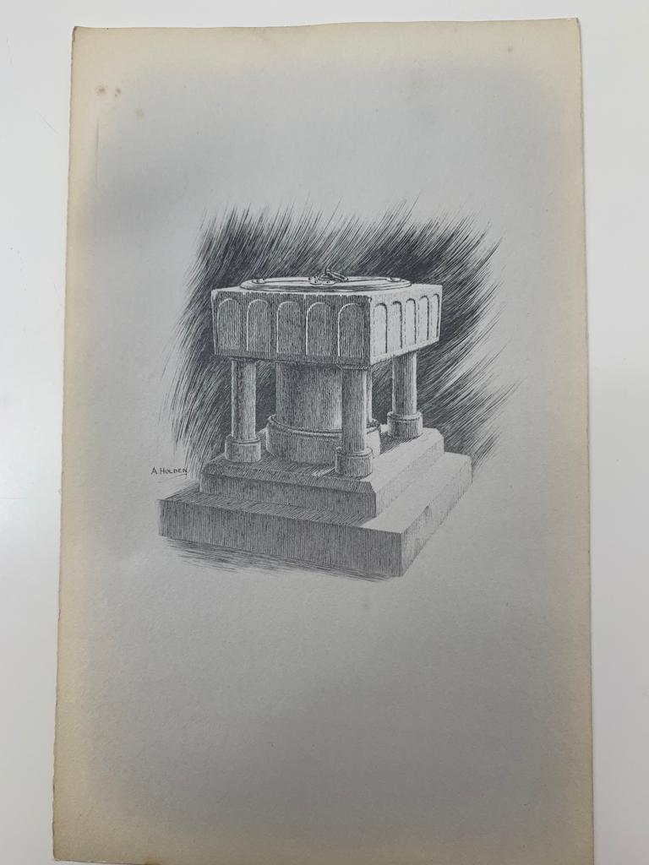
Font
Made of Bethersden Marble.
Thought to be from the original Norman church.

Slide 10
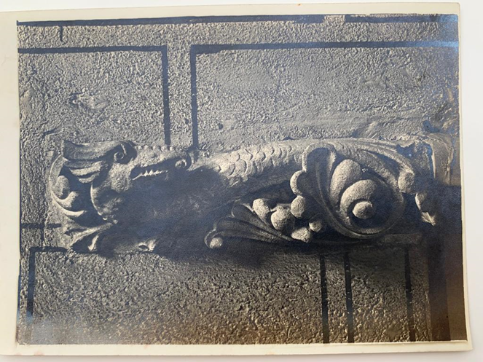
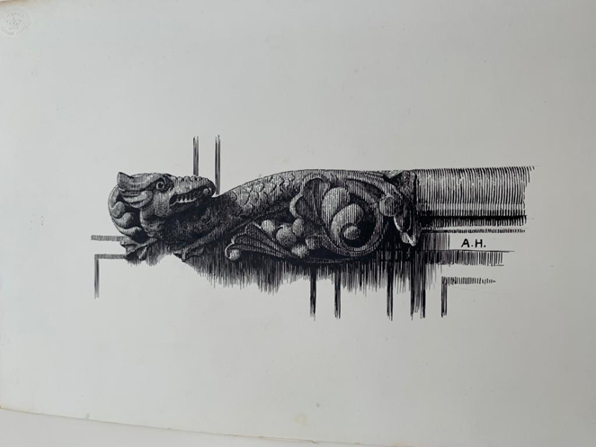
Parish room A former vicar was named Griffin

Slide 11
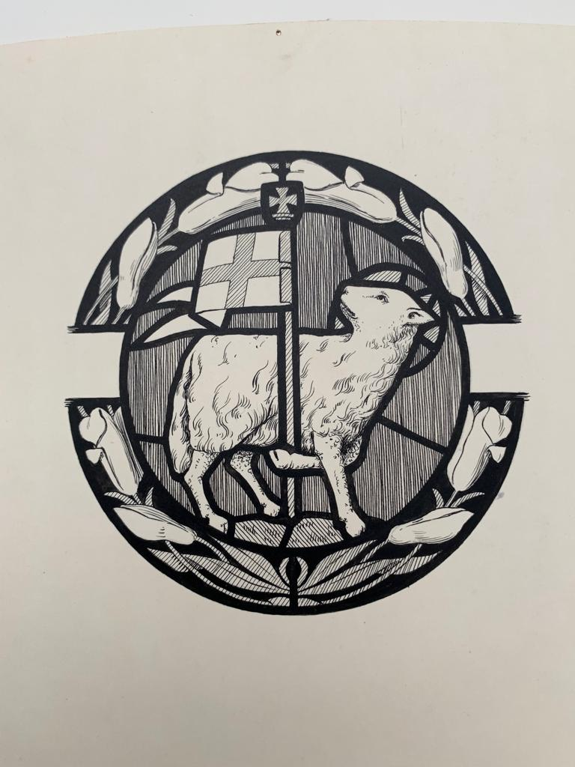
Detail of window
Note the lilies circular around the Agnes Dei
( Lamb of God)
The pennant of St George.
The lily is sometimes known as the Gethsemane and was supposed to have been sprinkled with Jesus’ blood as it grew at the foot of the cross.

Slide 12
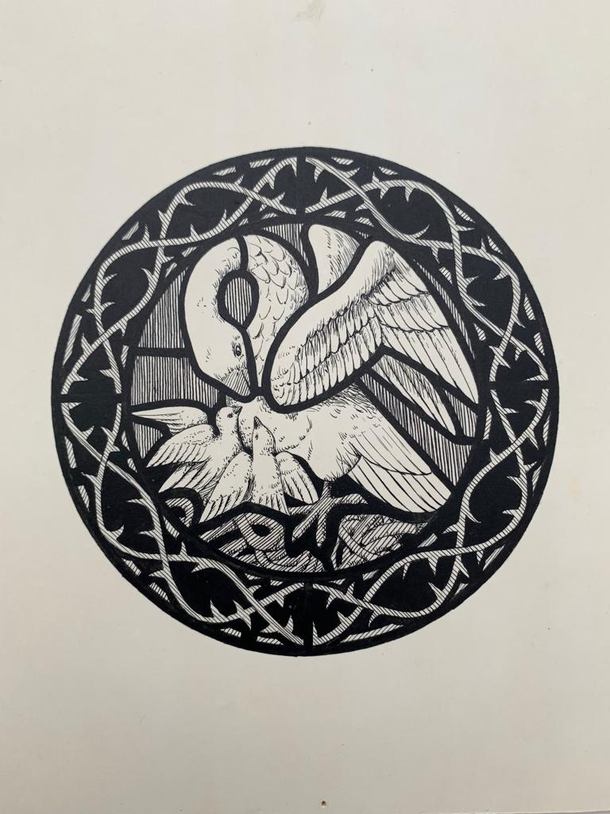
Detail from window in Hart Chapel
Showing a Pelican feeding her young .
The pelican was said to peck its breast to feed its young with its own blood. This selfless giving of its blood to feed, nurture and save its offspring, was seen as a direct analogy with Jesus’ sacrifice
Possible crown of thorns surrounding the Pelican.

Slide 13
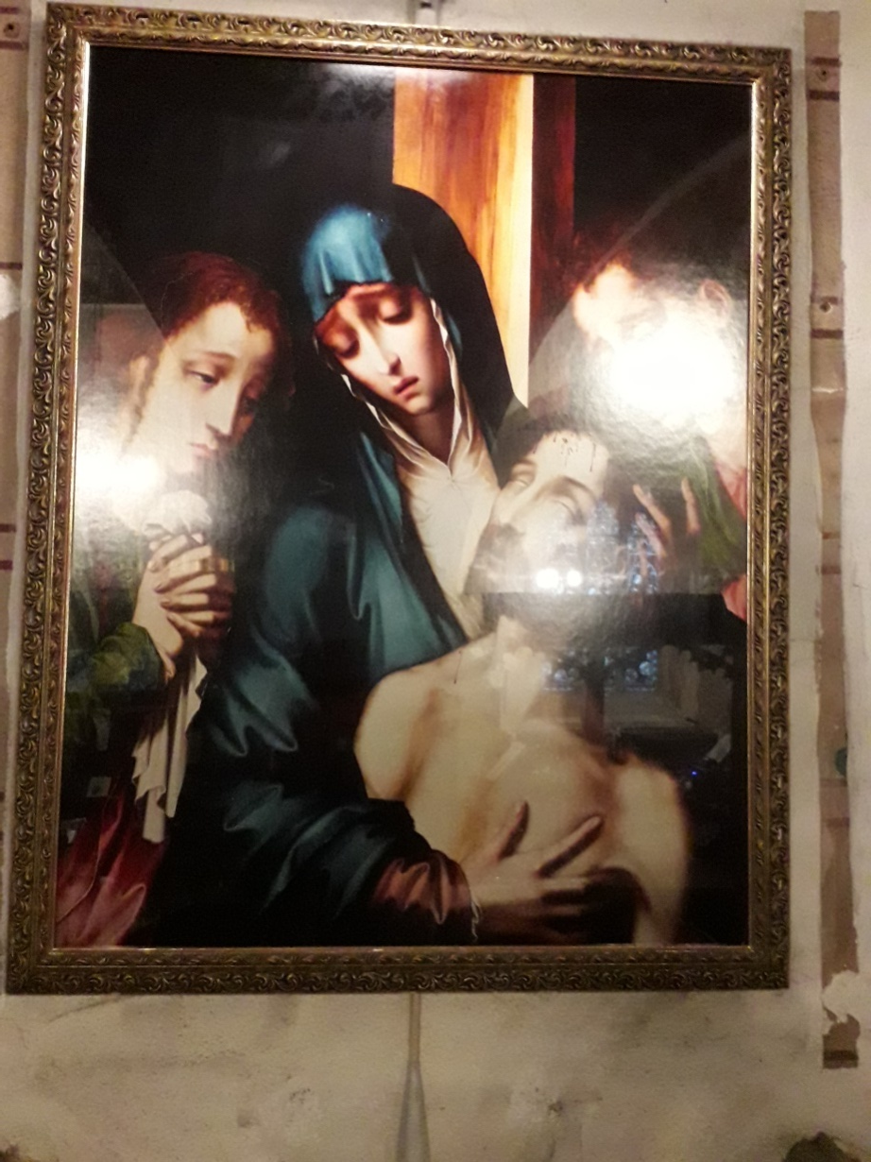
The Pieta Copy of a painting by Louis de Morales (1510 to 1586)
Pieta is Latin for dutifulness or devotion or pity or compassion.
Usually a picture or a sculpture of Mary holding Jesus at the end of his earthly life.
This one shows Mary the mother of Jesus, Mary Magdalene and the disciple Jesus loved.(John 19 v25-27)
From accepting Gods human form to letting it return.
Mary was there at the beginning and the end of Gods human interaction with the world in time and space

Slide 14
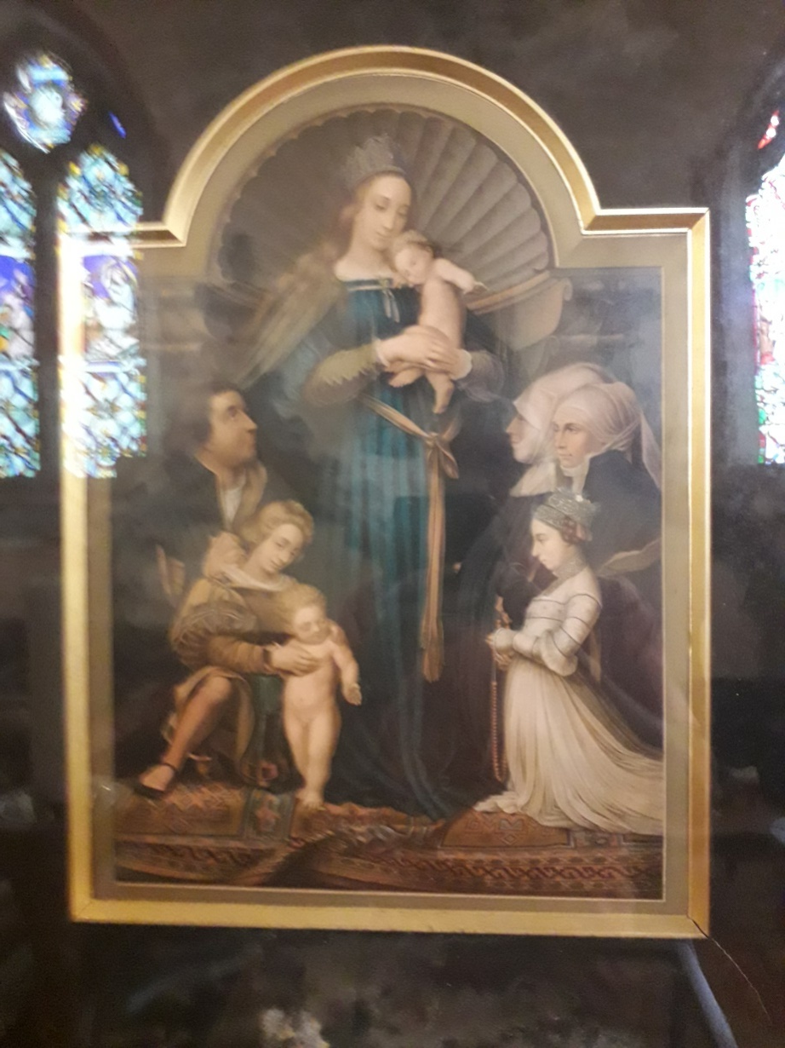
The Darmstadt Madonna In memory of Dorothea Williams wife of Rev. B Williams Vicar !944-1956
A copy (probably late Victorian) of a picture by Hans Holbein the Younger.
The original painted in 1536.
Shows Hans Meyer a mayor of Darmstadt. He was a staunch catholic and opposed to the Reformation.
It shows his first and second wives plus their daughter and two deceased sons.
The crown on the Madonna's head signifies her status as the Queen of Heaven.

Slide 15
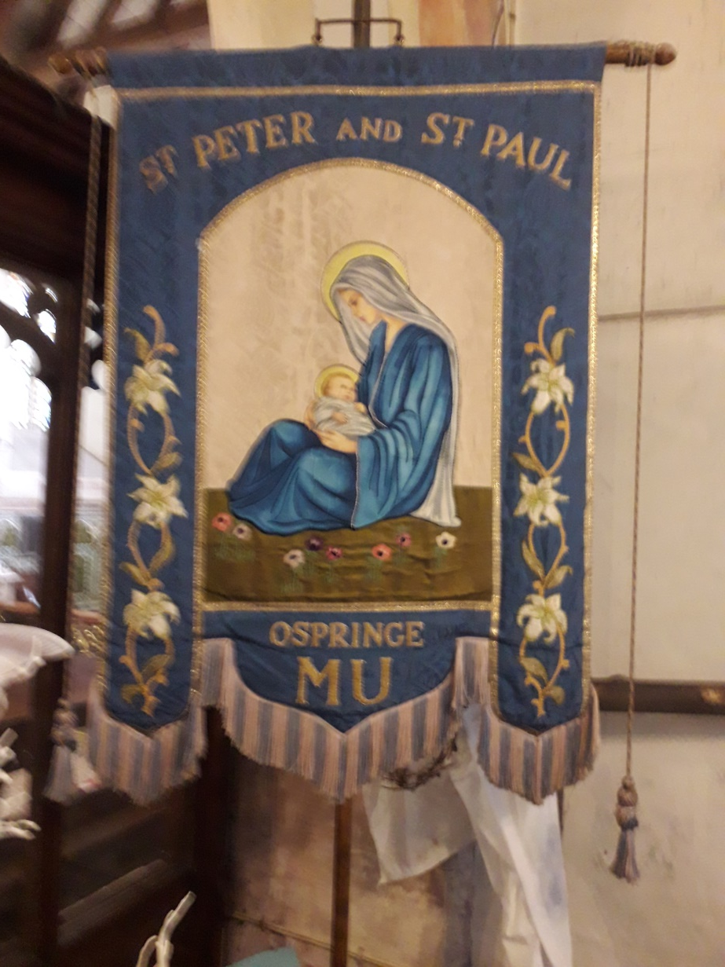
Banner
Mothers Union Banner
Mary the mother of Jesus and Lily’s
Song of Solomon
‘Like a lily among thorns is my darling among the maidens’
The Song of Solomon is interpreted as Jesus’ love for his Church and the lily is associated with the beauty of the Church.

Slide 16
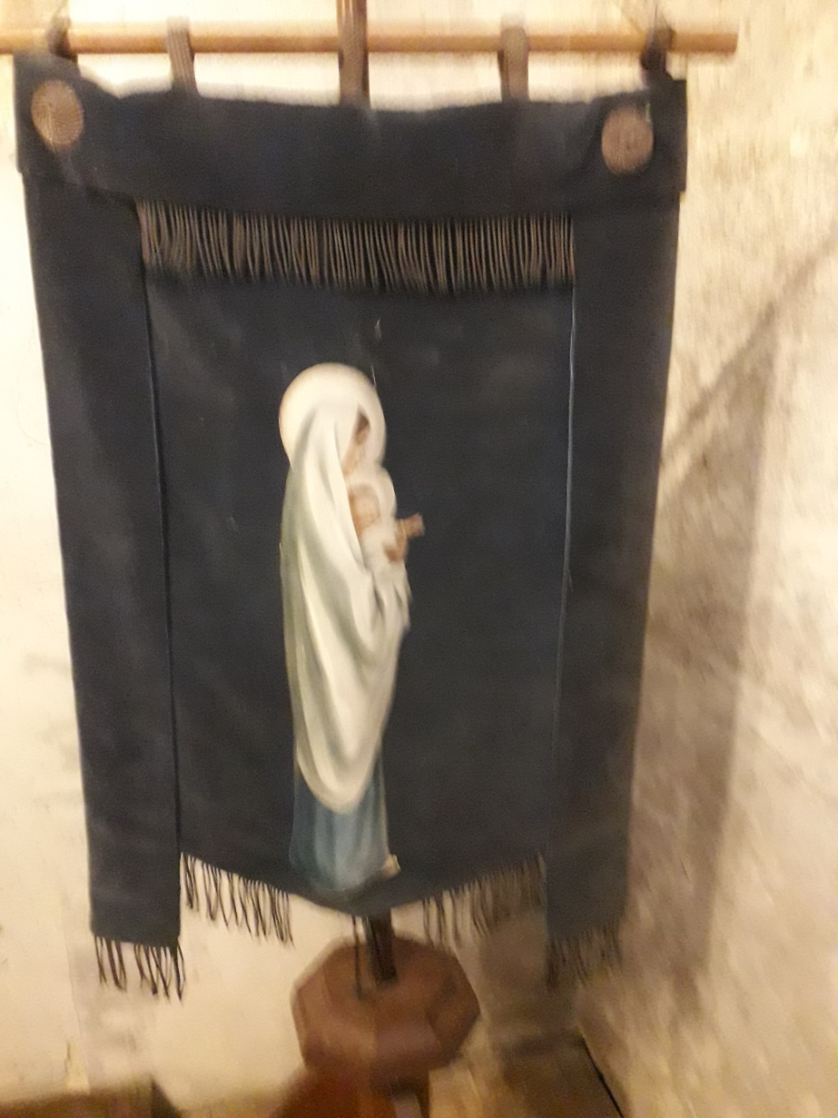
Banner
Mary holding Jesus

Slide 17
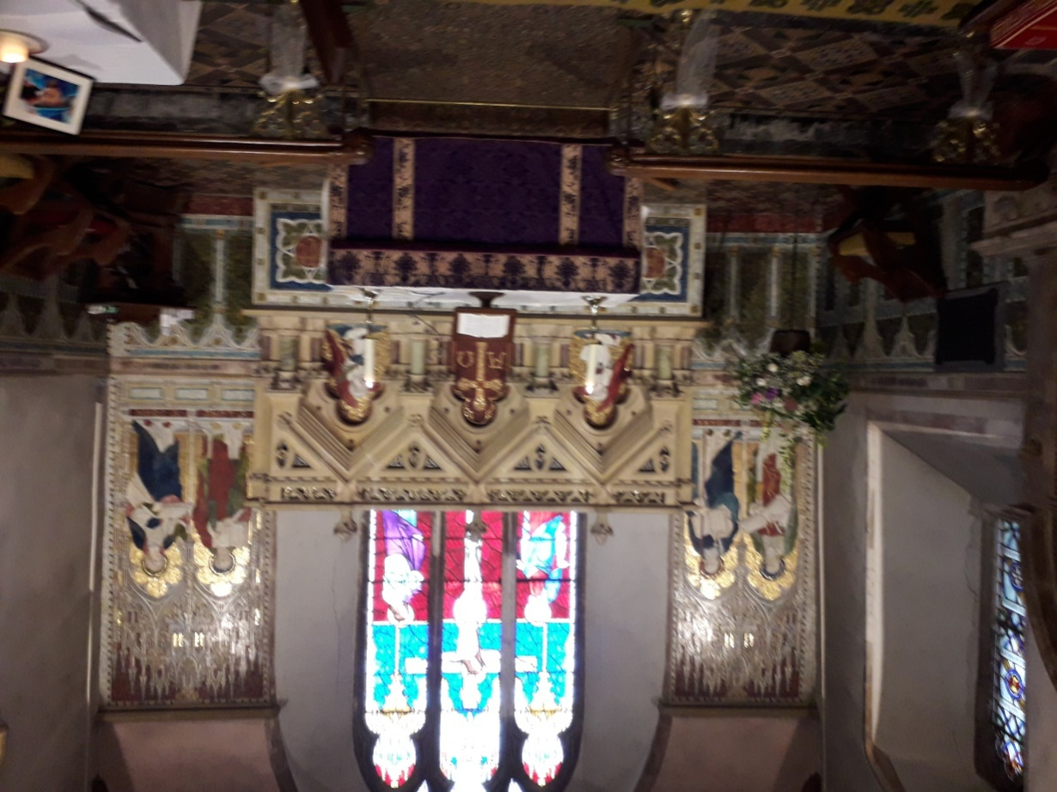
Mosaics East end of church
The East end of the church is set out in mosaics. From left to right.
Mathew ,Mark, Angel, Cross, Angel, Luke and John.
The mosaics depict the gospel writers with there identifying symbols.
Money bag for Matthew Tax collector.
Staff with cross at end for St Mark.
Angel with palm leaf

Slide 18
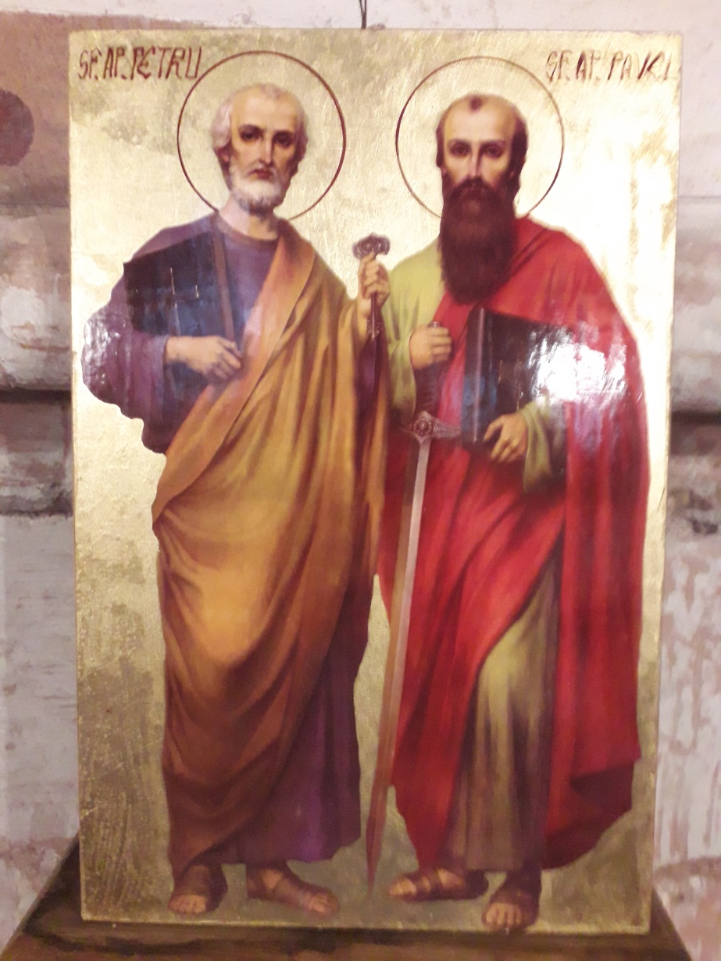
Icon
St. Petrus
Holds the keys to the kingdom.
Peter took the good news to the Jews following Jesus’s resurrection.
St Paulus
Carries a sword and the bible.
Paul took the good news to the gentiles following his conversion on the Damascus road.

Slide 19
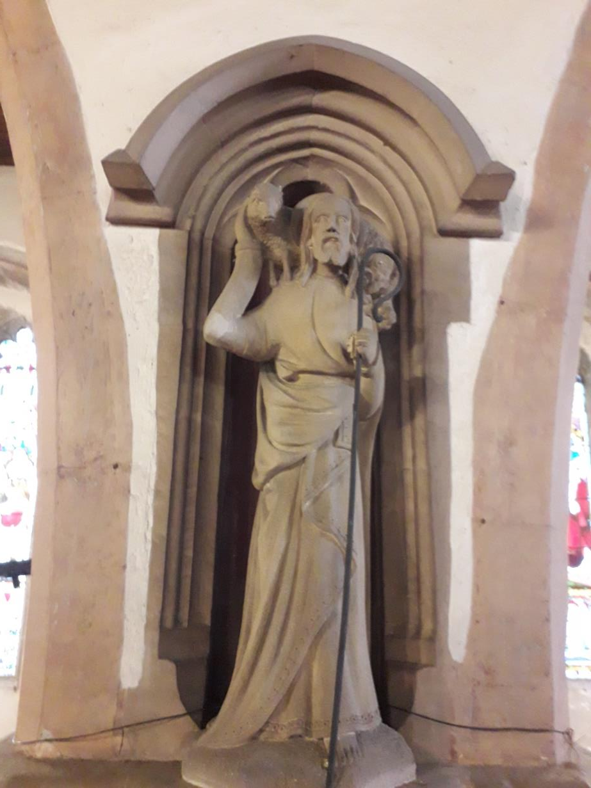
North East Pillar Shepherd carrying Lamb
Could be relating to Jesus the shepherd, St Francis of Assis or the Agnes Dei.

Slide 20
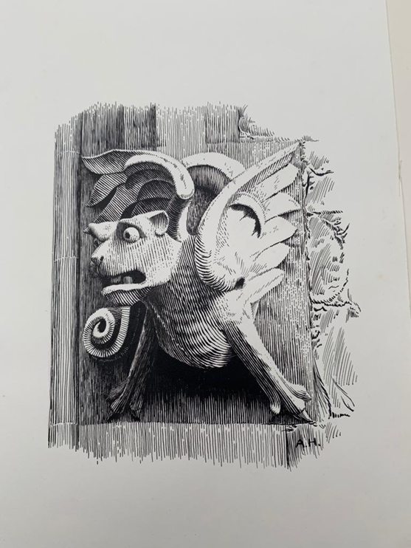
External Window North West End

Slide 21
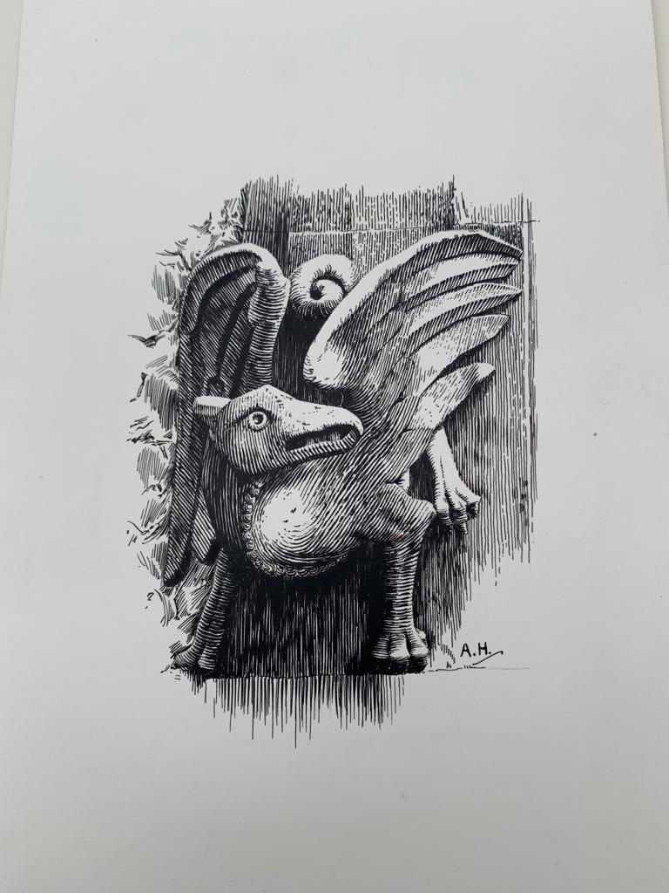
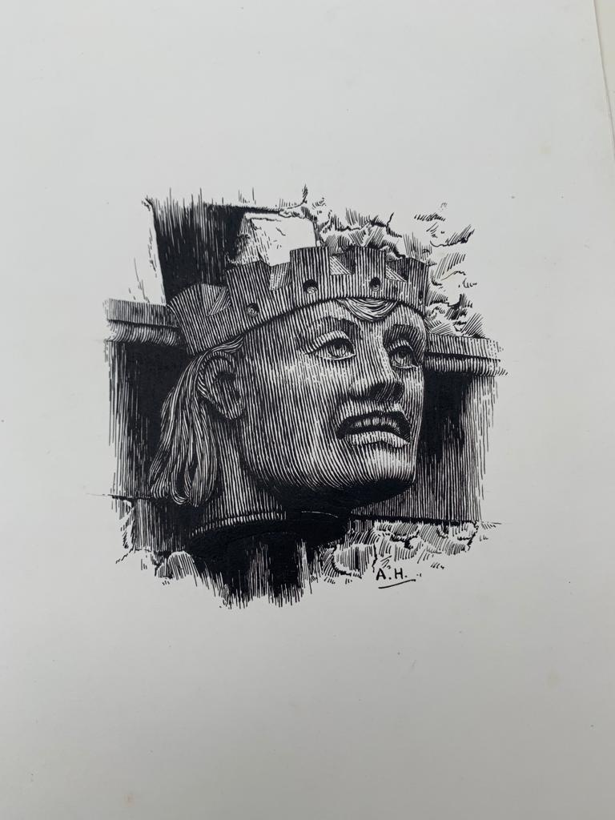
External Window West End and South wall Gutter
Griffin Note long hair and coronet

Slide 22
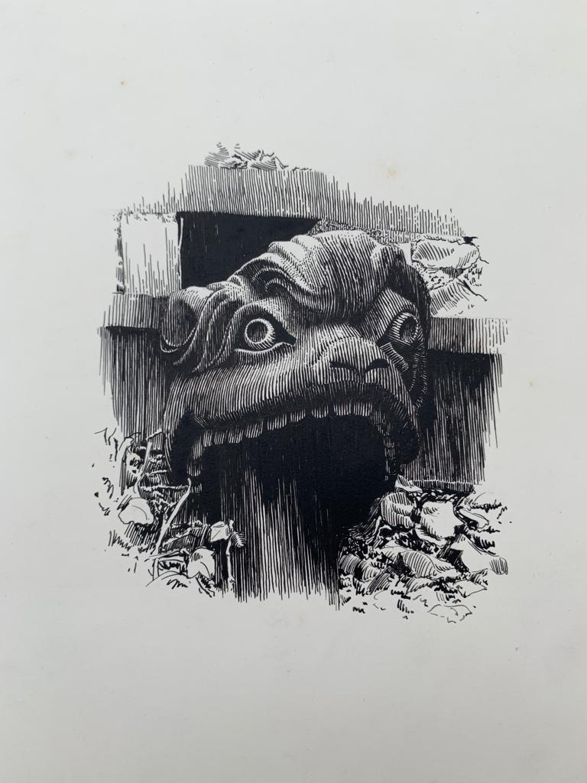
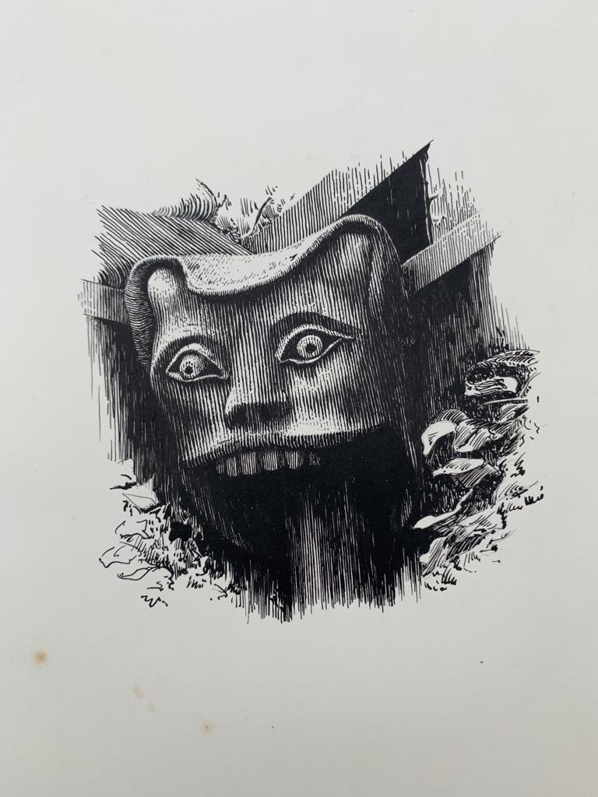
External North wall
Who are theses creatures

Slide 23
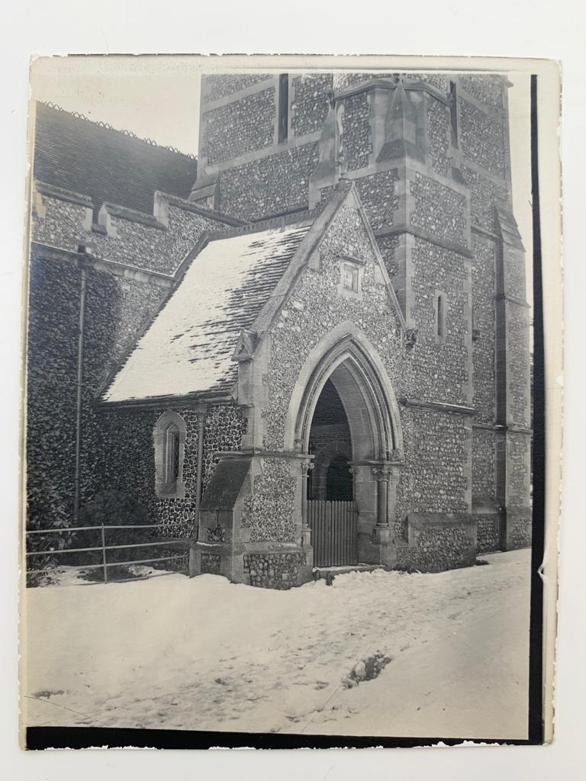
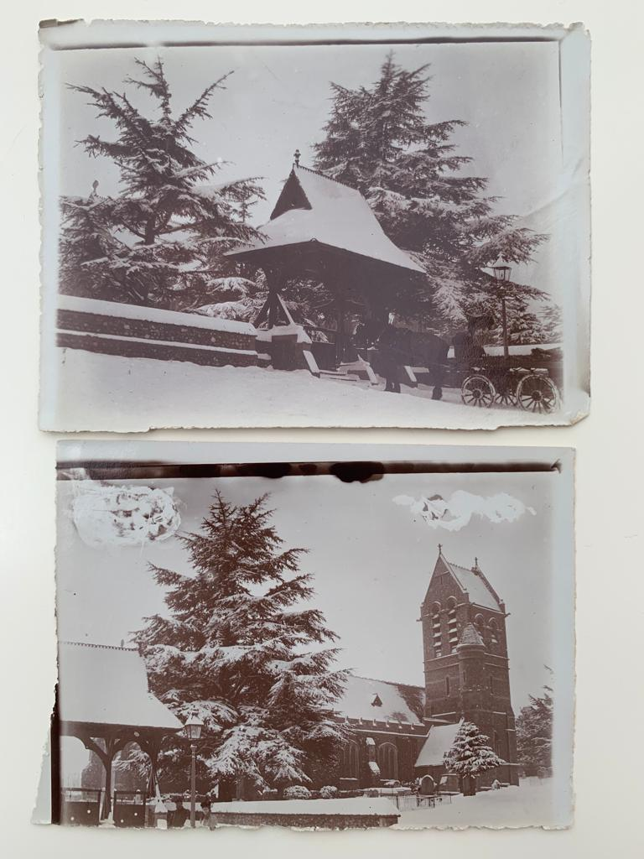
North door/Lych Gate

Slide 24
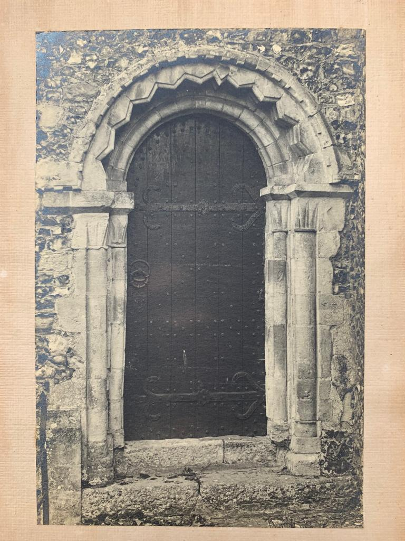
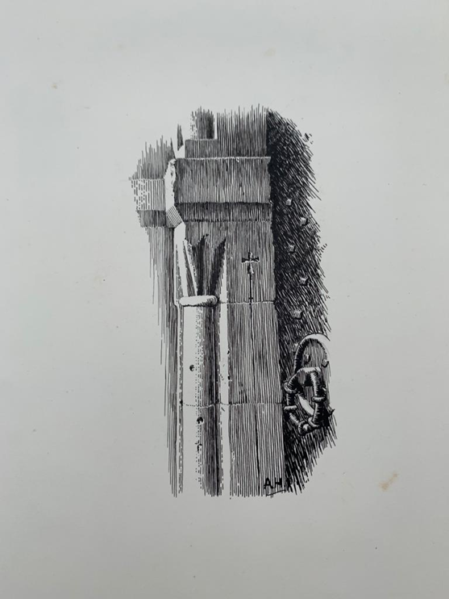
Chancel door north side Note cross on portal.

Slide 25
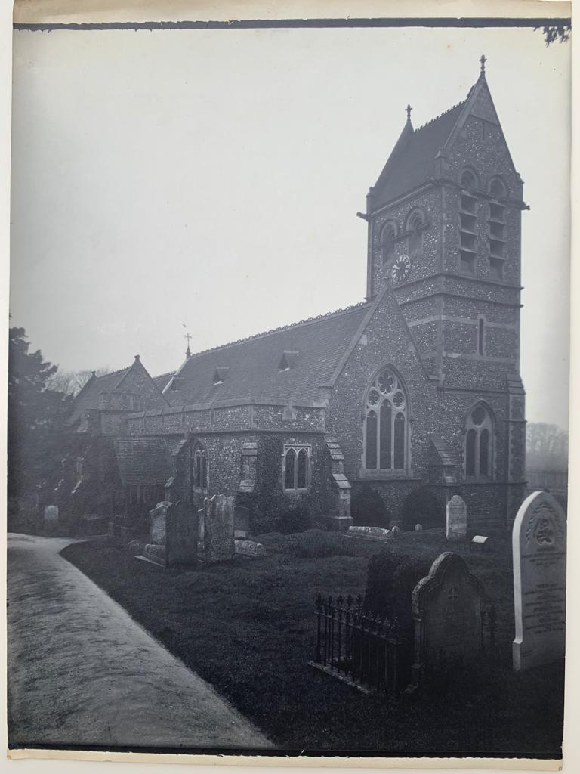
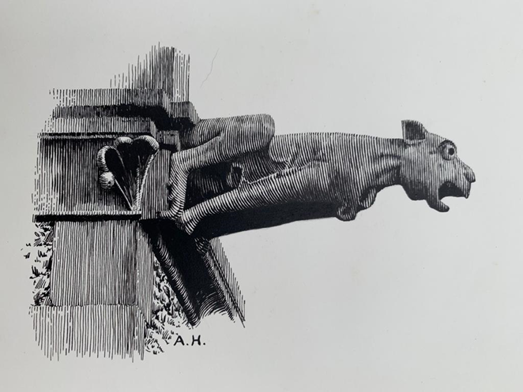
View from south west
At top of Tower. No longer visible
?the image may be a negative?

Slide 26
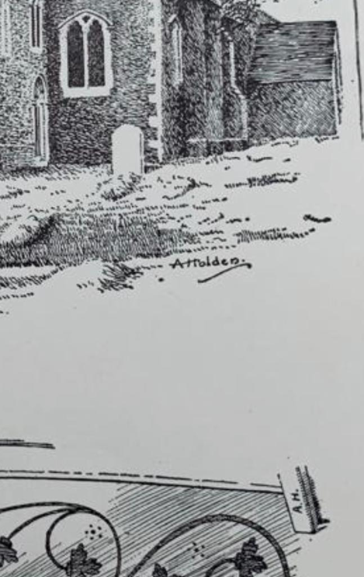
View west end south door

Slide 27
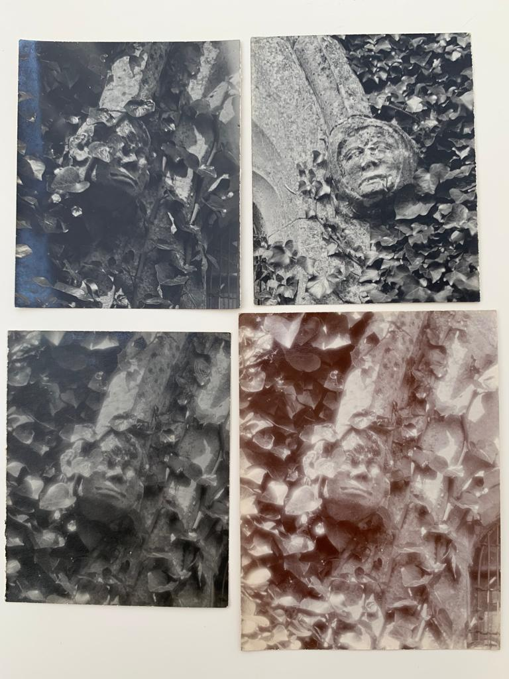
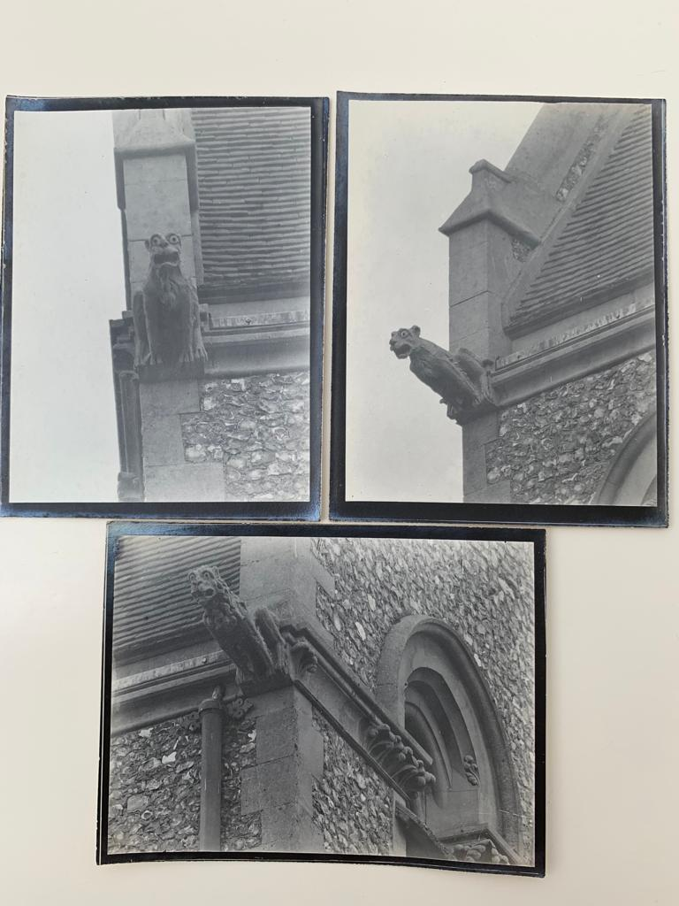
South wall faces around windows The griffins seem to have gone

Slide 28
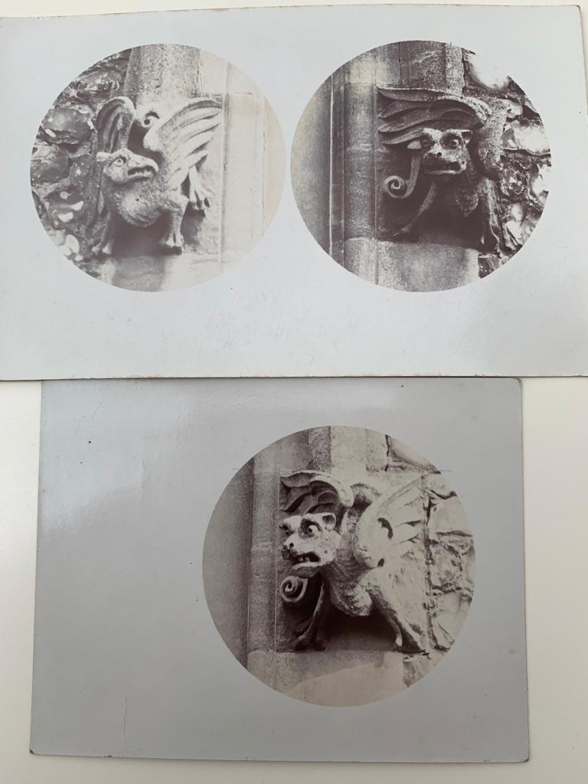
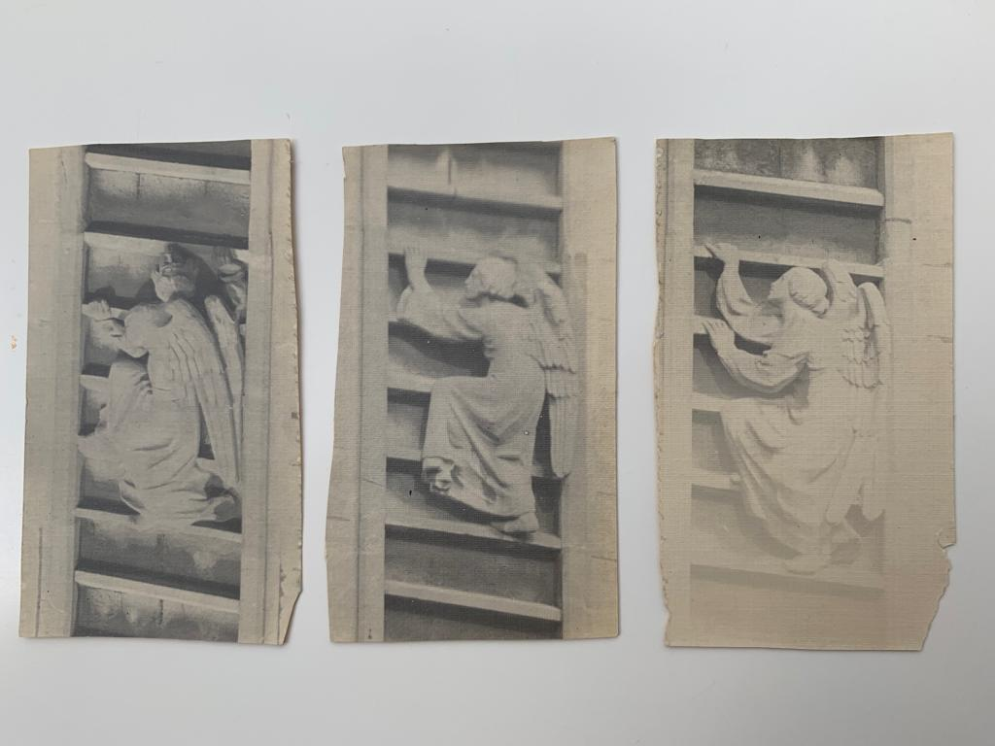
Windows west end/To be found

Slide 29
Information on stained glass in separate folder.
Information on monuments in separate folder.

Slide 30
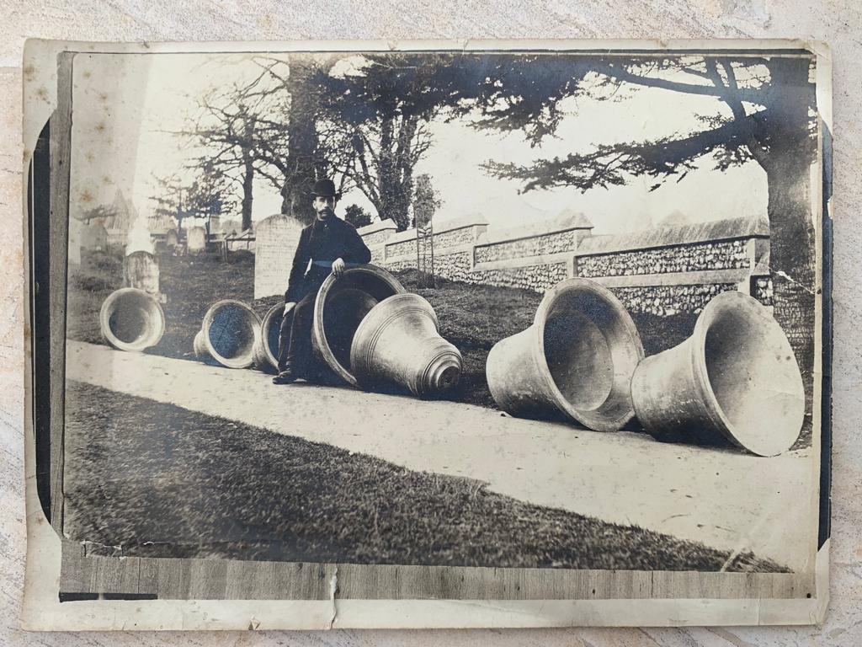
Bells going for the war effort

Slide 31
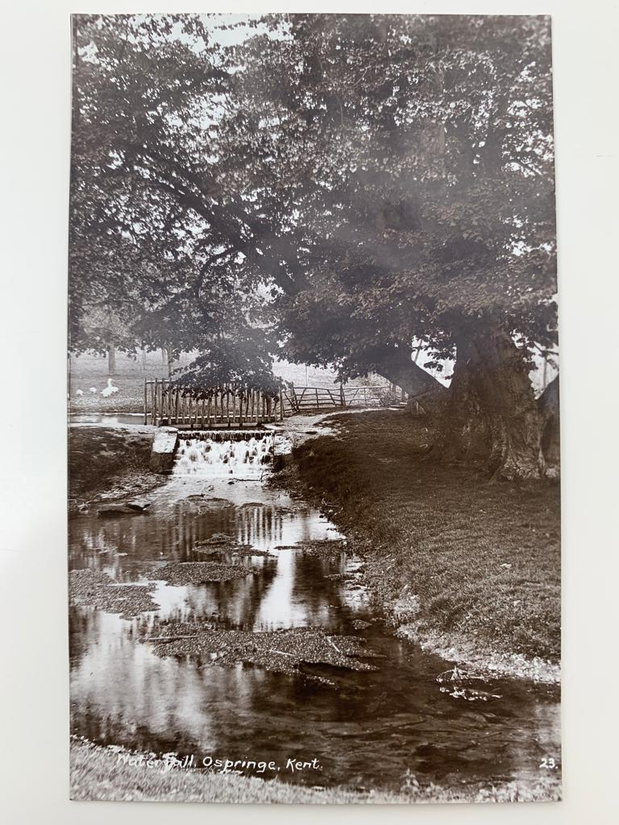
Waterfall at Lorrenden no longer running.
Concrete buttresses still observable in a copse at Lorrenden although water no longer running.

Slide 32
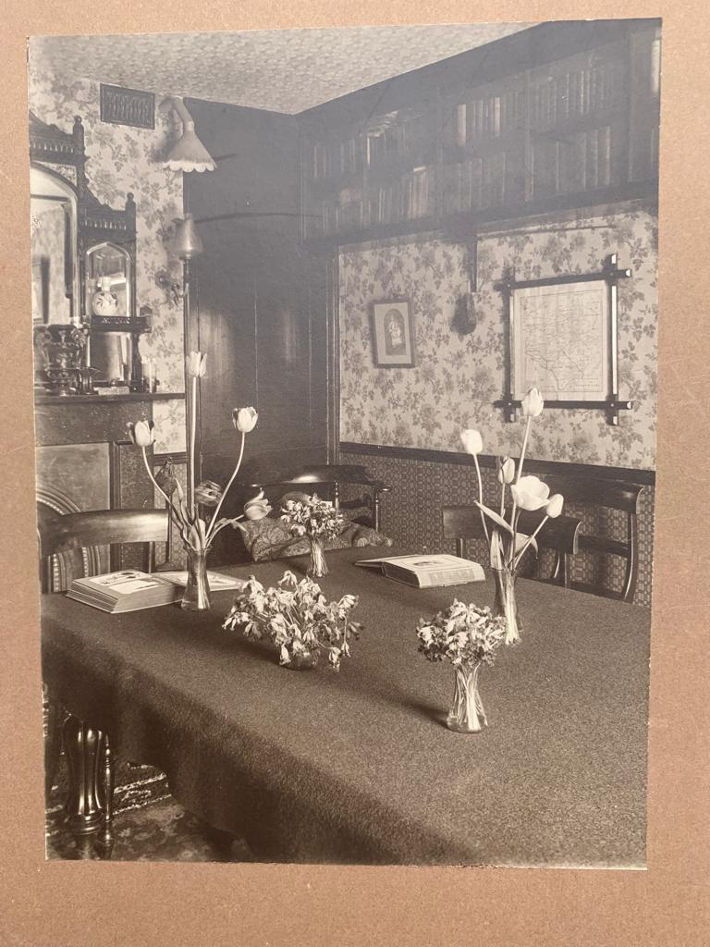
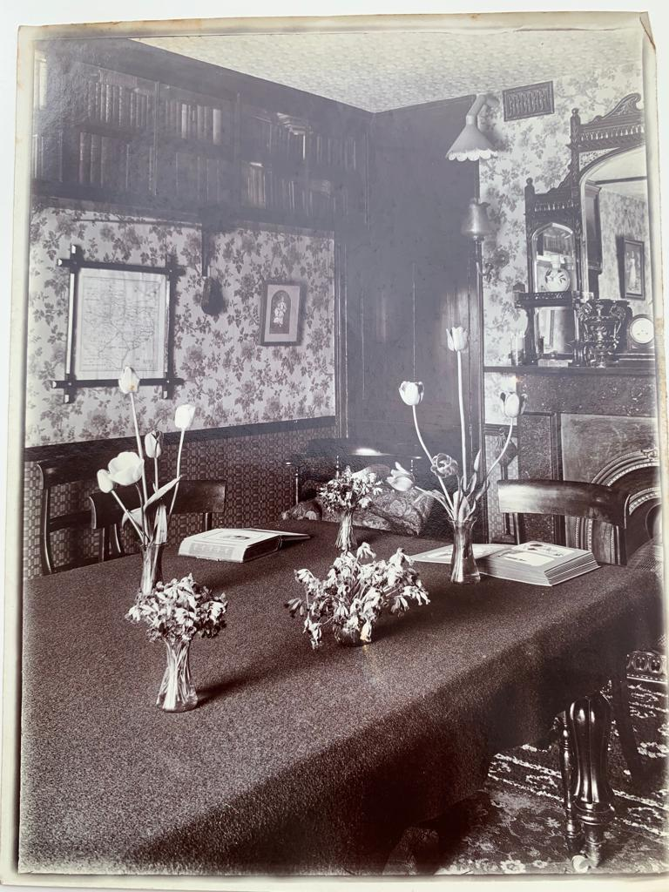
Interior of ‘Dormers’ Brogdale Rd

Slide 33
