Slide 1
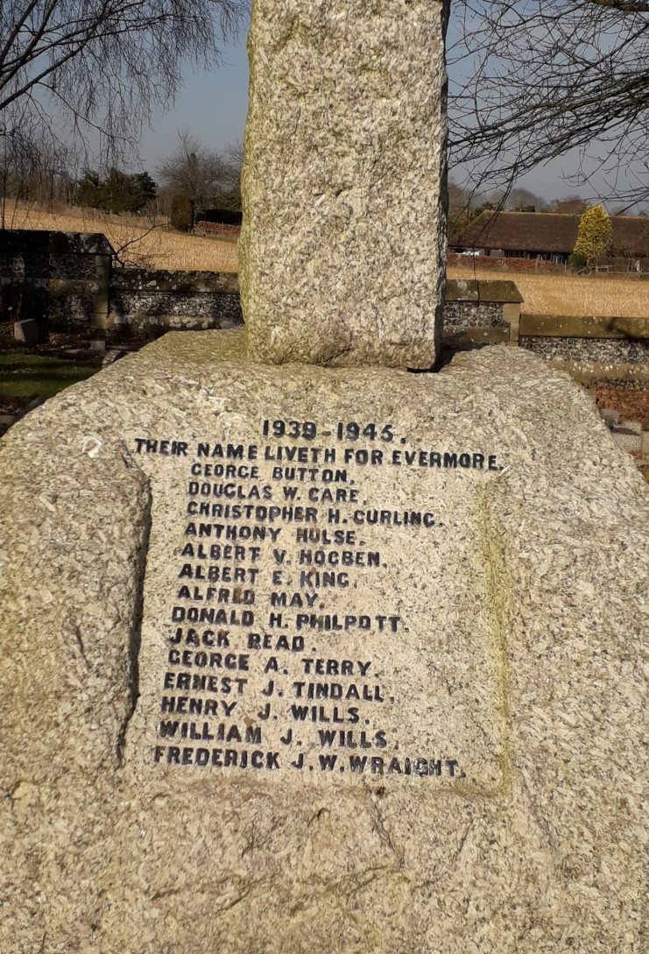
Memorial and Biographies of those Listed 1939 -1945

Slide 2
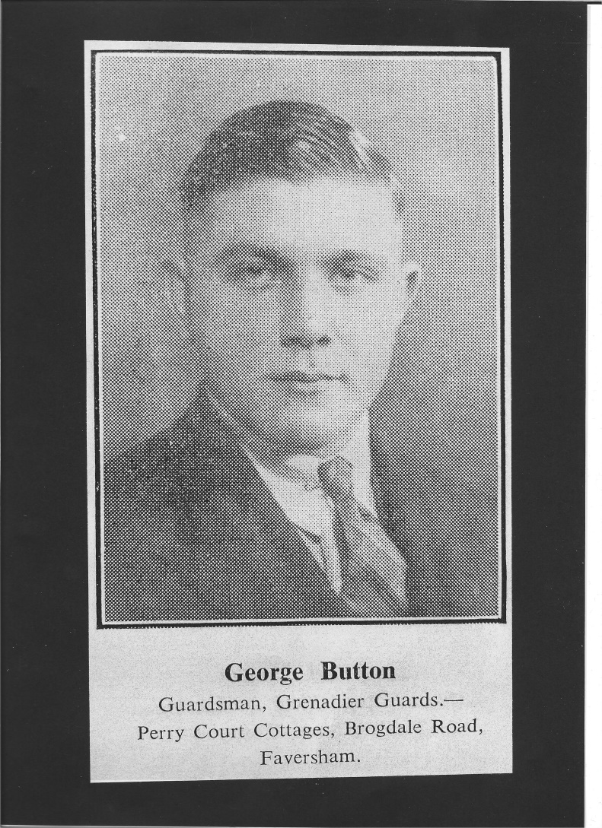
GEORGE BUTTON
(1918 – 21 May 1940 age 21)
Address: Perry Court Cottages, Brogdale Road, Faversham.
Parents: Stephen and Ellen Button. Brother: Charles Button
Rank: Guardsman
Service record: Territorial Army (part time volunteer)
The Buffs
3rd Bn Grenadier Guards. Rank: Guardsman (6286759)
Commemorated: Dunkirk Memorial column 32, France.
References
The War Years 1939-1945 in Faversham and District, page 89*.
cwgc.org
Faversham News reports:
04.07.1936/page 36 Faversham Wheelers time trial*
02.08.1940/p4 Reported missing*
03.01.1941/p2 Still reported missing
25.04.1941/p1 Confirmed dead
04.07.1941/p1 Obituary*
20.12.1946/p2 Minutes silence at Faversham Cycling Club meeting

Slide 3
GEORGE BUTTON
(1918 – 21 May 1940 age 21)
Summary and comment
In his youth George Button was a keen cyclist and active member of the Faversham Wheelers and later the Faversham Cycling Club. With these he won several local time trials and races. In 1936 the local paper mentioned the 18 year old George covering an undulating course over the North Downs to Wateringbury in just over an hour. With the wind in his face on the downhill sections, the weekly routine of farm work at Perry Court farm was left far behind. He cooled down with his mates for a swim in the river before cycling back to Ospringe, arriving tired but happy at 10 pm. Those care free days however were to disappear as war clouds gathered.
George also had an interest in the military, and signed up as a part time volunteer in the Territorial Army. This probably impressed the Army Recruiting Officer along with his fitness and smartness when he joined up as a professional soldier in 1938.
George was reported as ‘missing’ in the Faversham News of 02/08/1940 but death wasn’t confirmed until the 25/04/1941 edition, such is the chaos of war. Presumably he was part of the British Expeditionary Force that would later retreat to Dunkirk. Sadly, George wasn’t amongst those who made it back.

Slide 4
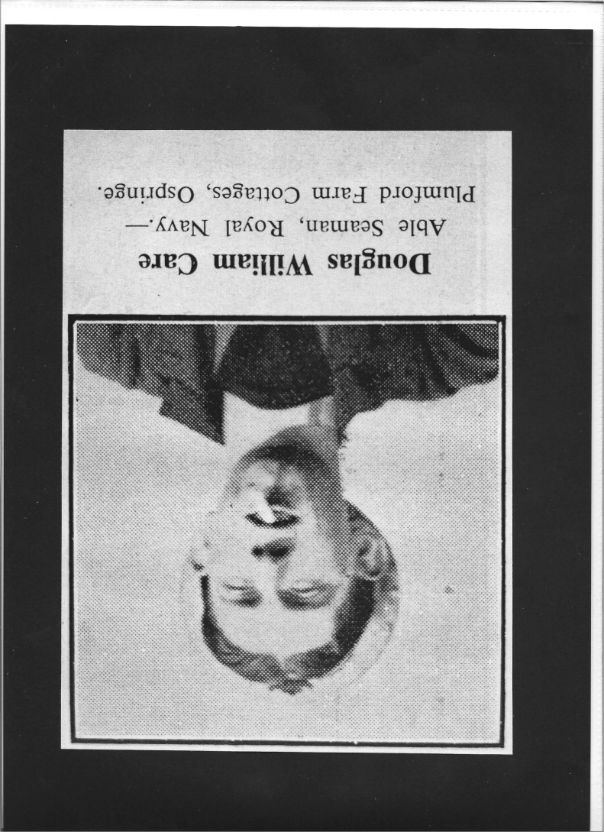
DOUGLAS WILLIAM CARE
(1919 - May 1940 age 19)
Address: Plumford Farm Cottages, Ospringe.
Parents: Mr & Mrs W. Care
Rank: Able Seaman, Royal Navy
Ship: HMS Pelican.
Summary
After leaving Lynsted School, Douglas was employed in farm work. He joined the Royal Navy in 1938 aged 17. His ship the sloop HMS Pelican was badly damaged off Narvik, Norway during an enemy air attack whilst on convoy duty. Possibly it was this engagement where he lost his life. Douglas enjoyed sport, and played for his ship’s football team.
The crippled HMS Pelican was later towed all the way back to Chatham Dockyard for repair and survived the war.
References
The War Years 1939-1945 in Faversham and District, page 71*.
Faversham News 03.05.1940 page 1 – Obituary*

Slide 5
CHRISTOPHER HIGHAM CURLING (1918 – 02 December 1942, age 24)
Address: Perry Court, Faversham
Family: John and Ethel Curling (parents). Hugh Curling (brother)
Rank: Flight Sergeant, Royal Air Force Volunteer Reserve (number 748682)
R.A.F. Squadron: 160
Commemorated: Fayid War Cemetery, I.B.23 Egypt. Personal inscription: ‘His ways are ways of pleasantness and all his paths are peace (after Proverbs 111.17)’
Summary and comment
For the period 11.06.1942 to 16.09.1942, 160 Squadron was based at Fayid in Egypt. From here they flew long range heavy bombing and reconnaissance missions to targets in Crete and Libya. The Squadron flew the American ‘Consolidated Liberator’ plane. One can only speculate that Christopher was wounded or injured during a mission with the plane managing to return to an Allied airfield. He died at 19 General Hospital, Middle East on 02.12.1942.
References
en.wikipedia (‘No. 160 Squadron RAF’)
Faversham News 11.12.42 page 5, deaths column*
Cwgc.org

Slide 6
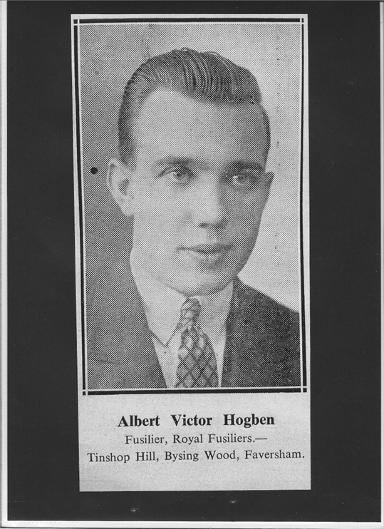
ALBERT VICTOR HOGBEN
(1923 to 20 October 1944) age 21
Address: Tinshop Hill, Bysing Wood, Faversham
Family: Parents Harold and Frances Hogben. Older brother and younger brother Sydney.
Rank: Fusilier, service number 14551767. Service record: The Buffs, Royal Fusiliers (City of London)
Commemorated: Cesena War Cemetery 11.F.12., Italy.
Personal inscription: ‘One of the bravest one of the best while doing his duty God took him to rest.’
References
The War years 1939-1945 in Faversham and District, page 78*.
cwgc.org
Faversham News:
01.12.1944 page 1 Obituary*
19.10.1945 page 7 In memoriam
18.10.1946 page 5 In memoriam
17.10.1947 page 3 In memoriam*

Slide 7
ALBERT VICTOR HOGBEN
(1923 to 20 October 1944) age 21
Summary
Albert attended Davington School and belonged to the Cubs before graduating to the Scouts. On leaving school he was apprenticed at the Short Brothers factory in Sheerness.
In about 1943 he joined The Buffs and in October was posted to Italy. Albert was involved in the Allies’ campaign to push north westwards up the Italian mainland. At times the Allies experienced fierce resistance from the enemy and at one stage Albert was hospitalised with head wounds.
On recovery, he was drafted to the Royal Fusiliers. In December 1944 the Faversham News reported ‘…while he was engaged in house to house fighting an enemy tank got a direct hit on a house and he received the severe wounds from which he died.’ This apparently took place at Calisise.

Slide 8
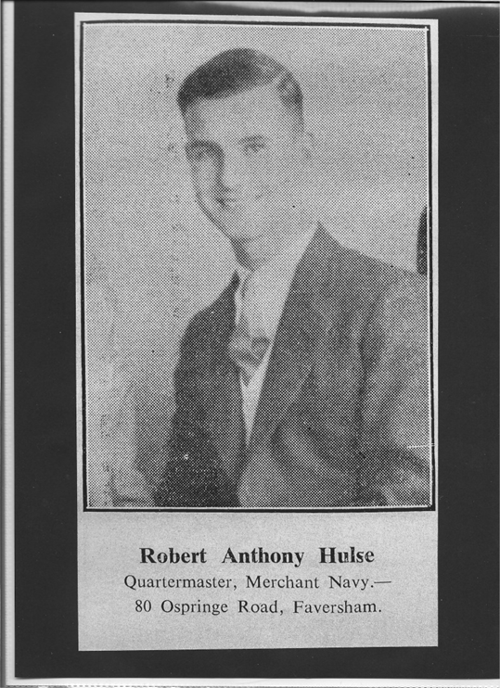
ROBERT ANTHONY ‘TONY’ HULSE (1917 – 28 April 1941, age 24)
Address: 80 Ospringe Road, Faversham
Family: Lieut-Colonel H. Hulse and Mrs Hulse (parents). Henry, Edward and Alexander (brothers).
Rank: Quarter-master, Merchant Navy. Ship: SS Port hardy (London), Port Line.
Commemorated: Tower Hill Memorial, Panel 83, U.K.
References
The War years 1939-1945 in Faversham and District, page 85*.
Cwgc.org
Shipwreckedmariners.org
Faversham News:
16.05.1941 page 1 – Obituary*.
30.05.1941 page 5 – Acknowledgement column*.
24.10.1941 page 5 - article ‘4 sons’*.

Slide 9
ROBERT ANTHONY ‘TONY’ HULSE (1917 – 28 April 1941, age 24)
Summary
Tony attended Faversham Grammar School during which time he was a member of Ospringe Church Choir. On leaving FGS, he enrolled at Gravesend Sea School. On completion there he went into the Merchant Navy. His last visit home was in October 1940, but could only stay for a few hours before re-joining his ship in Liverpool.
The loss of the SS Port Hardy is described overleaf. Of the complement of 98 on board, 97 survived with Tony being the only casualty. The survivors were picked up by the British rescue ship ‘Zaafaran’
It was the German U Boat U96 that fired the torpedo that led to the sinking of SS Port Hardy. U96 was later sunk in Wilhelmshaven docks by the US Air Force. U96 was later made famous in Lothar-Gunther Bucheim’s 1973 best seller ‘Das boot’ and the 1981 Oscar-nominated film adaption.

Slide 10
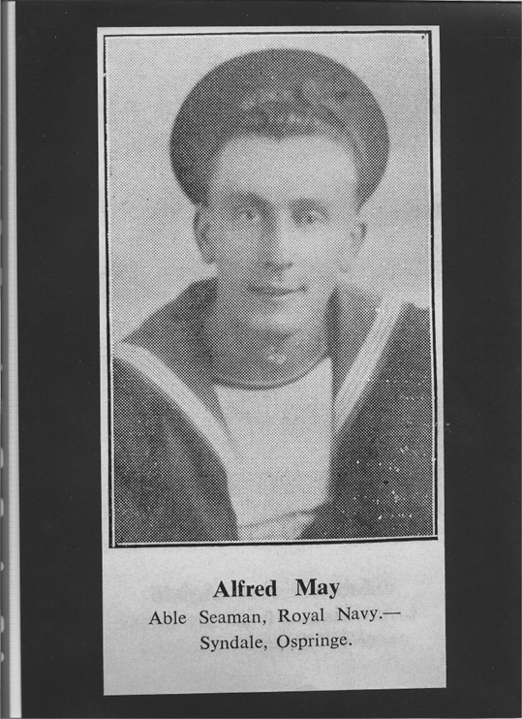
ALFRED MAY
(1925 – 11 April 1943, age 21).
Address: Syndale, Ospringe.
Family: Mr and Mrs A May (parents) and elder brother.
Rank: Able Seaman, Royal Navy. Service number C/JX335696.
Ship: SS Lancastrian Prince (Prince Line)
Commemorated: Chatham Naval Memorial 69,2 UK
References
The War Years 1939 – 1945 in Faversham and District, page 92*.
Cwgc.org
Wikipedia
Faversham News 05/07/1946, page 2 – obituary*

Slide 11
ALFRED MAY
(1925 – 11 April 1943, age 21).
Summary
Prior to joining the Royal Navy, Alfred worked at Messrs. Cremer’s brickfields in Ospringe. During wartime, it was common practice for RN sailors to help crew Merchant Navy vessels. Alfred was attached to the SS Lancastrian as a ‘DEMS’ gunner (defensively equipped merchant ship) of the Prince Line.
On 12/04/1943, the SS Lancastrian was on a convoy from Liverpool to Saint John, New Brunswick, Canada when it was torpedoed by German U Boat U-404 east of Newfoundland. The ship sank with the loss of all 44 hands (37 crew and 7 gunners).
U-404 was later sunk by depth charges on 24/07/1943 by three Liberators (two American and one British) in the Bay of Biscay.

Slide 12
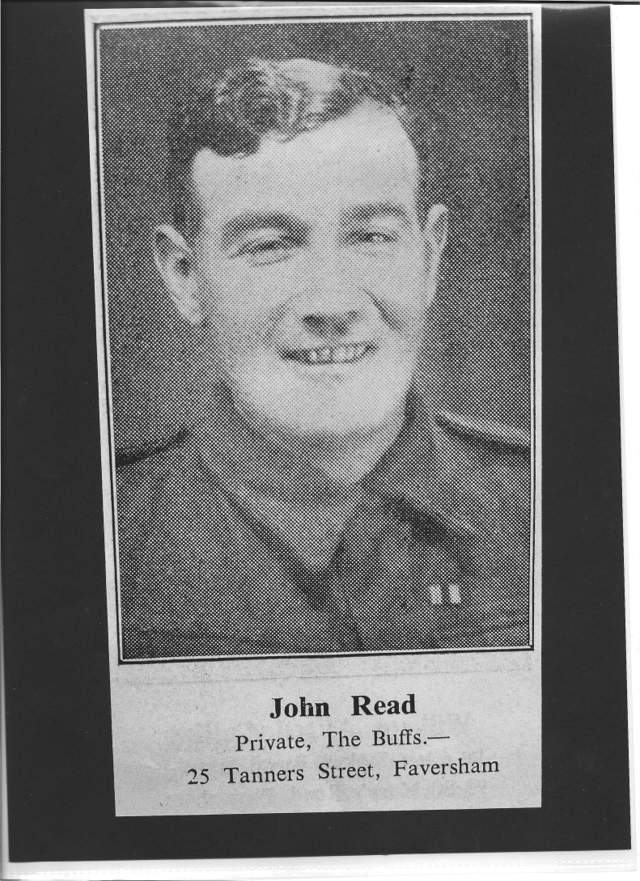
JOHN ‘Jack’ READ
(1914 - 01/02/1945, age 30)
Address: 25 Tanners Street, Faversham
Family: Mrs I. Read nee Seager (wife), John Read and Hester Philpott (parents), William Read and Charles Hubbard (brothers), Ronald Philpott (half-brother).
Rank: Private, (number 6290599). Regiment: 2nd Battn., The Buffs (Royal East Kent)
Commemorated: Rangoon Memorial, Face 4, Myanmar.
References
The War Years 1939 – 1945 in Faversham and District, page 96*.
Cwgc.org
Faversham News:
23/02/1945 page 1 – Mention in Ronald Philpott obituary*.
15/03/1946 page 1 – obituary*.

Slide 13
JOHN ‘Jack’ READ
(1914 - 01/02/1945, age 30)
Summary and Comment
Jack was employed at Queen Court Farm on leaving school. In April 1940 he joined The Buffs. He was posted overseas but on 01.02.1945 he was reported as missing whilst on the Burma front. In two cruel twists of fate, Jack’s father John Read was killed in the First World War. Jack’s death occurred the day after that of his half-brother Ronald Philpott, see above.

Slide 14
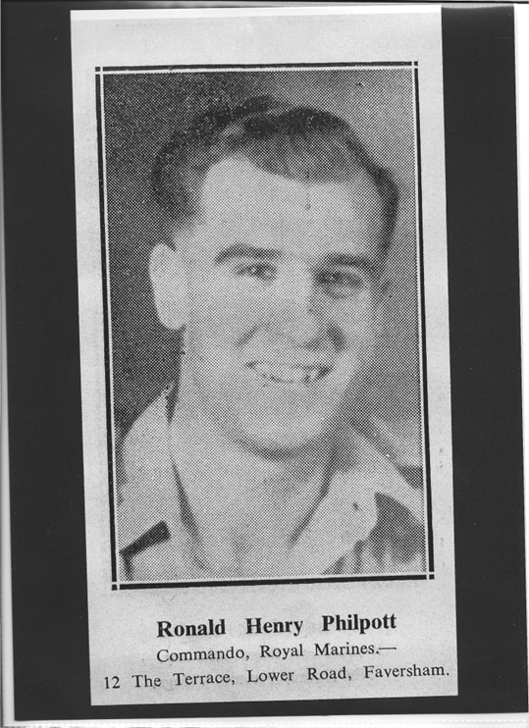
RONALD HENRY PHILPOTT**
(1922-31 January 1945, age 22)
Address: 12 The Terrace, Lower Road, Faversham
Family: Doreen Philpott nee Cornelius (wife), Harry and Hester Philpott (parents), Harry (older brother), Jack Read – William Read – Charles Hubbard (half-brothers).
Rank: Commando (number CH/X106487), Royal Marines number 42.
Commemorated: Taukkyan War Cemetery, IO.A.13 Myanmar.
Personal Inscription: ‘In memory of my dearest husband Ron. Though absent you are ever near me.’
References
The War Years 1939 – 1945 in Faversham and District page 96*.
Cwgc.org
Faversham News:
28/05/1943 page 2 - Wedding report*.
23/02/1945 page 1 – obituary*.
31/01/1947 page 5 – In memoriam column*.
**Name is wrongly shown on memorial as ‘Donald’.

Slide 15
RONALD HENRY PHILPOTT**
(1922-31 January 1945, age 22)
Summary and comment
Ronald was employed at George Beer & Rigden’s brewery (later Fremlins then Whitbread) and later Queenborough Glass Works.
At age 18 (1941) he enlisted in the Royal Marines, subsequently volunteering for the Commandos.
On 15/04/1943, whilst on leave he married Peggy Cornelius at Faversham Parish Church. Being a double wedding, it was quite a grand affair with many family members in uniform present. Nearly 200 guests attended the reception at the Recreation Club.
He was posted to Burma later in 1943. In June 1944 whilst training in Ceylon he had a lucky meeting with one of his half-brothers Jack Read of the Buffs Regiment. They briefly had a happy time together and it was then the photographs of them on file were taken. ‘Alas, it was to be their last meeting’ (Faversham News).

Slide 16
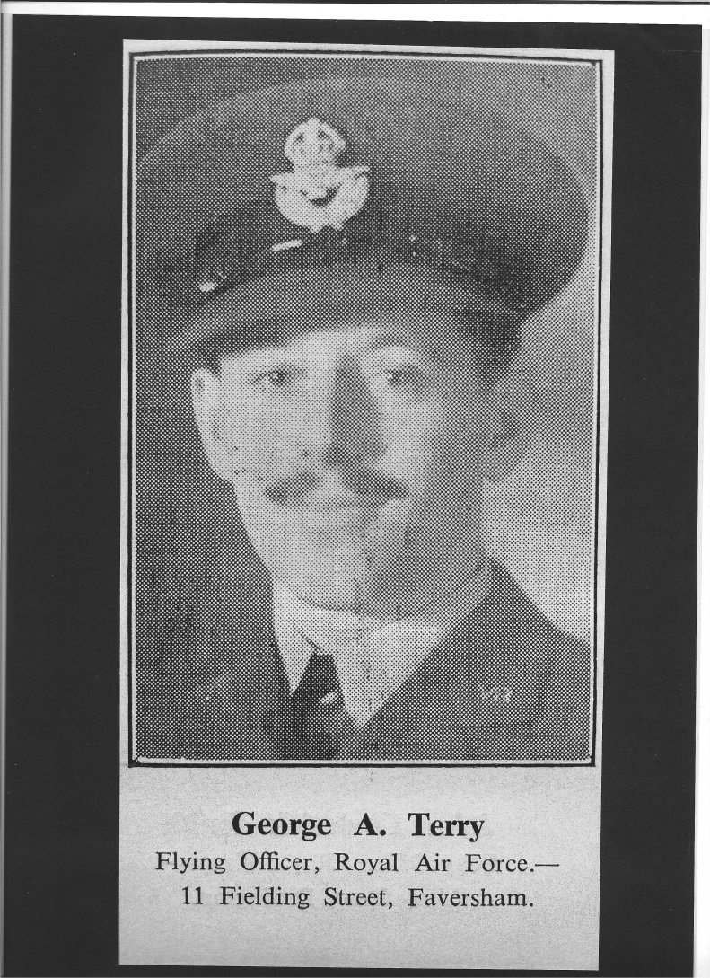
GEORGE ALEC TERRY
(1920 to 29 October 1943 age 23).
Address: 11 Fielding Street, Faversham.
Family: Mrs Betty Terry nee Davies (wife), Mr and Mrs Alec Terry (parents).
Rank: Flying Officer (number 132857), Coastal Command, 47 Squadron, RAF Volunteer Reserve.
Commemorated: Alamein Memorial, column 269 Egypt.
References
The War Years 1939 – 1945 in Faversham and District, page 65*.
Cwgc.org
Faversham News:
01/10/1938 page 3 – Evening classes success
05/11/1943 page 1 – reported missing*.
07/01/1944 page 1 – reported safe but wounded in Allied territory*.
05/07/1946 page 2 – obituary*.

Slide 17
GEORGE ALEC TERRY
(1920 to 29 October 1943 age 23).
Summary and Comment
George was educated at Ethelbert Road Boys School and later was employed in the office at Macknade under Mr Ivo Neame. He took evening classes, studied hard and was successful. Before joining the RAF in 1938 he was with Messrs Burley, Sittingbourne. George must have done well in the RAF. He took a commission while in Canada in 1942’ passing out as an Observer. In 1943 he married Betty Davies.
He was based in North Africa as from May 1943 but then his story becomes a bit confusing. In November 1943, his parents received the disturbing news that he was missing. Reassuring news came through in January 1944 that he was safe in Allied territory but wounded. However, this news would seem to have been false when his wife later received information that George had been killed while attacking a convoy in the Aegean Sea on 29/10/1943. He had been promoted to Flying Officer a few weeks before his death and had been mentioned in dispatches for distinguished services.

Slide 18
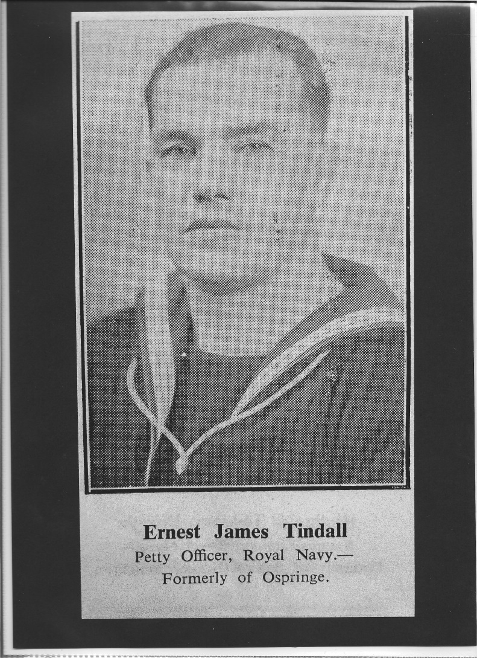
ERNEST JAMES TINDALL
(1907 - 30 August 1940, age 33).
Address: Ospringe Street, Ospringe.
Family: May Tindall (wife), Henry and Eliza Tindall (parents), and one older brother.
Rank: Petty Officer/telegraphist, number C/J106647, Royal Navy.
Ship: HMS Thames (Submarine).
Commemorated: Chatham Naval Memorial, 37.1, U.K.
References
The War Years 1939 – 1945 in Faversham and District, page 80*.
Cwgc.org
Faversham News:
19/01/1940 page 1 - Not aboard the missing HMS Starfish*.
04/10/1940 page 1 – obituary*.
04/10/1940 page 5 – ‘deaths’ column
06/08/1943 page 5 – ‘In memoriam’ column*.
Kentish Express page 5 – short obituary*.

Slide 19
ERNEST JAMES TINDALL
(1907 - 30 August 1940, age 33).
Summary and Comment
Ernest was educated at Ospringe School and was an Ospringe Church Choir member. When aged 11, he won a shooting competition as a Cadet at the Rifle Range. In 1919 he was winning prizes at Ospringe School for Prayer Book study and Church history, and in 1920 for drawing.
Some of his activities when aged 12 or 13 are recorded in a ‘factual’ novel by John Passfield. Ernest wanted to join the Royal Navy when old enough, so practised in pretend play on the derelict Ospringe Windmill that he was a ship’s captain, giving orders to his younger friends. At this time, he lived in Water Lane, and once tried to help push the Vicar’s car which had stalled in the water. The car suddenly jerked forward and Ernie fell flat into the stream.
He joined the Royal Navy when aged 15, receiving his training at Shotley, Harwich. Later he was lent to the New Zealand Navy for three years, and also served on the China and Malta Stations becoming an experienced submariner.
He was a keen sportsman and excelled at shooting winning several trophies. In 1925 the Parish magazine reported ‘Ernest Tindall, in the Navy has won prizes for Rifle Shooting and has represented his ship in team contests’
Submarine HMS Starfish sank in the North Sea on 09/01/1940 during action. The crew were rescued, but initially three were unaccounted for. One of these was an E. A. Tindall, thought to be Ernest. Messages of sympathy were promptly sent back home to relations causing distress. The mistake was quickly identified, and Ernest was granted 15 days leave shortly afterwards. It is not clear if his family received news of the mistake or he simply turned up on the doorstep. He humorously remarked to the Faversham News “Apparently I ought not to be here!”
Sadly 7 months later he was aboard the submarine HMS Thames which failed to return from a patrol in the North Sea and presumed lost. It was speculated that HMS Thames had hit a mine and was sunk with the loss of all hands. This time there was no reprieve for the distraught family.
.

Slide 20
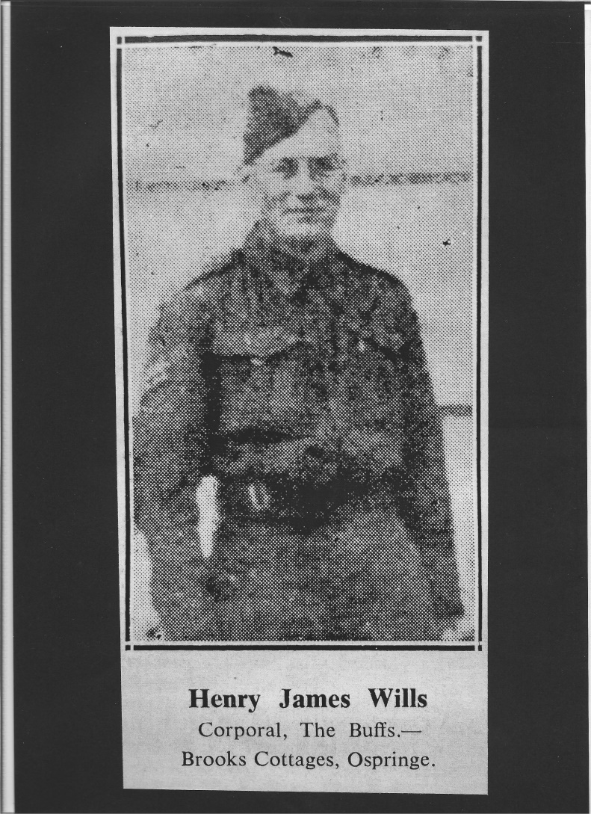
HENRY JAMES WILLS
(1919 – 19/06/1944, age 25)
Address: 1 Brooks Cottages, Ospringe.
Family: Ellen Wills nee Duckett (wife) and Mary (daughter), John and Alice Wills (parents), William Wills (younger brother).
Rank: Corporal (number 6289227). Regiment: The Buffs, Royal East Kent.
Commemorated: Orvieto War Cemetery. 1C,17 Italy.
Personal inscription: ‘We have lost but heaven has gained one of the best the World contained.’
Summary
Henry attended Ospringe School and was later employed at Queen Court Farm. He joined the Army shortly before the outbreak of war in 1939. He married a local girl, Ellen Duckett. She received official news in early July 1944 that he had been killed in action in Italy.
References
The War Years 1939 – 1945 in Faversham and District, page 81*.
Cwgc.org
Faversham News reports:
07/07/1944 page 5 – obituary*.
07/07/1944 page 5 – in memoriam.
21/06/1946 page 5 – in memoriam*
13/06/1947 page 5 – in memoriam*.

Slide 21
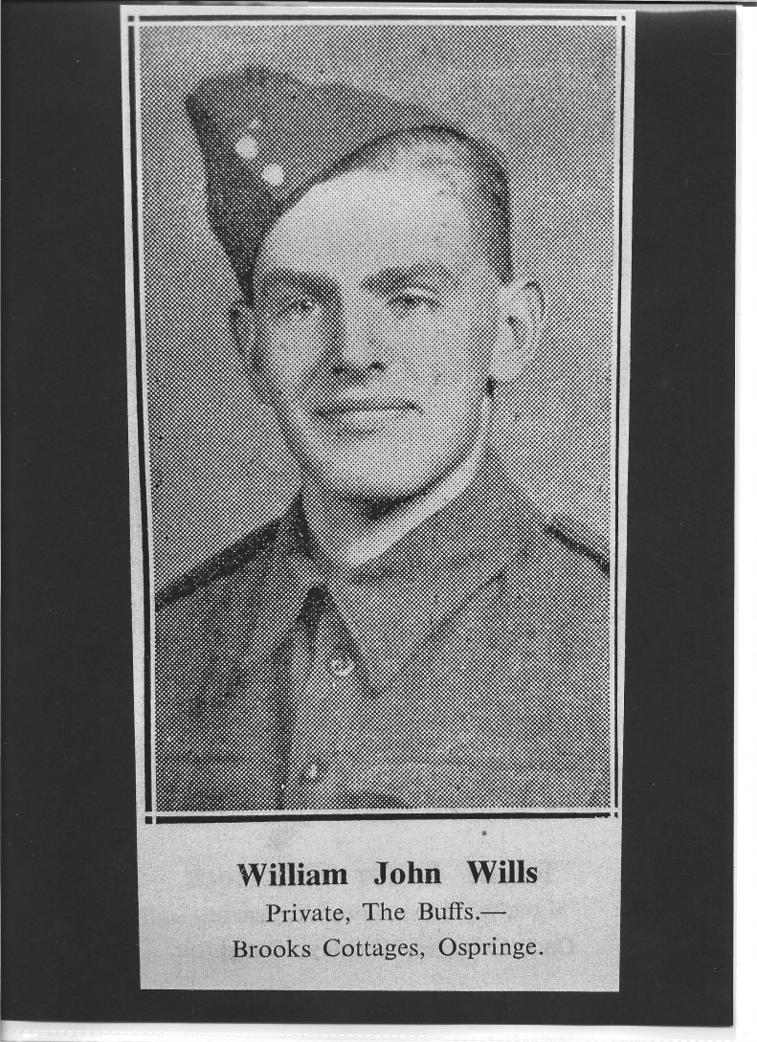
WILLIAM JOHN WILLS
(1926 - 31/03/1945, age 18 or 19)
Address: 1 Brook Cottages, Queen Court, Ospringe.
Family: John and Alice Wills (parents), Henry Wills (late older brother, see above) and sisters.
Rank: Private. Regiments: The Buffs, then then transfer to Royal Devonshire Regiment 2nd Bn.
Commemorated: Reichswald Forest War Cemetery 43.E.18 Germany.
Personal inscription: ‘He sleeps in God’s beautiful garden away from earth’s toil and pain.’
References
The War Years 1939 – 1945 in Faversham and District, page 81*.
Cwgc.org
Faversham News reports:
14/01/1944 page 3 – Court appearance.
20/04/1945 page 1 – obituary*.
20/04/1945 page 5 – in memoriam*

Slide 22
WILLIAM JOHN WILLS
(1926 - 31/03/1945, age 18 or 19)
Summary and comment
Ernest attended Ospringe School. He seems to have had problems in his youth, and had attended court three times for minor offences. He was placed on probation and warned by the Bench the third time after pleading guilty for the theft of a watch. William apparently heeded the warning and there were no further problems. He worked for a time at Queen Court Farm and for a haulage firm.
He was killed in action in Italy in March 1945. This was devastating news for his family. His elder brother Henry had also been killed in action in Italy some 9 months earlier.

Slide 23
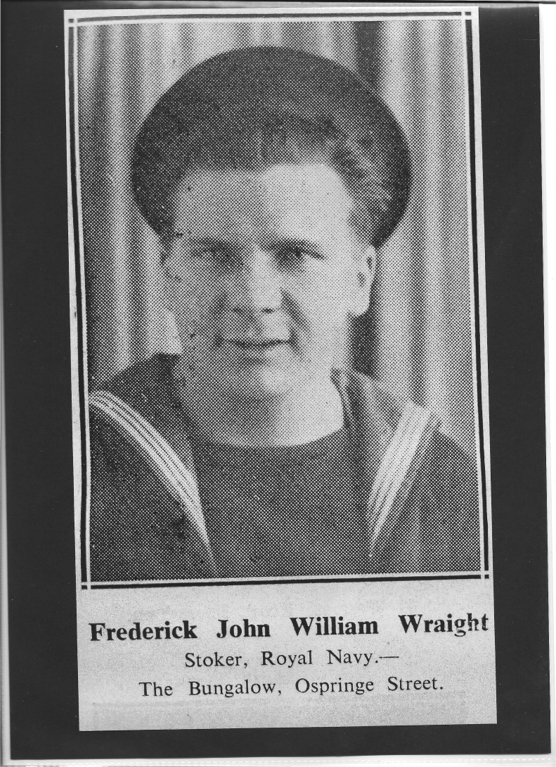
FREDERICK JOHN WILLIAM WREIGHT
(June 1924 - 13 June 1944, age 19)
Address: The Bungalow, Ospringe Street, Ospringe.
Family: Frederick and Kate Wraight (parents).
Rank: Stoker, Royal Navy. Ship: HMS Boadicea
Commemorated: Chatham Naval Memorial 78,1. U.K.
References
The War years 1939 – 1945 Faversham and District, page 95*.
Cwgc.org
Faversham News reports:
14/07/1944 page 1 – reported missing*.
18/08/1944 page 1 – obituary*.
13/06/1947 page 5 – in memoriam*.

Slide 24
FREDERICK JOHN WILLIAM WREIGHT
(June 1924 - 13 June 1944, age 19
Summary
On leaving Ospringe School at the age of 14, Frederick went as a sailing barge mate with his father. The cargo was usually bricks being shipped away from Faversham for local brickmaking firm Messrs Eastwood’s. He also worked as a lorry driver for Mr A. Bushell of Lower Road and also served part time in the National Fire Service. His interest however was on the water and he joined the Royal Navy following his 19th birthday in June 1943. During his service he had three voyages to Russia in the winter, enduring what was known to be ‘the worst journey in the World’. His ship, HMS Boadicca was engaged in operations connected with the Normandy landings when it was attacked by German aircraft. It sank quickly following a magazine explosion. Only 12 of the 182 crew survived.

