Slide 1
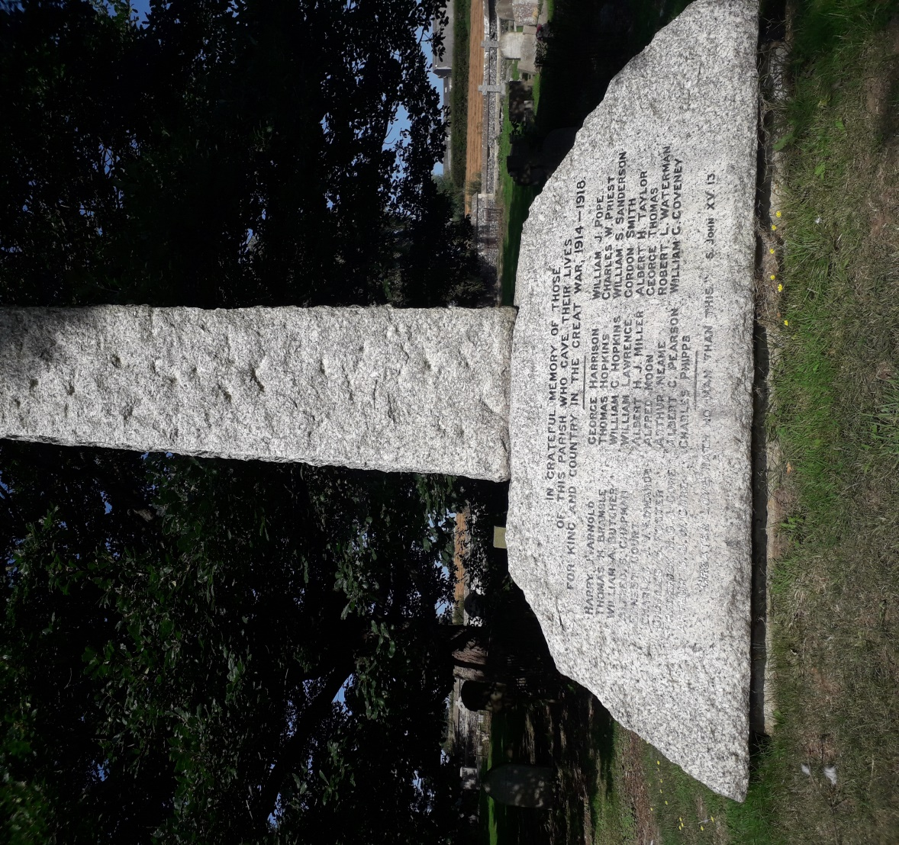
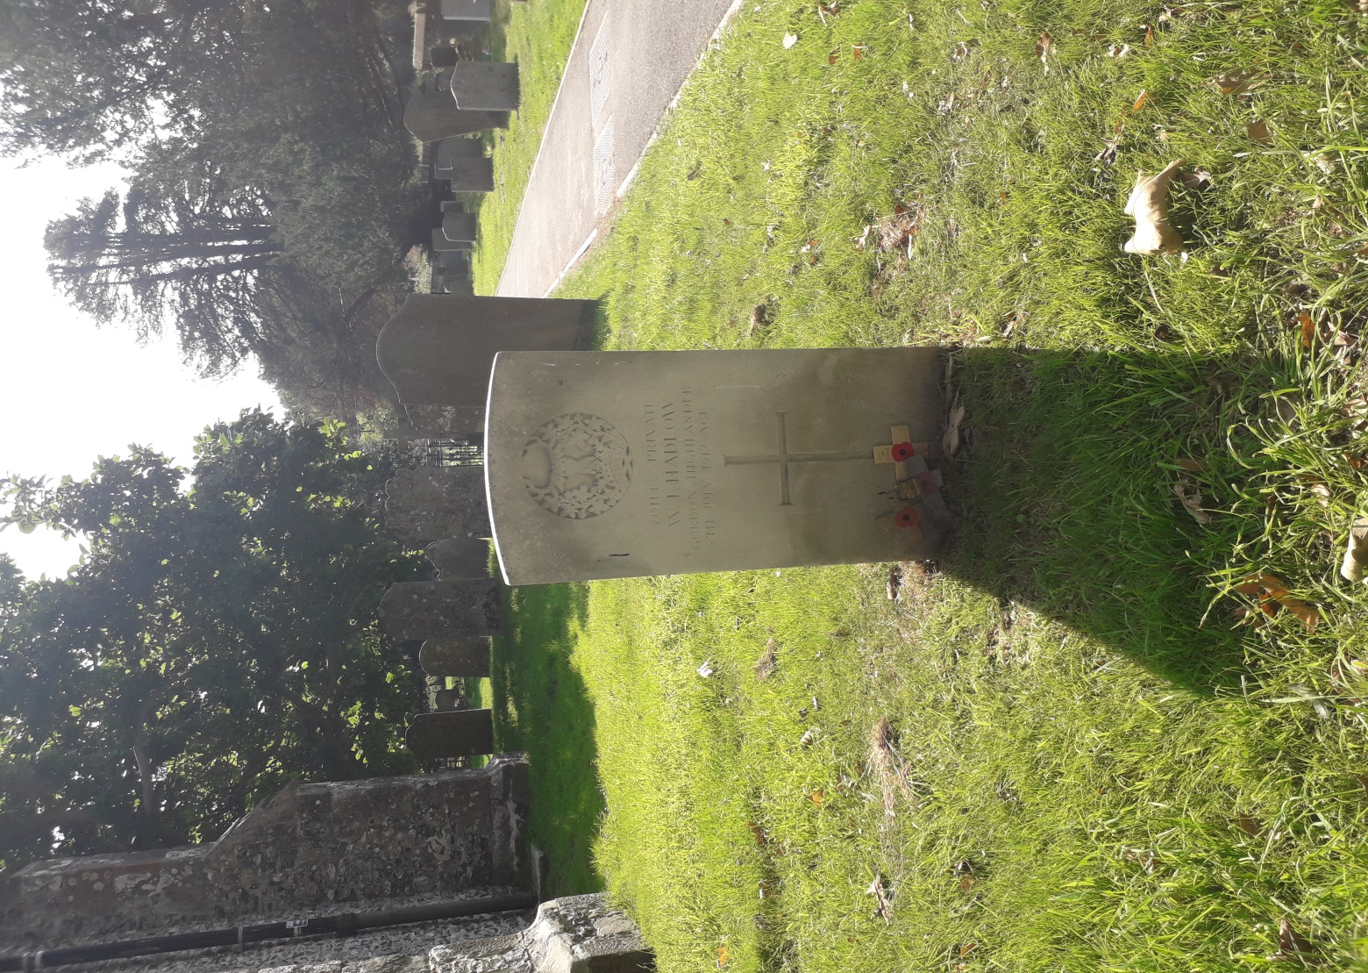
World War 1
1914 to 1918

Slide 2
Henry Joseph (AKA Harry) Arnold
1880 to 27/09/1915
Place of Birth Ospringe Kent
Son of James and Mary Arnold
Private The Buffs(East Kent Regiment) 2nd Battalion G/4394
Age at death 35
Died France Loos Memorial Panels 15 to 19
Occupation General Labourer
Lived in Ospringe

Slide 3
Thomas Henry Bramble
1885 to 29/10/1914
Place of Birth Ospringe Kent
Born at Whitehill, Ospringe, Faversham. Son of Thomas and Jane Bramble.
Private The Buffs(East Kent Regiment ) 1st Battalion L/8166
Age at death 29
England Oxford (Botley) Cemetery 11 8
Occupation Labourer. Soldier since 1906

Slide 4
William Alfred Stockbridge Butcher
1898 to 14/08/1918
Place of Birth Boughton under Blean
Son of William and Elizabeth Butcher, of Ethelbert Rd., Faversham, Kent.
Private The Buffs (East Kent Regiment) 6th Battalion G/24948
Age at Death 20
Died France Vis-En-Artois Memorial Panel 3.

Slide 5
Alfred Stephen Chapman
23/06/1886 to 01/01/1915
Place of Birth Guston Dover
Son of Mr. and Mrs. Alfred Chapman, of Chilham, Kent; husband of Jane Rose Chapman, of 1, Garden Place, Tanner St., Faversham, Kent.
Leading Stoker Royal Navy HMS Formidable
Place of Burial Chatham Navy Dockyard Memorial Plot 11
Occupation Milkman
Spouse Jane Rose married 31/12/1908 Faversham Kent

Slide 6
William George Coveney
1891 to 10/05/1916
Place of Birth Ospringe Kent
Son of George and Florence Coveney
Wife Ada Hart Married 1914 17 Water Lane Faversham
Munition Worker Faversham Gunpowder Works
Age at Death 25
Died Ospringe
Occupation Brewery Worker

Slide 7
Earnest Court
1867 to 02/04/1916
Place of Birth Minster in Thanet
Son of Stephen and Harriet Court
Private The Buffs (East Kent Regiment) 2nd/4th Battalion T/20213
Place of Death Faversham. Faversham Explosion Plot
Age at death 49
Occupation Road Labourer
Husband of Catherine Court, of Ospringe, Faversham.

Slide 8
Charles Joseph Victor Edwards
1889 to 15/09/1916
Place of Birth Ospringe Kent
Son of John and Matilda Louisa Edwards, of Whitehill, Ospringe, Faversham, Kent.
Lance Corporal Rifle Brigade 9th Battalion 3123
Age at death27
Died France Thiepval Memorial Pier and Face 16 B and 16 C.

Slide 9
Charles S. Foster
North Staffordshire Regiment
Age at Death Unknown
Place of Death unknown

Slide 10
Arthur Sydney Berty William GORE
1891 to 16/12/1917
Place of Birth :Ospringe Kent
Son of Henry and Sarah Gore
Private Royal Fusiliers 22Battalion 63051
Buried France Rocquigny-Equancourt Road British Cemetery, Manancourt V11B
Occupation Agricultural Labourer

Slide 11
Frederick Henry George J Gore
1893 to 12/08/1917
Place of Birth Ospringe Kent
Son of Henry and Sarah Gore
Lance Corporal (The Queens Royal West Surrey Regiment) 10th Battalion 7663
Age at Death 24
Died France Etaples Military Cemetery XXV. M. 12A.
Occupation Horseman on Farm

Slide 12
William James Hadlow
1891 to 08/07/1917
Place of Birth Ospringe
Son of William and Elizabeth Hadlow of Lorenden Cottages Ospringe. 3 sisters.
Gordon Highlanders 4th Reserves & 2/5th Battalion 201145
Age at death 25
Died 1st East General hospital, Cambridge .
Occupation: Footman, Hyde Park Square London.

Slide 13
George Harrison
1884 to 04/09/1914
Place of Birth Eastling Kent
Son of James and M. A. Harrison, of Ospringe Square, Faversham.
Private Grenadier Guards 2nd Battalion 10528
Age at death 30
Place of Death France Guards Grave, Villers Cotterets Forest I. 19.
Occupation Engine Cleaner

Slide 14
William George Hopkins
1888 to 03/06/1918
Place of Birth Faversham Kent
Son of James and Jane Hopkins
Wife Clara Croucher Married 1912
Lived in Ospringe
Private Royal Sussex Regiment 2nd/6th Battalion 22012
Age at death 30
Died Pakistan Karachi 1914 -1918 War memorial

Slide 15
Thomas Edward Hopkins
1892 to 26/03/1918
Place of Birth Faversham Kent
Son of James and Jane Hopkins
Lance Corporal Machine Gun Corps Infantry 12th Company
24845
Age at Death 26
Died France Pozieres Memorial Panel 90 to 93
Occupation Labourer

Slide 16
Frederick William (AKA William) Lawrence MM
1888 to 18/05/1918
Place of Birth Stratford Essex
Son of Agnes Lawrence
Corporal Royal Engineers 154 Field Company 65806
Age at Death 30
Died France St. Sever Cemetery Extension, Rouen Q. III. H. 18.
Occupation Carpenter

Slide 17
Albert Henry James Miller
1898 to 04/10/1917
Place of Birth :Sittingbourne
Private Gloucester Regiment 12th Battalion 34419
Died Belgium Tyne Cot Memorial Panel 72 to 75
Age at death 19
Spouse Dorothy Pearce Married 1916

Slide 18
Alfred Moon
1883 to 11/03/1916
Place of Birth Ospringe
Son of Nathaniel and Esther Moon
Private The Buffs East Kent Regiment 6th Battalion G7982
Died France Loos Memorial Panel 15 to 19
Occupation Farm Labourer

Slide 19
Arthur Neame
23/08/1871 to 17/03/1916
Place of birth :Faversham Kent
Son of Percy Beale and Florence Neame, of The Mount. Faversham.
Age at death 45
Buried Ss. Peter And Paul's Churchyard, Ospringe North East
Major Royal Garrison Artillery Kent Heavy Battery
Occupation Brewer Director Shepherd Neame

Slide 20
Albert Charles PEARSON
1888 to 28/09/1915
Place of Birth Bredgar, Kent .
Son of George and Frances Rayfield Pearson,
8, Dawson's Row, Ospringe, Faversham, Kent
Rank:Private The Buffs (East Kent Regiment) 2nd Battalion L8264
Occupation Bricklayer Labourer
.Age At Death 27
Country of Burial France
Cemetery Loos Memorial Panel 15 to 19

Slide 21
Charles Phipps
1894 to 08/10/1918
Place of Birth Ospringe Kent
Son of Walter and Sarah Phipps, of Ospringe St., Faversham, Kent.
Sergeant The Buffs (East Kent Regiment) 1st Battalion G/9154
Age at Death 24
Died France Vadencourt British Cemetery, Maissemy III. C. 29.

Slide 22
William James Pope
1894 to 10/03/1917
Place of Birth Dunkirk Kent
Son of Mrs. Elizabeth Ann Pope, of Creasys House, Bucks Wood, Crawley, Sussex. Born at Dunkirk, Faversham, Kent.
Oxford and Bucks Light Infantry1st/1st Bucks Battalion 265681
Age at death 23
Place of Death France Hem Farm Military Cemetery, Hem-MonacuI. L. 18.
Occupation Under Gardener

Slide 23
Charles William Priest
1895 to 09/08/1917
Place of Birth Faversham Kent
Son of Charles and Emma Jane Priest, of 34, Upper Brents, Faversham, Kent.
Private The Buffs (East Kent Regiment) 6th Battalion G/13615
Age at Death 22
Place of Death France Arras Memorial Bay 2.
Occupation Shepherds boy
Lived Luddenham

Slide 24
William Stephenson Sanderson
1882 to 20/09/1916
Place of Birth Stocton
Son of the late John and Mary Sanderson; husband of Fanny Wilgress Sanderson, of The School House, Painter's Forstal, Faversham, Kent.
Married 1906
Lived in Rochester
Private Duke of Wellington’s West Riding Regiment 8th Battalion 13298
Age at Death 34
Died France Thiepval Memorial Pier and Face 6 A and 6 B.

Slide 25
Gordon Albert Smith
1890 to 25/06/1915
Place of Birth Boughton under Blean
Son of William E. and Sarah E. A. Smith, of 22, South Rd., Faversham, Kent.
Rifleman Rifle Brigade 9th Battalion S/8321
Age at Death 25
Died Belgium Ypres (Menin Gate) Memorial Panel 46 - 48 and 50.

Slide 26
Albert Henry Taylor
1891 to 21/09/1914
Place of Birth :Egerton Kent
Sergeant Worcestershire Regiment B. Coy 2nd Battalion 9303
Son of William and Sarah Taylor, of Ospringe, Faversham, Kent; husband of Annie Margaret Simons (formerly Taylor), of 31, Elderton Rd., Westcliff-on-Sea, Essex.
Died France Villers-En-Prayeres Communal Cemetery B3
Age at Death 23
Occupation: Grocers Assistant Lived in Brixton

Slide 27
George Thomas
1884 to 26/10/1918
Place of birth Westbere
Son of James and Emma Thomas, of Scott's Farm, Ospringe, nr. Faversham.
Private The Buffs( 10th (R. East Kent and West Kent Yeomanry) Battalion 35520
Age at Death 24
Died France Terlinctcthun British Cemetery, Wimille VI. C. 40.
Occupation Shepherd

Slide 28
Robert Luck Waterman
24/08/1881 to 16/09/1916
Place of Birth Ditton
Son of Jane Frances Waterman, of The Chalet, Birchington, Kent, and the late John Waterman.
Private London Regiment 1st/23rd Battalion 4983
Age at death 35
Died FranceThiepval Memorial Pier and Face 9 D 9 C 13 C and 12 C.
Occupation Drapers Clerk
Lived at 11 Vere St. Middx

Slide 29
Our thanks to :
Steve Palmer . Historical Research Group Sittingbourne
Roger Bennett Ospringe Church Archivist
Mark Stefanick
Sources
BMD Gordon Highlanders Museum
Census Faversham News
SDGW
CWGC

