Slide 1
Mission Weekend 11th-13th September
Our Benefice joined with all parishes in the Diocese last weekend for the Centenary celebrations.

Slide 2
It was such a busy day on the Saturday (find the lost sheep, fish for disciples, plant seeds, colouring pots, prayer and food) Here are a selection of pictures....

Slide 3
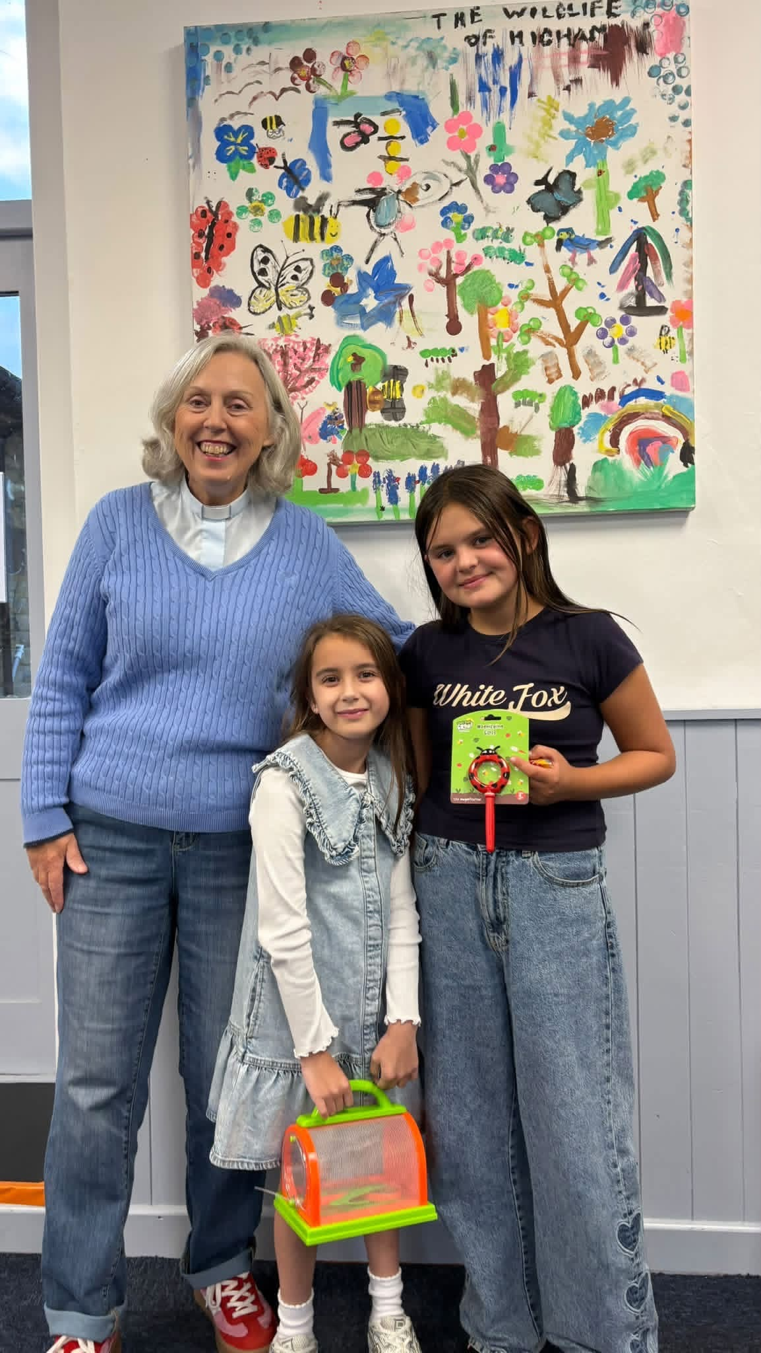
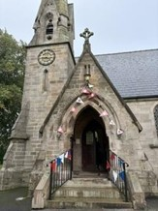
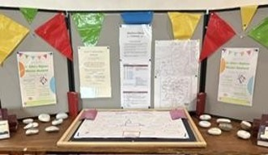
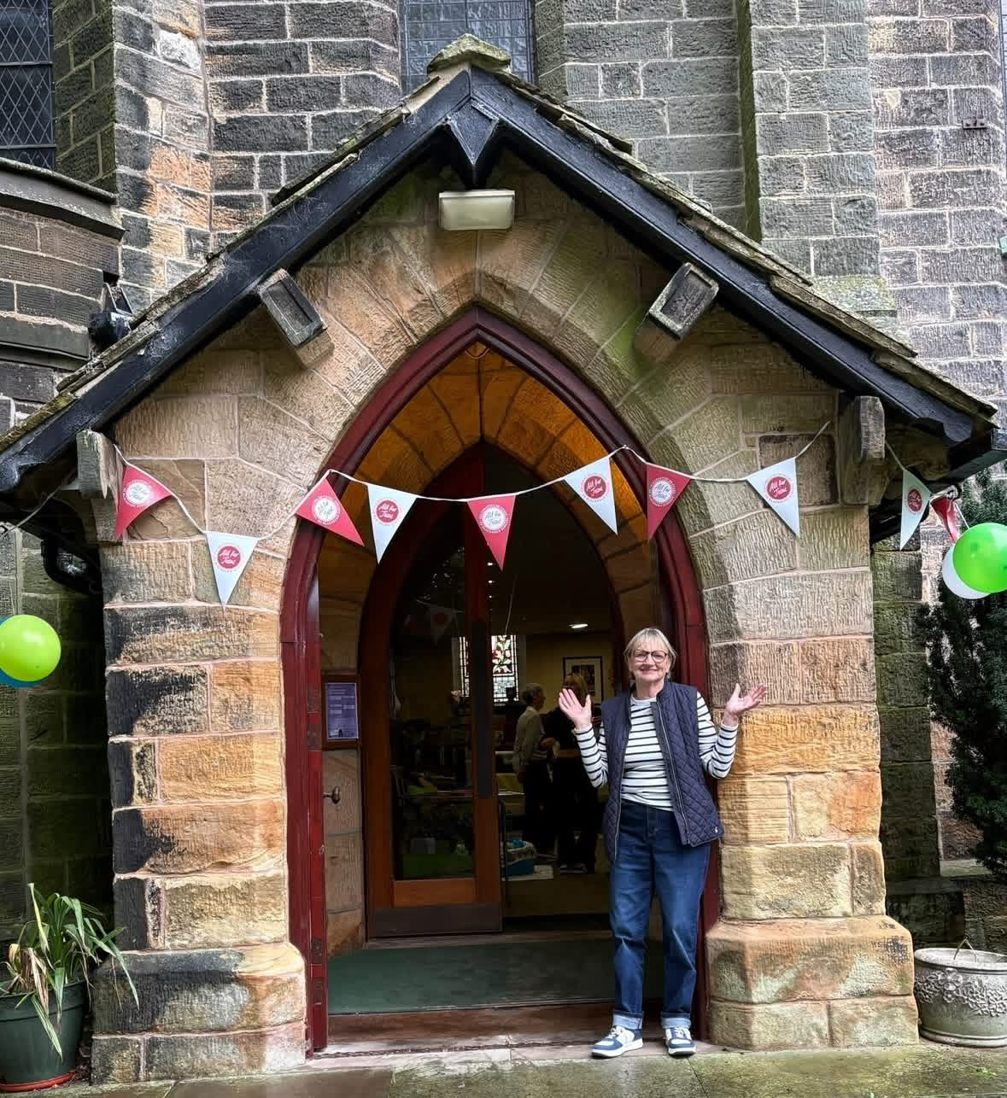

Slide 4
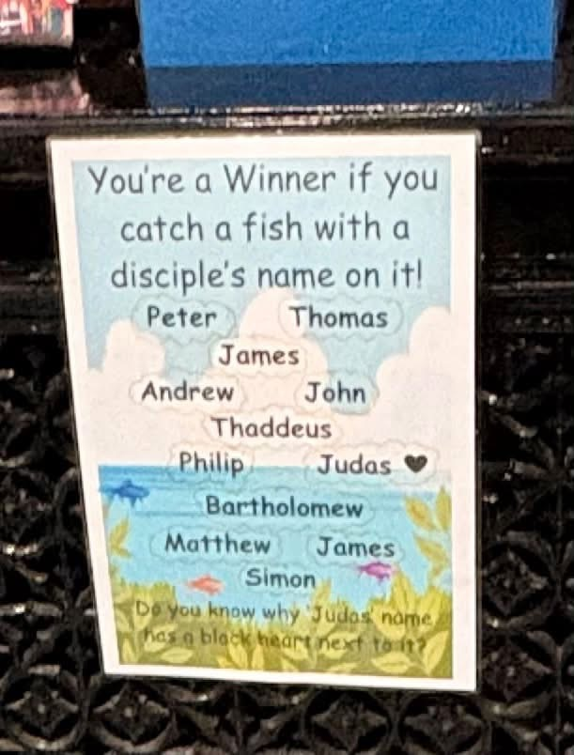
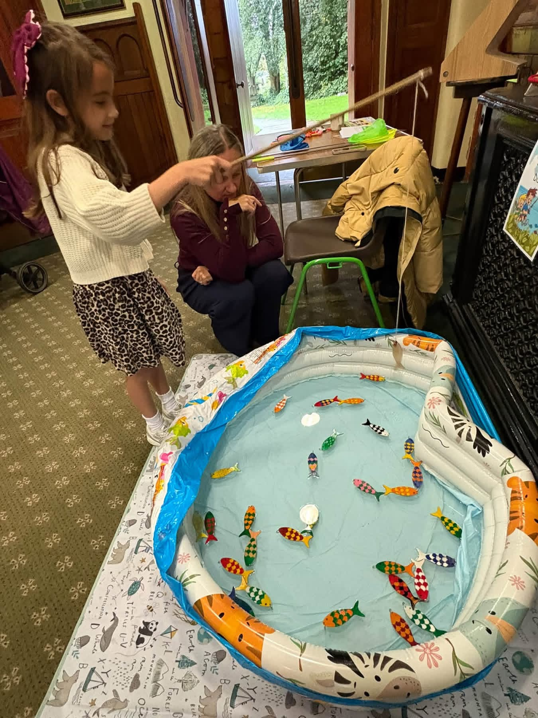

Slide 5
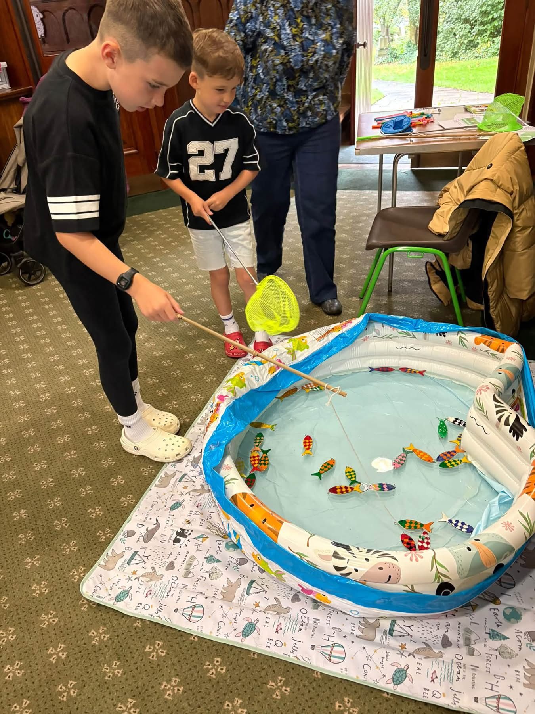
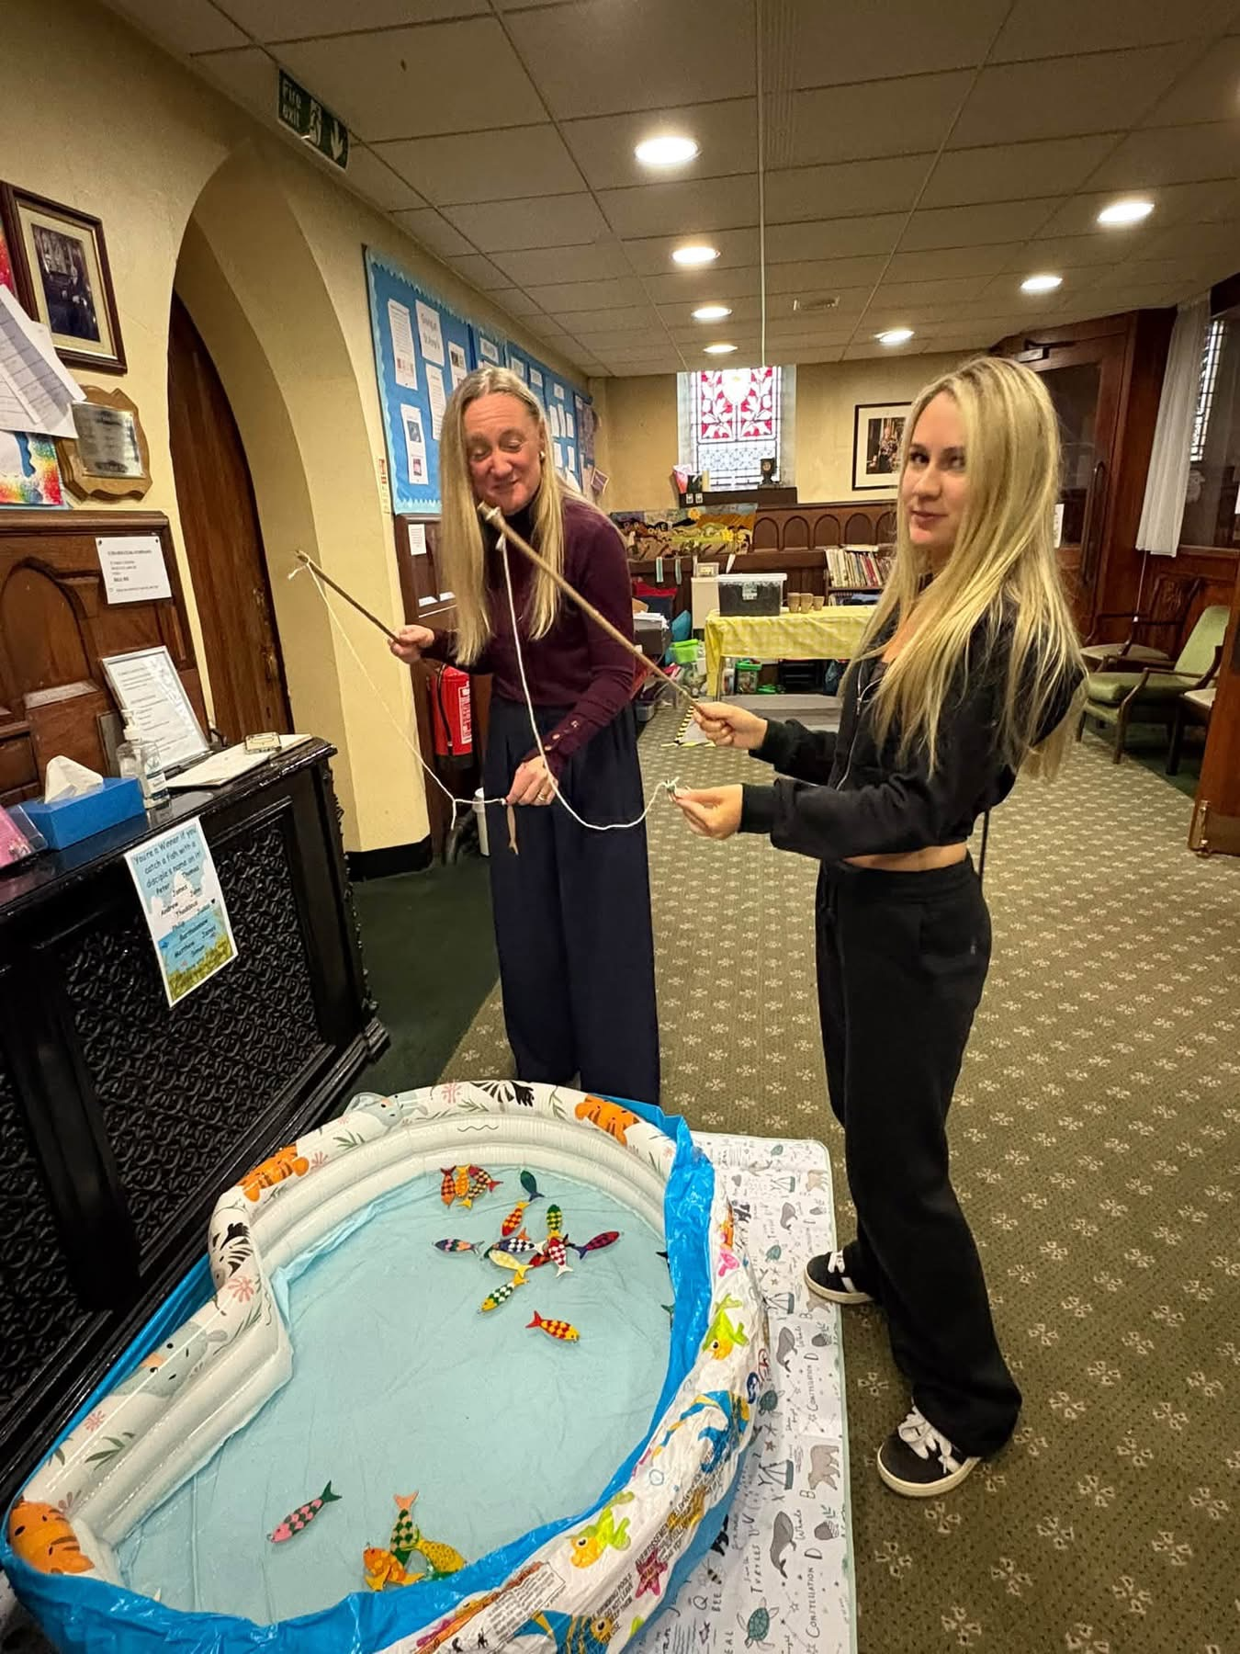

Slide 6
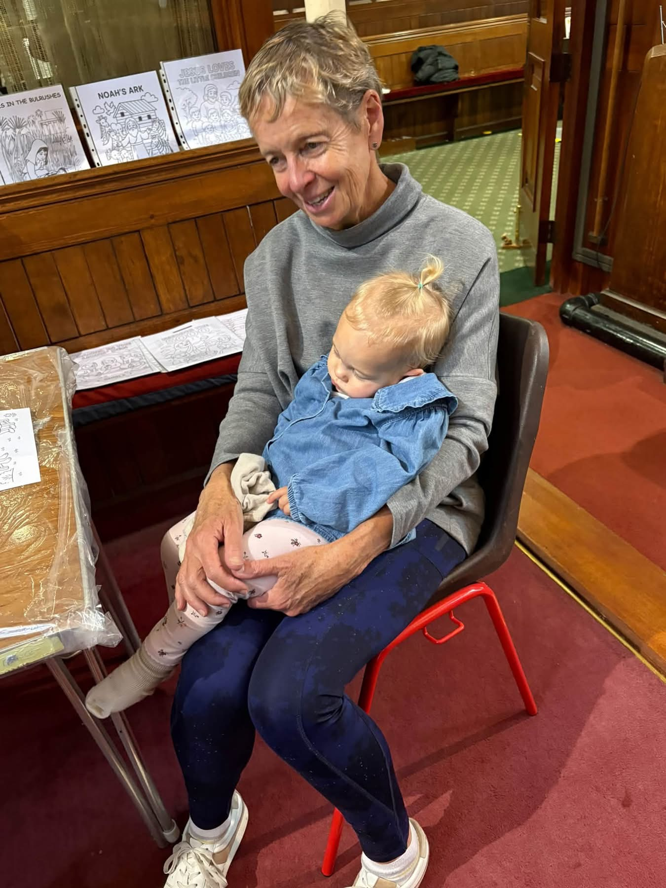
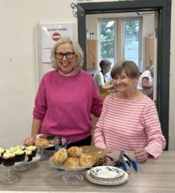
Thank you to all who helped with our weekend and to all who came along.
Many answered the Call to follow Jesus in our Sunday services…we look forward to seeing you again.

