Slide 1
Pendle Deanery
Bishop Philip Visit
Wednesday 9th September 2026

Slide 2
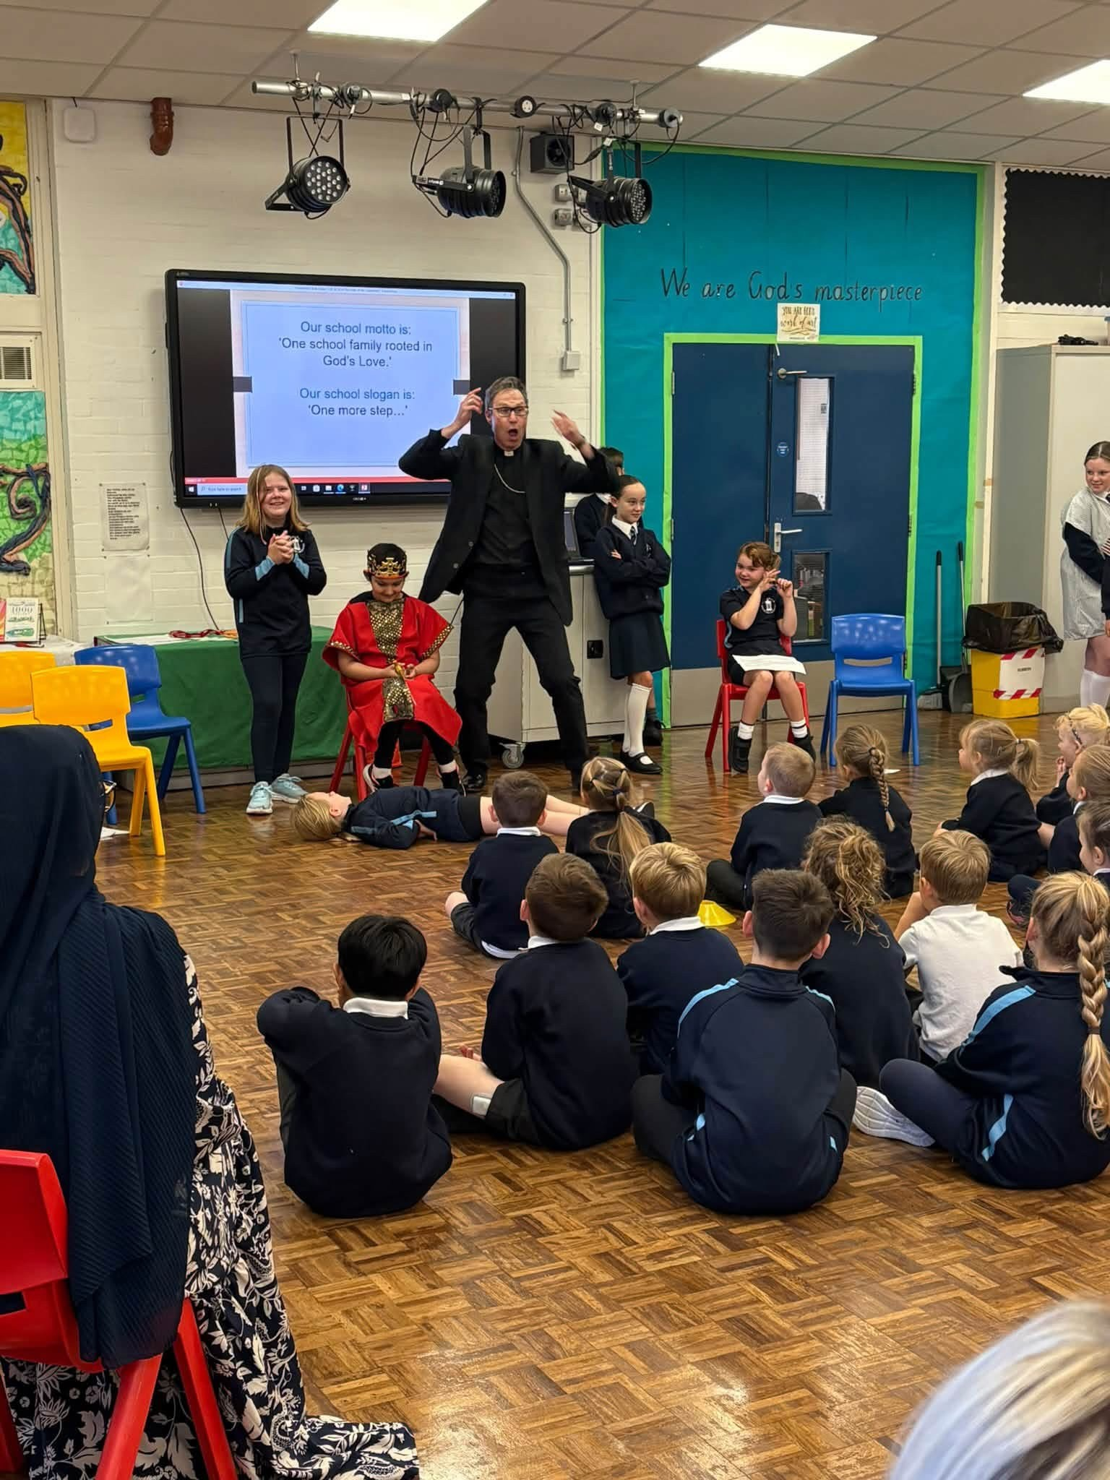
St John’s school Higham

Slide 3
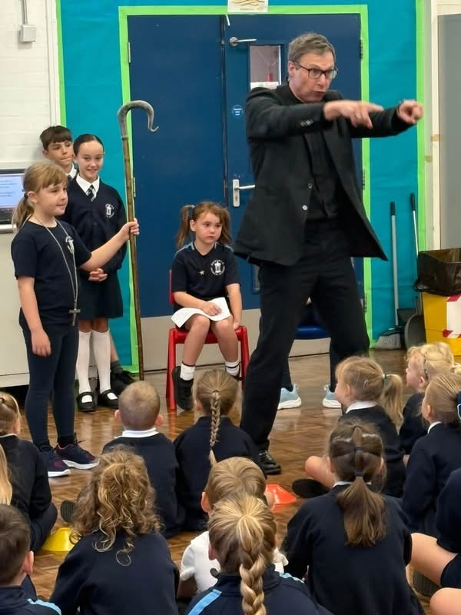

Slide 4
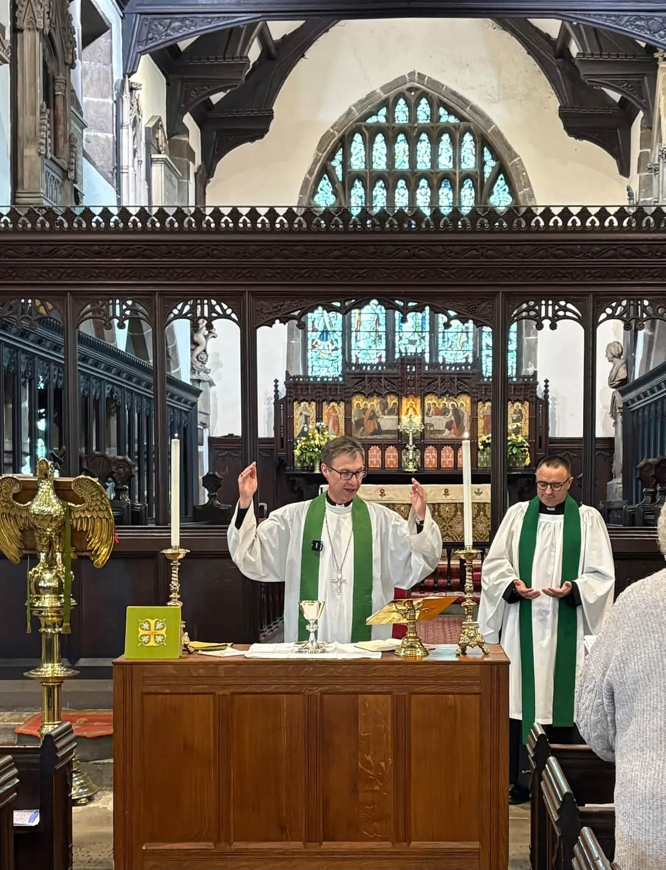
Deanery Eucharist at St Bartholmew’s, Colne

Slide 5
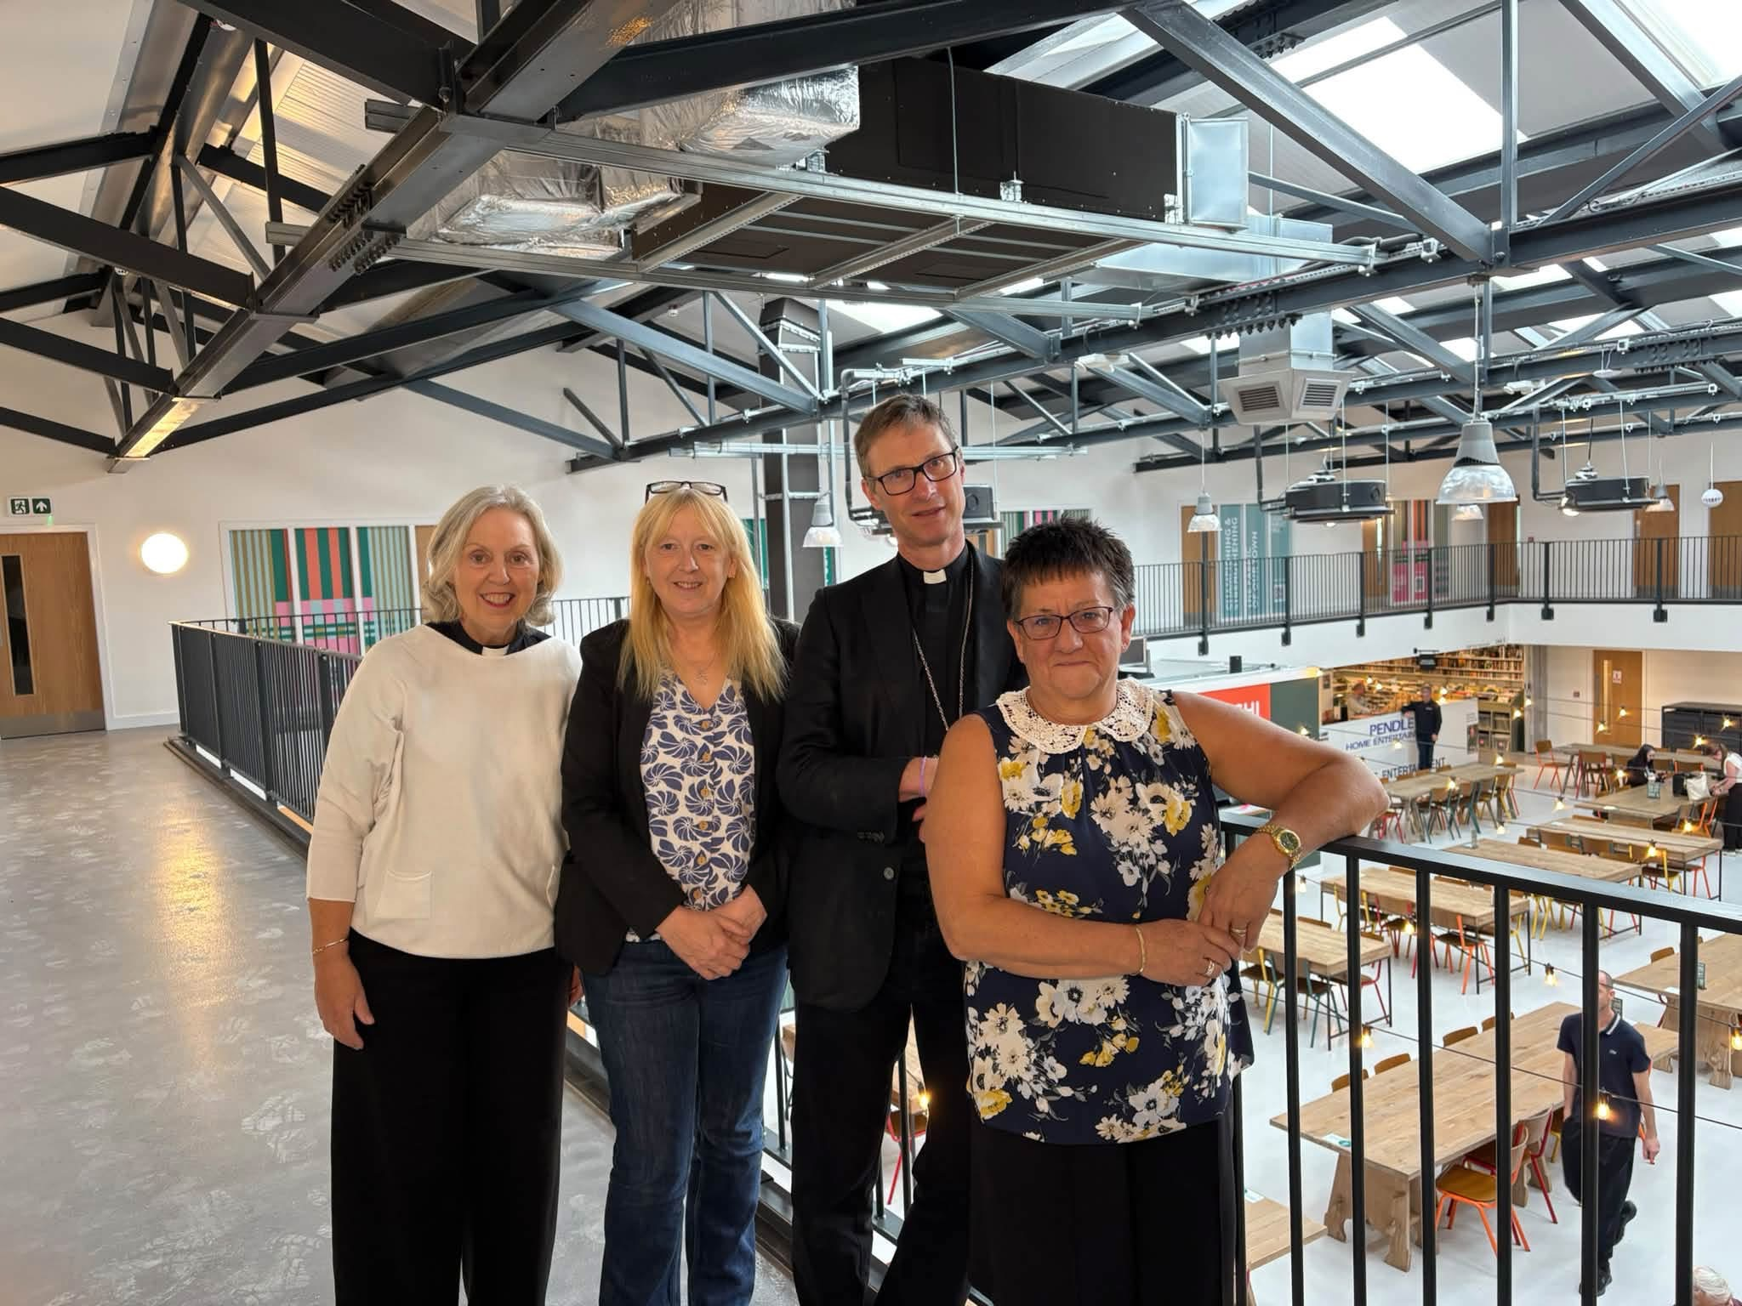
New Market Hall, Colne

Slide 6
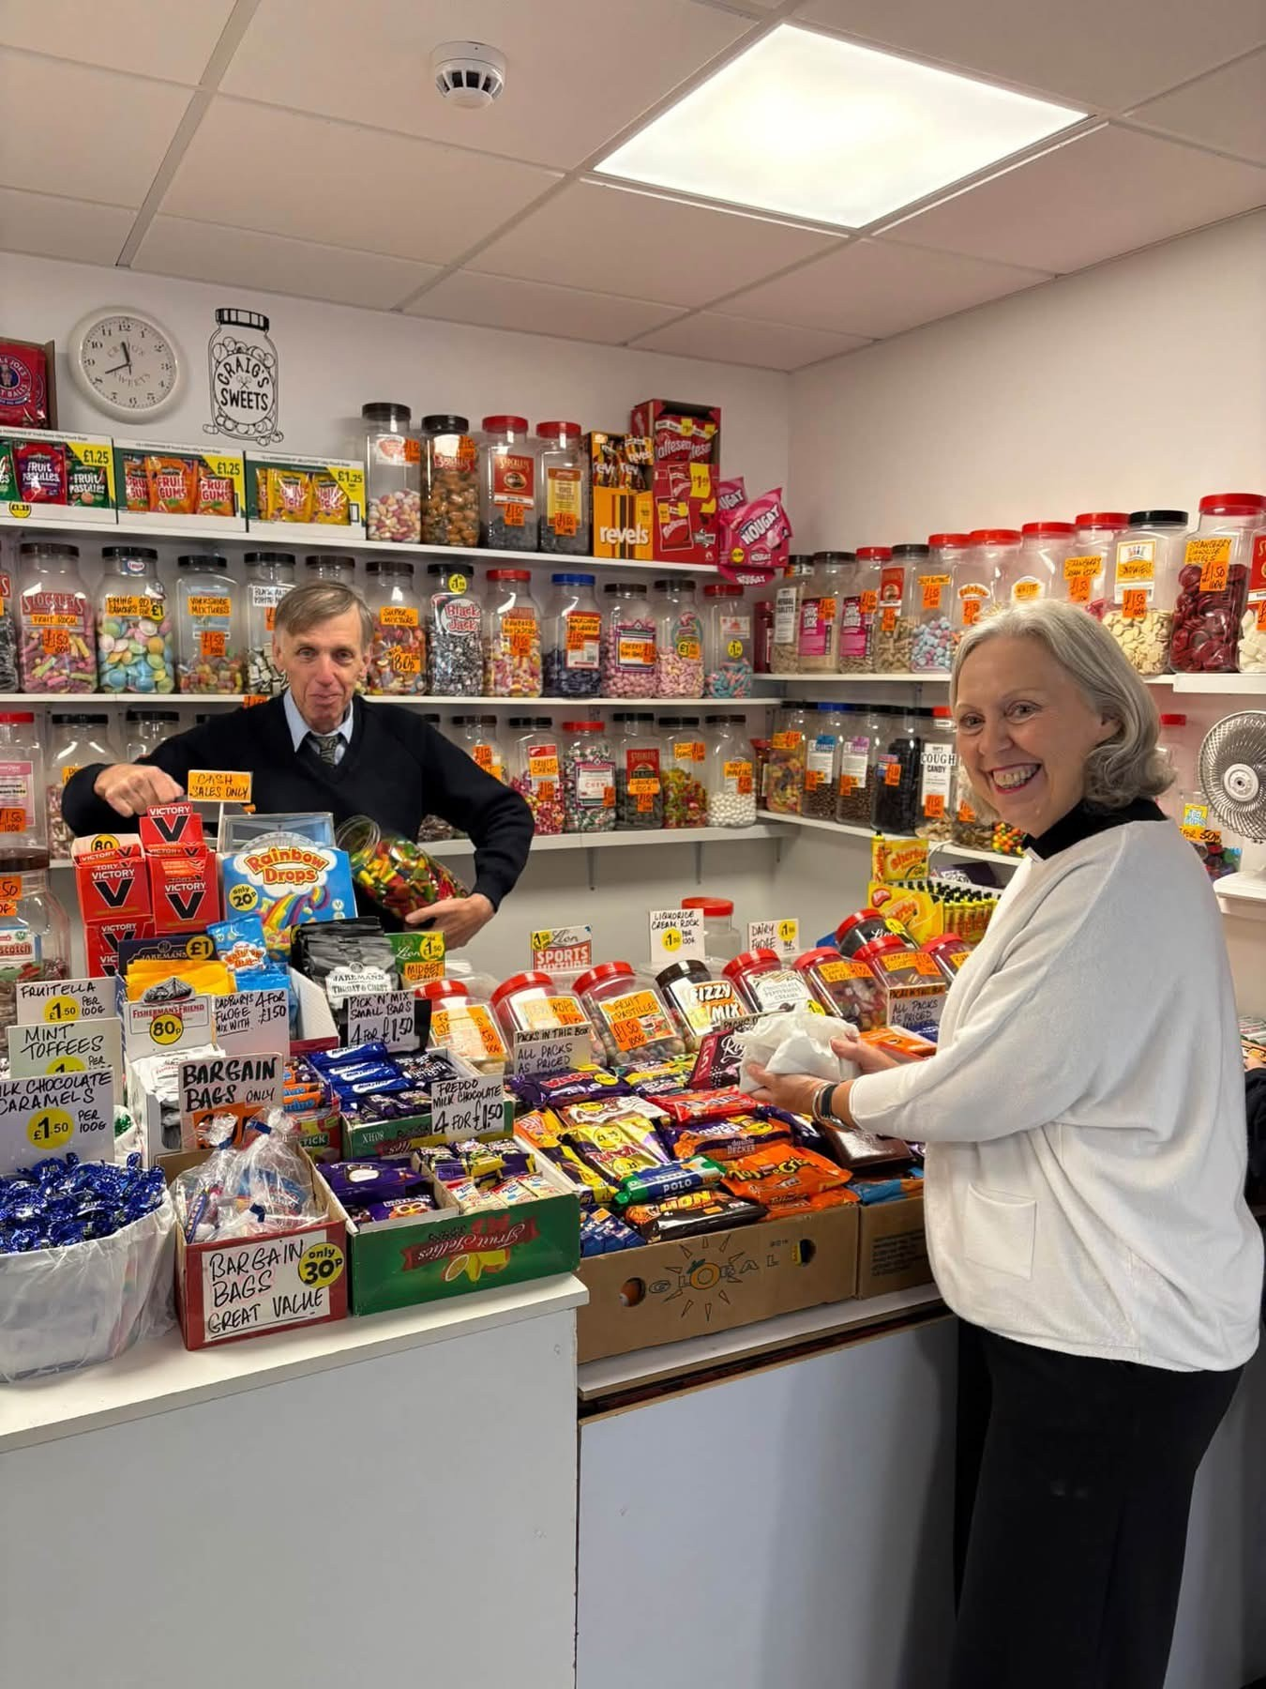

Slide 7
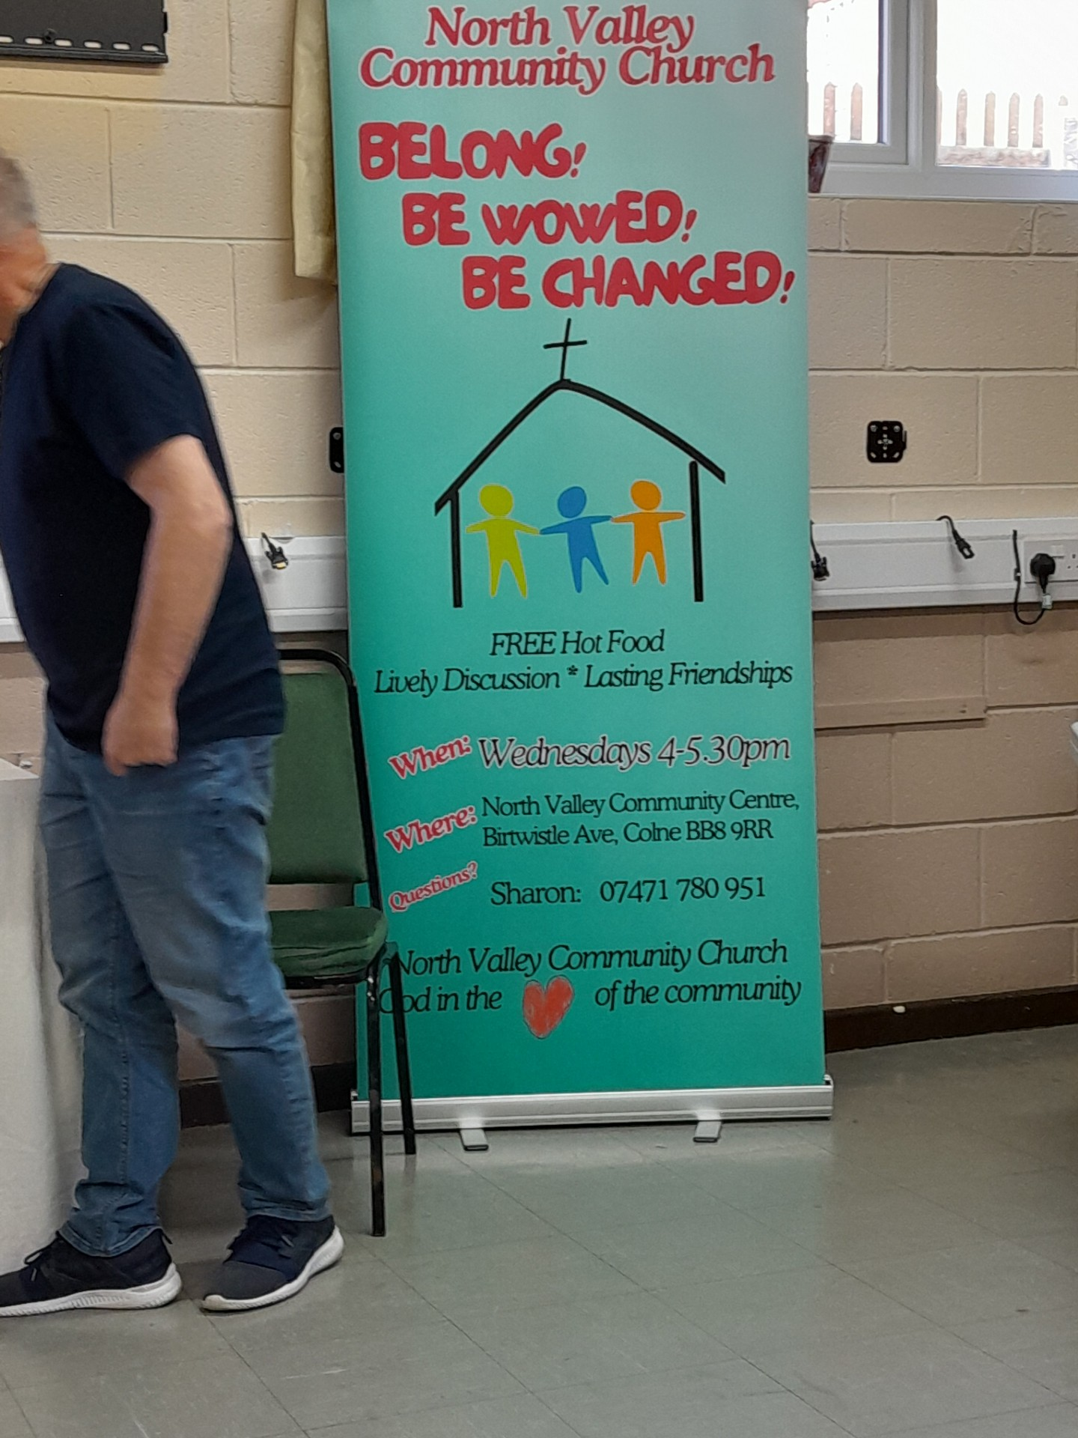
North Valley Community Centre

Slide 8
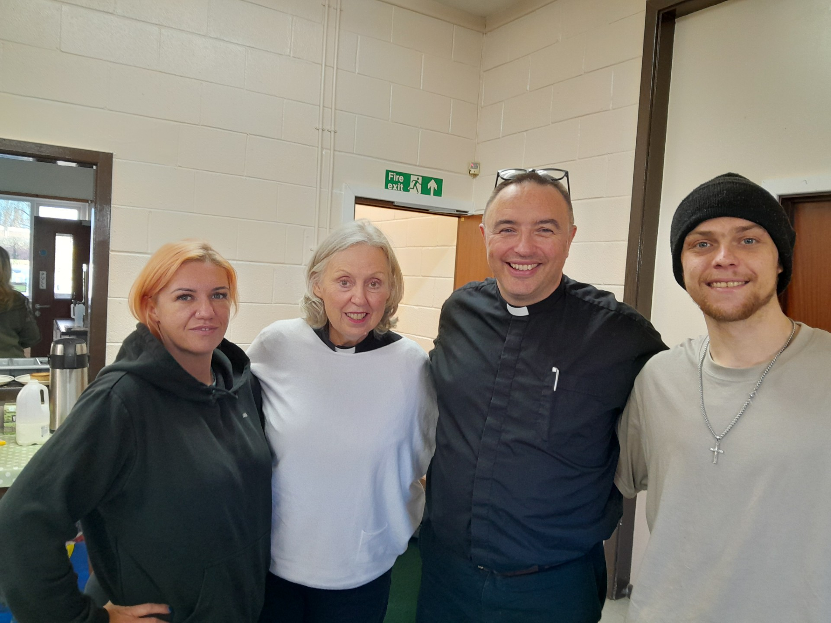

Slide 9
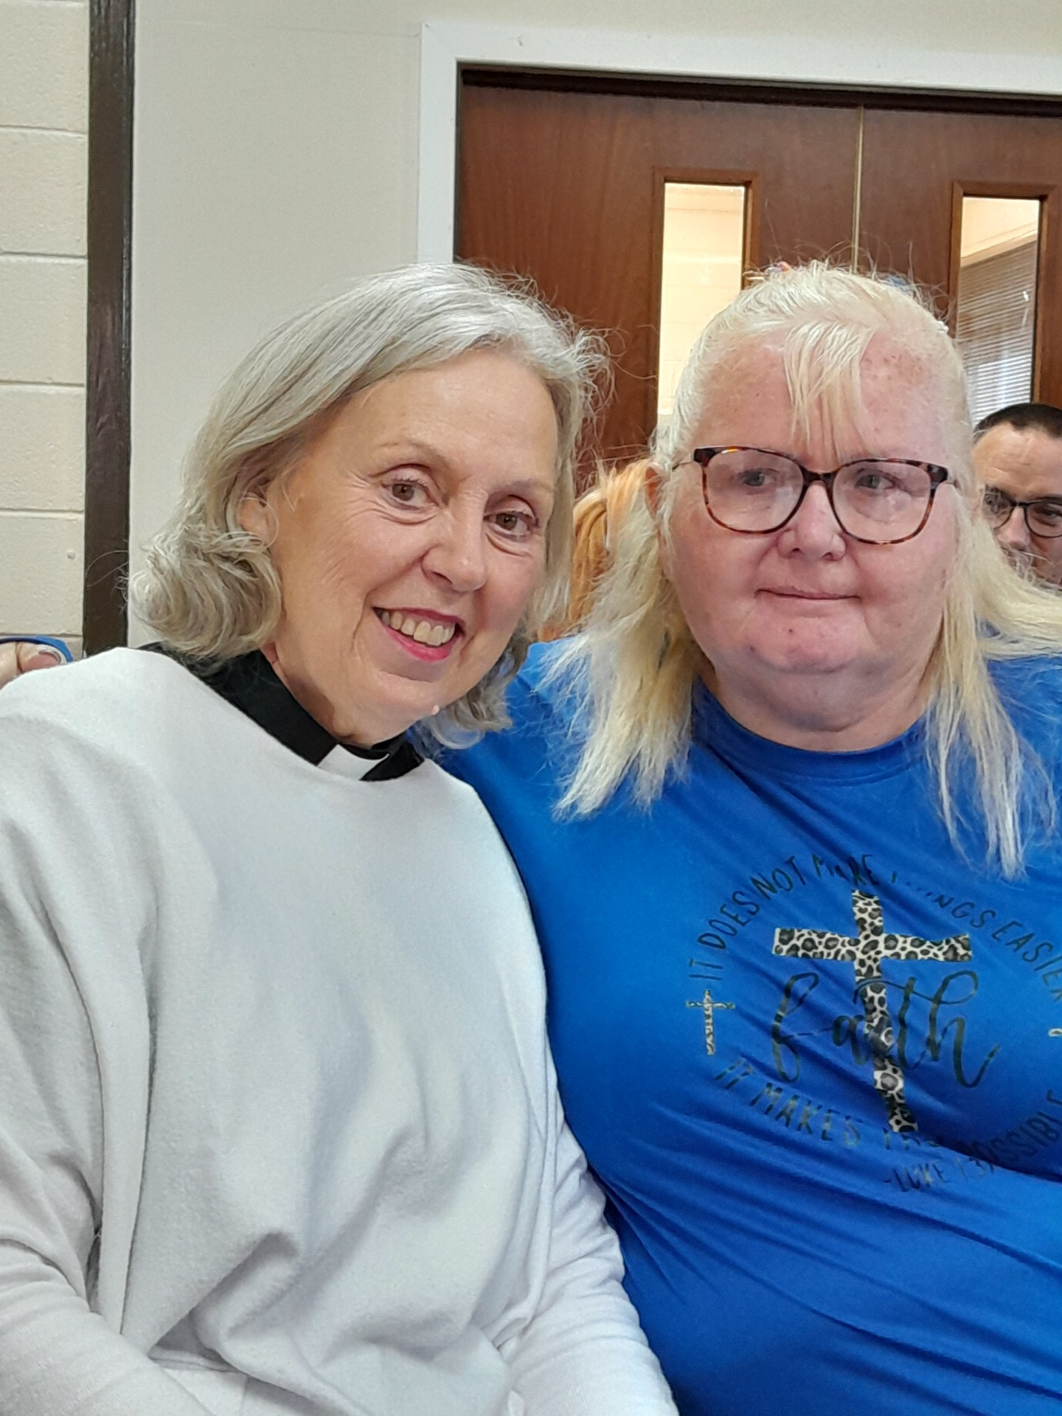

Slide 10
