Slide 1
Weddings
July 2026

Slide 2
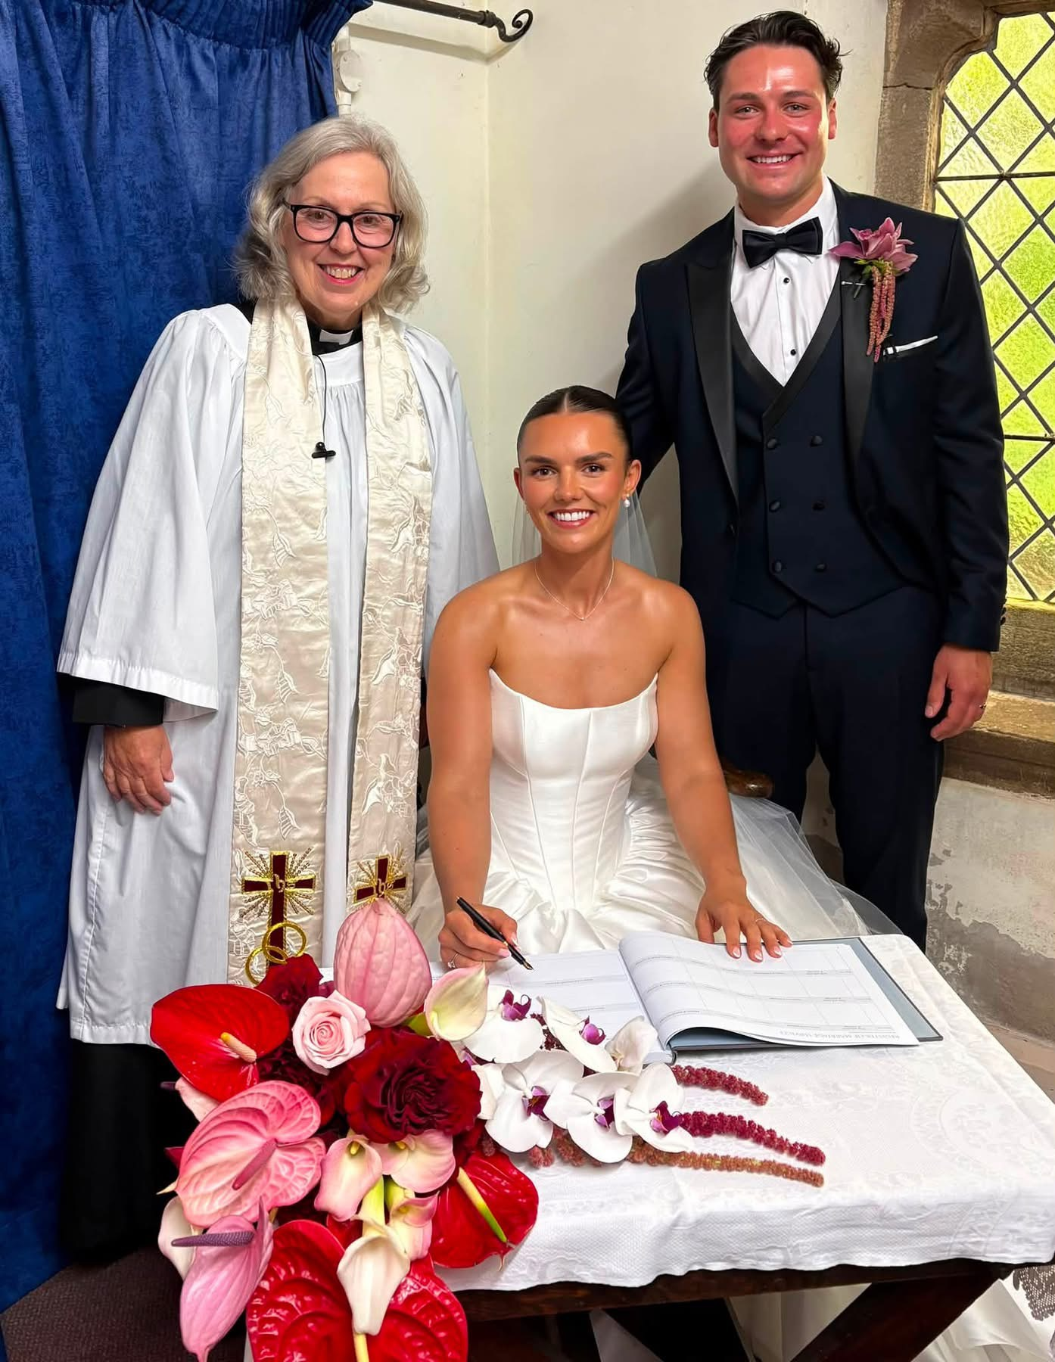
Congratulations to Elley and Sam-Mr &Mrs Shaw

Slide 3
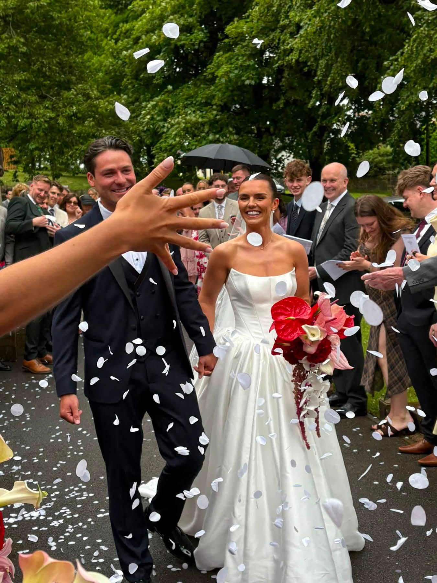
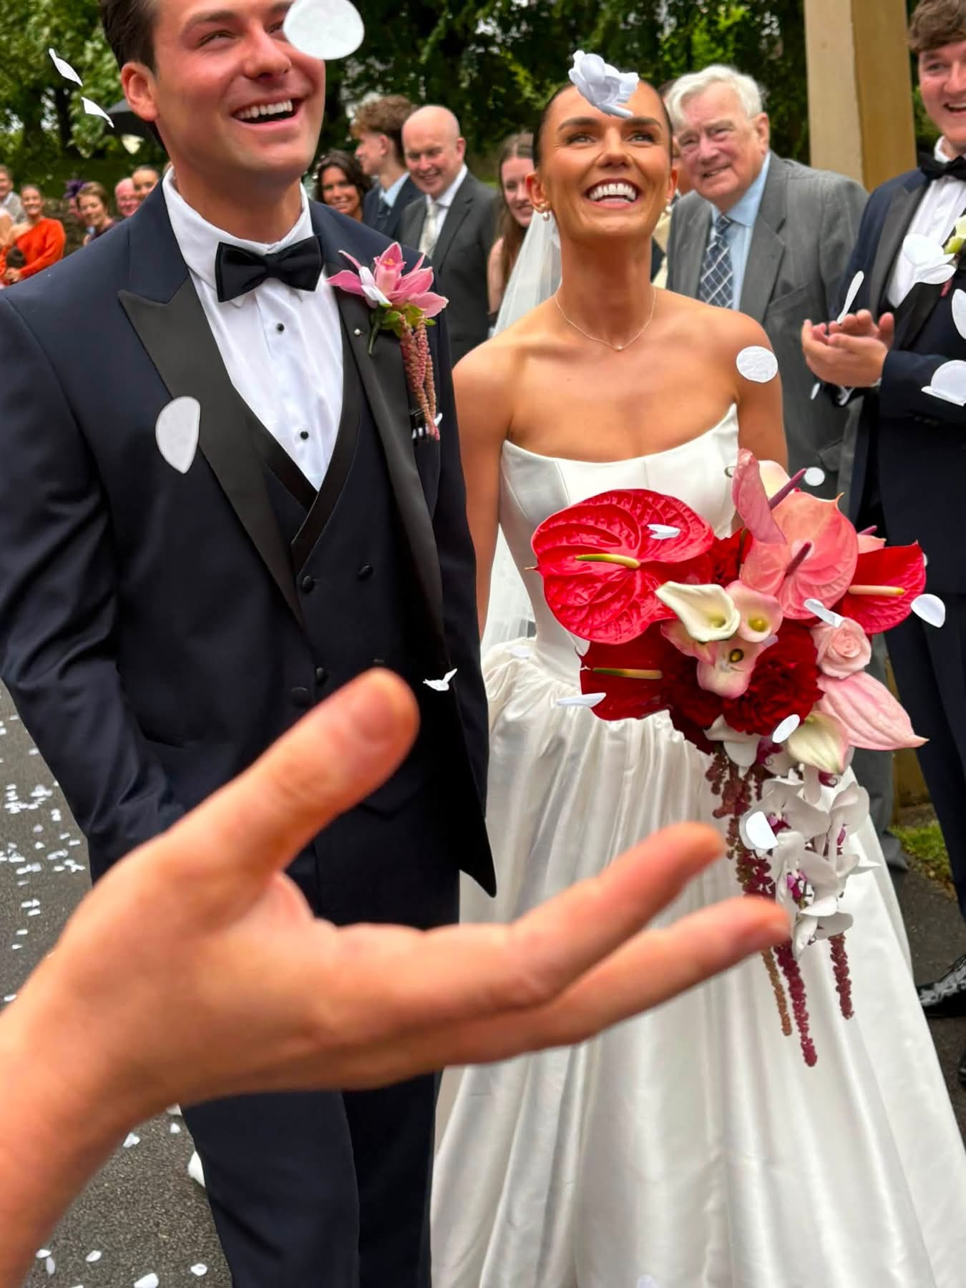

Slide 4
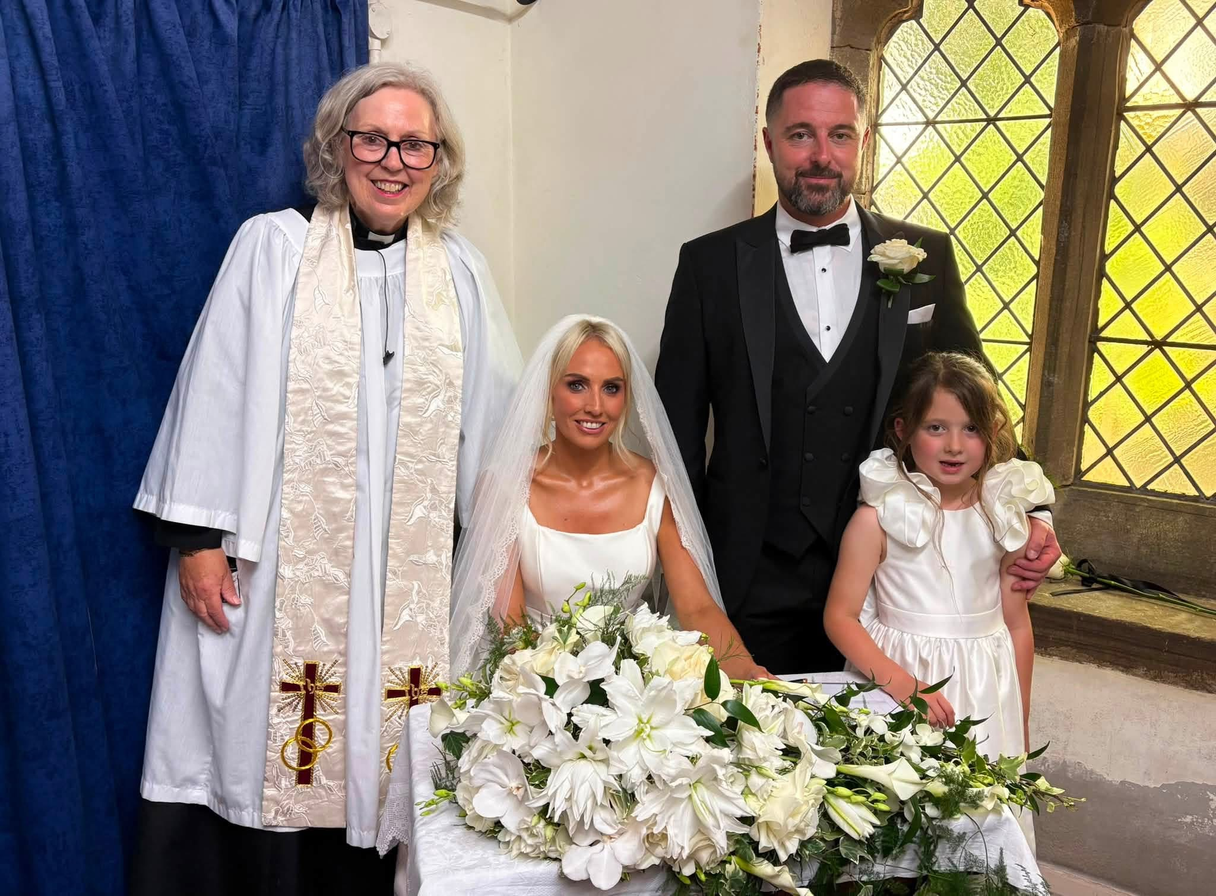
Congratulations to Sophie and Shaun - Mr and Mrs Clough And to Eadie who was baptised

Slide 5
