Slide 1
Friday Faith & Fun
Met on Friday 12th June in the Refectory.
We followed on from our May session when we heard all about the disciples of Jesus. This week we explored what it means to be a disciple of Jesus today and be ‘fishers of men’. All followed by pie and peas, donuts and pop!.
Next session is July 10th when it is our summer party. All welcome!

Slide 2
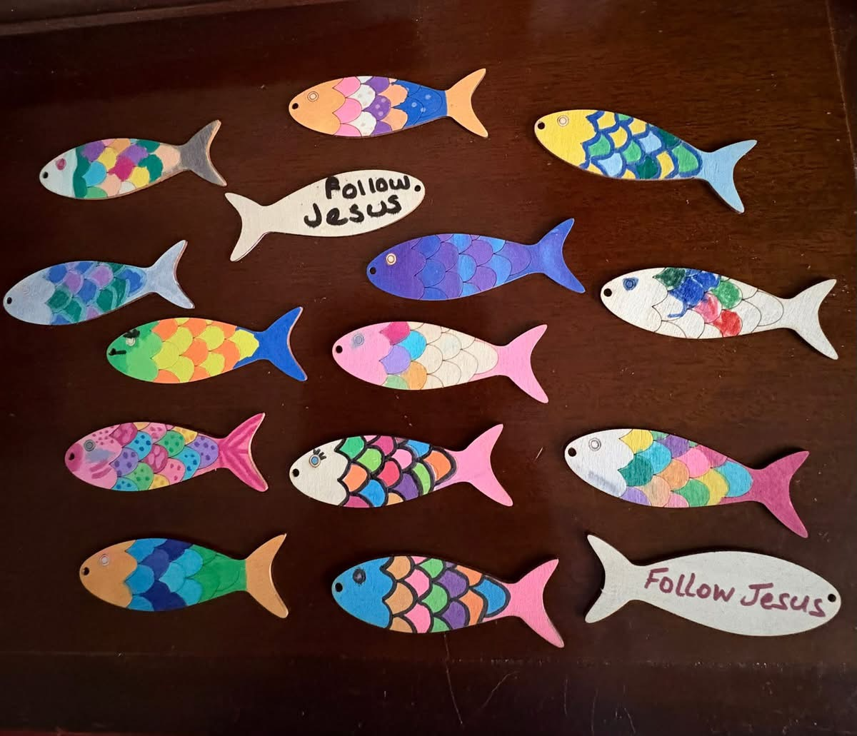

Slide 3
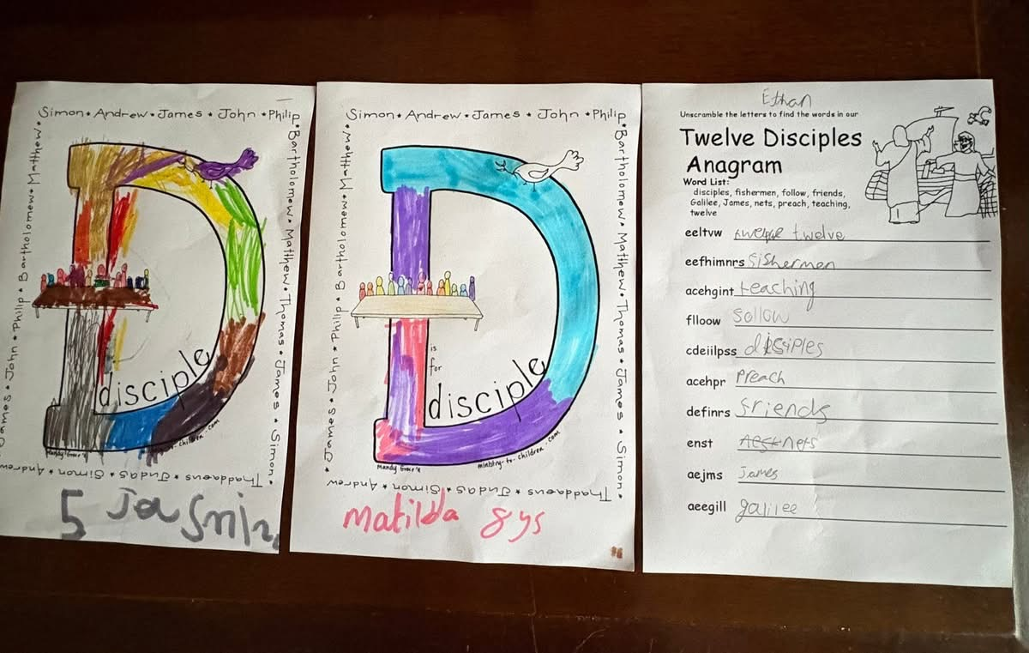

Slide 4
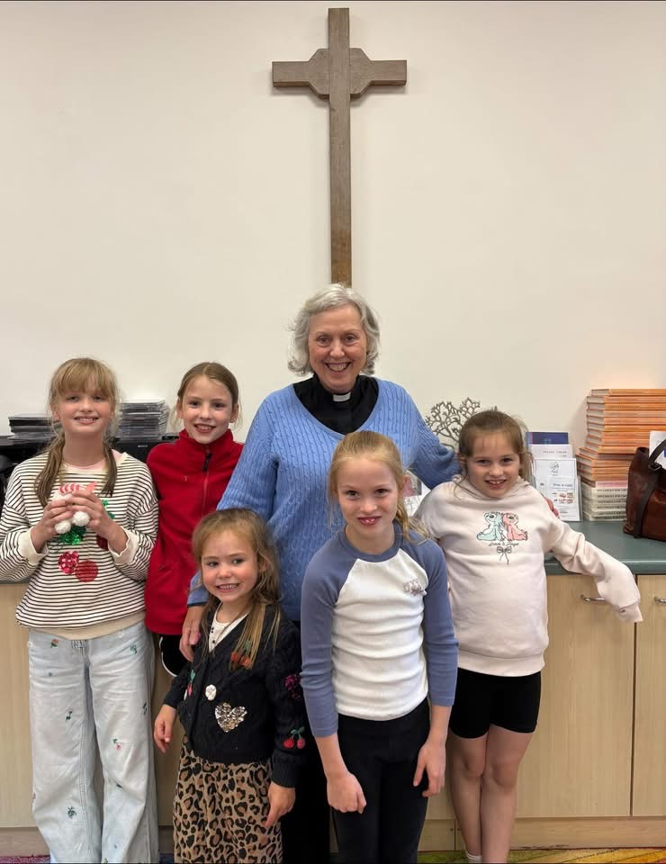

Slide 5
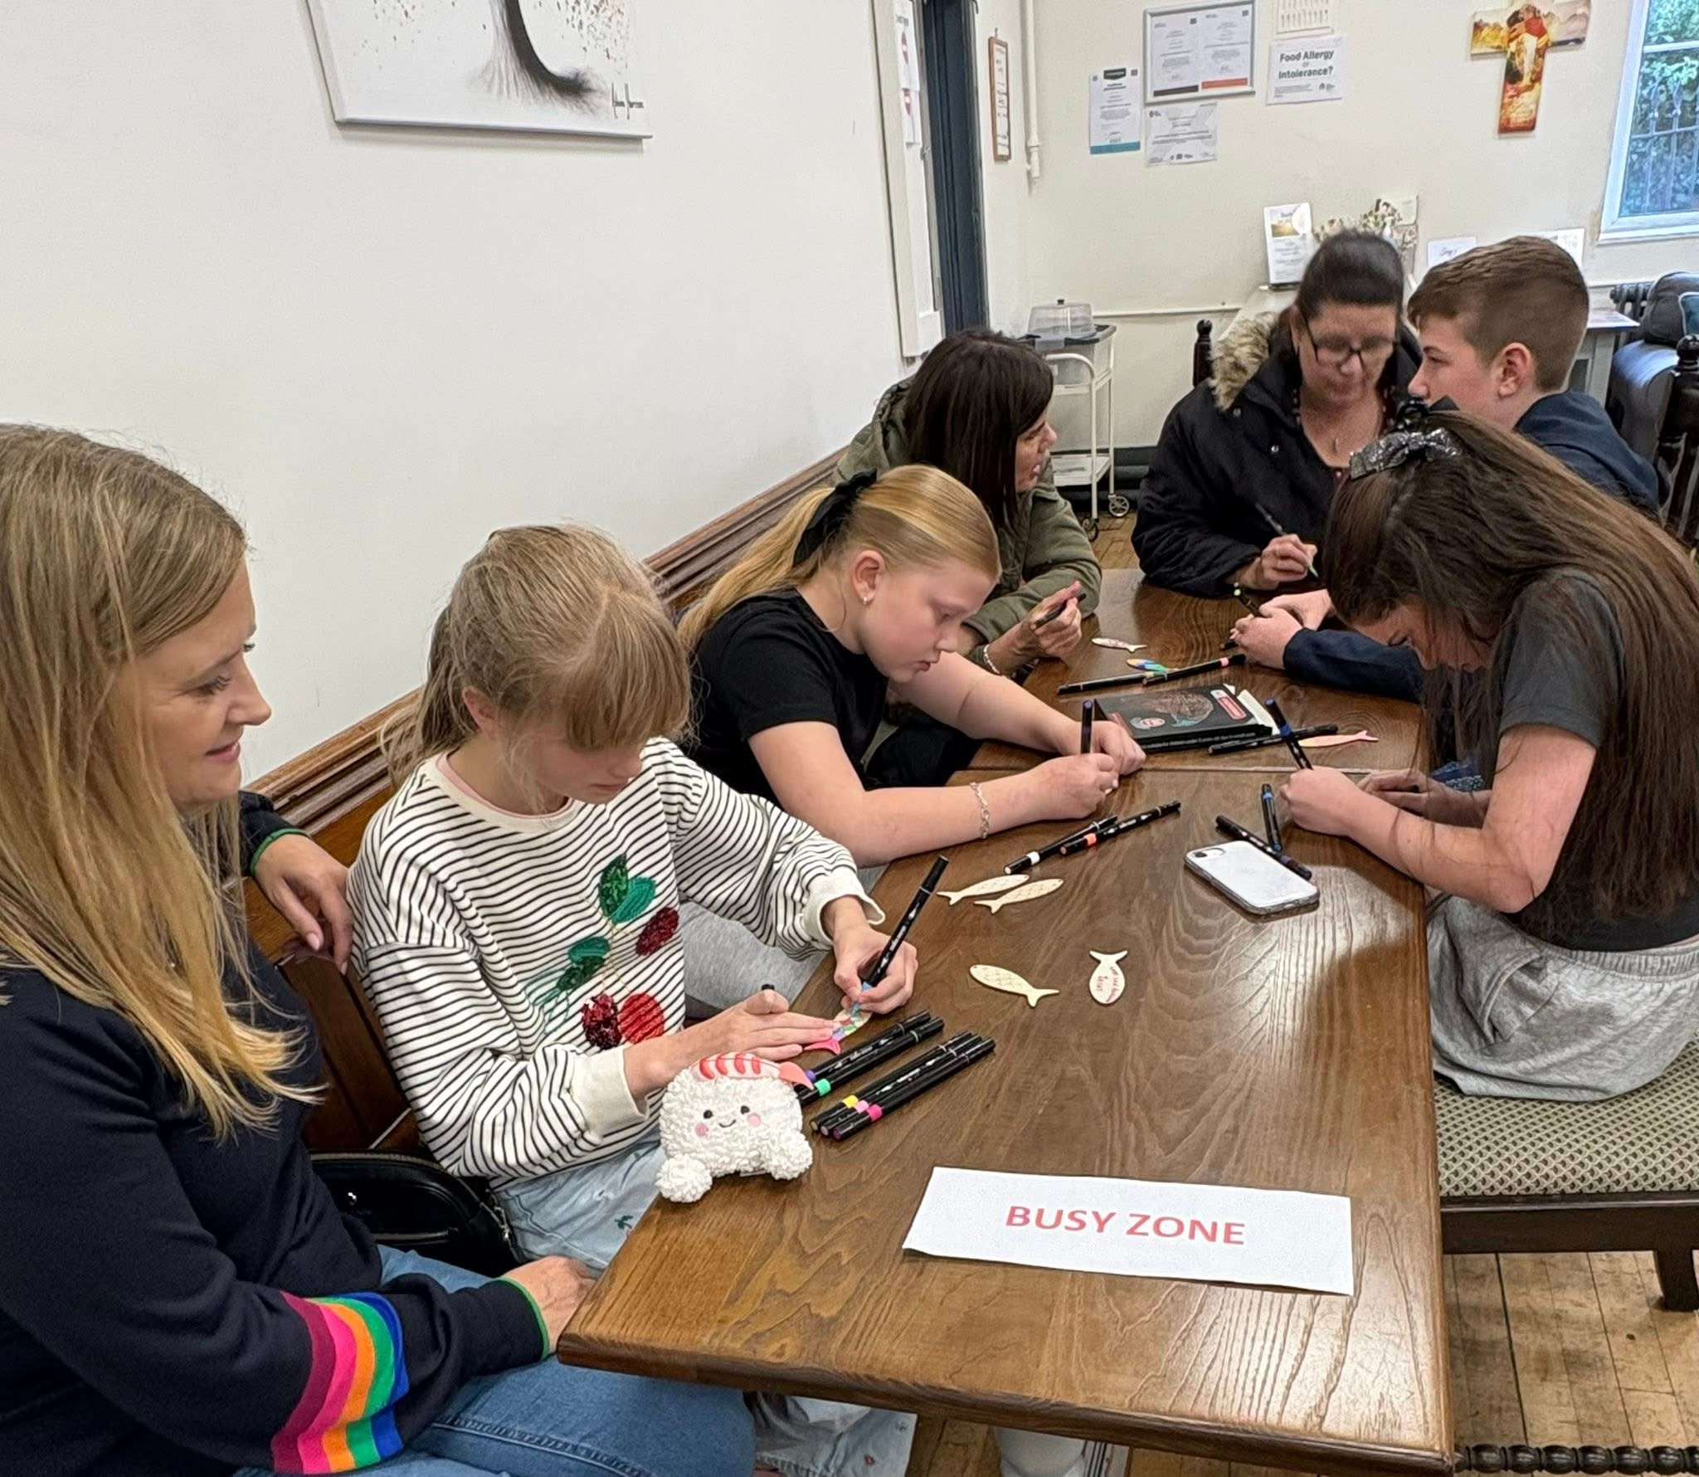

Slide 6
