Slide 1
Afternoon Tea
At the Refectory Fence

Slide 2
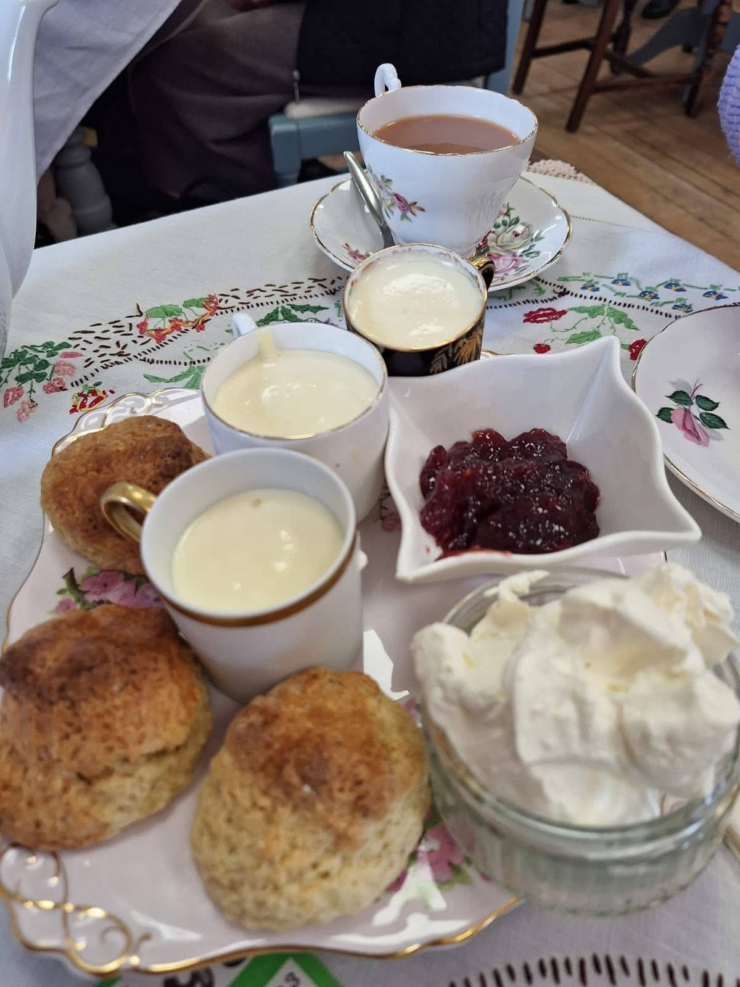

Slide 3
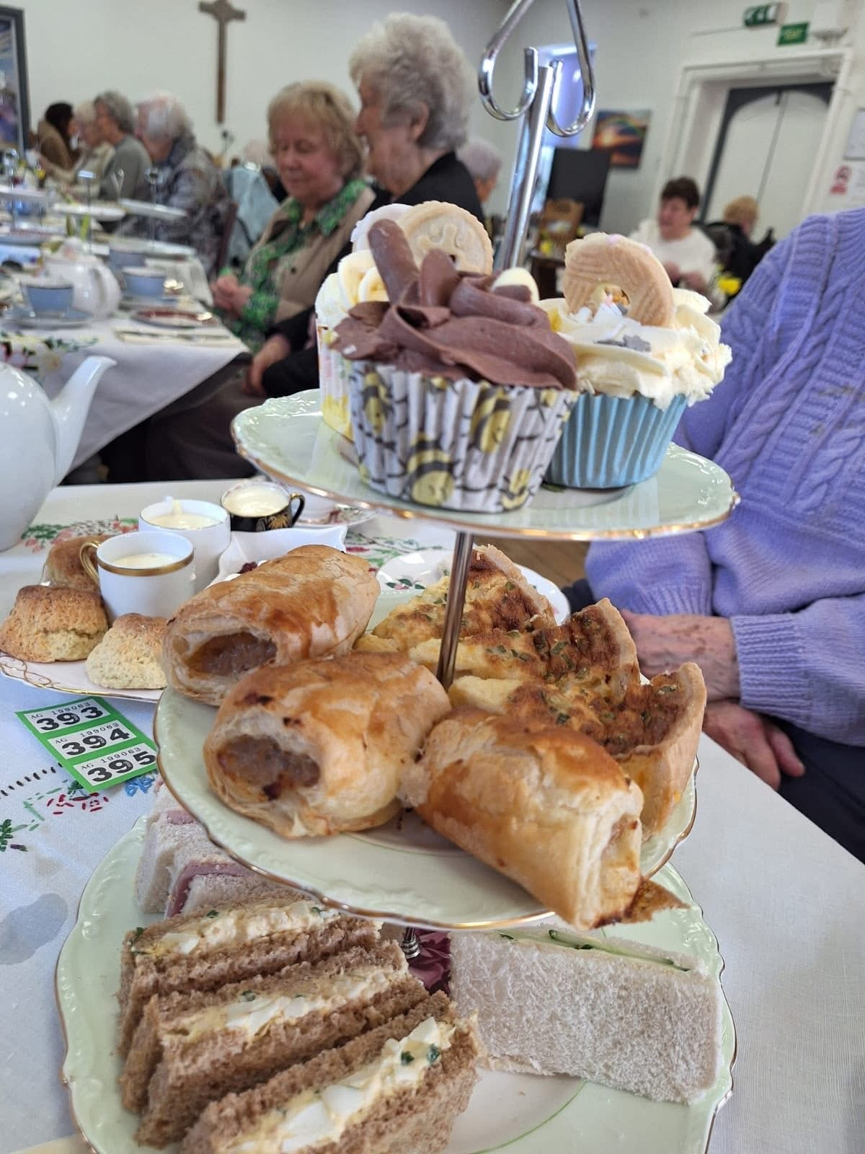

Slide 4
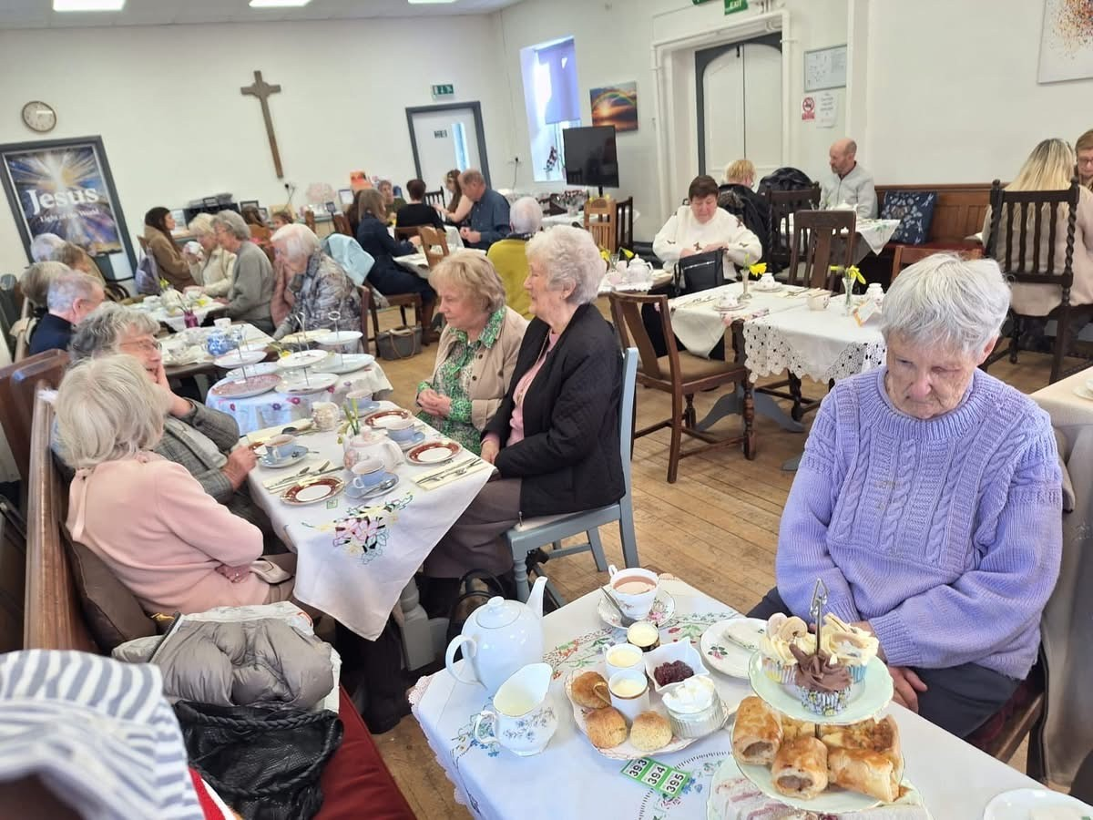

Slide 5
Afternoon Tea at The Refectory was a delicious success!! Thank you to all who helped and all who came.
Saturday 14th February, God provided the sunshine and Rosemary, and her team provided a delicious ‘posh afternoon tea!
We raised just short of £400 for much needed church funds (heating repairs needed in The Refectory)

