Slide 1
Curry and Quiz
Friday 27th February 2026

Slide 2
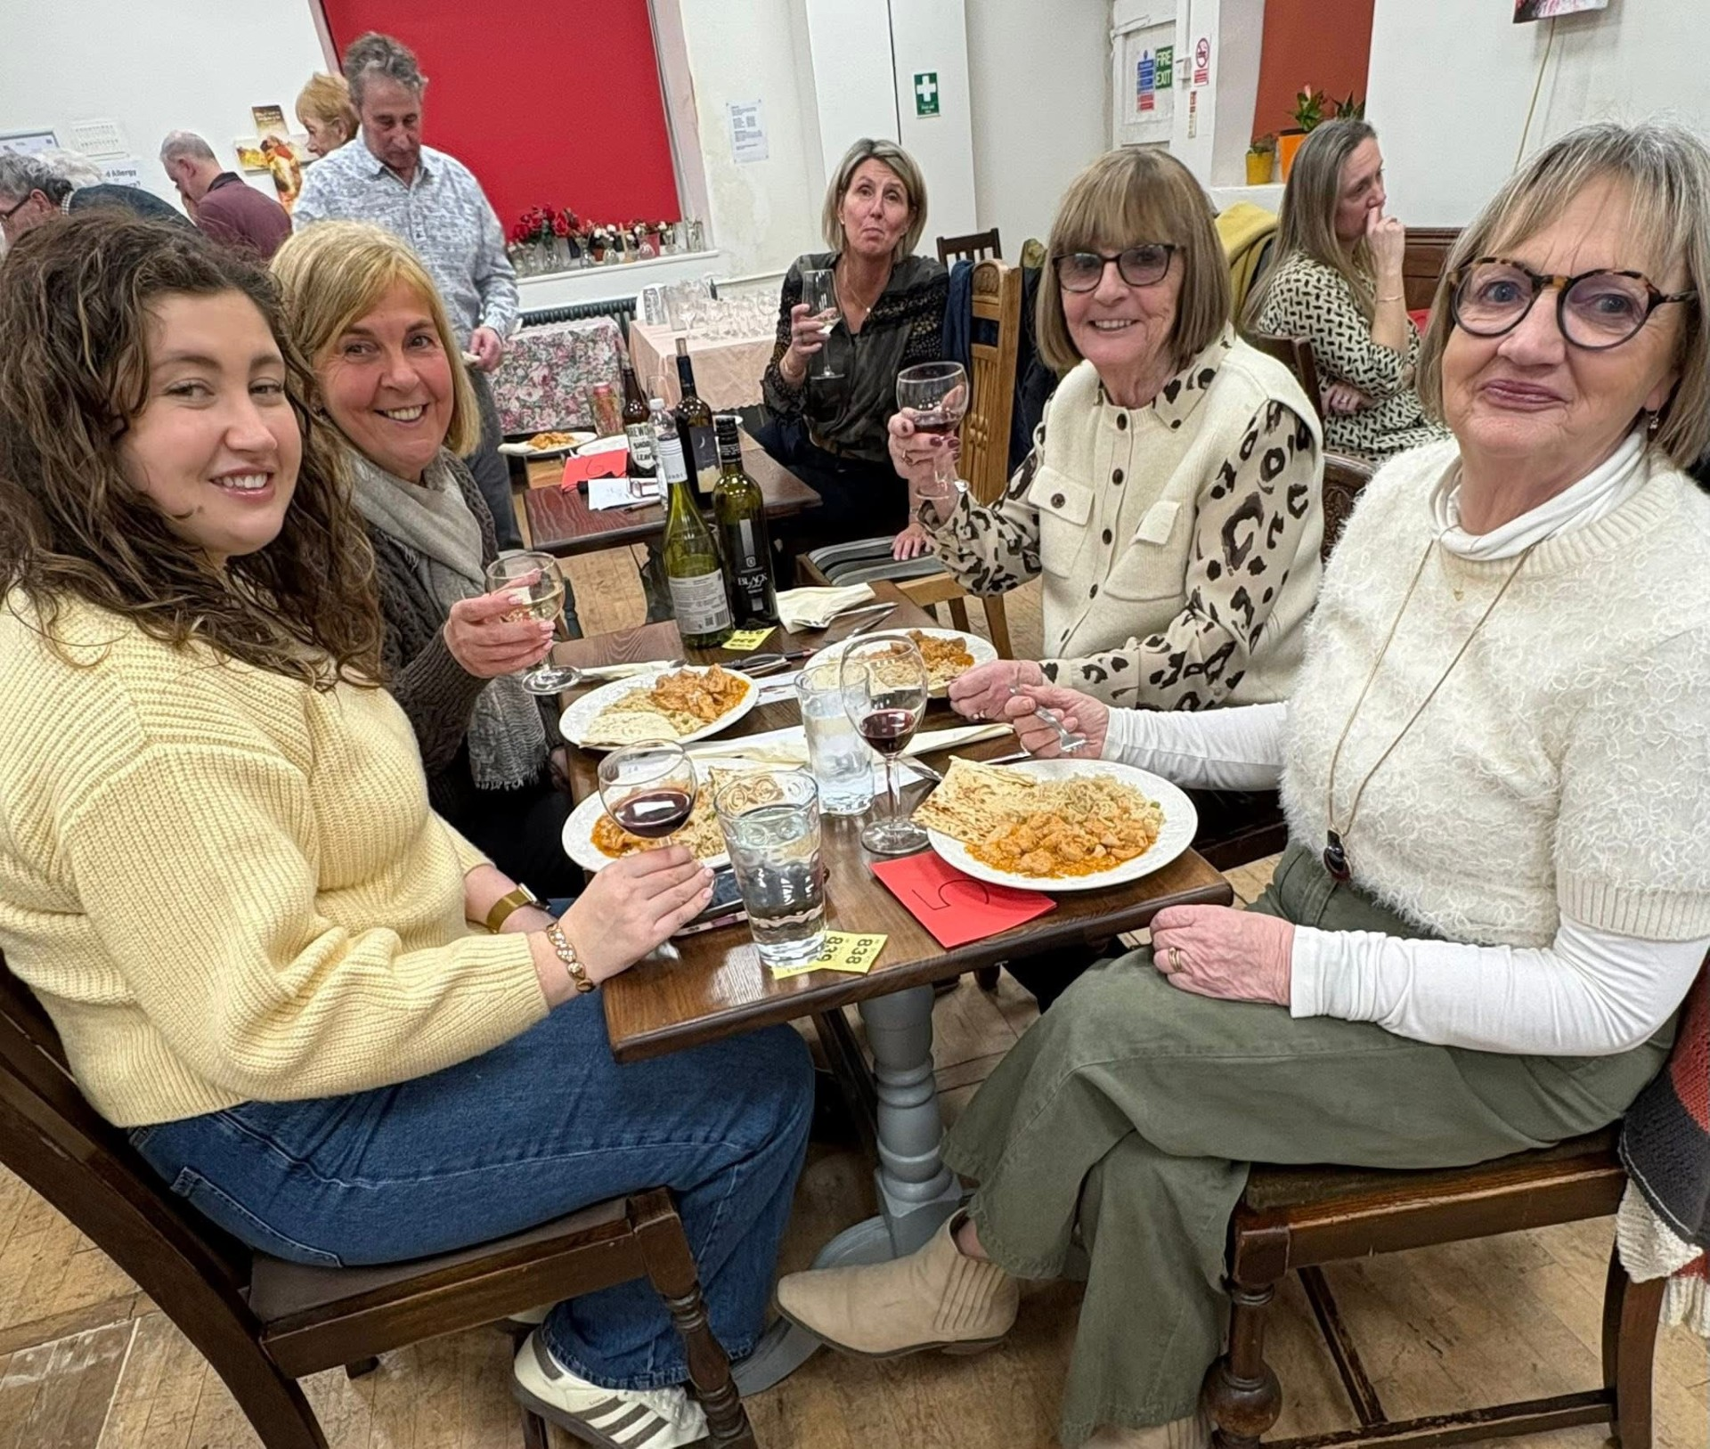

Slide 3
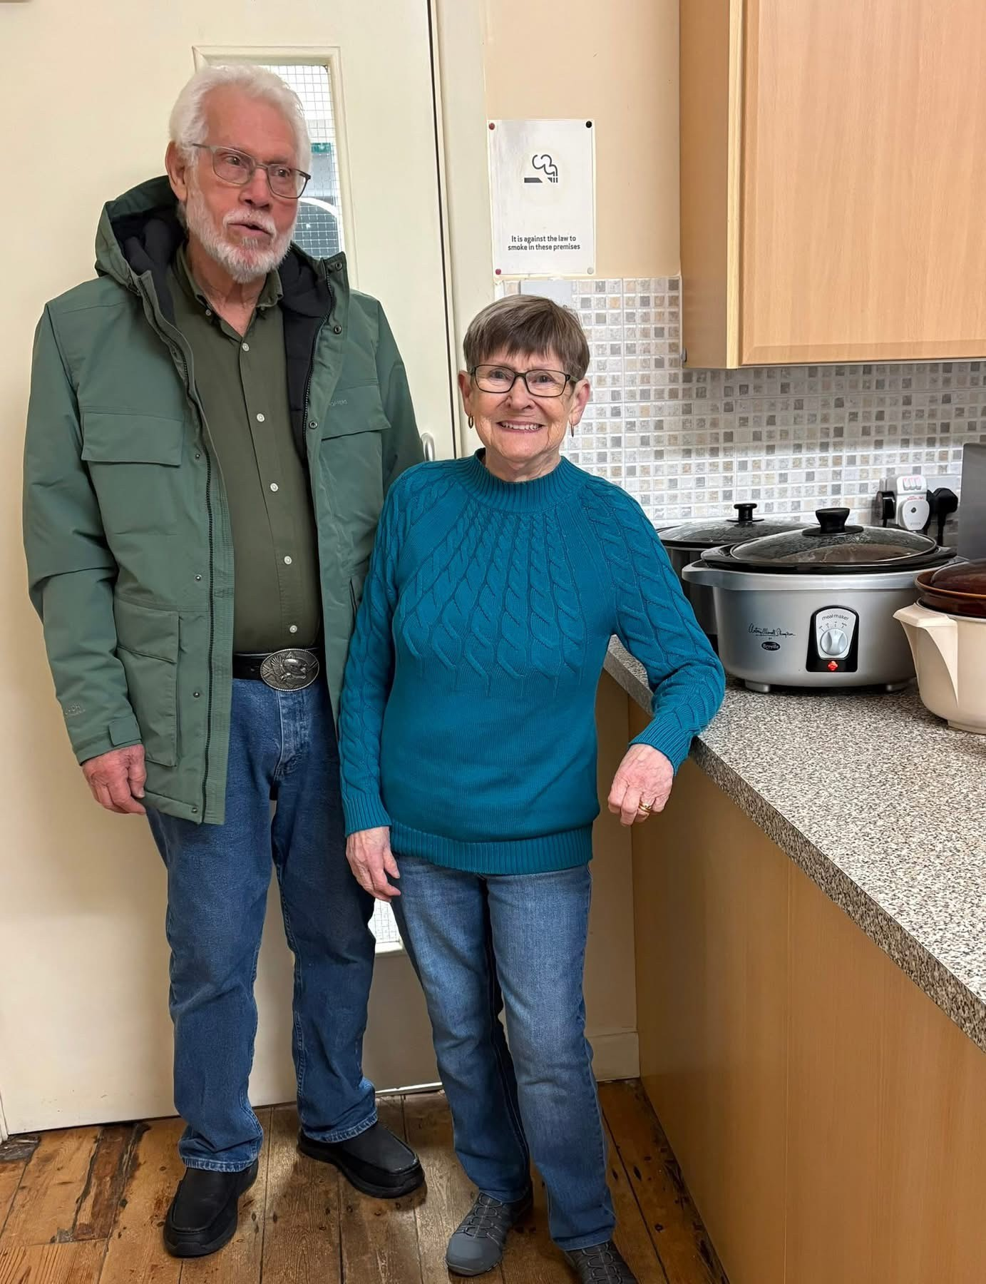

Slide 4
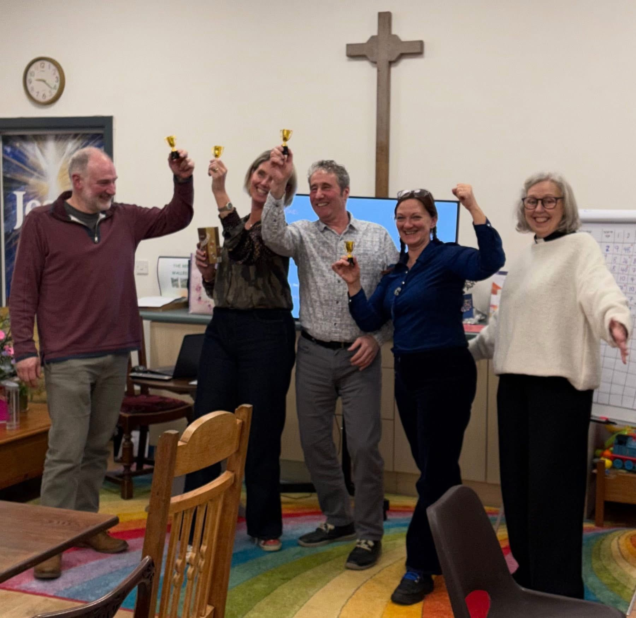

Slide 5
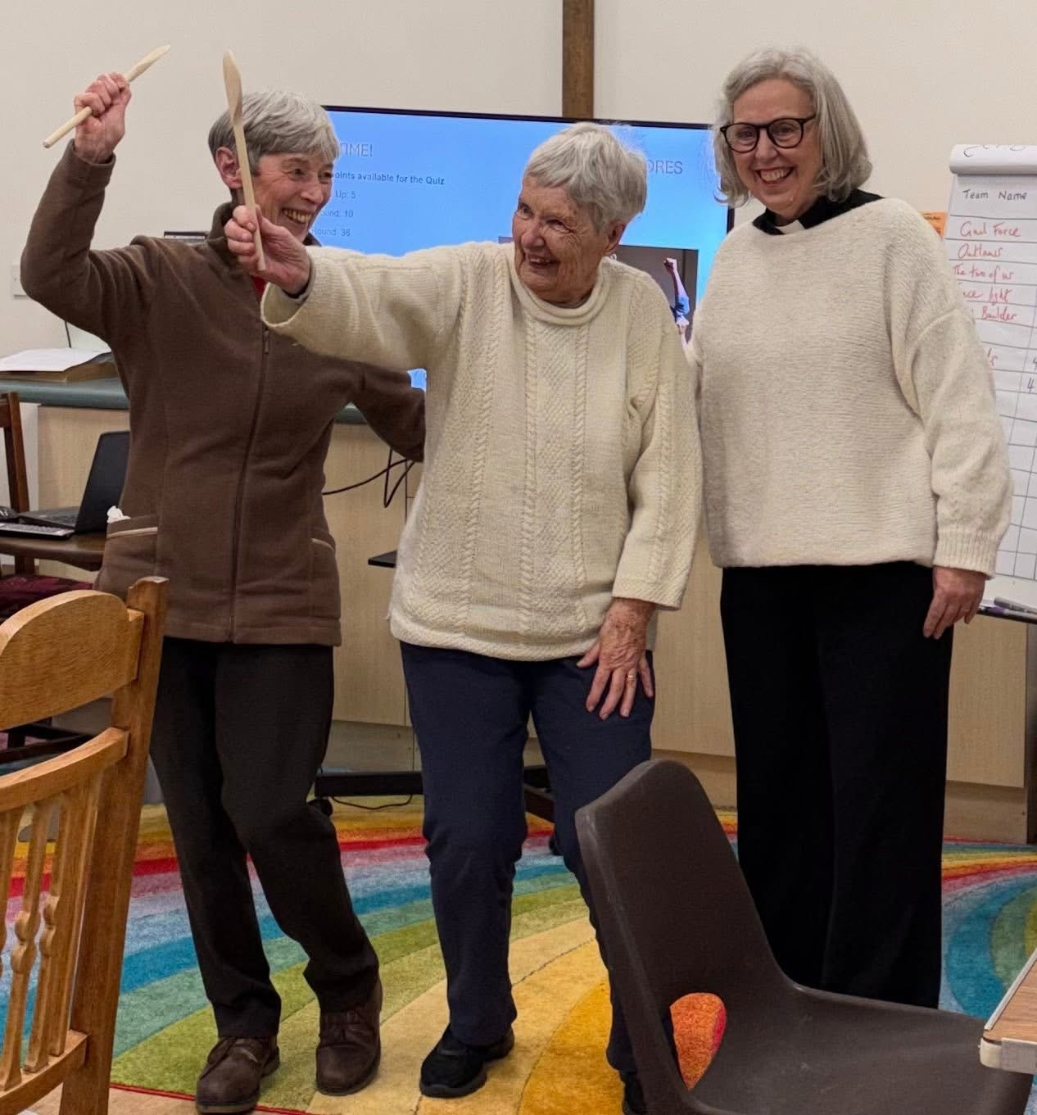

Slide 6
Thank you to all who helped on the night and all who came.
We made £360 for church funds
(Refectory water burst to repair!)

