Slide 1
Transforming Our Seating: From Pews to Chairs, and back to Pews
Exploring innovative seating solutions for better comfort, flexibility and Health & Safety
Notes:
AI-generated content may be incorrect. --- This presentation outlines our exciting project to improve seating by transitioning from traditional pews to modern chairs. We'll explore the current situation, benefits of change, and our plans for both short-term and long-term seating solutions.
1

Slide 2
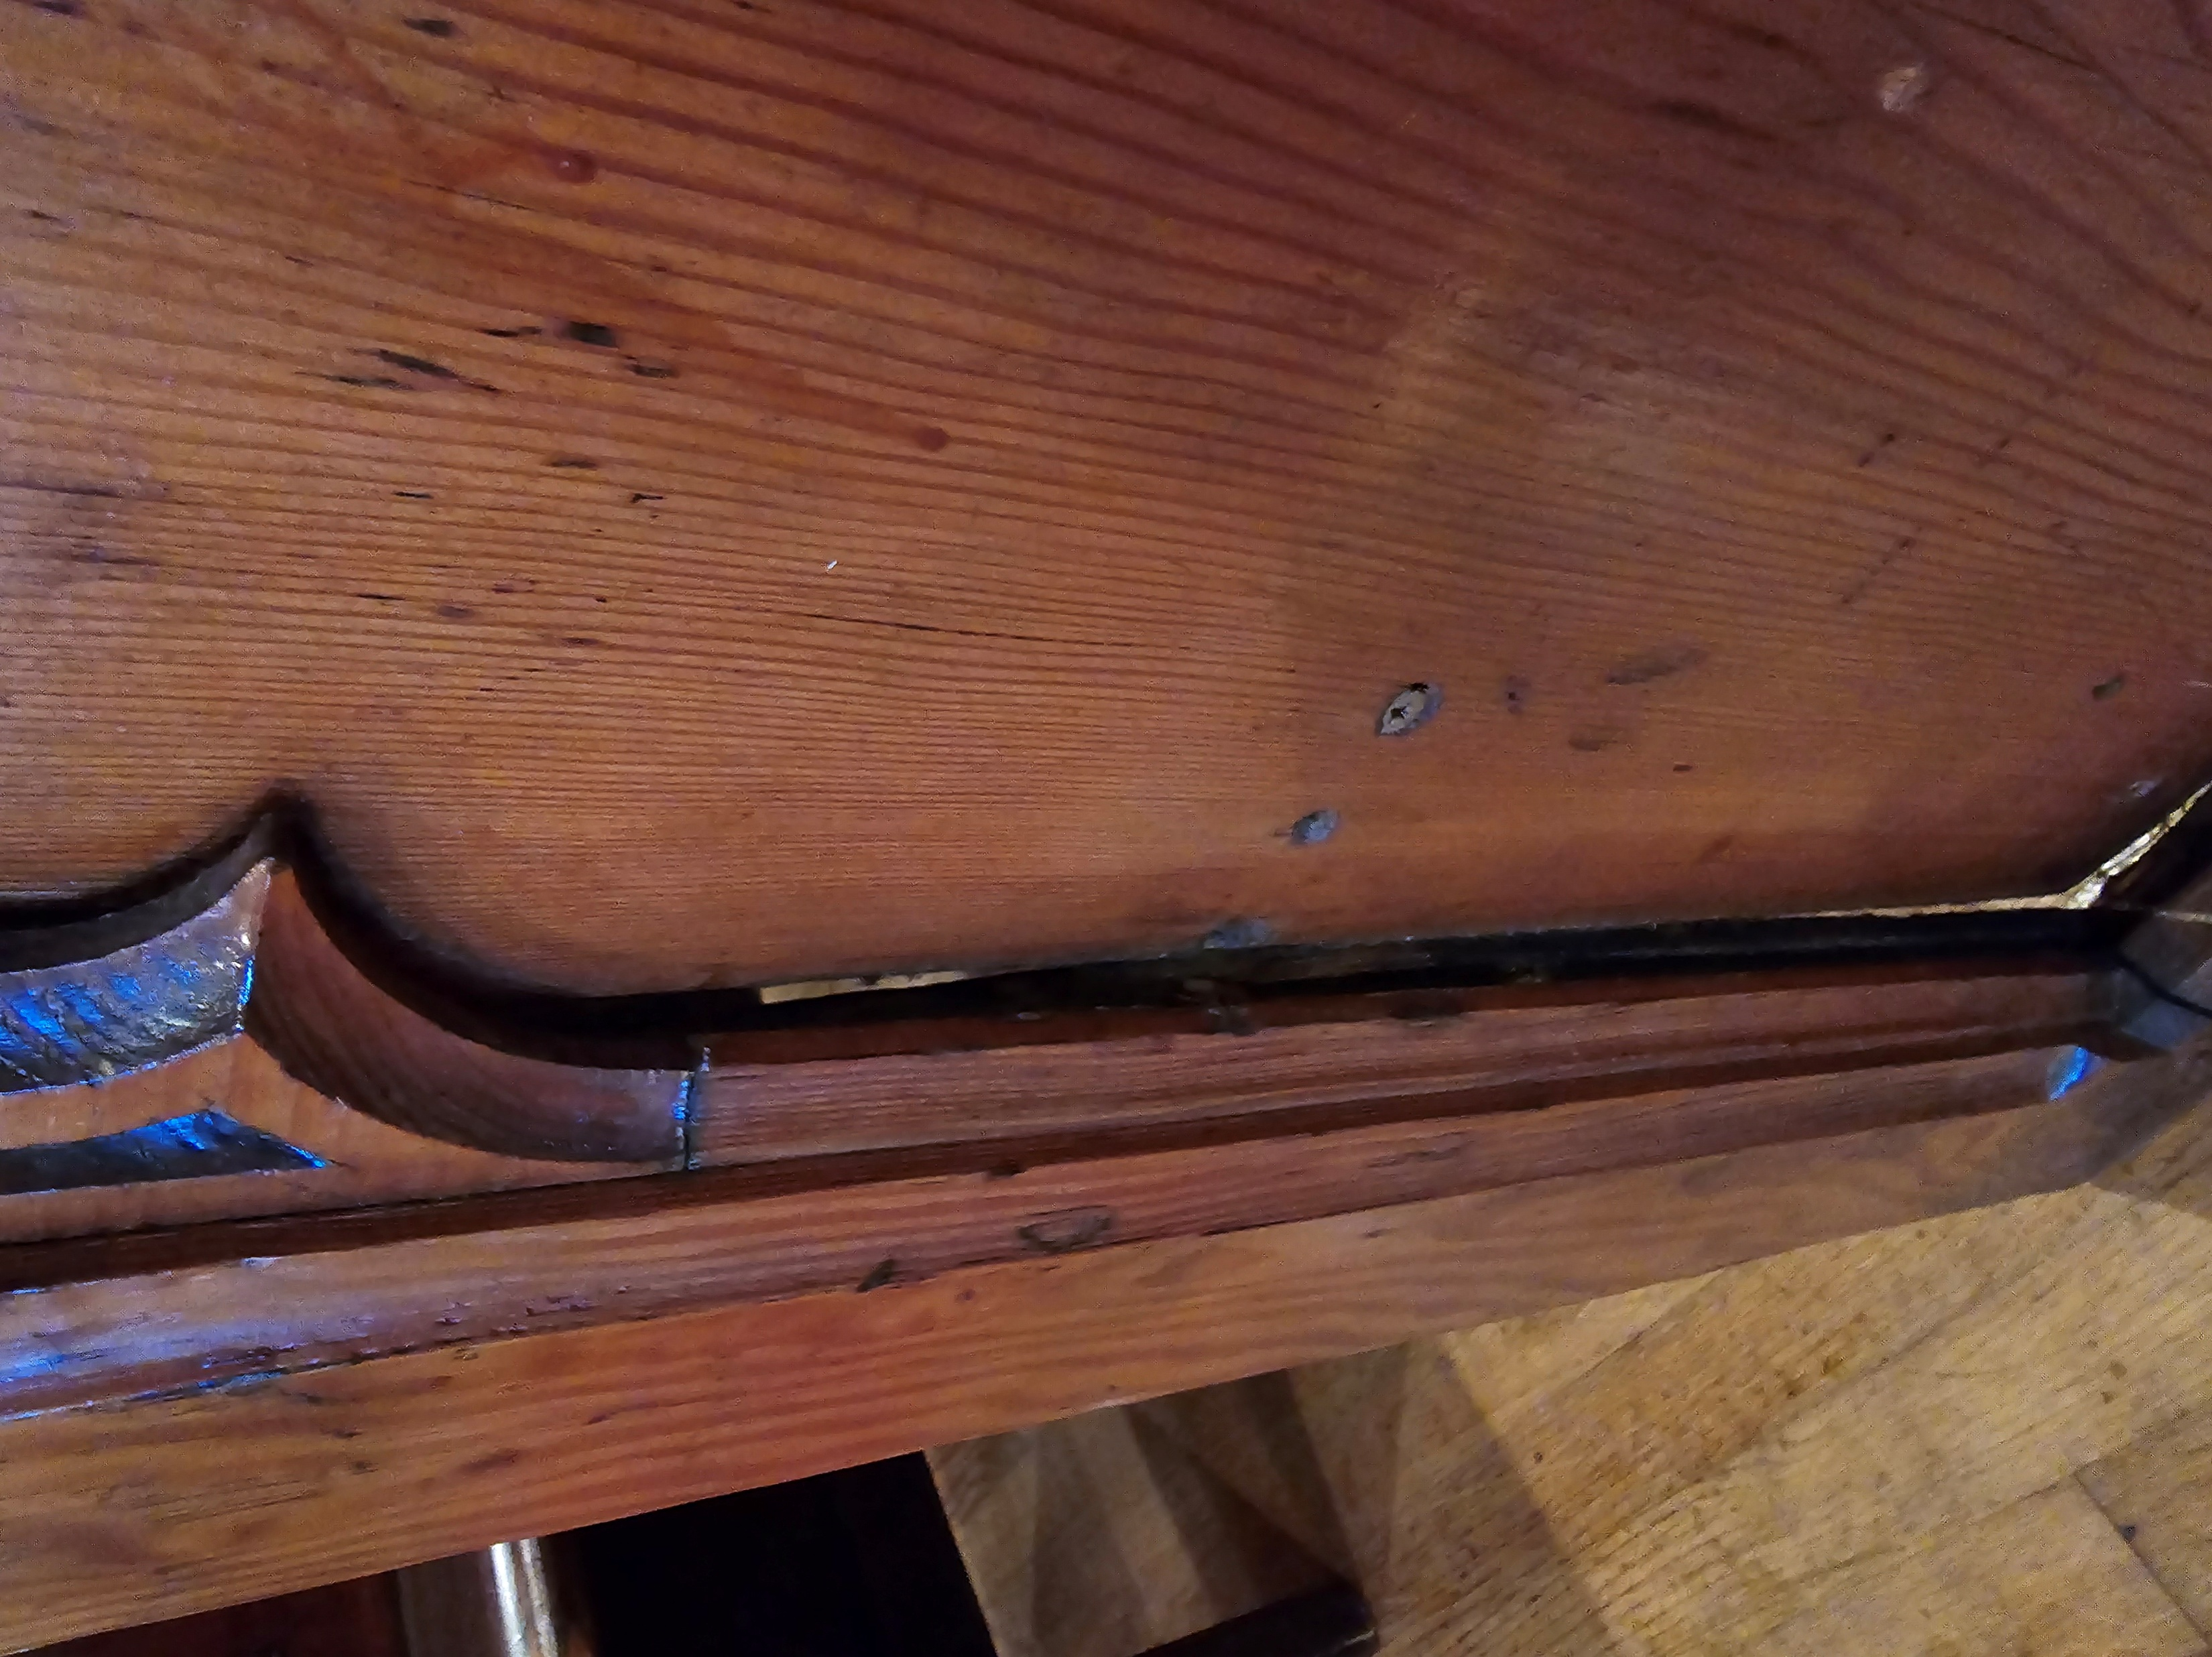
Current Seating Situation: Overview of Existing Pews
Wooden Pews
  The seating consists of a mix of wooden pews from various locations, brought to the church second hand in the mid ‘80’s to replace metal chairs.
Concerns & Limitations
  Current pews lack modern ergonomic comfort, which can affect prolonged seating experiences, they are heavy to move and in doing so scratch the floor. Many pews have been identified as being potentially dangerous due to joints coming part, splits in wood, previous repairs to screw the pews ends on are failing and the feet have worn to the point were pews tip if people sit too far forward.
Flexibility and Space Issues
  The design restricts adaptability and efficient use of available space for varying service requirements and does not meet accessibility needs in relation to the Disability Discrimination Act or Family Friendly policies.
Notes:
--- Our current seating consists of traditional wooden pews that have served us well but present limitations in comfort, flexibility, and space utilization. Understanding these constraints is essential for the forthcoming improvements. Image source: Microsoft 365 content library
2

Slide 3
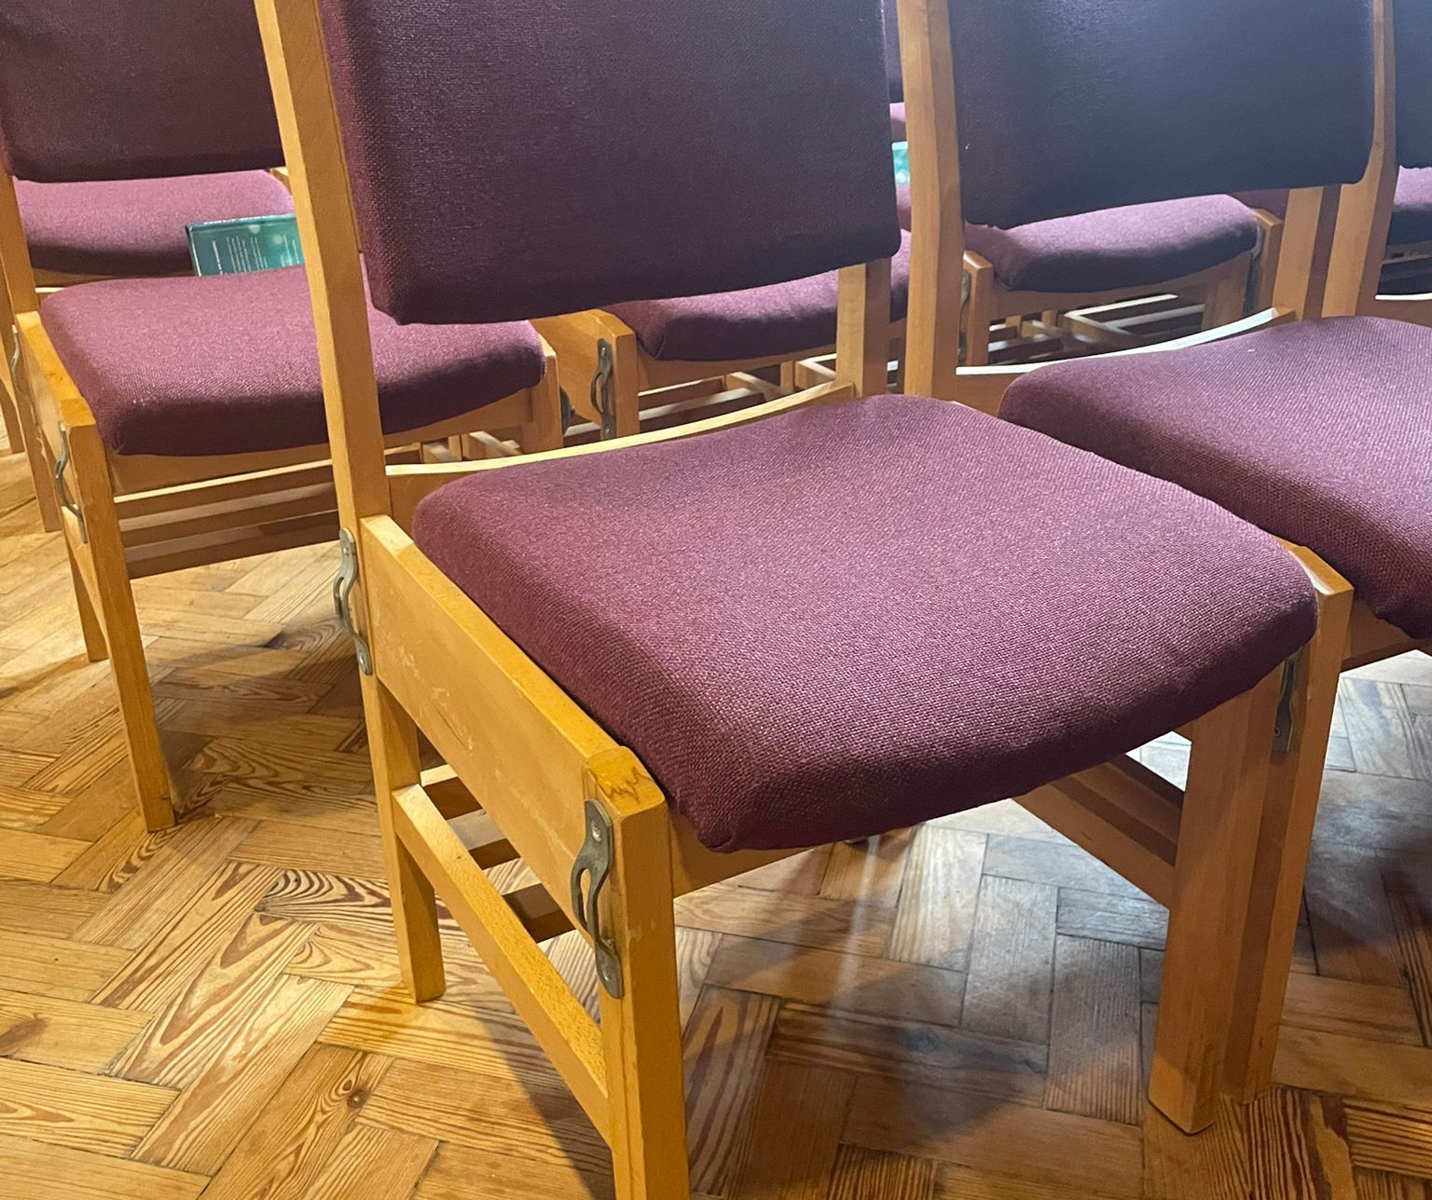
Motivation for Change: Benefits of Flexible Seating
Increased Comfort
  Modern chairs provide enhanced comfort, promoting better posture and longer engagement during events.
Easy Reconfiguration
  Flexible seating allows quick and simple rearrangement to suit different types of services, events and accessibility needs.
Improved Accessibility
  New seating options enhance accessibility, ensuring inclusive participation for all community members.
Inviting Atmosphere
  Flexible seating creates a welcoming and engaging environment that encourages interaction. Especially important as we seek to grow, with the help of a new Parish Priest.
Notes:
--- Switching to modern chairs offers numerous benefits including increased comfort, easier reconfiguration for different events, improved accessibility, and a more inviting atmosphere for our community. Image source: Microsoft 365 content library
3

Slide 4
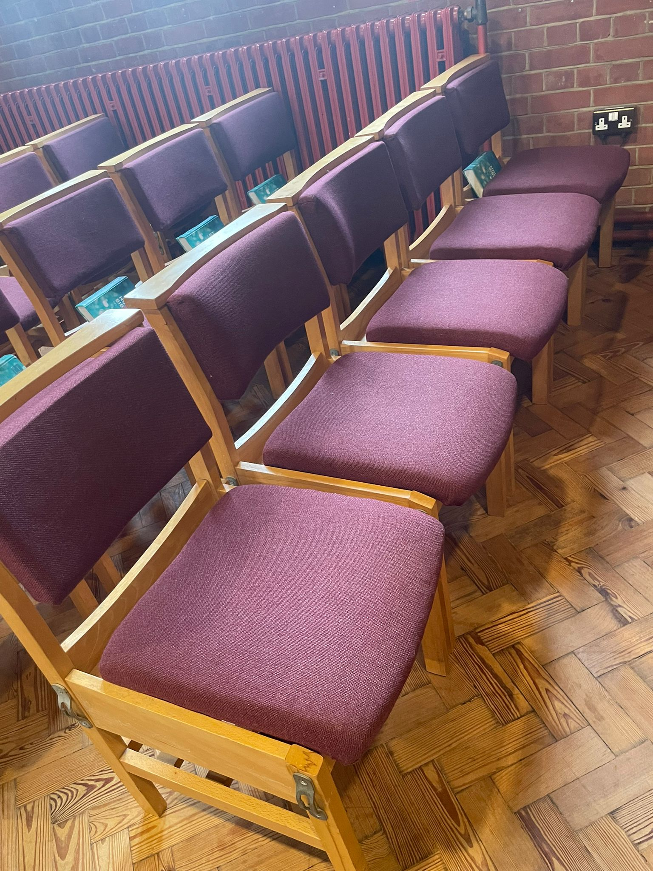
Short-Term Plan: Replacing Pews with Temporary Chairs
Temporary Seating Replacement
  Replacing pews with good quality, second hand, church chairs offers a fast, flexible, low-cost seating solution that meets our immediate goals and satisfies Health & Safety concerns.
Enhanced Comfort and Flexibility
  Temporary chairs improve comfort and allows us to assess what flexible space arrangements we need for the future, for various activities.
Feedback and Adjustment
  Gathering user feedback on temporary chairs guides future long-term seating decisions, in particular the outcome of the plan to re-introduce stacking pews in the medium- long term.
Notes:
--- Initially, we plan to replace pews with temporary chairs to quickly enhance comfort and flexibility. This approach allows us to gather feedback and adjust before finalizing long-term solutions. Image source: Microsoft 365 content library
4

Slide 5
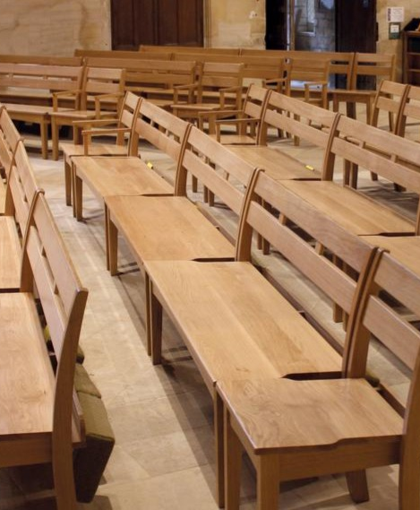
Long-Term Vision: Investing in new stackable Pews
Investment in Quality
  Focusing on high-quality stackable pews ensures durability and long-term value for our needs. One preferred option is for Oak, stacking Pews, from a company called Treske based in Thirsk. Examples of their work can be found in many Churches and Cathedrals, including our own Cathedral! Other quality manufacturers exist in the UK and Northern Ireland.
Comfort-Oriented Design
  Chairs designed for comfort support user well-being and encourage a welcoming environment.
Adaptability to Needs
  Stackable Pew configuration solutions are adaptable to evolving requirements and various uses. They can be easily moved on a specially designed trolley and can be configured to seat from 1-5, in whatever configuration is requested.
Notes:
--- Our long-term goal is to invest in high-quality, durable chairs designed for comfort and adaptability. This will create a welcoming environment tailored to our community's evolving needs. Image source: Microsoft 365 content library
5

Slide 6

Implementation Timeline and Key Milestones
Phases
  The project advances through structured phases: The Diocesan Advisory Committee has agreed to the faculty in principle, subject to a consultation period ending on 22nd August 2025. At which point any objections will be considered before the faculty is signed off. Once fully confirmed the chairs can be purchased and transported – the ones shown are from another C of E church.
  Community Engagement
  Notices are posted internally, externally and online. Families who original made donations forexisting pews and those with plaques, will be contacted directly. Where family members are known, they will be asked whether they wish to remove the pew for their own use or to reinvest it into the new proposals. Remaining pews will be offered for sale to the community first, before an external company is contacted.
Notes:
--- The project will proceed through clear phases, including assessment, temporary chair installation, feedback collection, and final chair acquisition. Key milestones will keep the community informed of progress. Image source: Microsoft 365 content library
6

Slide 7
Conclusion
Enhanced Comfort
Flexibility and Adaptability
Modern chairs provide improved comfort compared to traditional pews, encouraging longer and more enjoyable use.
Replacing pews with chairs increases space flexibility and allows for easier reconfiguration of the environment. An assessment can then be made about future requirements for stackable pews, for which fundraising will be needed.
Notes:
Transitioning from pews to modern chairs promises to enhance comfort and flexibility in our space. With your support and involvement, we look forward to creating a more inviting and adaptable environment for everyone.
7

