Slide 1
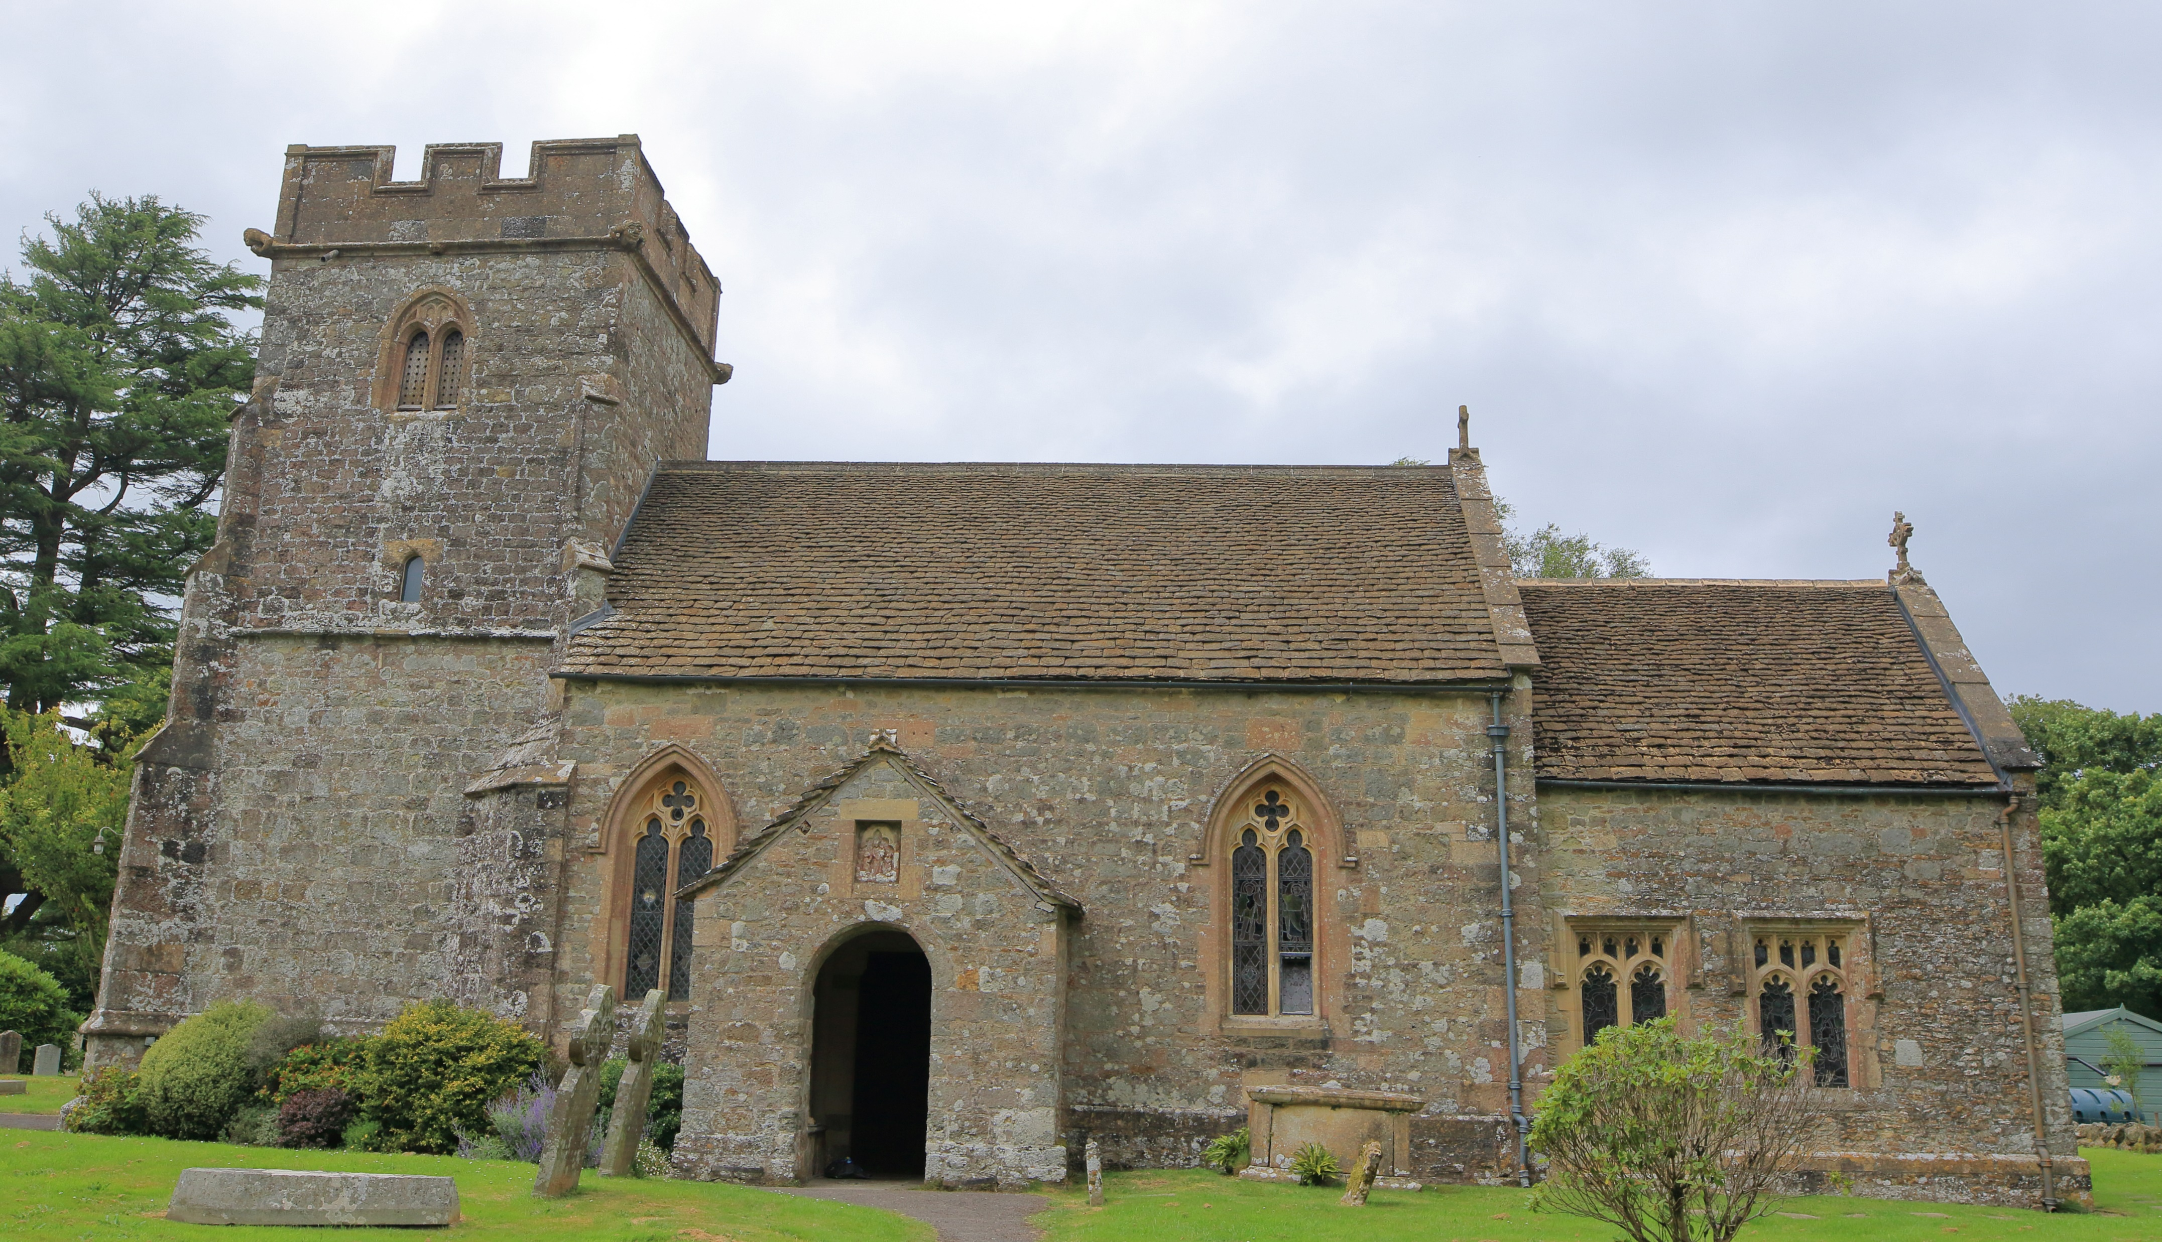
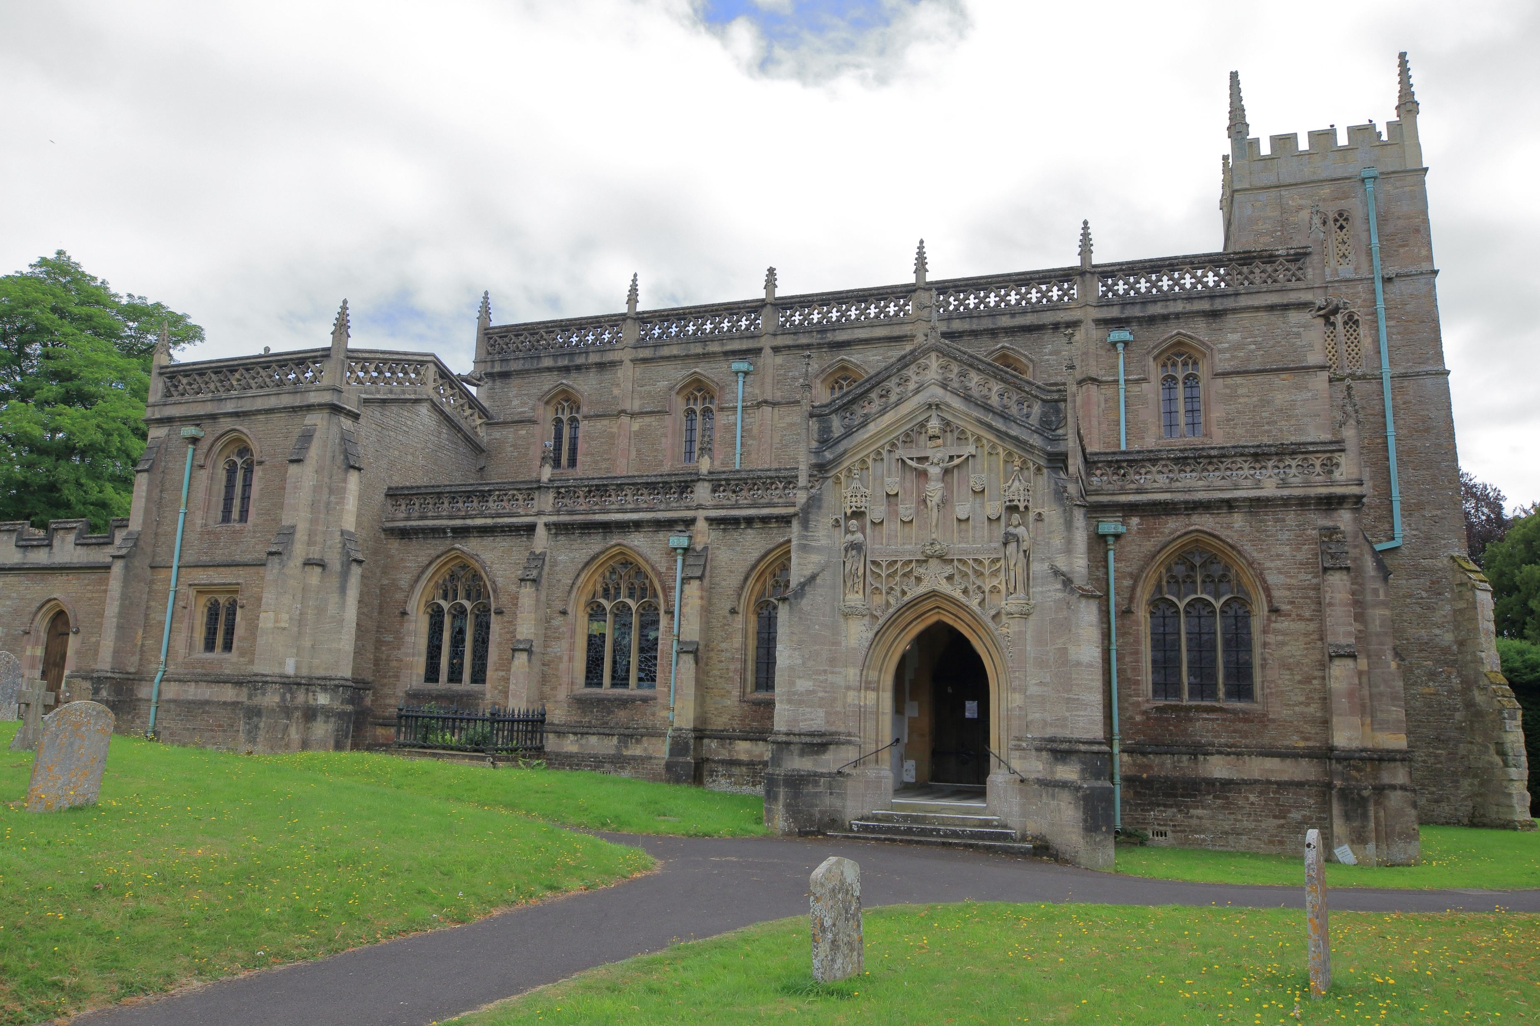
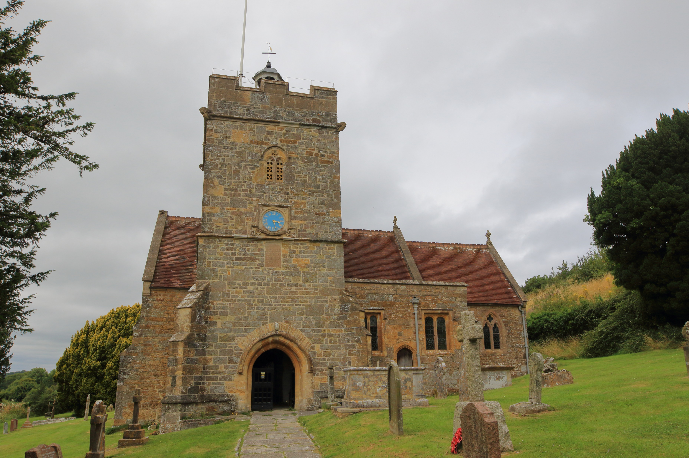
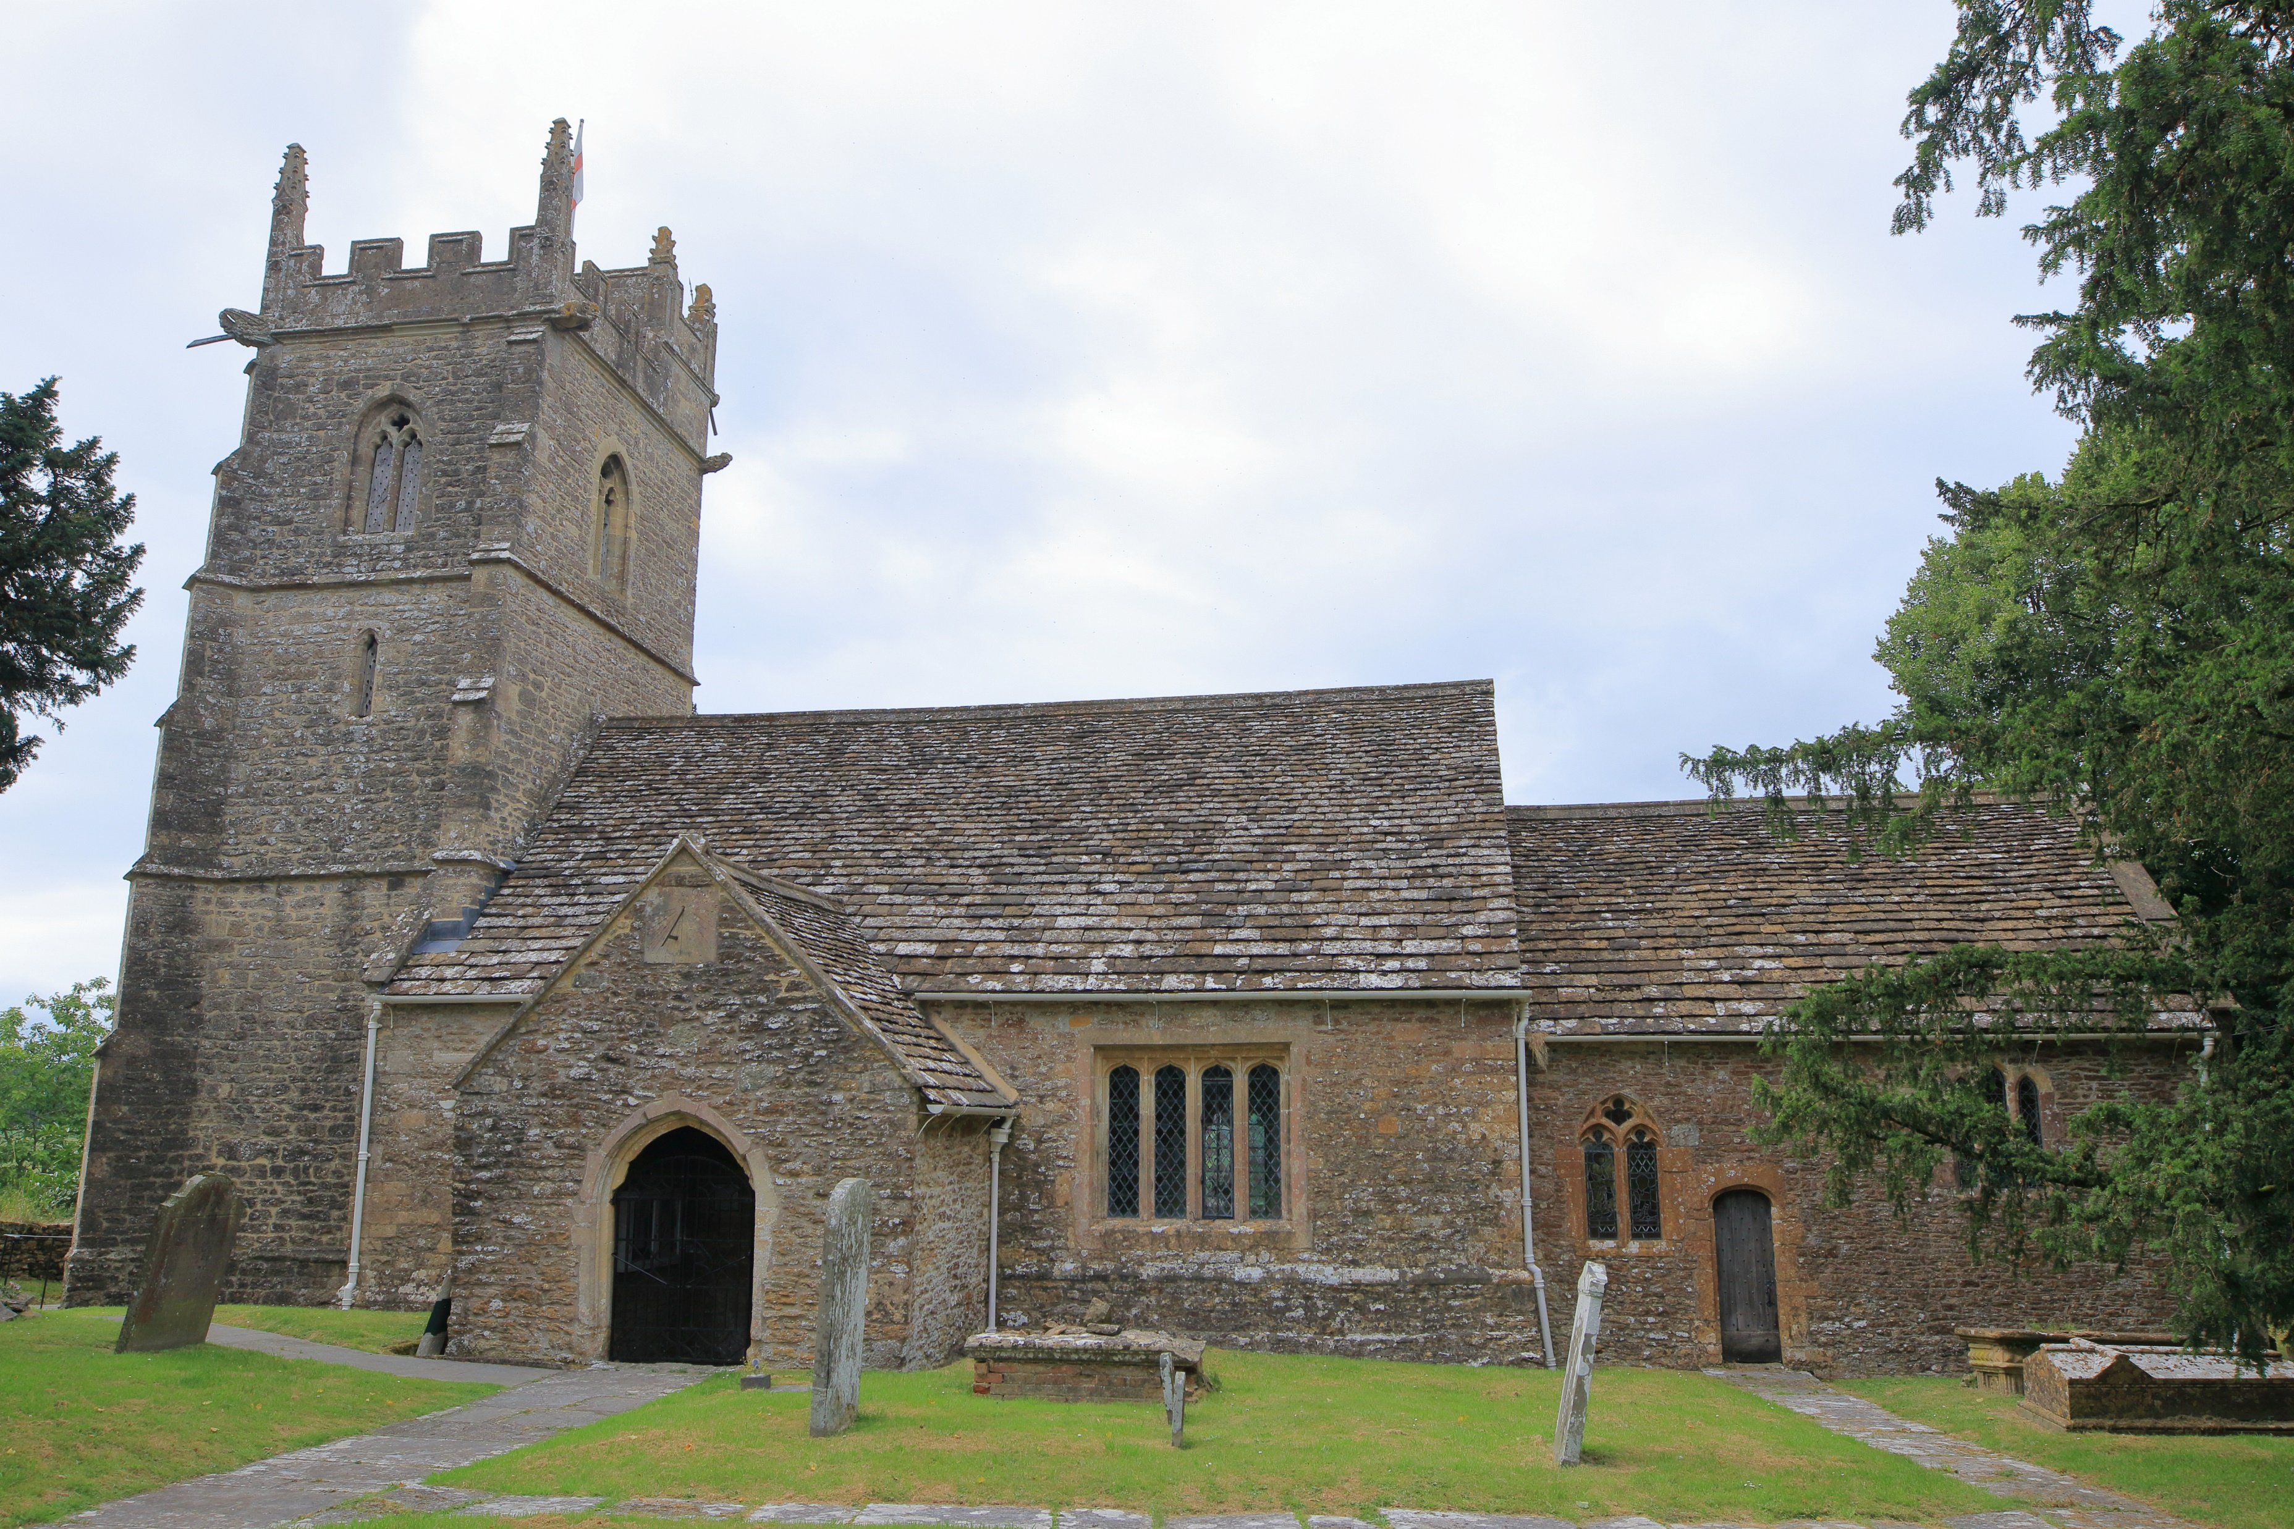
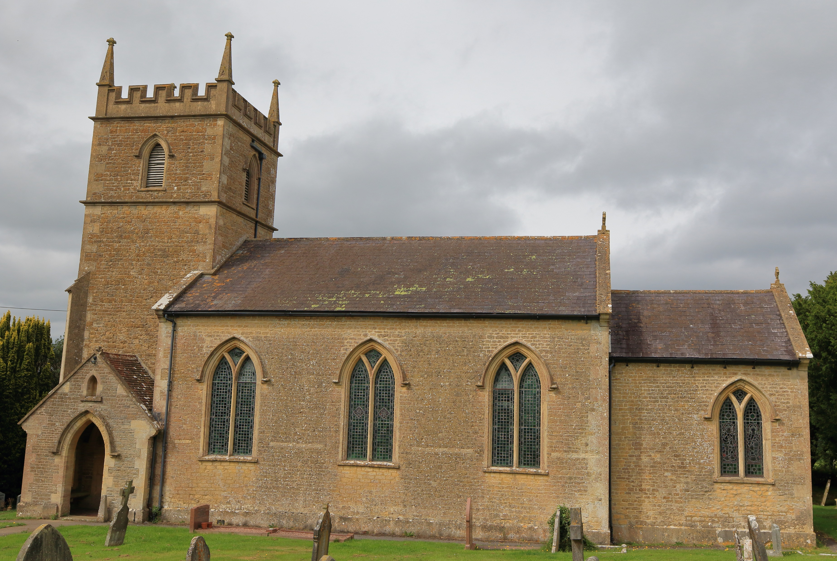
WORSHIP PLAN – NOVEMBER 2026
Sunday 1st November
9am Rise & Shine Families St Michael’s Church, Pen Selwood
9am Holy Communion St Lawrence’s Church, Cucklington
10am Café Church St John’s Church, Charlton Musgrove
10:30am Holy Communion St Peter & St Paul’s Church, Wincanton
6pm All Souls Service St Peter & St Paul’s Church, Wincanton
Sunday 8th November
10:45am Remembrance Service St Peter & St Paul’s Church, Wincanton
10:45am Remembrance Service St Andrew’s Church, Stoke Trister
10:55am Remembrance Service St Michael’s Church, Pen Selwood
Sunday 15th November
9am Holy Communion St Lawrence’s Church, Cucklington
9am Morning Service St Michael’s Church, Pen Selwood
10am Morning Praise St John’s Church, Charlton Musgrove
10:30am Holy Communion St Peter & St Paul’s Church, Wincanton
Sunday 22nd November
10:30am Whole Benefice Communion–St Stephen’s Church, Charlton Musgrove
Sunday 29th November
10:30am Whole Benefice Advent Service–St Andrew’s Church, Stoke Trister
For more information contact office@wincantonparishchurch.co.uk
01963 824503

