Slide 1


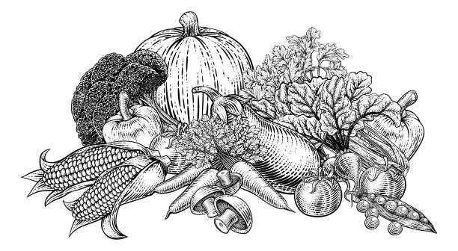
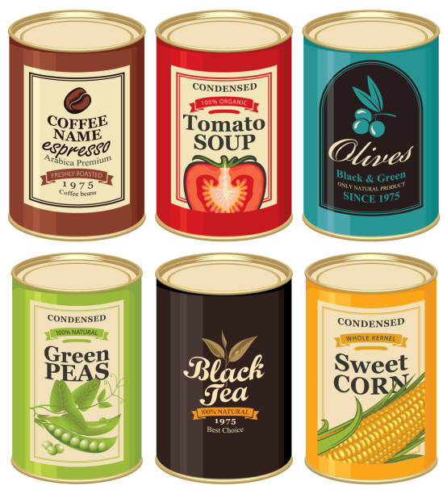

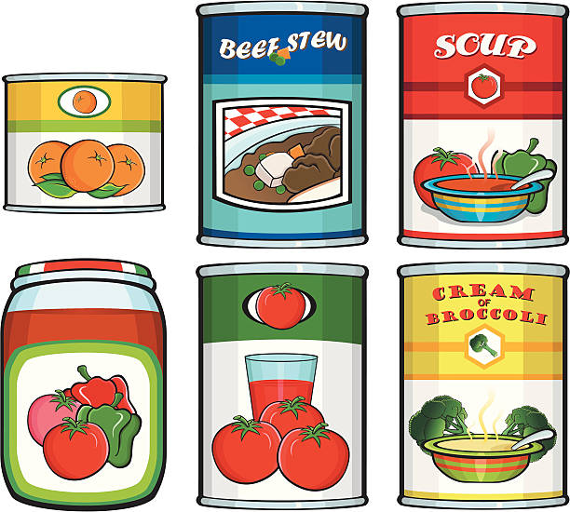
HARVEST FESTIVAL
4th October 10.30am
We are collecting for Edenbridge Food Bank.
No perishable goods please – tins & dried food in date very much appreciated. Leave in box at the back of Church.
A very warm welcome to all

