Slide 1
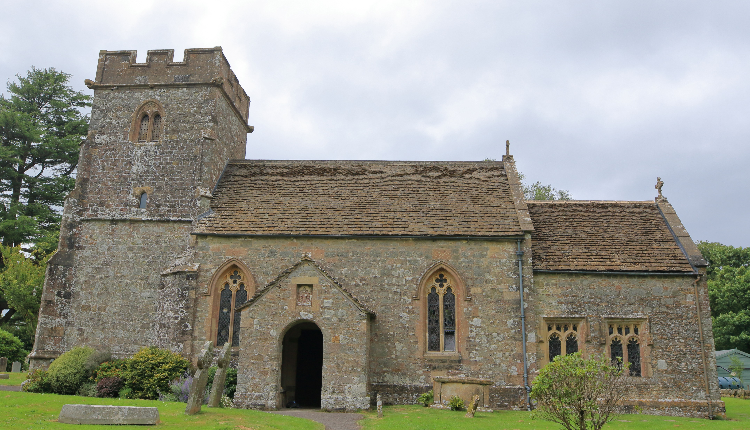
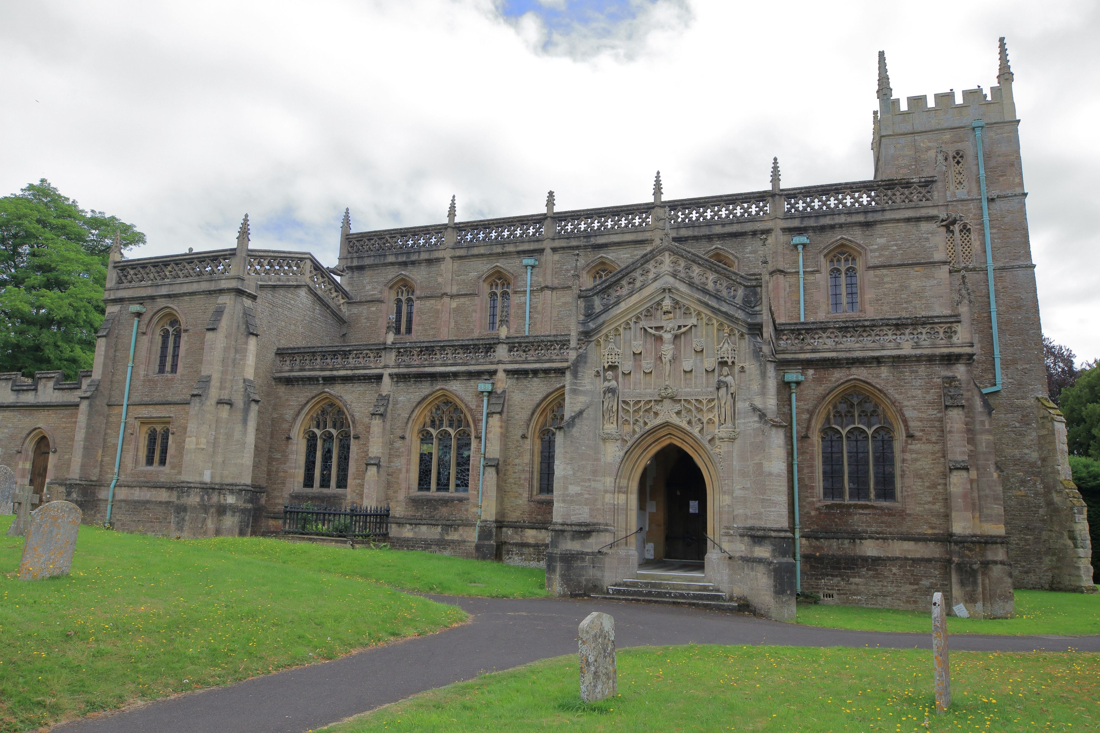
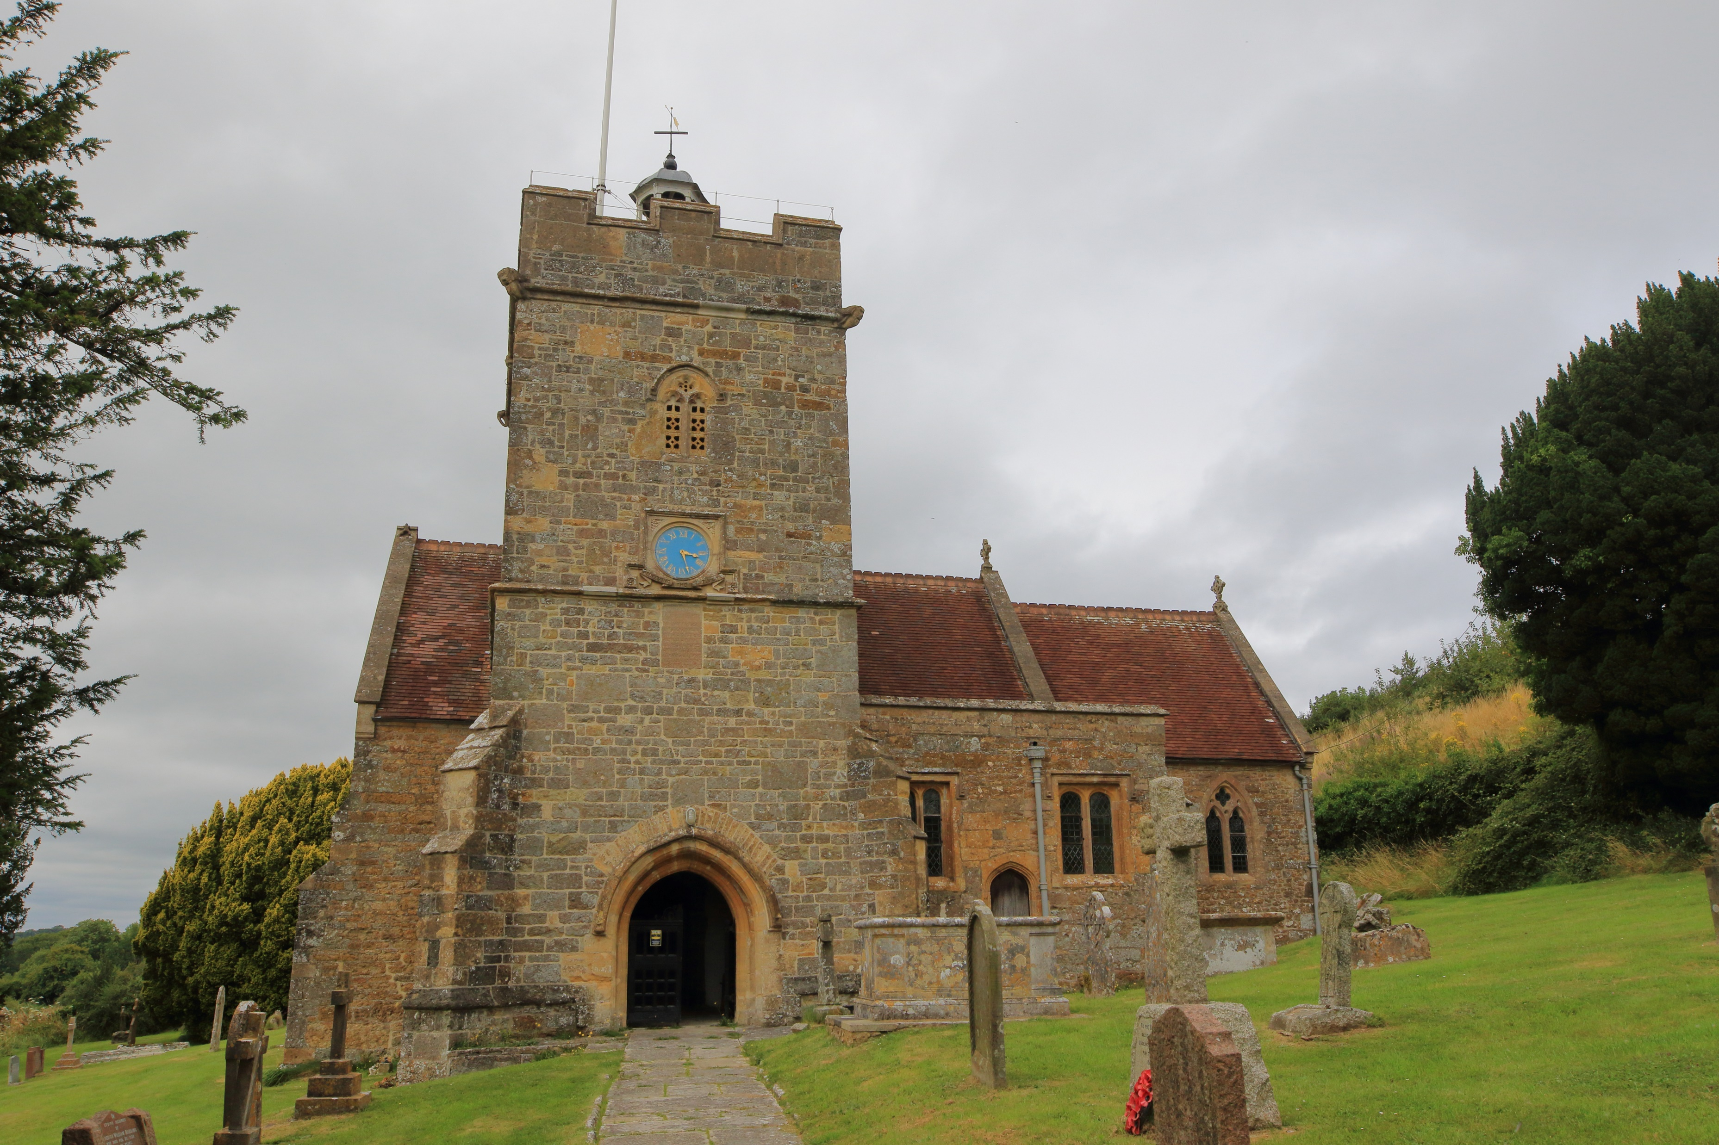
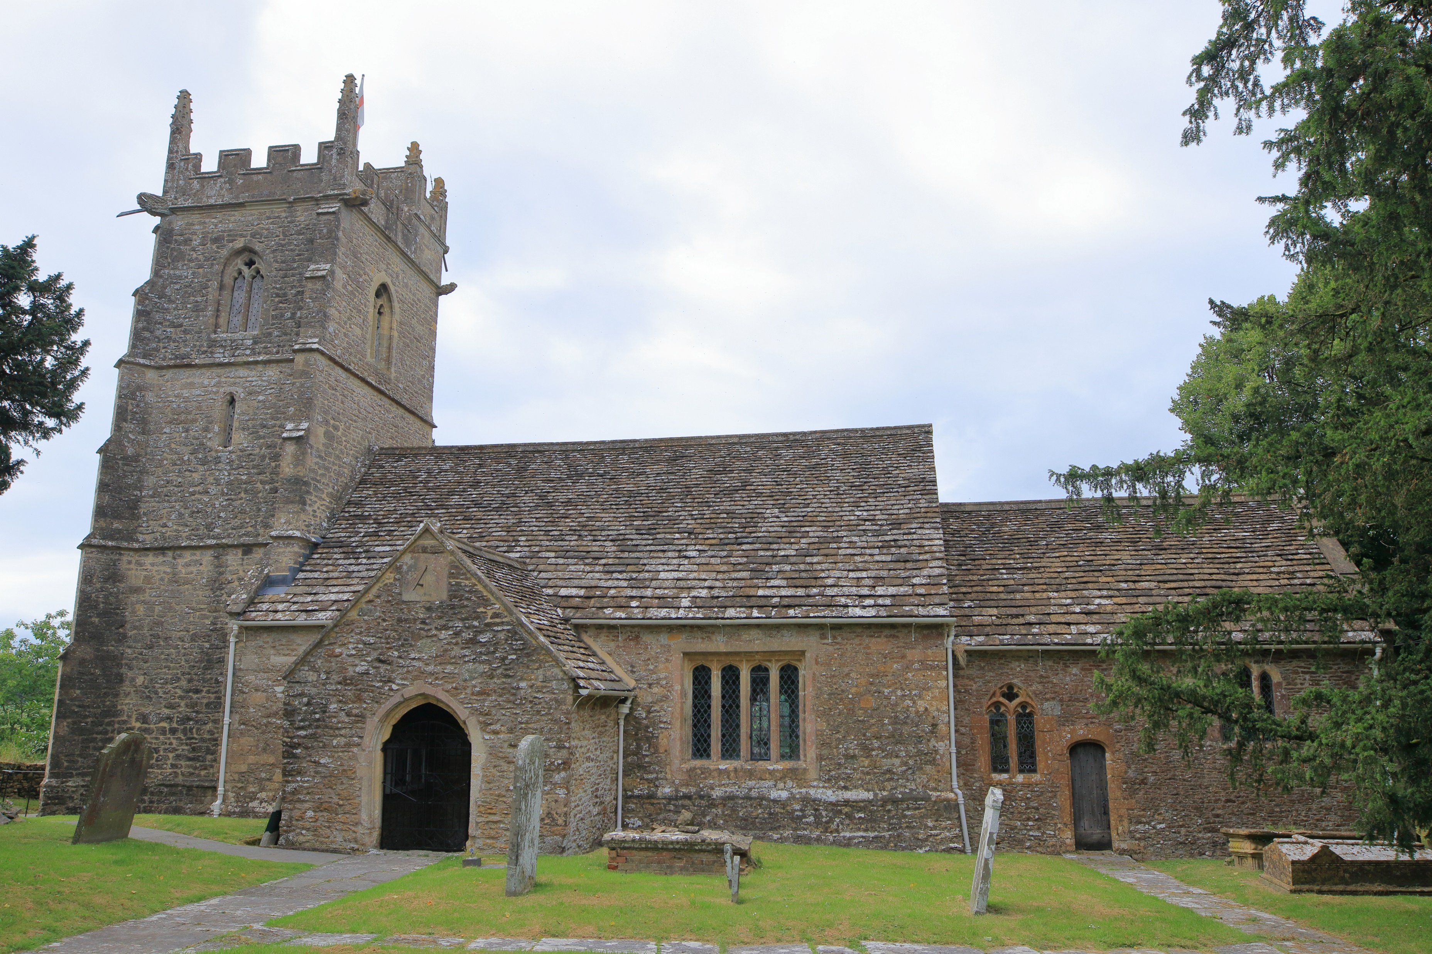
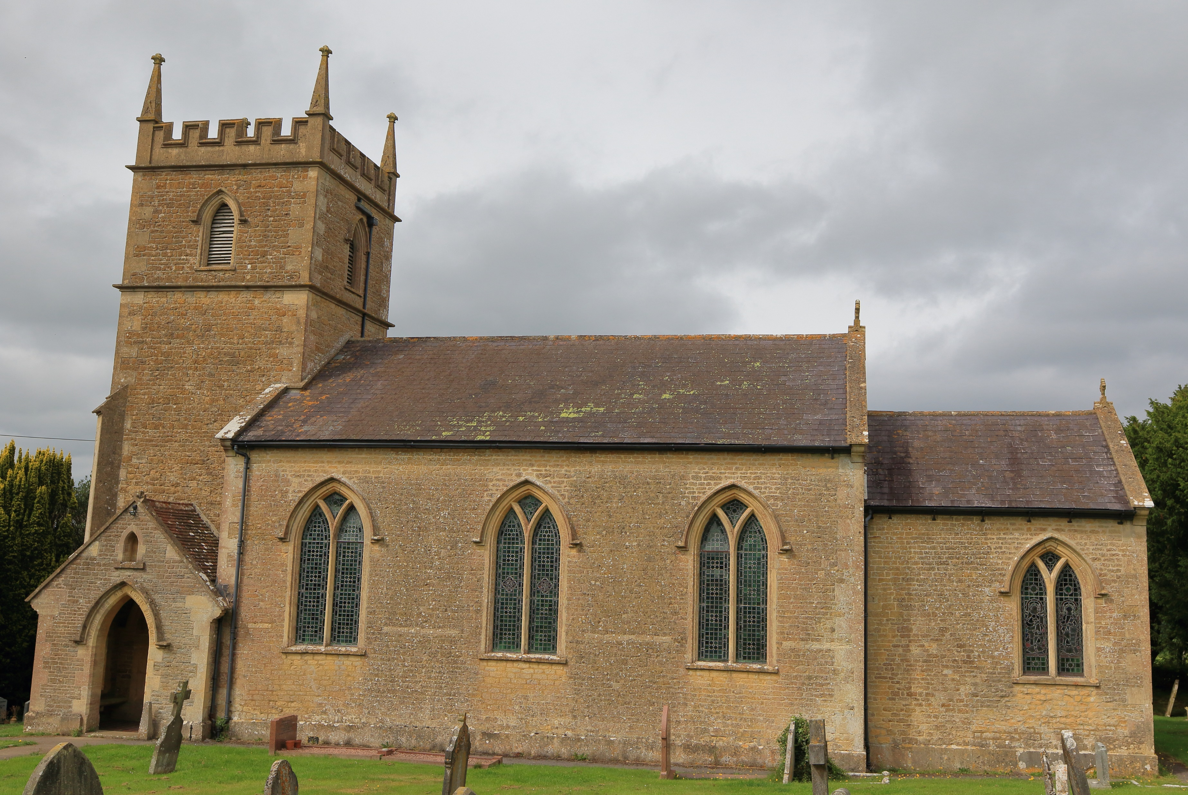
WORSHIP PLAN – OCTOBER 2026
Sunday 4th October
9am Rise & Shine Families St Michael’s Church, Pen Selwood
9am Holy Communion St Lawrence’s Church, Cucklington
10am Café Church St John’s Church, Charlton Musgrove
10:30am Harvest Festival St Peter & St Paul’s Church, Wincanton
Sunday 11th October
9am Holy Communion St Stephen’s Church, Charlton Musgrove
9am Holy Communion St Michael’s Church, Pen Selwood
10:30am Morning Worship St Peter & St Paul’s Church, Wincanton
11am Harvest Festival St Lawrence’s Church, Cucklington
Sunday 18th October
9am Holy Communion St Lawrence’s Church, Cucklington
10am Morning Praise St John’s Church, Charlton Musgrove
10:30am Holy Communion St Peter & St Paul’s Church, Wincanton
Sunday 25th October
10:30am Whole Benefice Communion – St Peter & St Paul’s Church, Wincanton
For more information contact office@wincantonparishchurch.co.uk
01963 824503

