Slide 1
PILGRIMAGE
PRAYER
God, You called your servant Abraham from Ur in Chaldea, watching over him in all his wanderings, and guided the Hebrew people as they crossed the desert.
Guard these your children who, for the love of your Name, make this spiritual pilgrimage together.
Be their companion on the way, their guide at the crossroads, their strength in weariness, their defense in dangers, their shelter on the path, their shade in the heat, their light in the darkness, their comfort in discouragement, and the firmness of their intentions;
that through your guidance, they may arrive safely at the end of their journey and, enriched with grace and virtue, may return to their homes filled with salutary and lasting joy.
Amen.
Pilgrim’s
Prayer
For pilgrims on
the Way of St James
Translated from the
Codex Calixtinus
12th century, adapted
Walk in grace.
Source: Codex Calixtinus, 12th century · translation via Journey with Jesus

Slide 2
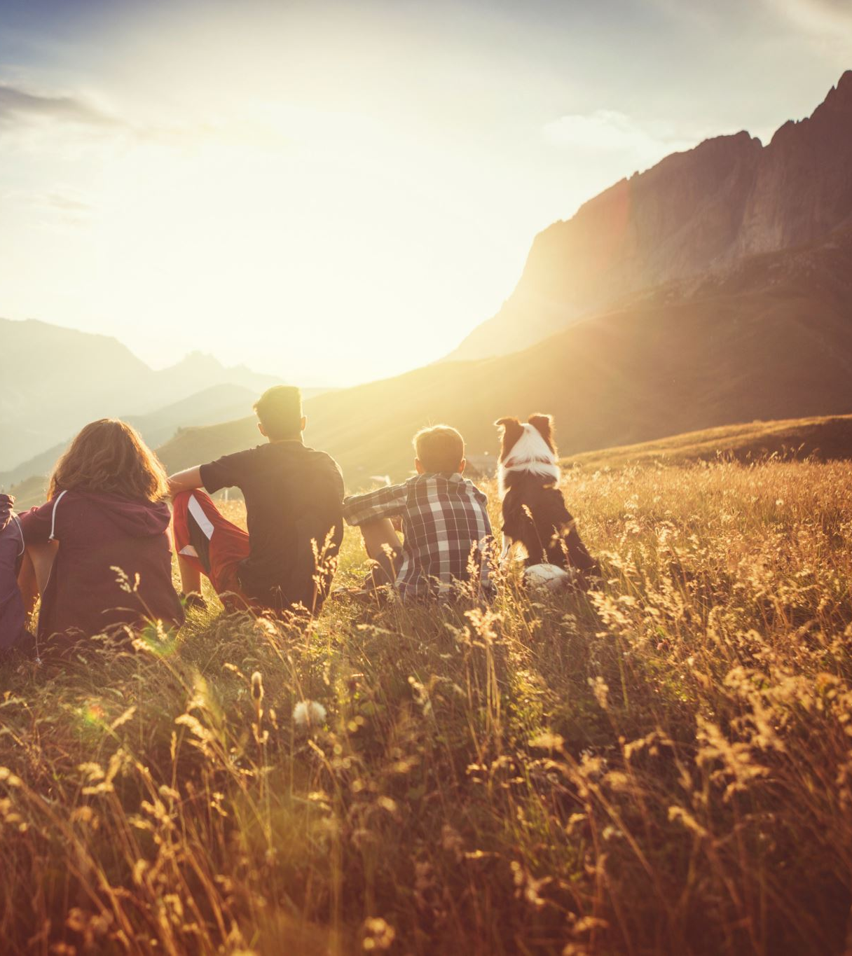
Talking about Pilgrimage
Pilgrimage is about two things – making a journey to a destination that inspires you and making a commitment to live differently
We are not going to be actually travelling but we are hoping that you will take this opportunity to take a transformational spiritual journey with us
Our journey will unfold over 5 sessions - every other week for the next 10 weeks, taking us almost to the start of Advent

Slide 3
How the weeks will unfold
Week 1 (today) – The Journey Begins
Week 2 - What Drives Us Forward?
Week 3 – Who Helps Us Along The Way?
Week 4 – How Do We Handle Hard Times?
Week 5 – What Is The Final Goal?
The Map of the Journey

Slide 4
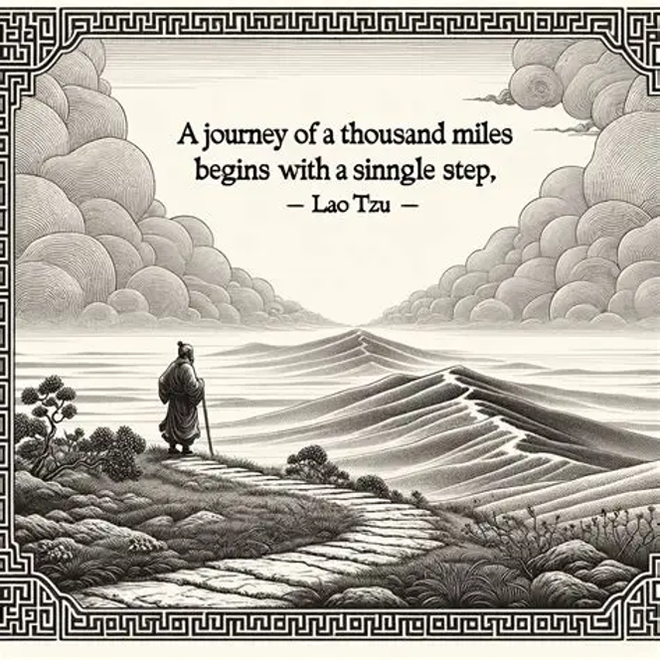
Where does the journey begin?
The Call: Hearing God's voice inviting you to leave your old life.
The Decision: Deciding to trust God and take the first step.
The Leaving: Letting go of sin, bad habits, and worldly safety.

Slide 5
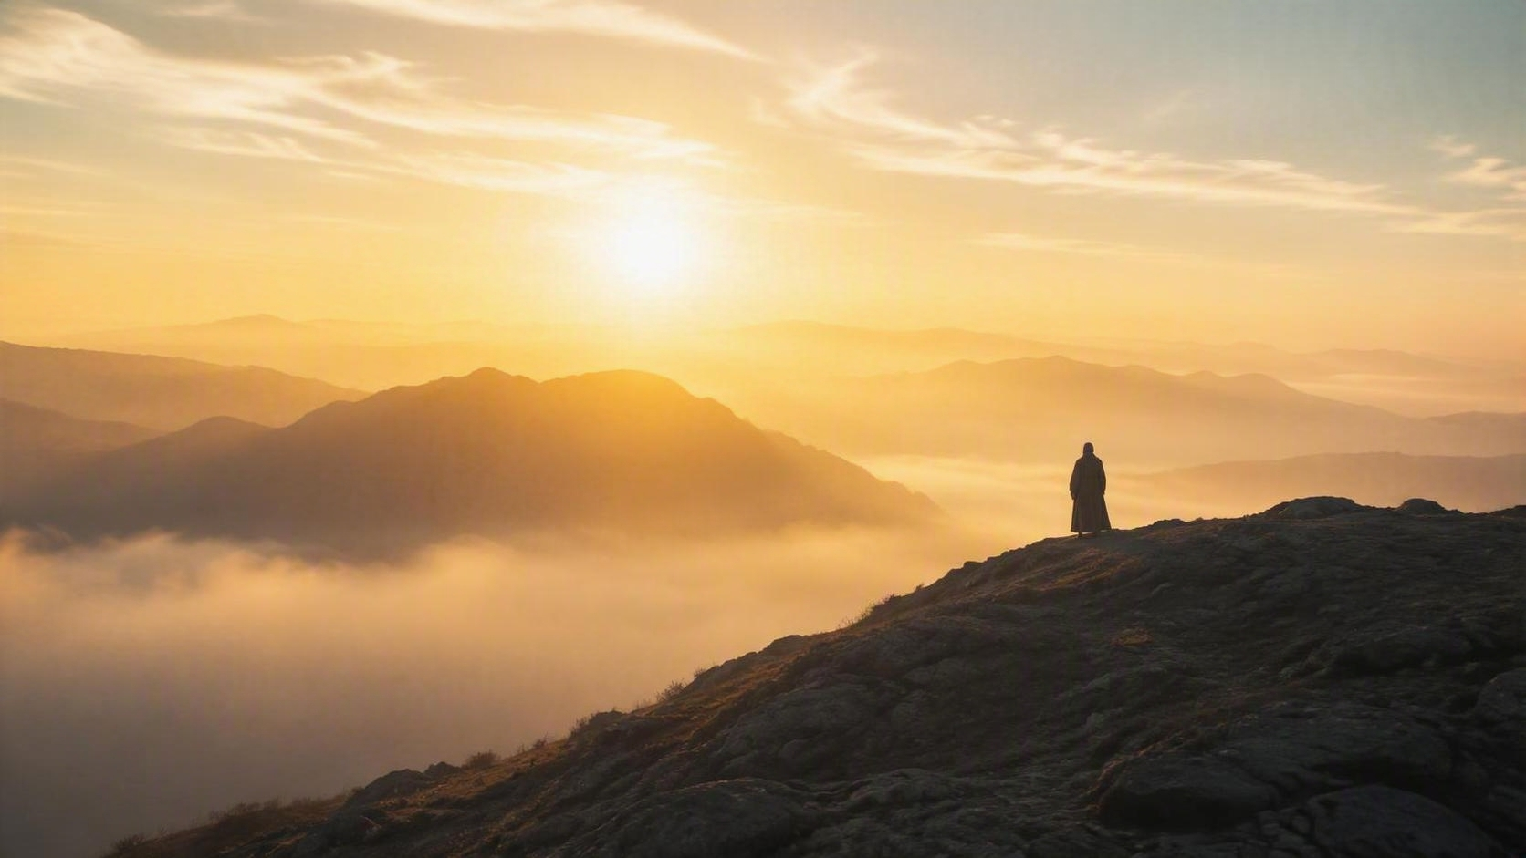
PILGRIMAGE · 01
The Call
“Wherefore seeing we also are compassed about with so great a cloud of witnesses, let us lay aside every weight, and the sin which doth so easily beset us, and let us run with patience the race that is set before us,
Looking unto Jesus the author and finisher of our faith; who for the joy that was set before him endured the cross, despising the shame, and is set down at the right hand of the throne of God.”
HEBREWS 12:1–2 · KJV
Before the road appears, a voice asks you to leave the life you know.
Hearing God’s voice inviting you to leave your old life.
What comfort has become a cage?

Slide 6
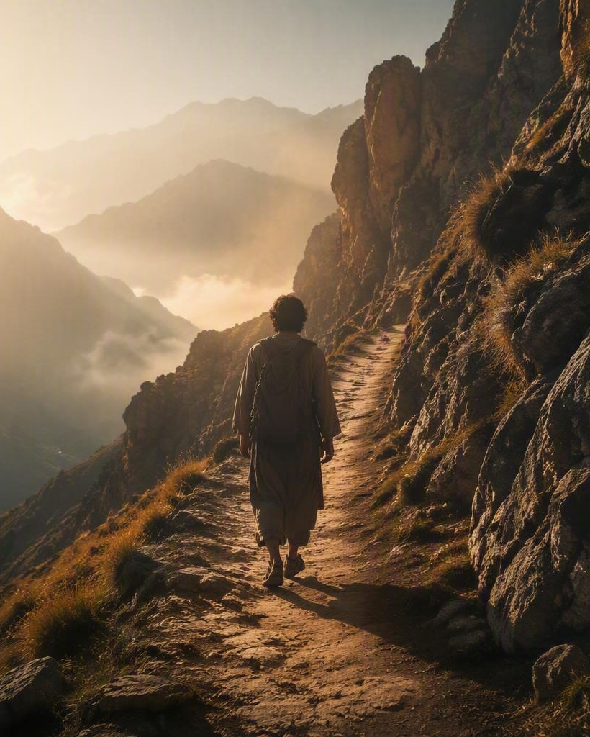
25 Therefore I say unto you, Take no thought for your life, what ye shall eat, or what ye shall drink; nor yet for your body, what ye shall put on. Is not the life more than meat, and the body than raiment?
32 (…after all these things do the Gentiles seek:) for your heavenly Father knoweth that ye have need of all these things.
MATTHEW 6:25 & 32 · KJV
PILGRIMAGE · 02
The Decision
Trust is not the absence of fear.
It is the moment faith becomes movement.
Take the
first step.
Deciding to trust God before the whole path is visible.

Slide 7
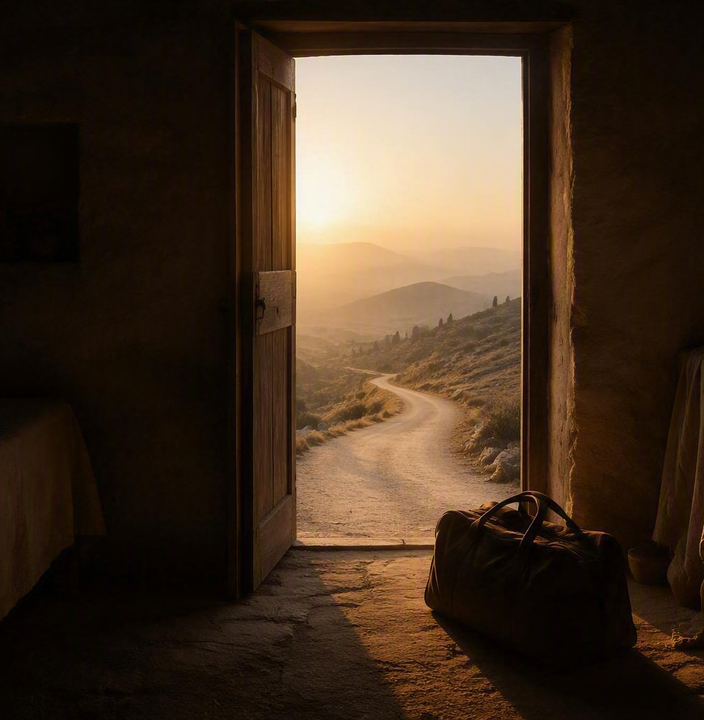
PILGRIMAGE · 03
The Leaving
A pilgrim travels lighter by surrendering what cannot enter the new life.
SIN
HABITS
FALSE SAFETY
“Keep yourself as a pilgrim and a stranger on the earth, who has nothing to do with the affairs of the world. Keep your heart free and lifted up to God, because we have here no abiding city.”
THOMAS À KEMPIS · THE IMITATION OF CHRIST
Let go—not because the road is easy,
but because God is worth following.

Slide 8
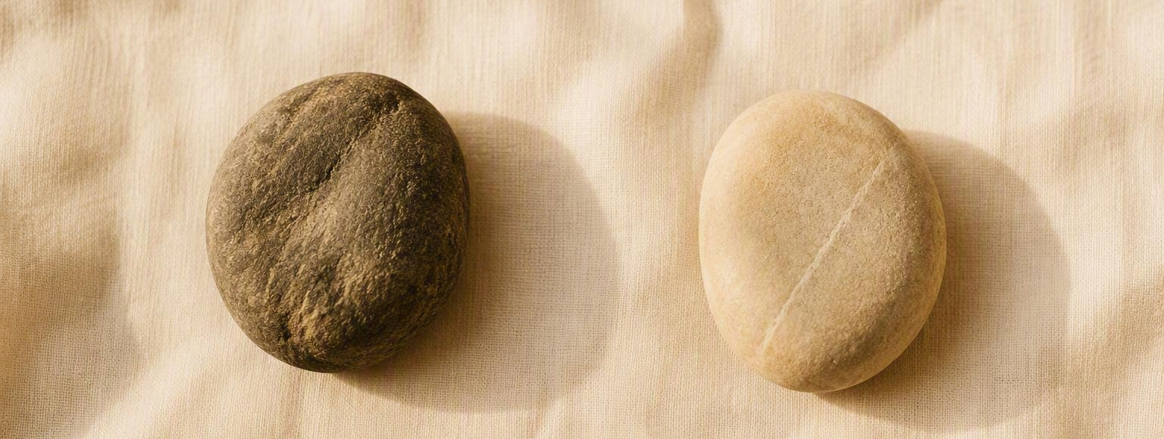
PILGRIMAGE · PRACTICE
The Stones
Choose two stones. Let each one carry a different intention.
THE STONE YOU LEAVE
THE STONE YOU KEEP
Something in your life
you want to abandon.
A tangible reminder of
a new commitment you are making.

