Slide 1
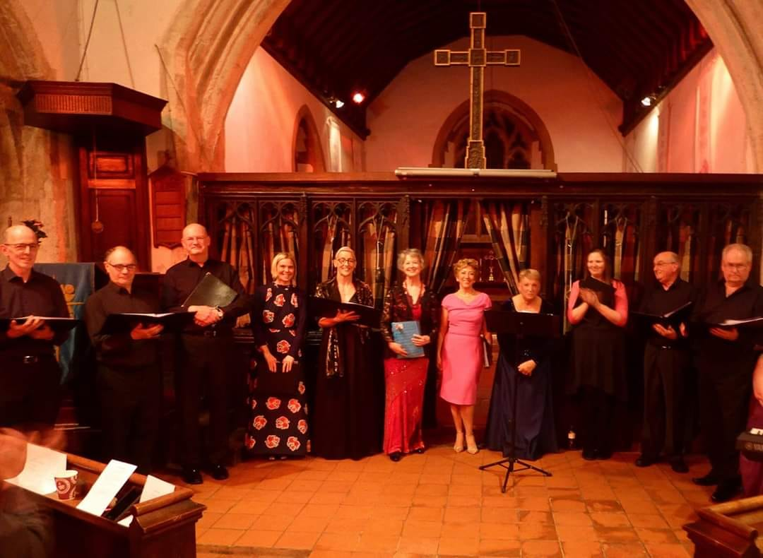

St George’s Church, Littleport welcomes back the
Including a guest appearance by the
Littleport Community Singers
Saturday, 29th August 2026
2-4pm
Free to attend (donations towards St George’s improvements project very much appreciated)
Refreshments included
This Kent-based singing group started over 20 years ago. Littleport resident, Kathryn Buck, has sung with them for most of that time. Once again occasion, her friends in the group have very kindly offered to return to Littleport to do another concert. Their repertoire is varied, with something for everyone.

