Slide 1
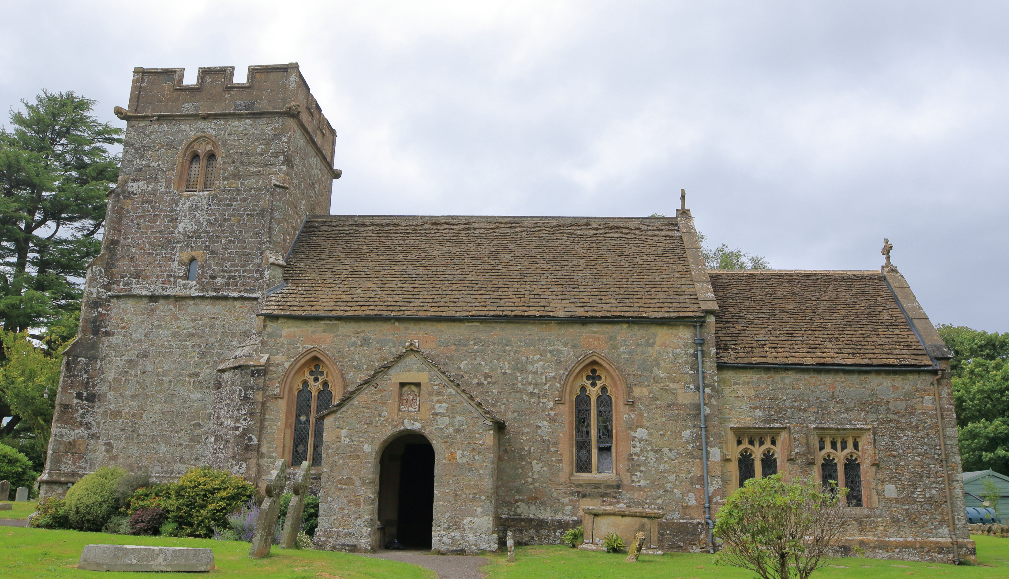
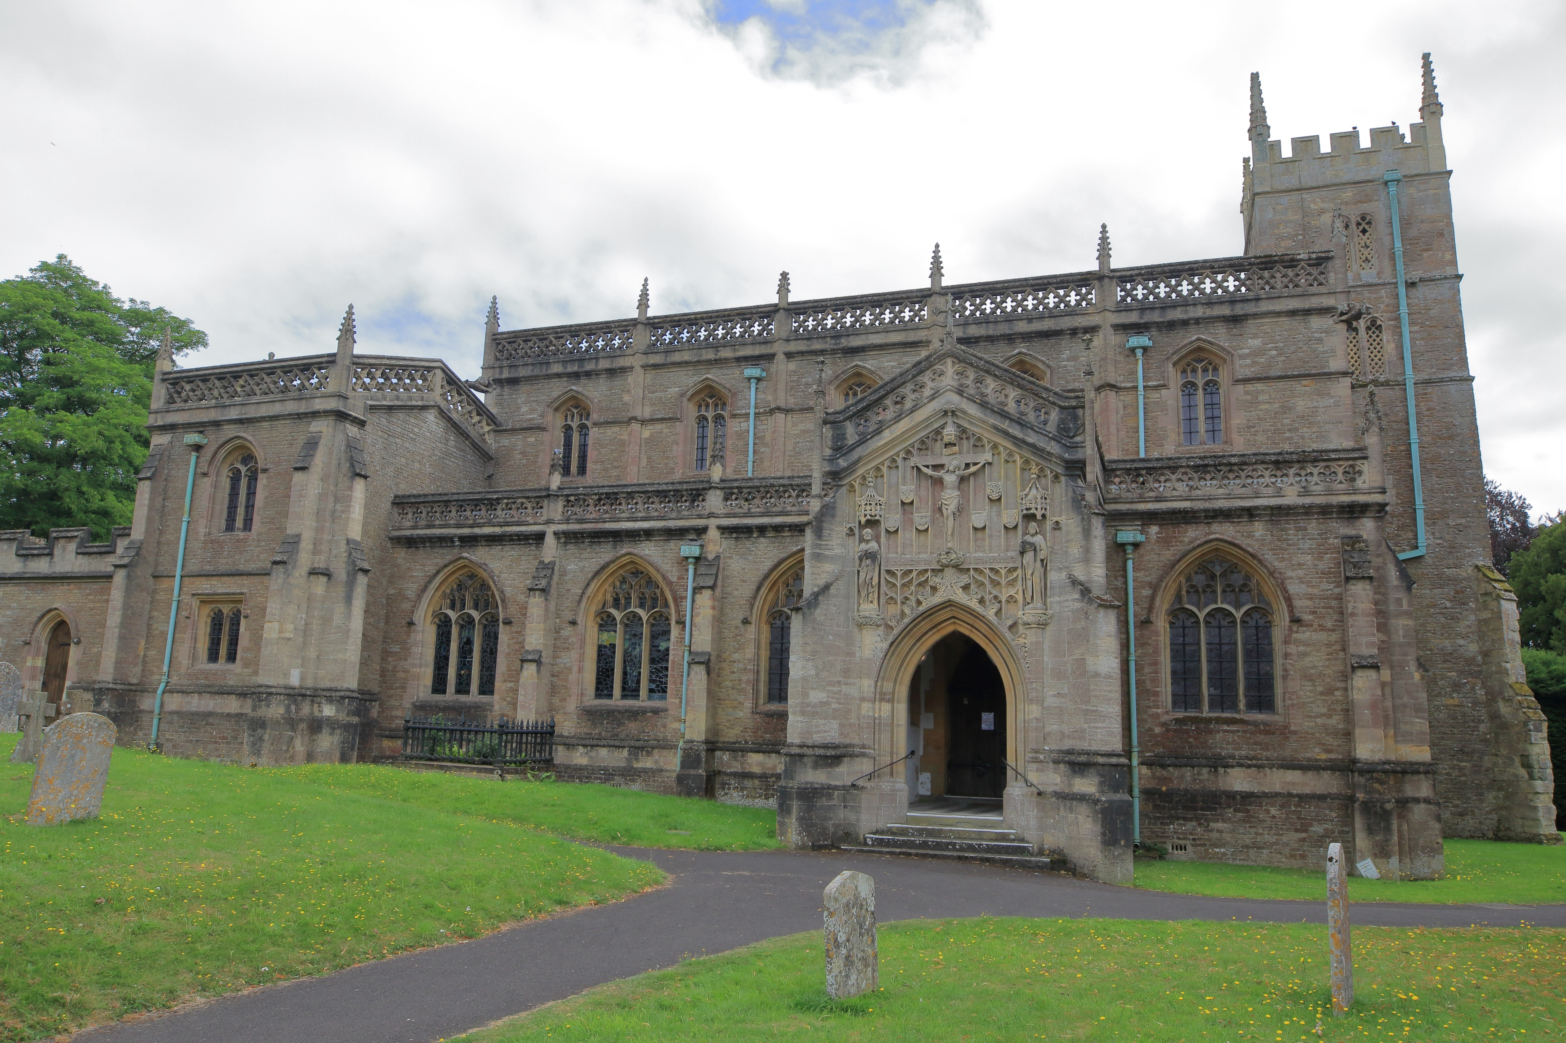
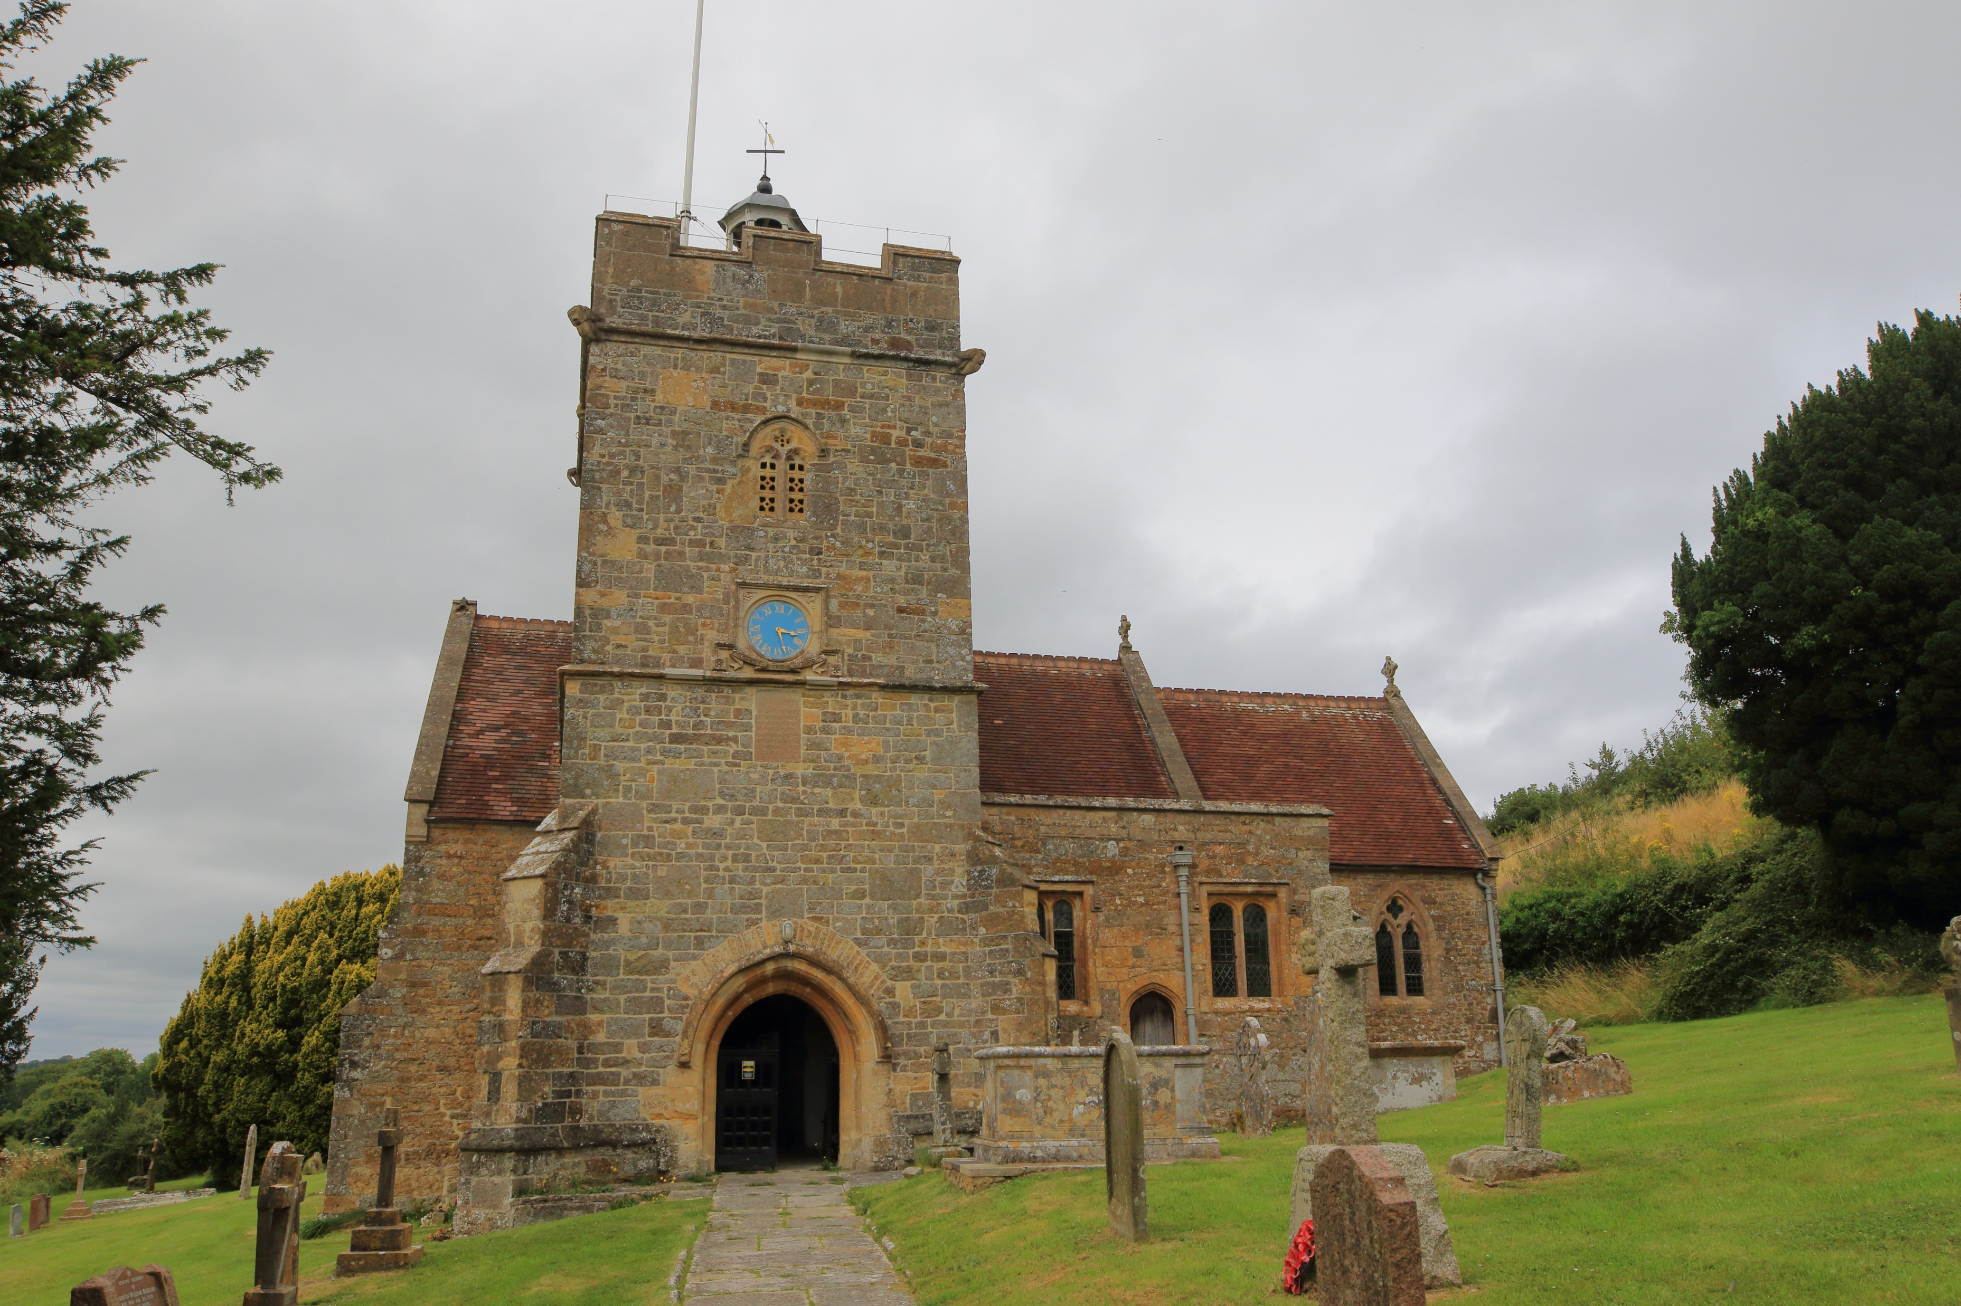
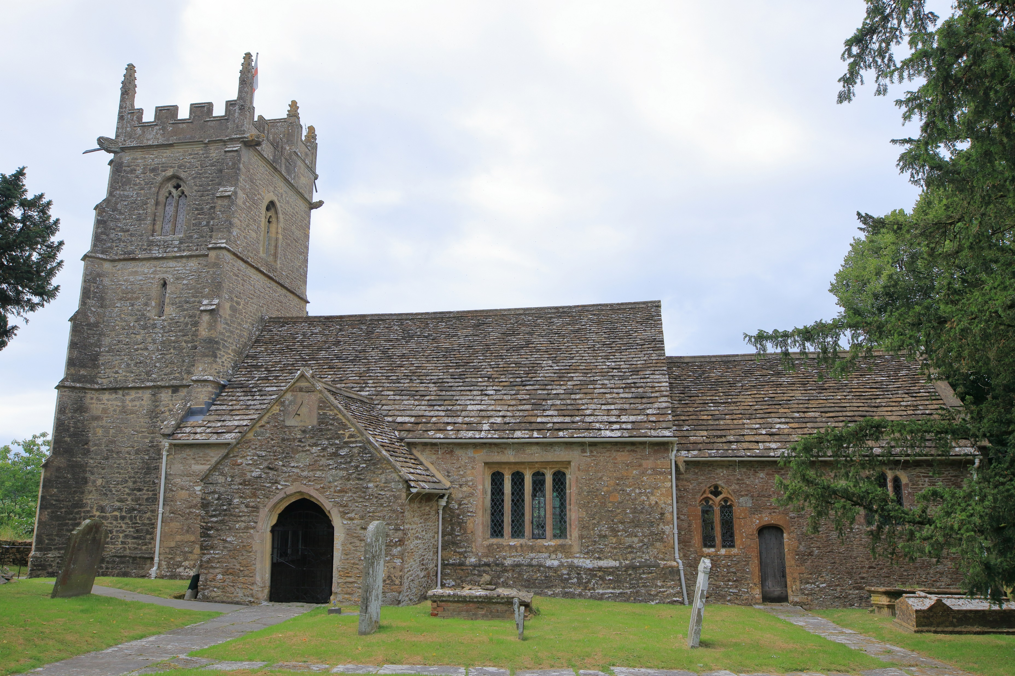
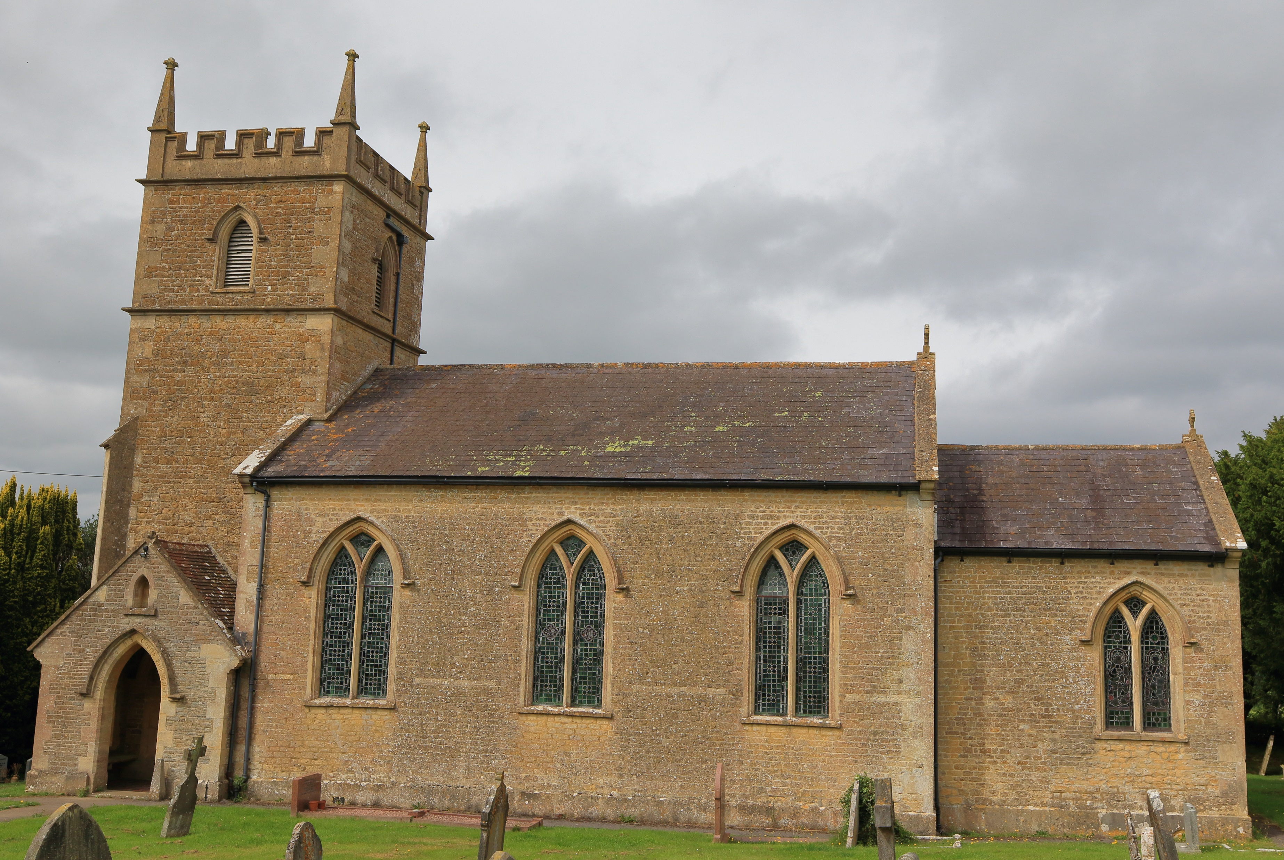
WORSHIP PLAN – JULY 2026
Sunday 5th July
9am Rise & Shine Family Service St Michael’s Church, Pen Selwood
9am Holy Communion St Lawrence’s Church, Cucklington
10am Café Church St John’s Church, Charlton Musgrove
10:30am Holy Communion St Peter & St Paul’s Church, Wincanton
Sunday 12th July
9am Holy Communion St Stephen’s Church, Charlton Musgrove
9am Holy Communion St Michael’s Church, Pen Selwood
10:30am Morning Worship St Peter & St Paul’s Church, Wincanton
6:30pm Evening Service St Lawrence’s Church, Cucklington (Sung)
Sunday 19th July
9am Morning Service St Michael’s Church, Pen Selwood
9am Holy Communion St Lawrence’s Church, Cucklington
10:30am Morning Praise St John’s Church, Charlton Musgrove
10:30am Holy Communion St Peter & St Paul’s Church, Wincanton
Sunday 26th July
10:30am Whole Benefice Communion – St Andrew’s Church, Stoke Trister
For more information contact office@wincantonparishchurch.co.uk
01963 824503

