Slide 1


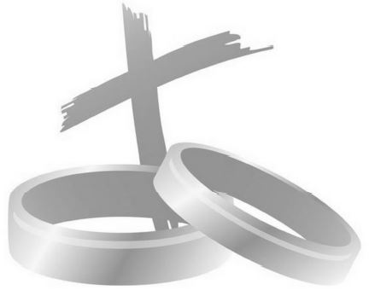
Marriage Celebration
Sunday July 19th – 10.30am
Were you married at St Mary Magdalene?
Or have you attended a memorable wedding of a family member or friend in Cowden Church?
COME AND JOIN US FOR A SPECIAL SERVICE TO CELEBRATE MARRIAGE - ALL VERY WELCOME
Refreshments after the service

