Slide 1
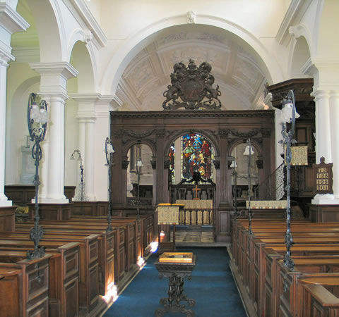
INGESTRE CHURCH 350 YEAR ANNIVERSARY
ST MARY THE VIRGIN INGESTRE STAFFORD
SUNDAY 14 JUNE 11-5
Tickets https://tickets.myiknowchurch.co.uk/gb/NzA5Ni0y/t

