Slide 1

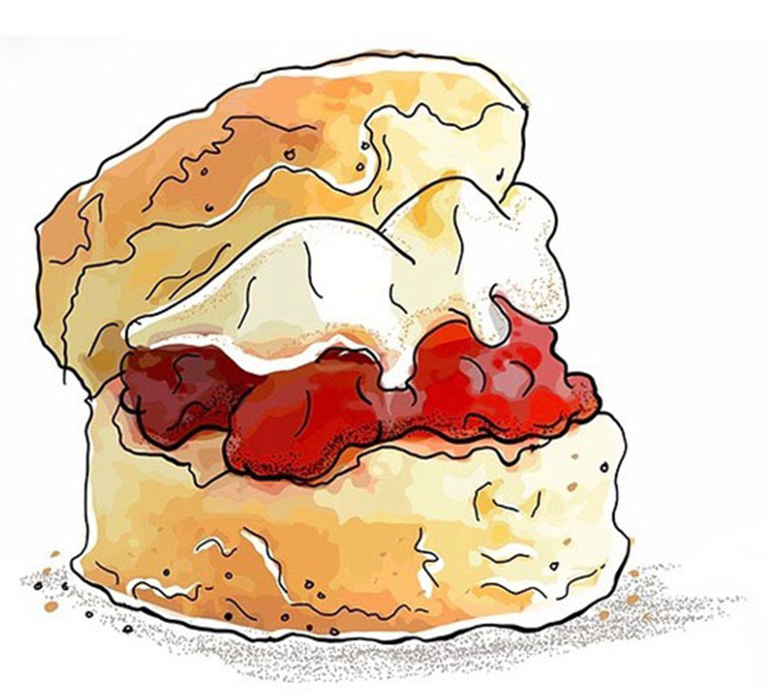


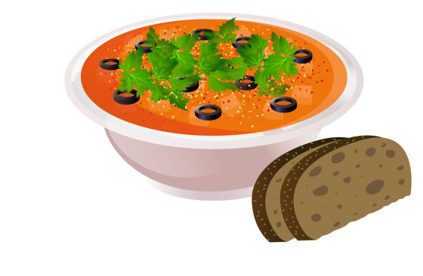



Open Café
for the Folk Festival @St Philip’s Church
Saturday 23rd May, 10am-7pm
Sunday 24th May, noon - 4.30pm
Monday 25th May, 11.30am - 11pm
Free tea, coffee and juice
Breakfast bacon butties, cinnamon
buns & pains au chocolat
Hot drinks to takeaway
Delicious lunches – homemade
bread & soup, quiche & salads
Cream teas
Homemade cake & traybakes
Hot chocolate
Vegetarian & vegan options
All welcome – hope to see you there!

