Slide 1
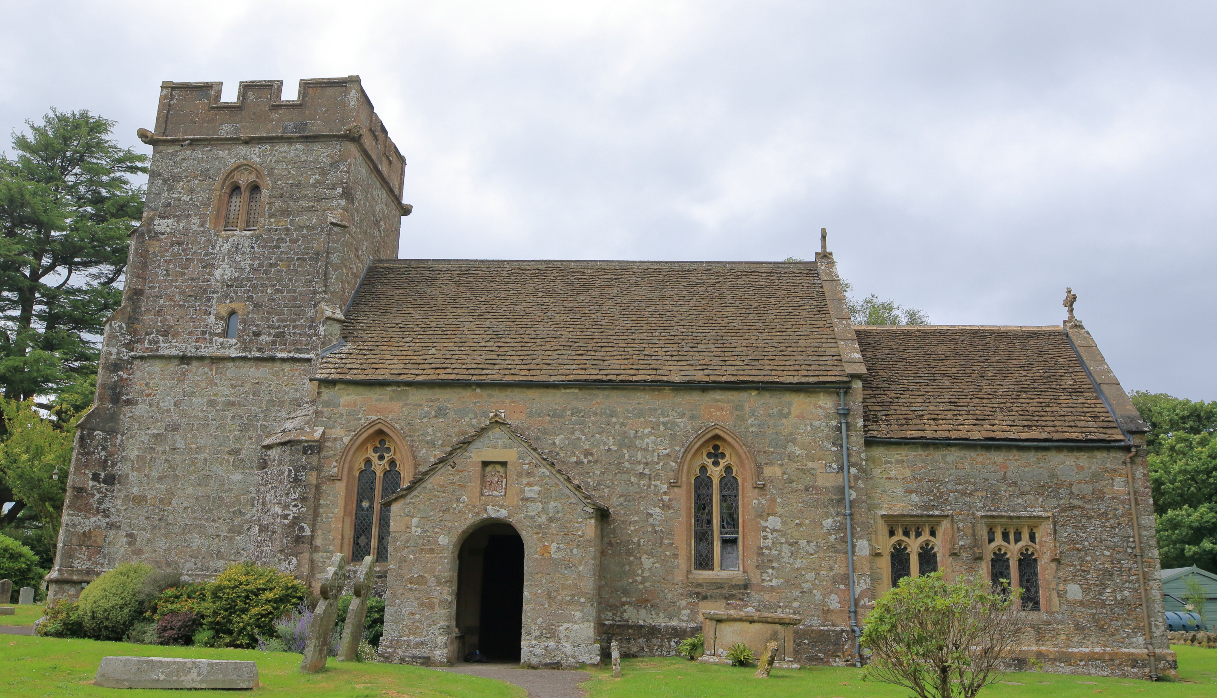
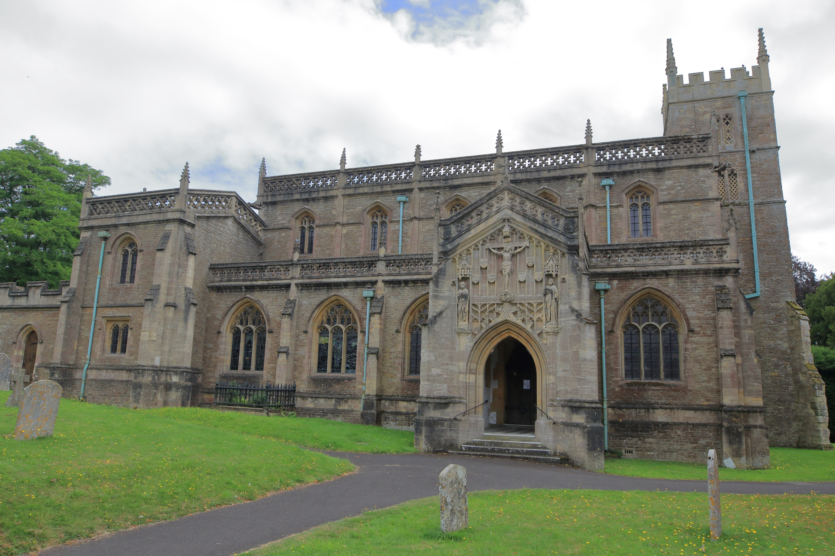
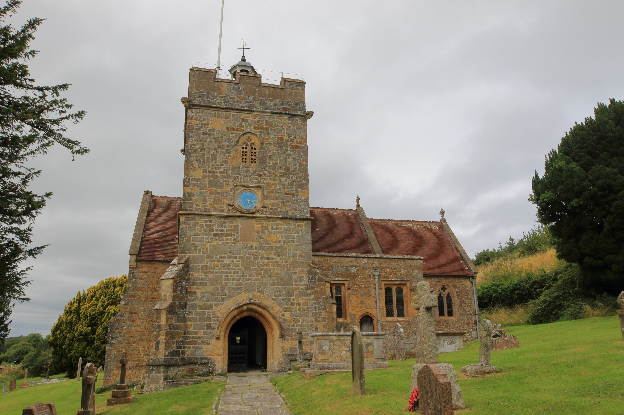
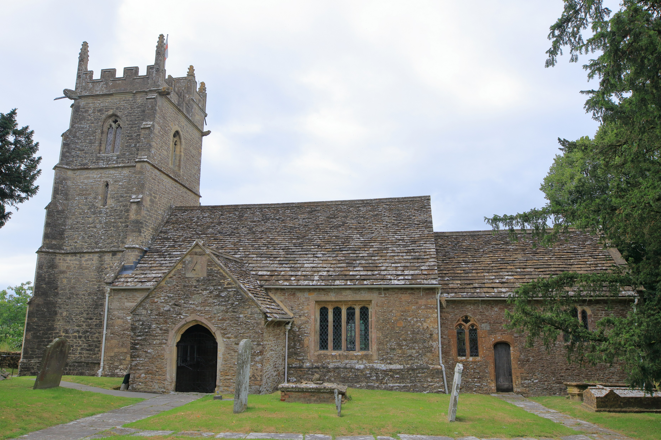
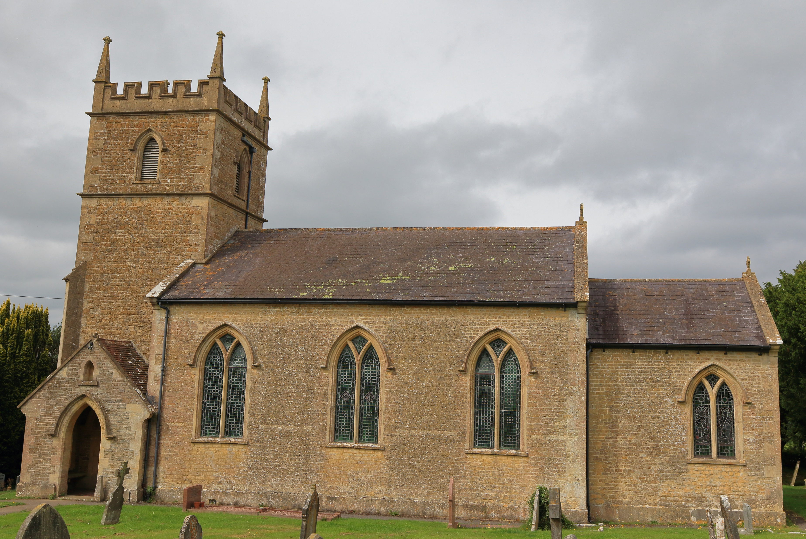
WORSHIP PLAN – APRIL 2026
Wednesday 1st April
7pm Compline St Peter & St Pauls, Wincanton
Thursday 2nd April
7pm Maundy Thursday St Peter & St Pauls, Wincanton
Simple Agape meal & Communion
Friday 3rd April
2pm Good Friday Reflections St Michaels, Pen Selwood
Sunday 5th April
6:15am Sunrise Service St Andrews, Stoke Trister
9am Easter Holy Communion St Michaels, Pen Selwood
9am Easter Holy Communion St Lawrences, Cucklington
10am Easter Holy Communion St Stephens, Charlton Musgrove
10am Easter Family Communion St Peter & St Pauls, Wincanton
Sunday 12th April
9am Holy Communion St Stephens, Charlton Musgrove
9am Holy Communion St Michaels, Pen Selwood
10:30am Morning Worship St Peter & St Pauls, Wincanton
6:30pm Evening Service St Lawrences, Cucklington
Sunday 19th April
9am Morning Service St Michaels, Pen Selwood
9am Holy Communion St Lawrences, Cucklington
10:30am Morning Praise St Johns, Charlton Musgrove
10:30am Holy Communion St Peter & St Pauls, Wincanton
6:30pm Evening Service St Andrews, Stoke Trister
Sunday 26th April
10:30am-4pm Benefice Vision Day – Charlton Musgrove Village Hall Starting with Café Church at 10:30am, and ending with short Communion 3:30pm.
For more information contact office@wincantonparishchurch.co.uk
01963 824503

