Slide 1
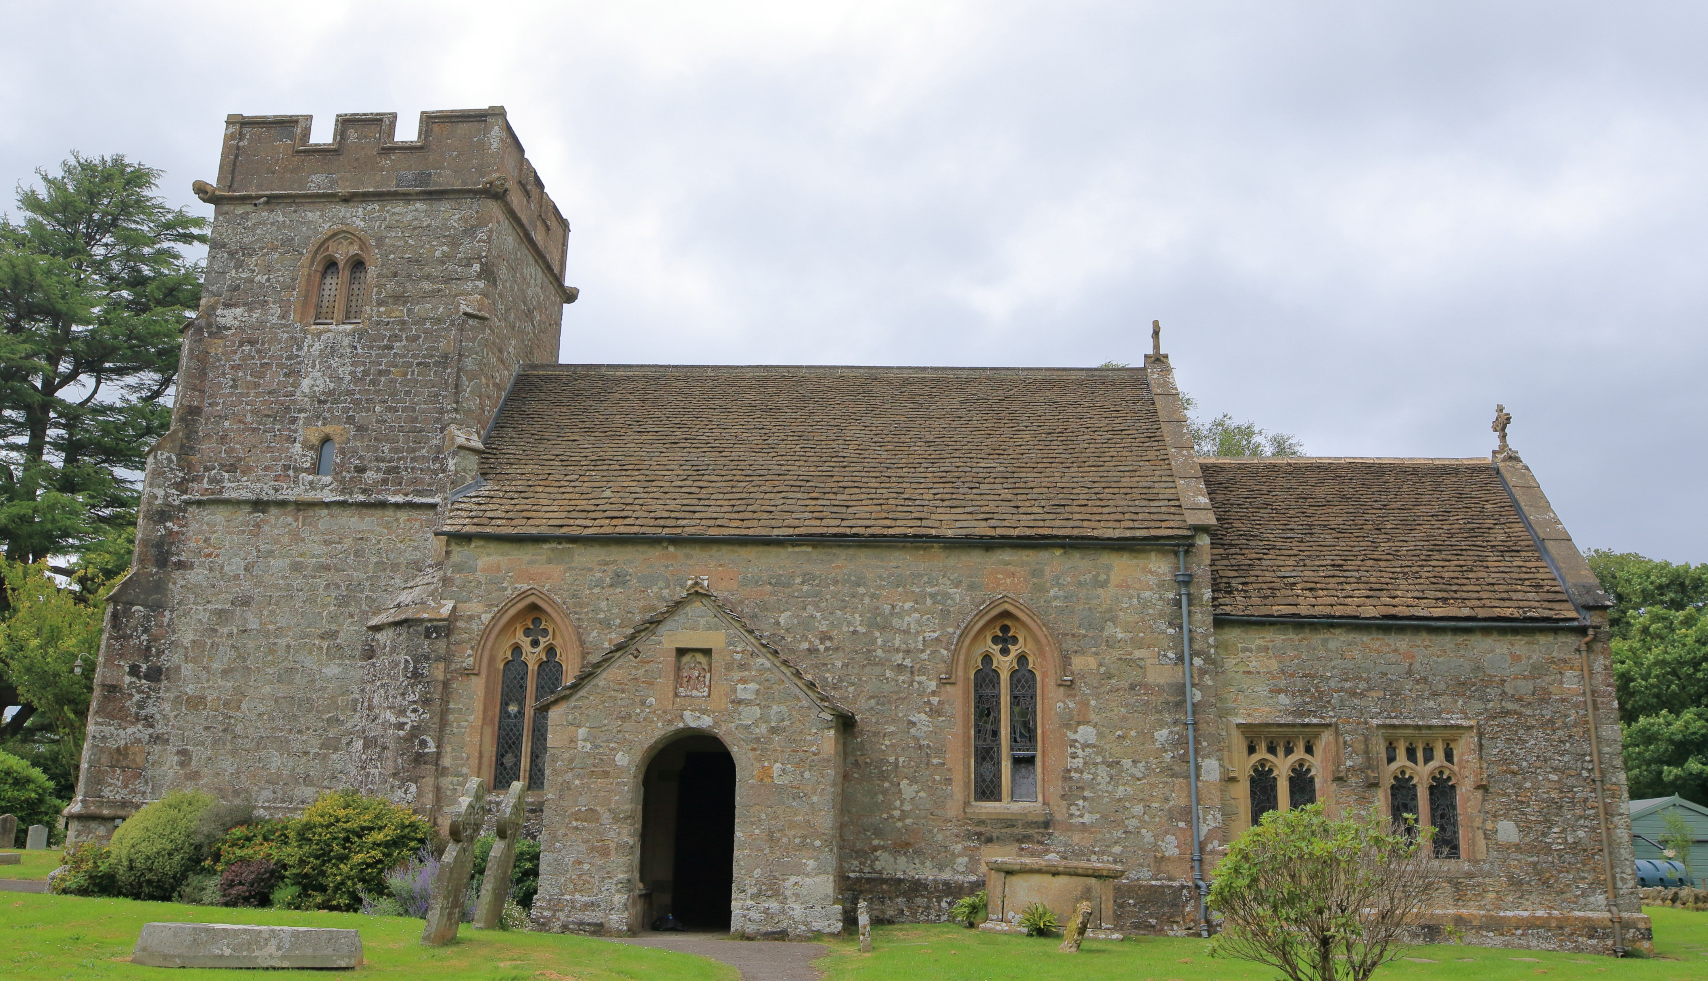
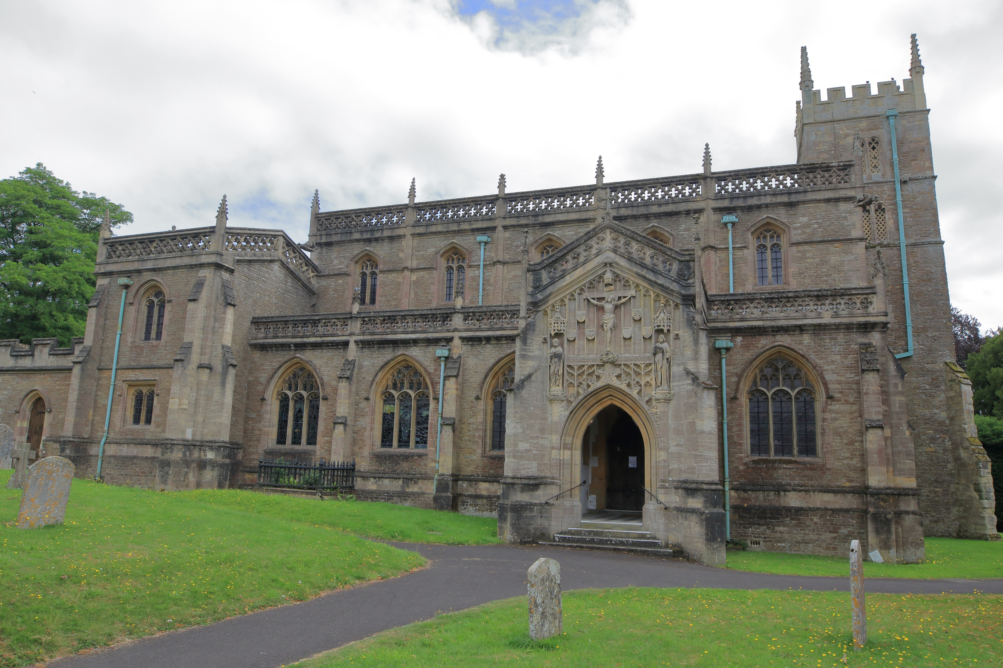
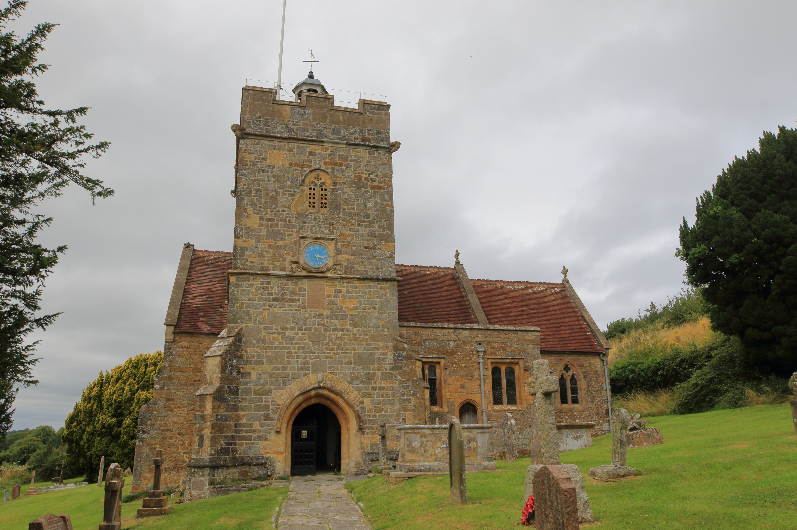
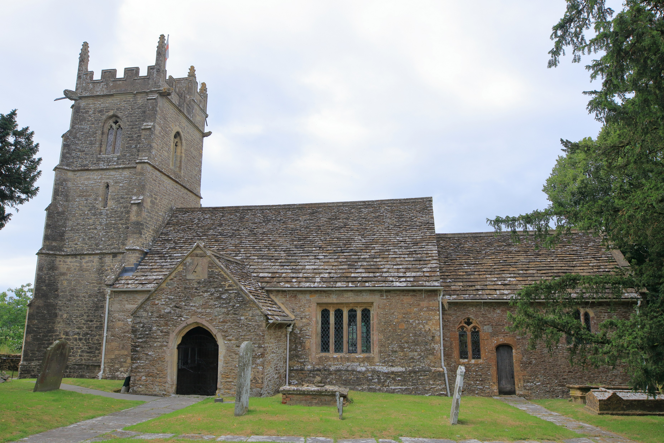
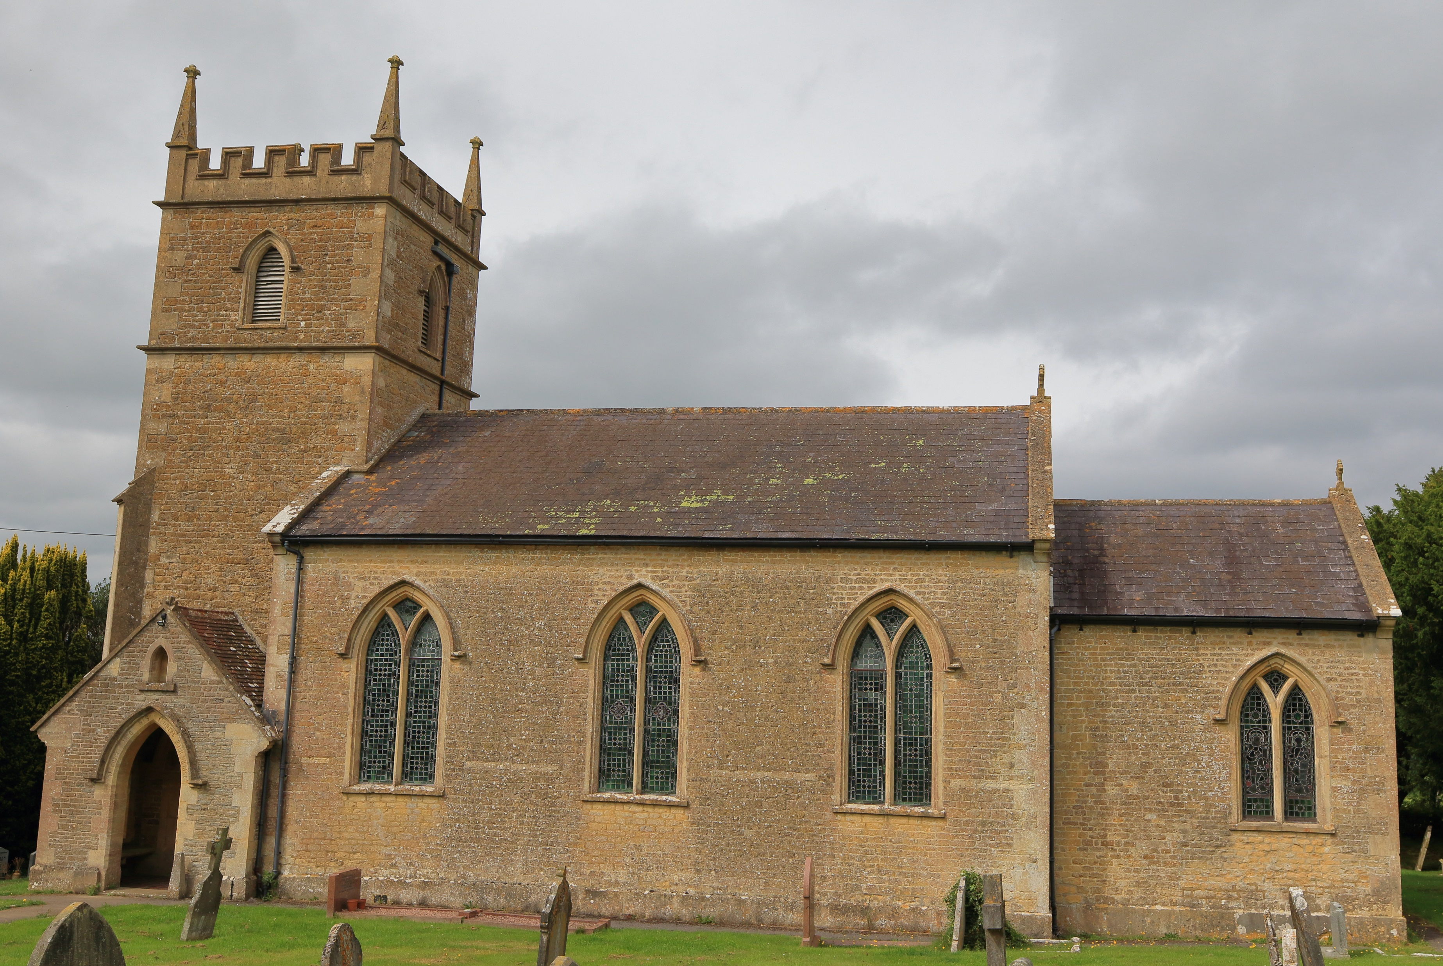
WORSHIP PLAN – MARCH 2026
Sunday 1st March
9am Rise & Shine Families St Michaels, Pen Selwood
10am Said Holy Communion St Lawrences, Cucklington
10am Cafe Church St Johns, Charlton Musgrove
10:45am Holy Communion St Peter & St Pauls, Wincanton
Sunday 8th March
10:30am Holy Communion St Stephens, Charlton Musgrove
Sunday 15th March
9am Holy Communion St Michaels, Pen Selwood
10am Morning Praise St Johns, Charlton Musgrove
10:45am Morning Worship St Peter & St Pauls, Wincanton
6pm Evensong St Lawrences, Cucklington
Sunday 22nd March
9am Holy Communion St Lawrences, Cucklington
10:45am Holy Communion St Peter & St Pauls, Wincanton
4pm Evensong St Michaels, Pen Selwood
Sunday 29th March
10am Holy Communion St Michaels, Pen Selwood
For more information contact office@wincantonparishchurch.co.uk
01963 824503

