Slide 1
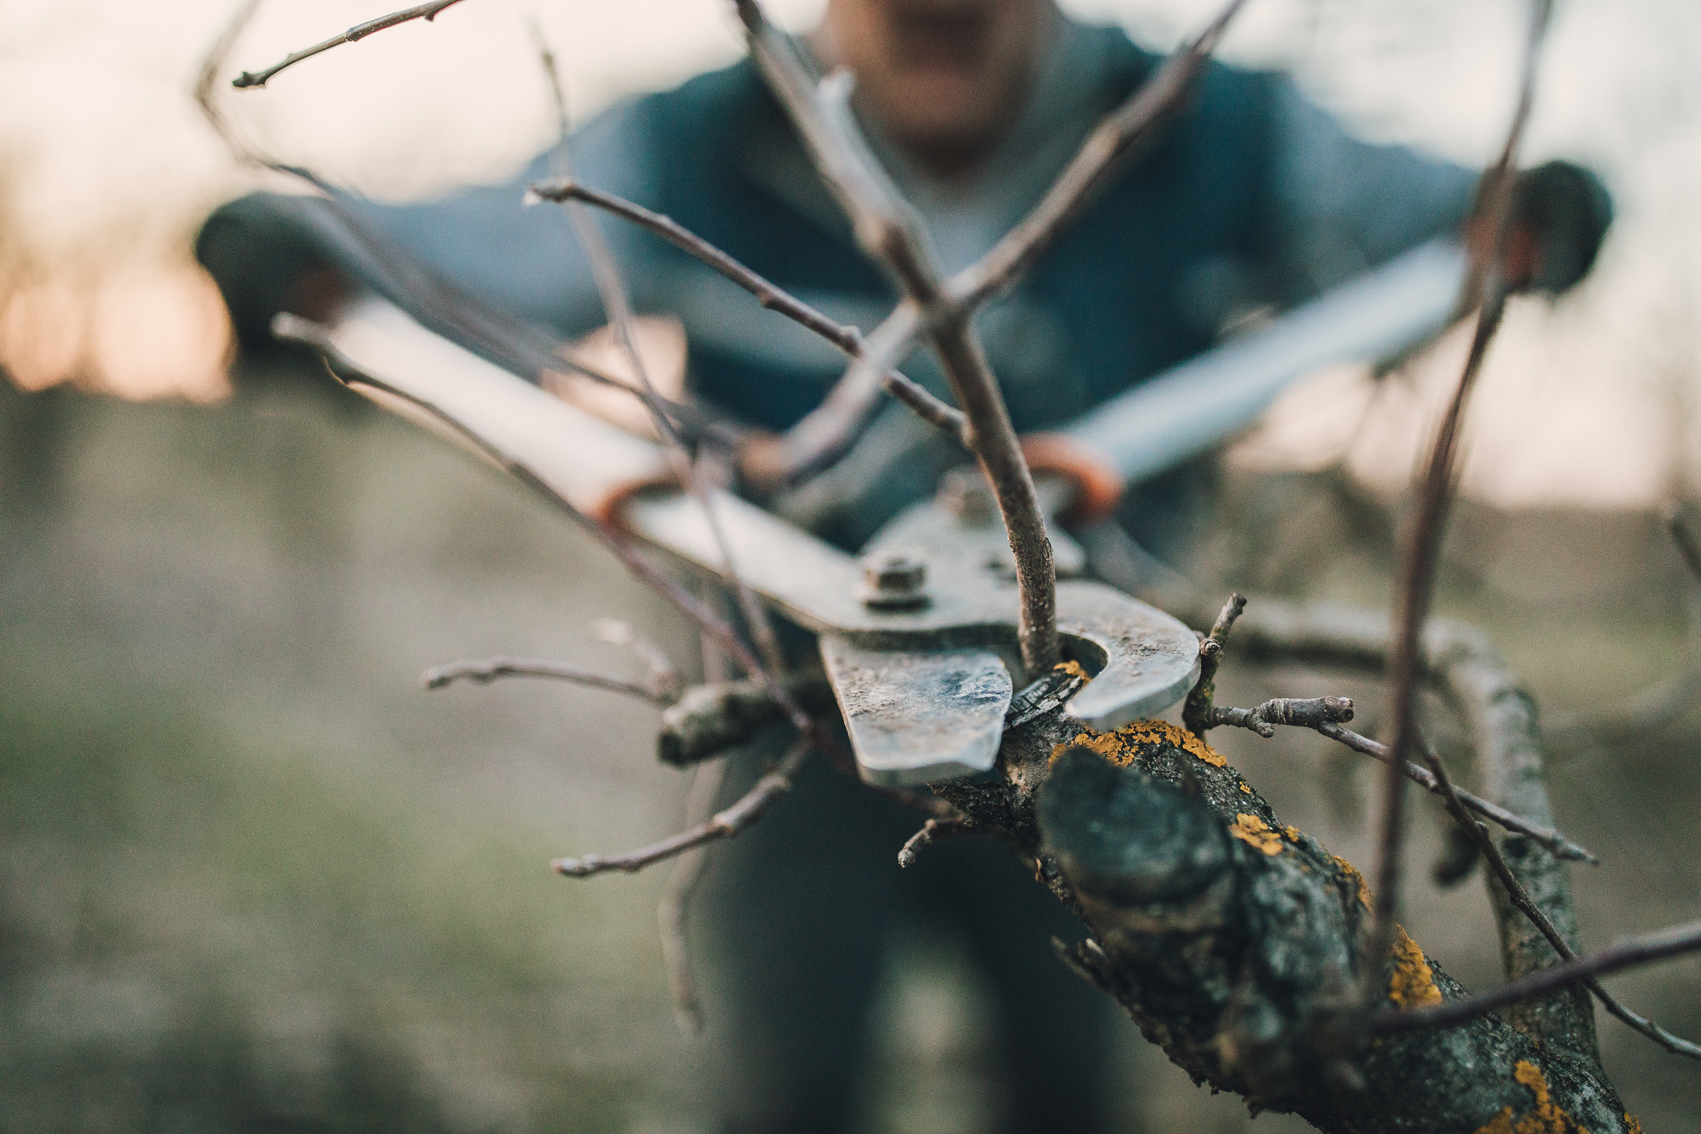
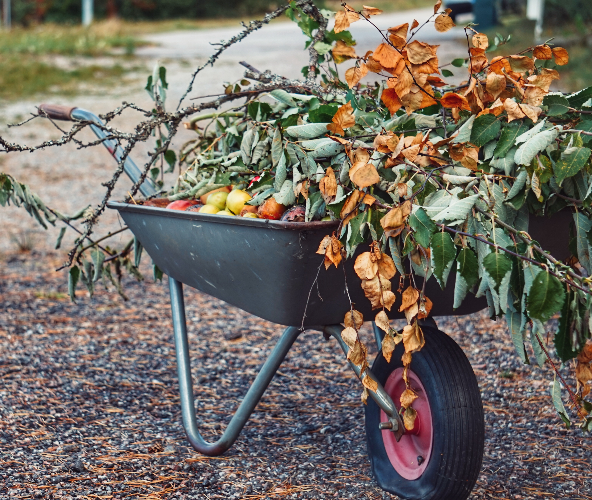
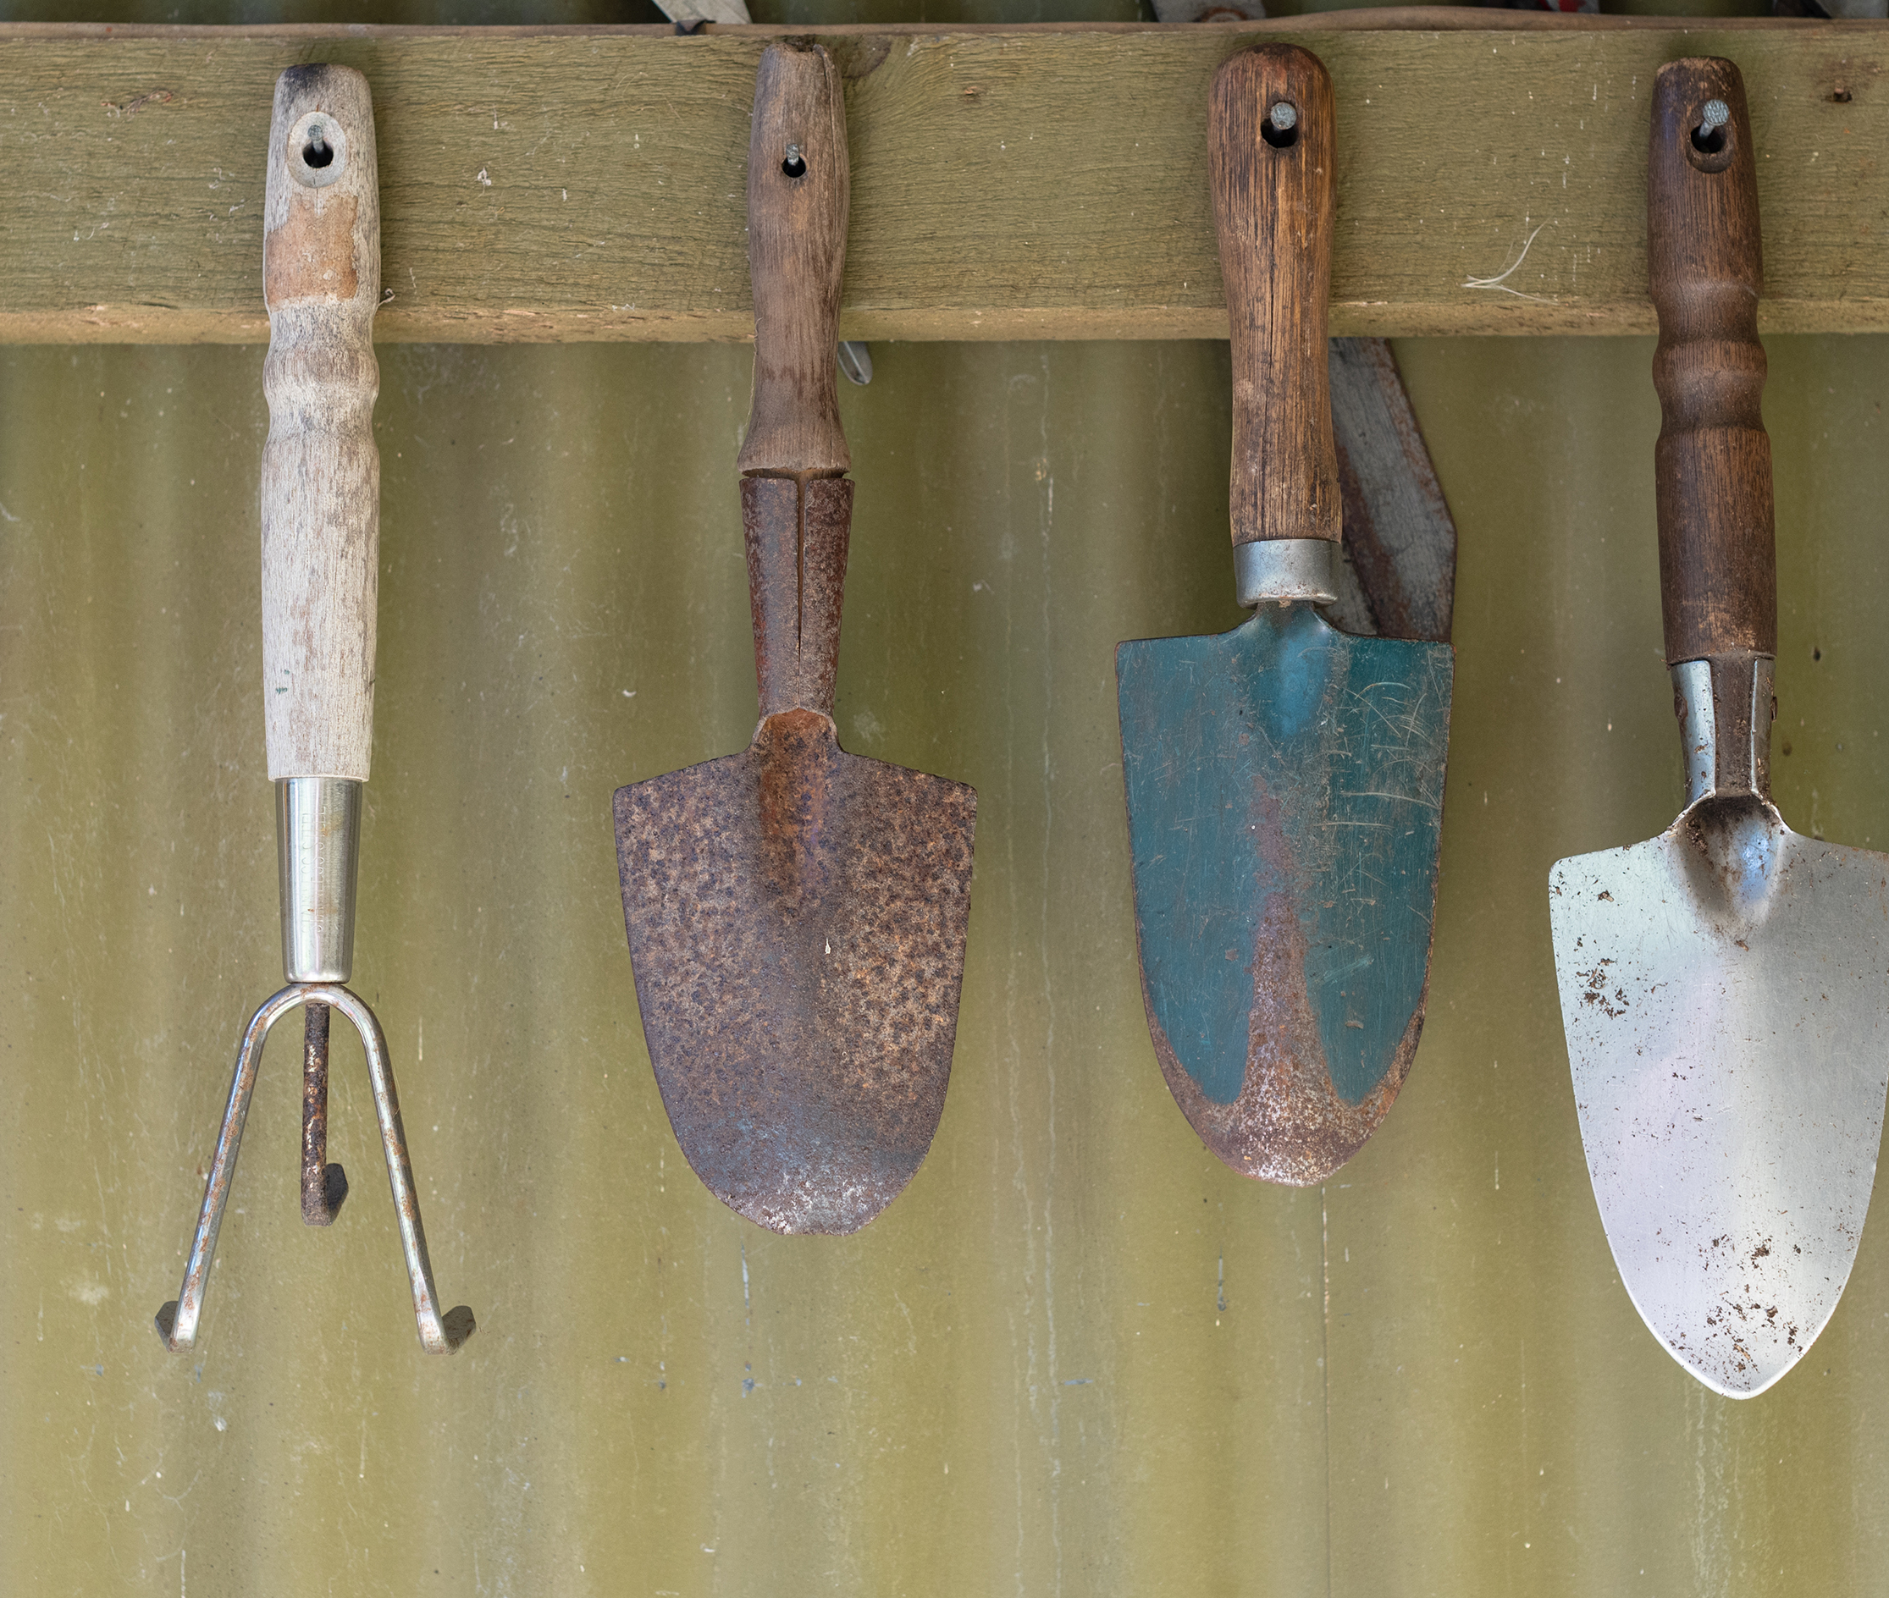
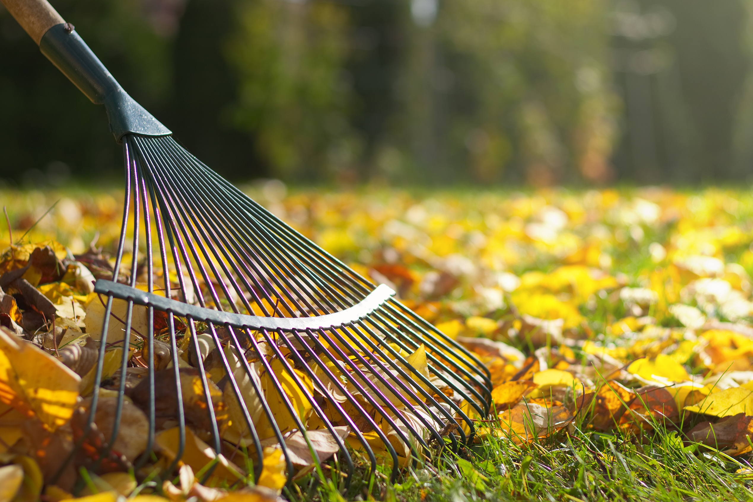
Church Yard Clean Up
Saturday March 28th from 10am
No experience necessary, bring your own gardening gloves and tools. Stay for as long as you feel able. Refreshments provided.

Slide 2
Church Yard Clean Up
Saturday November 9th 10.00am. Lets get the Church yard looking really tidy for Remembrance Day, No experience necessary, bring your own gardening gloves and tools

