Slide 1



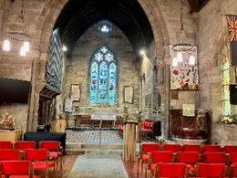

Traditional Sung Evensong
Service led by John Diggle who is retiring as a Reader this year
Sunday 8th February 2026
at 5pm at St Philip’s Church, Kelsall
Book of Common Prayer liturgy
60-minute service followed by wine and cheese refreshments
Everyone welcome
Further information: john.diggle@talk21.com or 01829 752608

