Slide 1


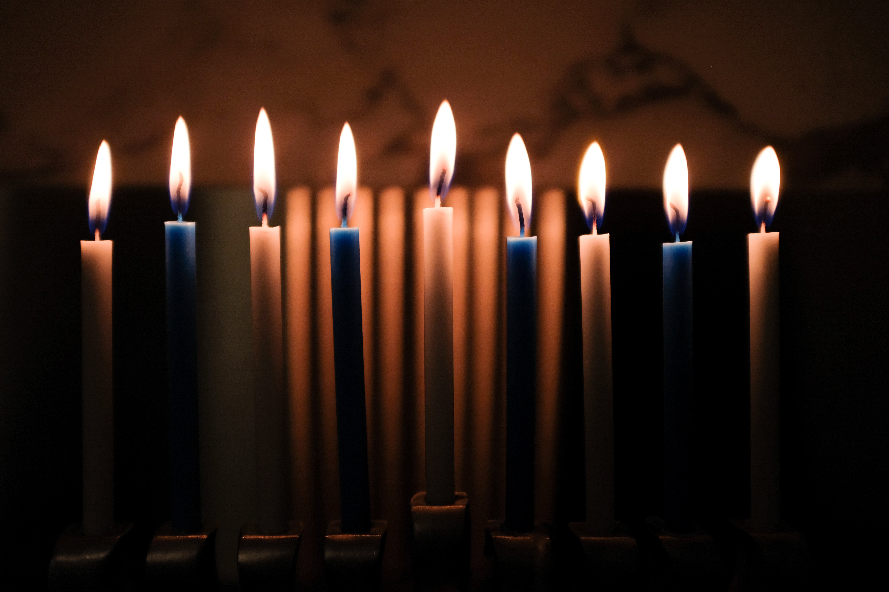
CAROLS BY CANDLELIGHT
Sunday 21st December 6pm
Get into a festive mood with our service of lessons and carols telling the Christmas story.
All very welcome – refreshments afterwards

