Slide 1
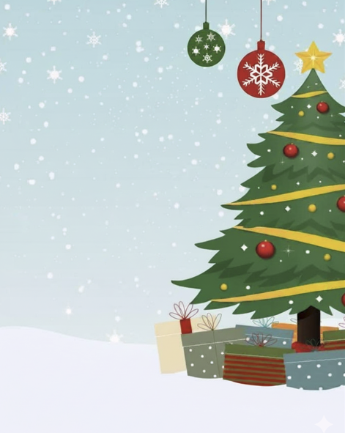
Christmas
Lights Switch on
Leeds City Council in partnership with
St Mary’s Church Beeston and
Beeston in Bloom
Event includes
Carol Singing
Salvation Army
Burger in a Bun
Hot/cold drinks
Thursday 27th November 2025 @ 6pm
Outside Nisa then afterwards at Beeston Parish Centre, Town Street Beeston

