Slide 1

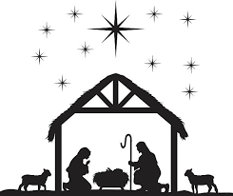
Christmas Eve
3pm Christingle Service
6pm Carols round the Christmas Tree in the Church yard
Christmas Day 10.30am
Family Holy Communion
WARM WELCOME TO ALL

