Slide 1

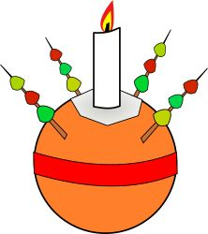
Christmas Eve - 3pm
Christingle - the story of Christmas for children
Lots of fun making a Christingle and learning what it is all about.
A very warm welcome to all whatever your age

