Slide 1

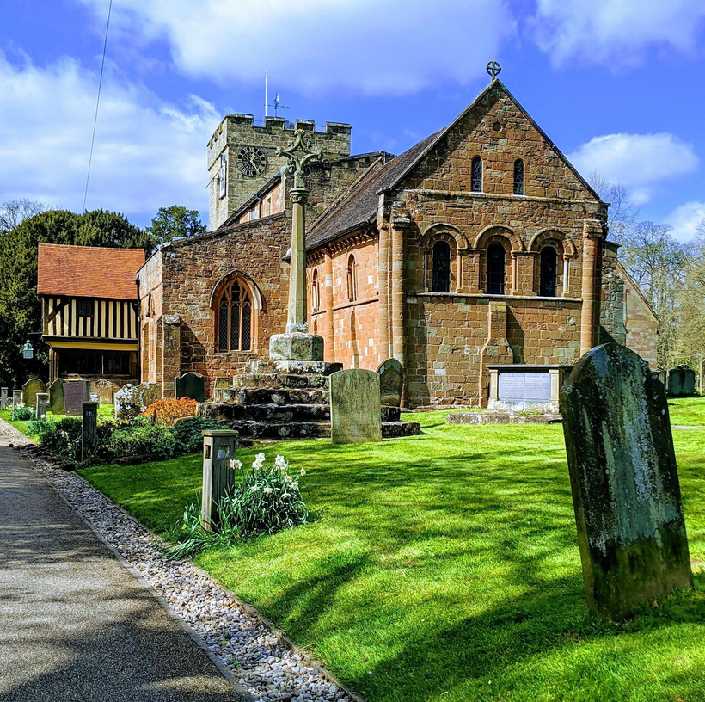

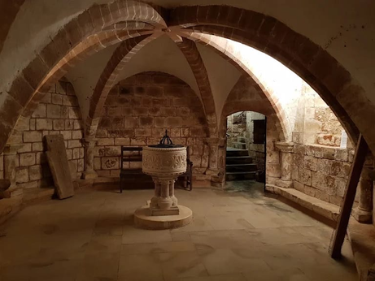
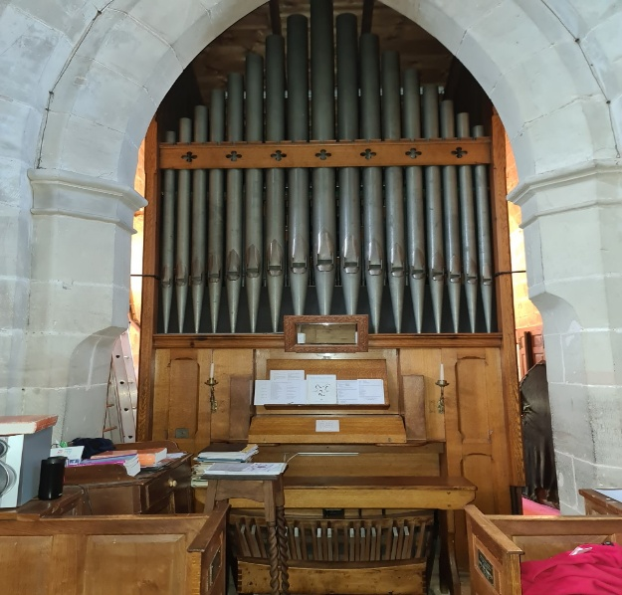


United in music
Berkswell
Music Festival
PAtron: Gaynor Keeble, Mezzo Soprano
Lunchtime Recital
Featuring our Patron, mezzo soprano
Gaynor Keeble
A selection of songs & music
from celebrated composers
across the eras by soloists
& ensembles
Sunday
21 Sept
12-1pm
Venue: St John Baptist Church, Berkswell, CV7 7BJ
£5 audience ticket or free with a Festival Ticket
For tickets & further details please contact musicfestival@berkswellchurch.org.uk
St. John Baptist Church, Church Lane, Berkswell, CV7 7BJ
/BerkswellChurch

