Slide 1

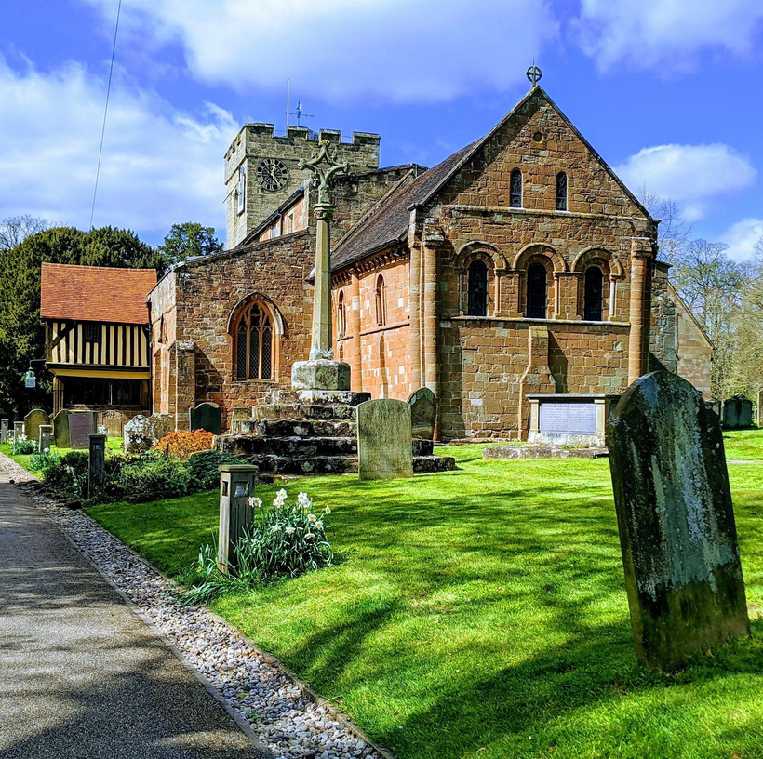

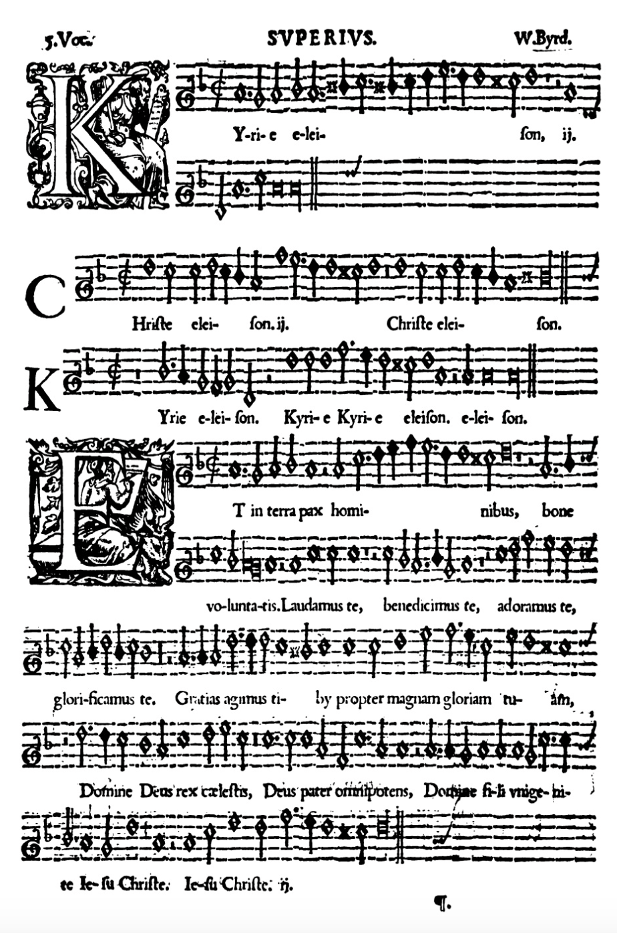
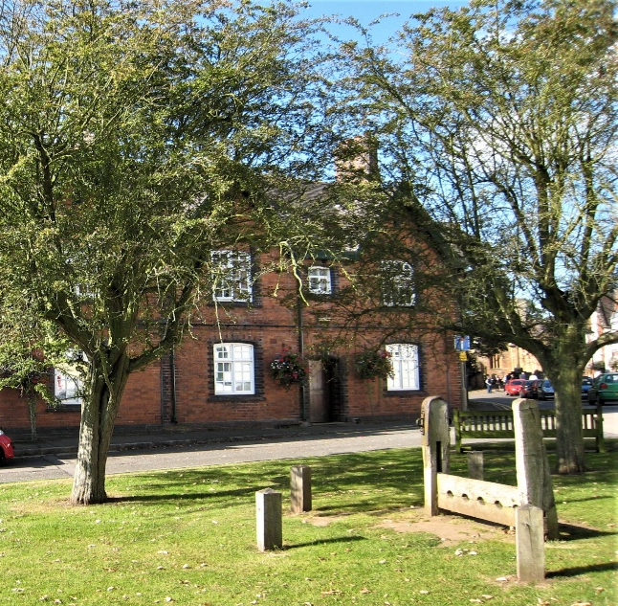


United in music
Berkswell
Music Festival
PAtron: Gaynor Keeble, Mezzo Soprano
Madrigal Mystery Tour
A selection of madrigals by visiting local choirs:
Stoneleigh Male Voice Choir
Blue Coat School Choir
Uniting Singers
Spa Chorale
Berkswell Church Choir
Friday
19 Sept
7pm
Venue: St John Baptist Church, Berkswell, CV7 7BJ
£5 audience ticket or free with a Festival Ticket
For tickets & further details please contact musicfestival@berkswellchurch.org.uk
St. John Baptist Church, Church Lane, Berkswell, CV7 7BJ
/BerkswellChurch

