Slide 1

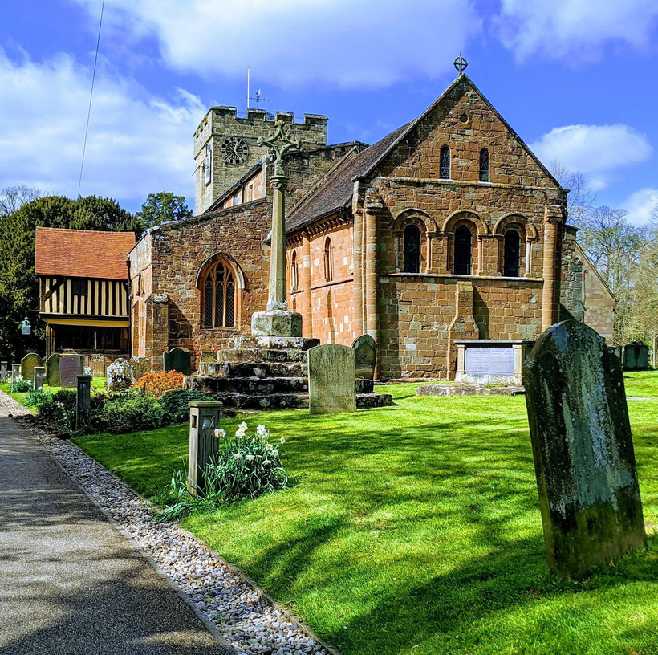

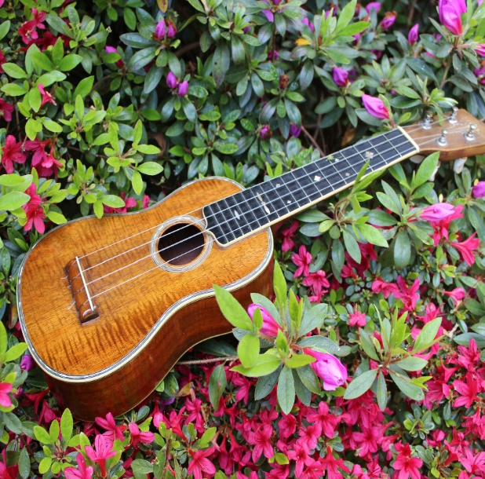
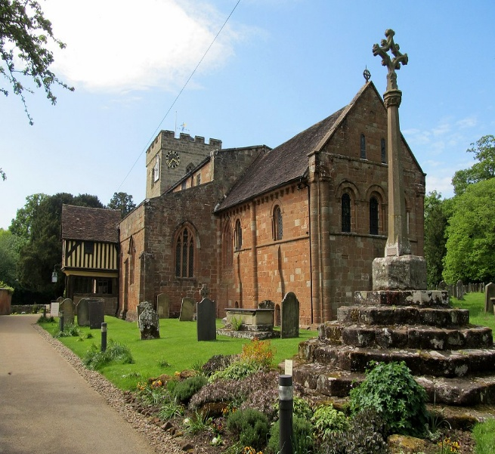


United in music
Berkswell
Music Festival
PAtron: Gaynor Keeble, Mezzo Soprano
Coventry Ukelele band
Ukuholics
perform for us
a selection of their favourite tunes
Sunday
21 Sept
2-3pm
Venue: St John Baptist Church, Berkswell, CV7 7BJ
£5 audience ticket or free with a Festival Ticket
For tickets & further details please contact musicfestival@berkswellchurch.org.uk
St. John Baptist Church, Church Lane, Berkswell, CV7 7BJ
/BerkswellChurch

