Slide 1
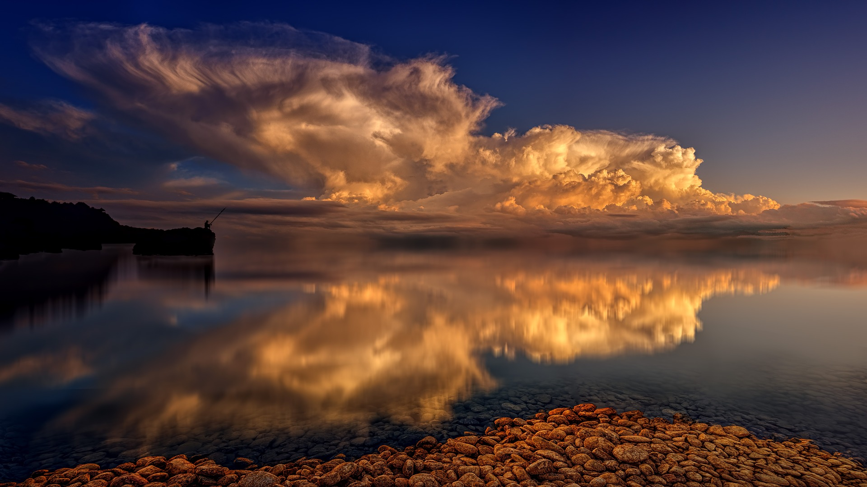
FRIDAY
EVENING
PRAYER
(Week 1B)
WELCOME TO YOUR CHURCH
Together: Growing, Caring, Sharing in God’s Love
Notes:
The music starts 30 min. bef. the service

Slide 2
WELCOME TO OUR FRIDAY EVENING PRAYER. This PowerPoint presentation will give you all you need to celebrate at home this service. For the Song/Hymn, just click on the titles, and the weblink will open it directly in your computer. Watch the video in full screen, then come back to this presentation. You have the choice between a modern song or a traditional hymn. The Psalm can be read by two people or two groups of people if you want. The photos are from Pixabay, or Wikimedia, public domain. You may start by lighting a candle.
Notes:
The music starts 20 min. bef. the service

Slide 3
(Time of quiet to be in presence of the Lord)
Notes:
The music starts 30 min. bef. the service

Slide 4
The Lord is my light and my salvation.
All My God shall make my darkness to be bright.

Slide 5
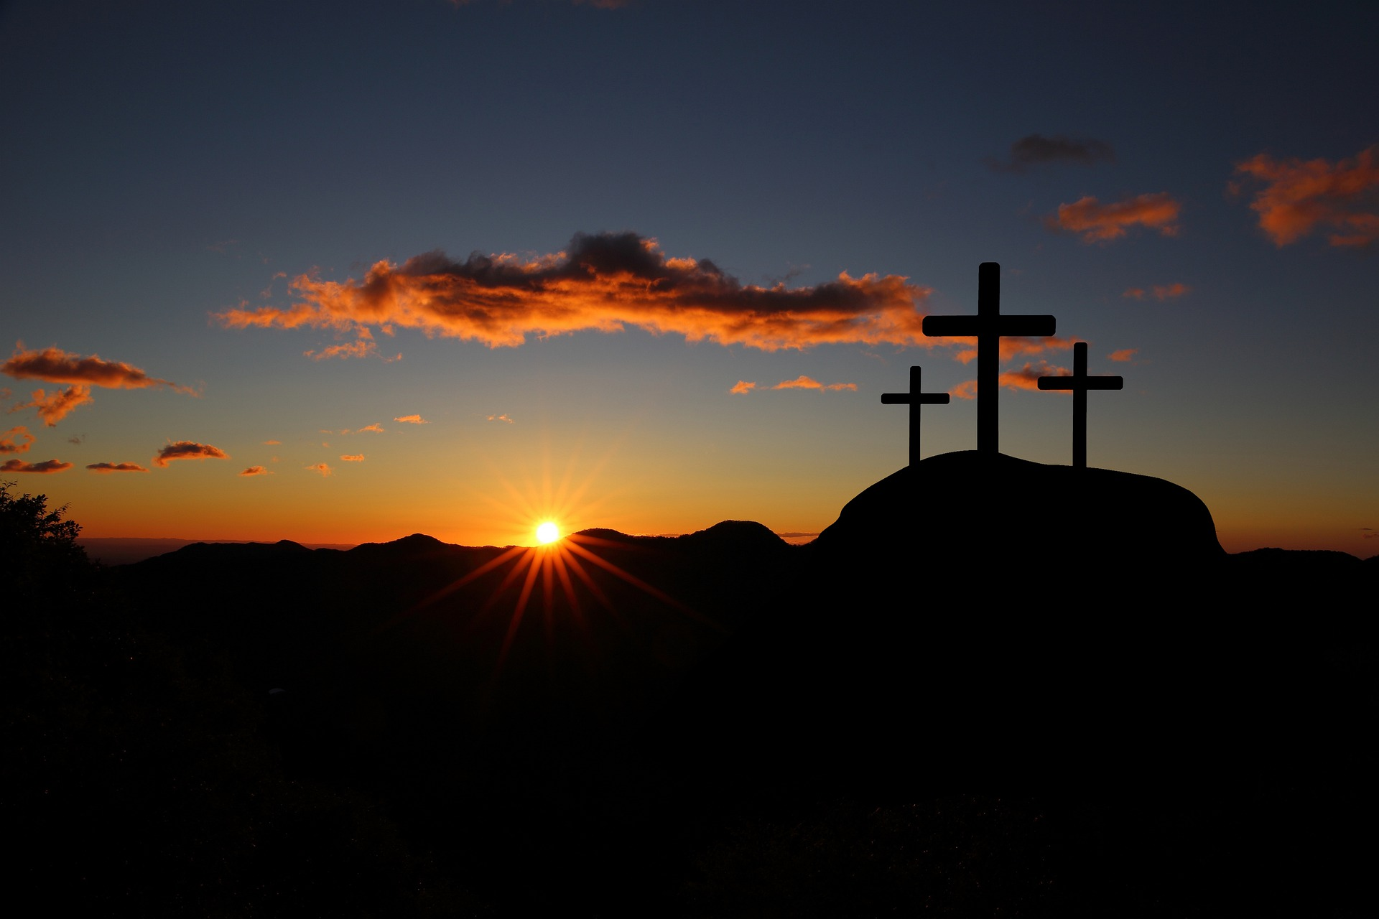
SONG/HYMN
Modern Song: ‘Evidence’
Traditional Hymn: ‘Near the cross’

Slide 6

Blessed are you, Lord God, creator of day and night:
All to you be praise and glory for ever!

Slide 7
As darkness falls around us:
All come and renew your promise.

Slide 8
Reveal among us the light of your presence:
All be our peace and comfort now and always.

Slide 9
Blessed be God, Father, Son and Holy Spirit:
All Blessed be God for ever!

Slide 10
That this evening may be holy, good and peaceful, let us pray with one heart and mind.

Slide 11
All As our evening prayer rises before you, O God, so may your mercy come down upon us, to cleanse our hearts and set us free to sing your praise, now and for ever. Amen.

Slide 12

THE WORD OF GOD
A light on our path

Slide 13
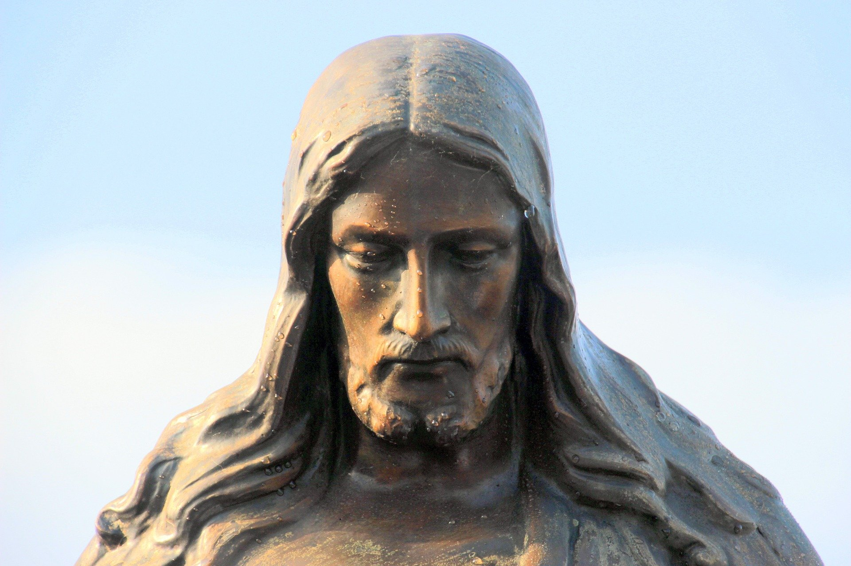
PSALM
Psalm 59, part 2
(Good News Version)

Slide 14
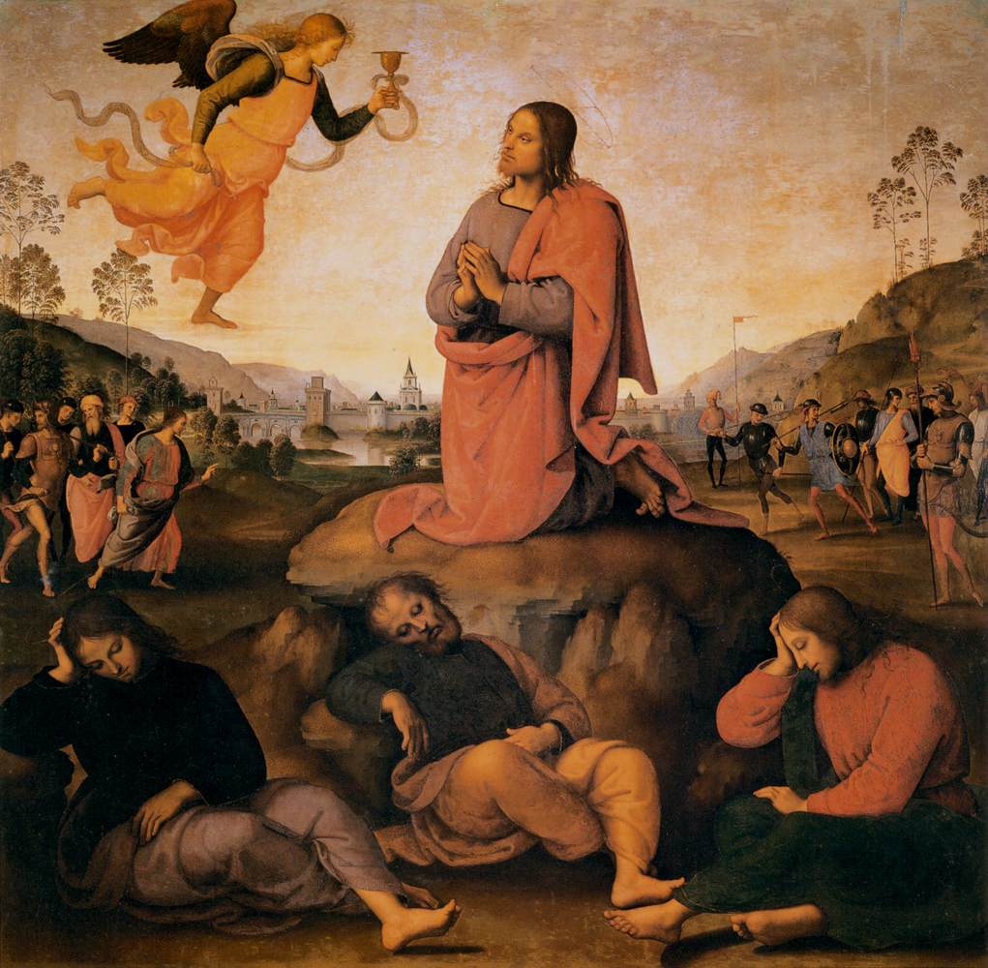
¹¹ Do not kill my enemies, O God, or my people may forget.
Scatter them by your strength and defeat them,
O Lord, our protector.

Slide 15
¹² Sin is on their lips; all their words are sinful;
may they be caught in their pride!
Because they curse and lie,
¹³ destroy them in your anger;
destroy them completely.

Slide 16
Then everyone will know that God rules in Israel,
that his rule extends over all the earth.

Slide 17
¹⁴ My enemies come back in the evening,
snarling like dogs as they go about the city,
¹⁵ like dogs roaming about for food
and growling if they do not find enough.

Slide 18
¹⁶ But I will sing about your strength;
every morning I will sing aloud of your constant love.
You have been a refuge for me,
a shelter in my time of trouble.

Slide 19
¹⁷ I will praise you, my defender.
My refuge is God,
the God who loves me.

Slide 20
Glory to the Father,
by the Son,
in the Holy Spirit,
as it was in the beginning,
is now,
and shall be for ever.
Amen.
Or:
Glory to the Father,
and to the Son,
and to the Holy Spirit,
as it was in the beginning,
is now,
and shall be for ever.
Amen.

Slide 21
Strong and merciful God,
stand with the oppressed
against the triumph of evil
and the complacency of your people
and establish in Jesus Christ
your new order of generosity and joy,
for he is alive and reigns now and for ever.
Amen.

Slide 22

READING
Follow a Reading Plan of your choice:
https://www.biblegateway.com/reading-plans/
or read the verses on the next slide.

Slide 23
¹ We who have strong faith should help the weak with their problems. We should not please only ourselves. ² Each of us should please our neighbours. Let us do what is good for them in order to build them up. ³ Even Christ did not please himself. It is written: “The bad things people have said about you have been aimed at me also.” (Psalm 69.9) (Romans 15.1-3; NIrV)

Slide 24
Forsake me not, O Lord;
All be not far from me, O my God.
Make haste to help me,
All O Lord of my salvation.
Glory to the Father, by the Son, in the Holy Spirit:
All Forsake me not, O Lord; be not far from me, O my God.

Slide 25

PRAYERS FOR THE WORLD

Slide 26
-For our family, friends and all whom we love
-For the day and its tasks
-For the prisoners and the victims of their crimes.

Slide 27
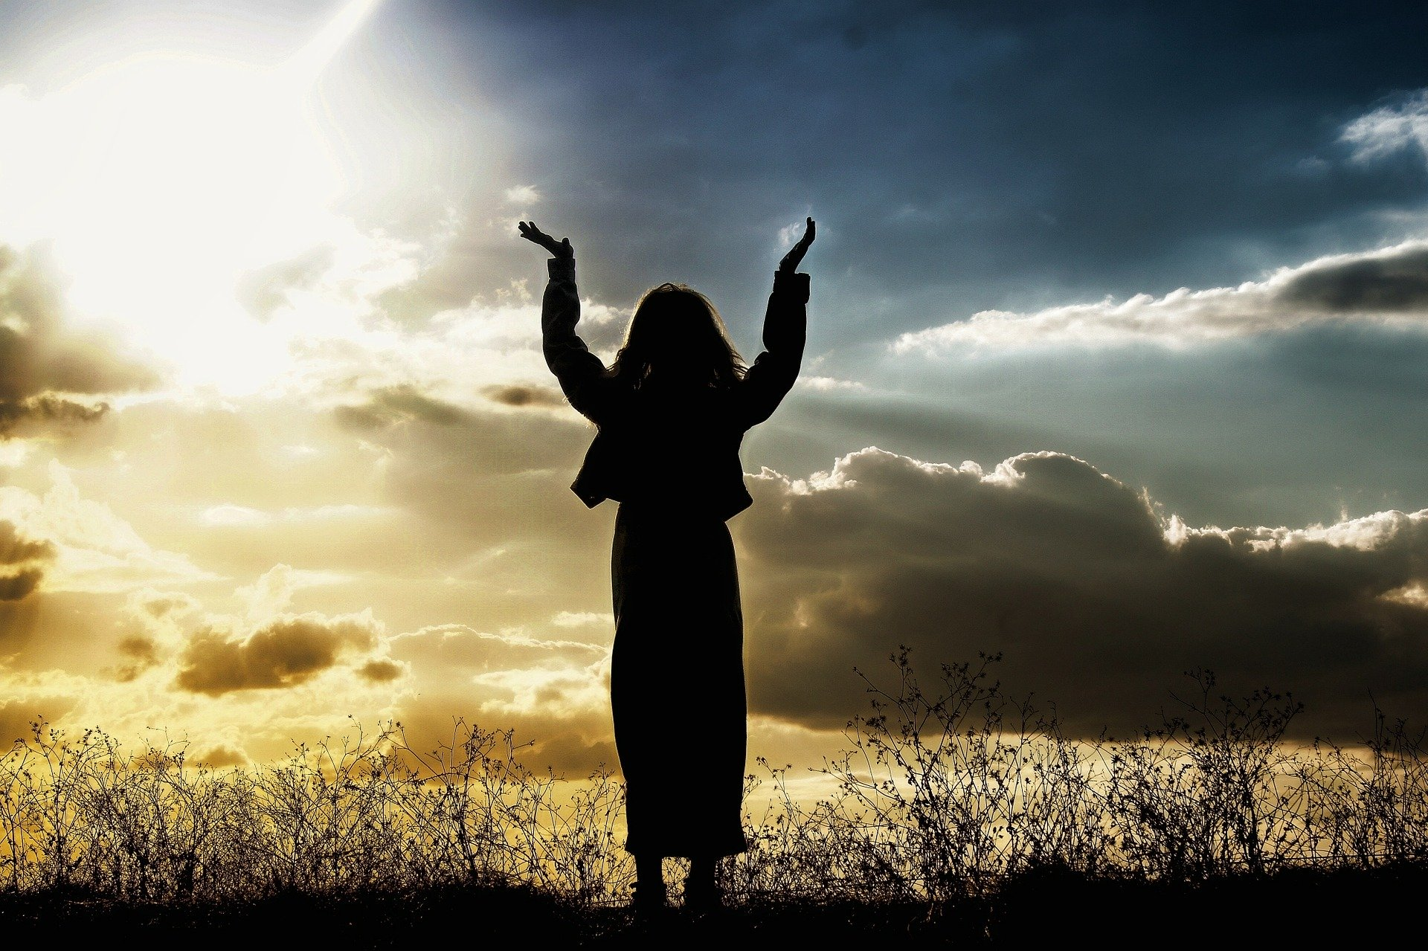
(We offer ourselves to the Lord)

Slide 28
All Heal us, O God, from all our afflictions and keep us steadfast in your love; bind up our wounds, raise us from death, and lead us to fulness of life; through Jesus Christ, our Saviour. Amen.

Slide 29
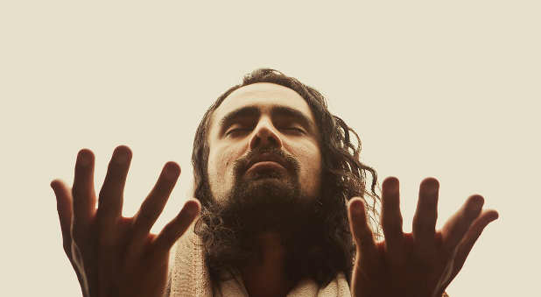
THE LORD’S PRAYER
As our Saviour taught us, so we pray with confidence:

Slide 30
(Modern Version)
(Traditional Version)
Our Father in heaven,
Hallowed be your name;
Your kingdom come;
Your will be done;
on earth as in heaven.
Give us today our daily bread.
Forgive us our sins,
as we forgive those
who sin against us.
And lead us not into temptation;
but deliver us from evil.
For the kingdom,
the power and the glory
are yours,
now and for ever.
Amen.
Our Father who art in heaven,
Hallowed be thy name;
Thy kingdom come;
Thy will be done;
on earth as it is in heaven.
Give us this day our daily bread.
Forgive us our trespasses,
as we forgive those
who trespass against us.
And lead us not into temptation;
but deliver us from evil.
For thine is the kingdom,
the power and the glory
for ever and ever.
Amen.

Slide 31
SONG/HYMN
Modern Song: ‘All my hope’
Traditional Hymn: ‘At the cross’

Slide 32
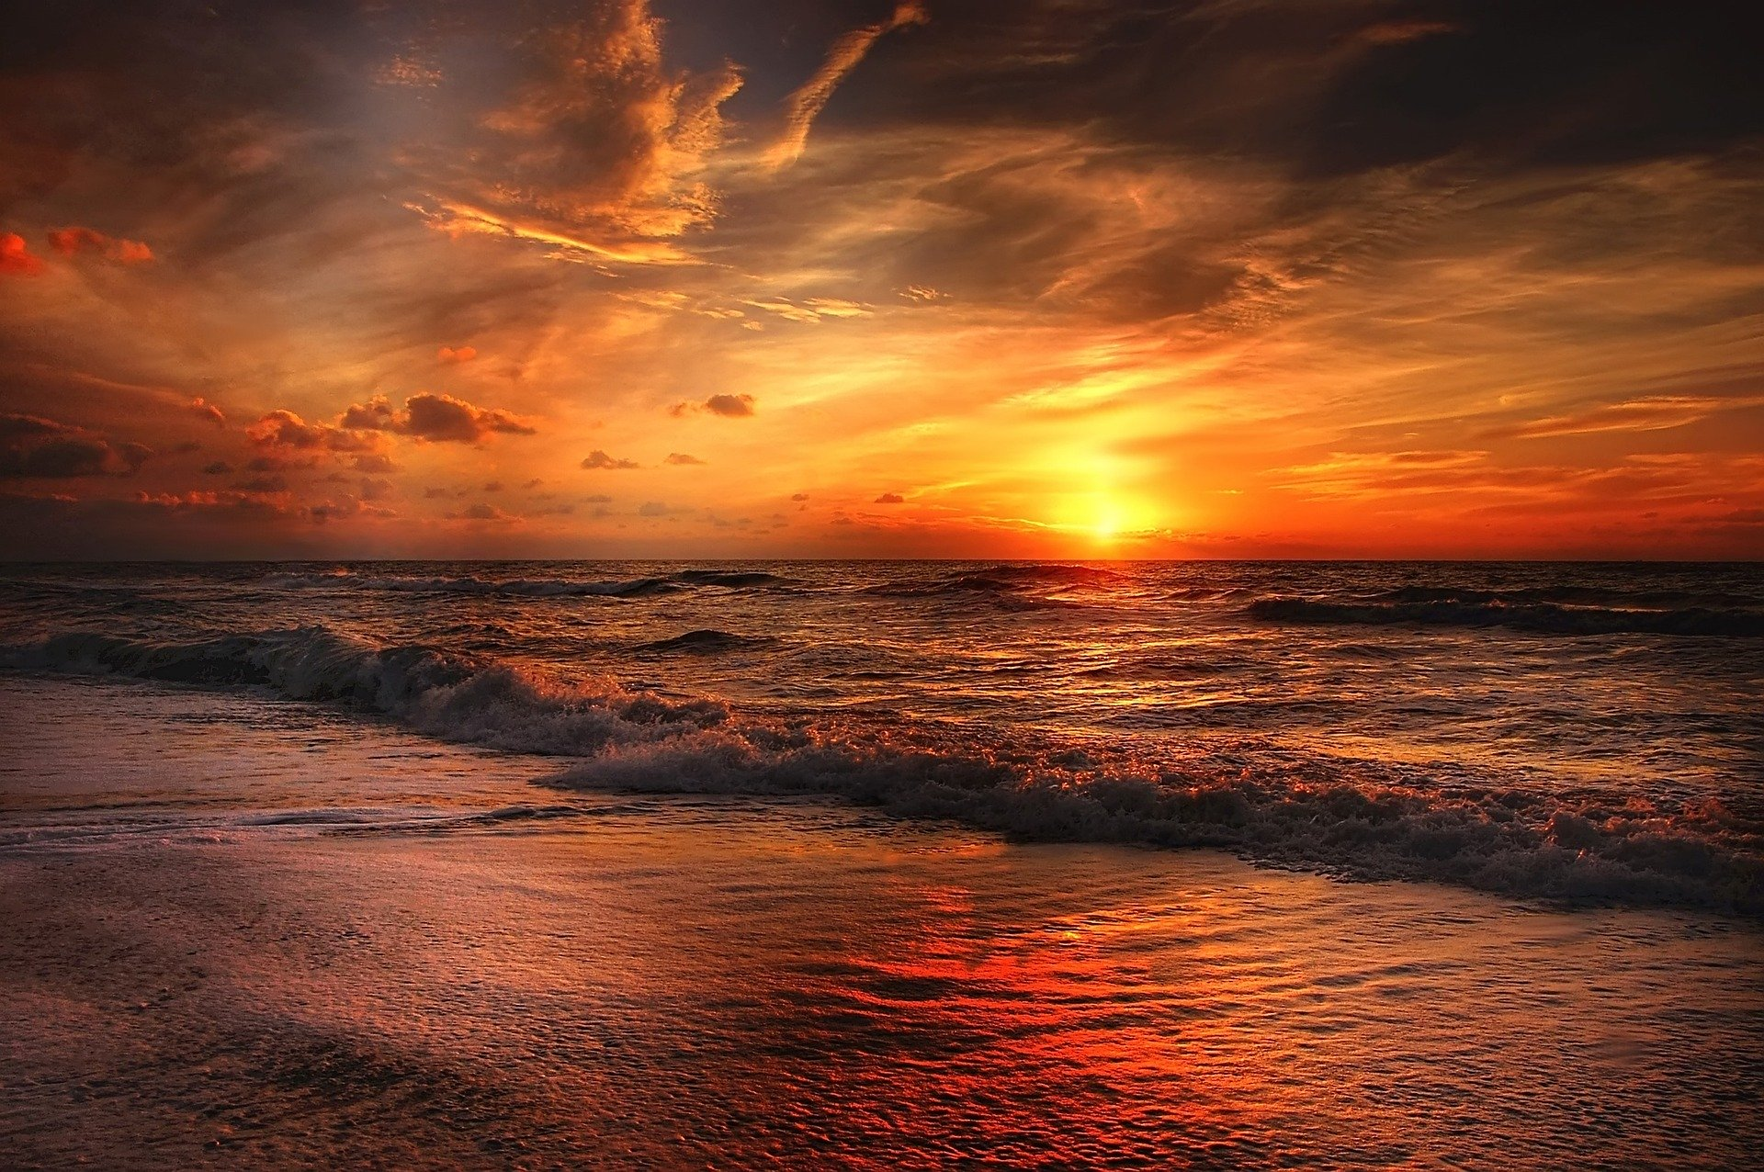
SENDING OUT
All The grace of our Lord Jesus Christ, the love of God, and the fellowship of the Holy Spirit, be with us all evermore. Amen.

Slide 33
Let us bless the Lord.
All Thanks be to God.

Slide 34
If you want to help us in our mission, you can securely give us online by using the link offered on the homepage. Many thanks.
Some material in the service is © The Archbishops’ Council 2000, 2002, 2006

